Slide 1




Slide 2

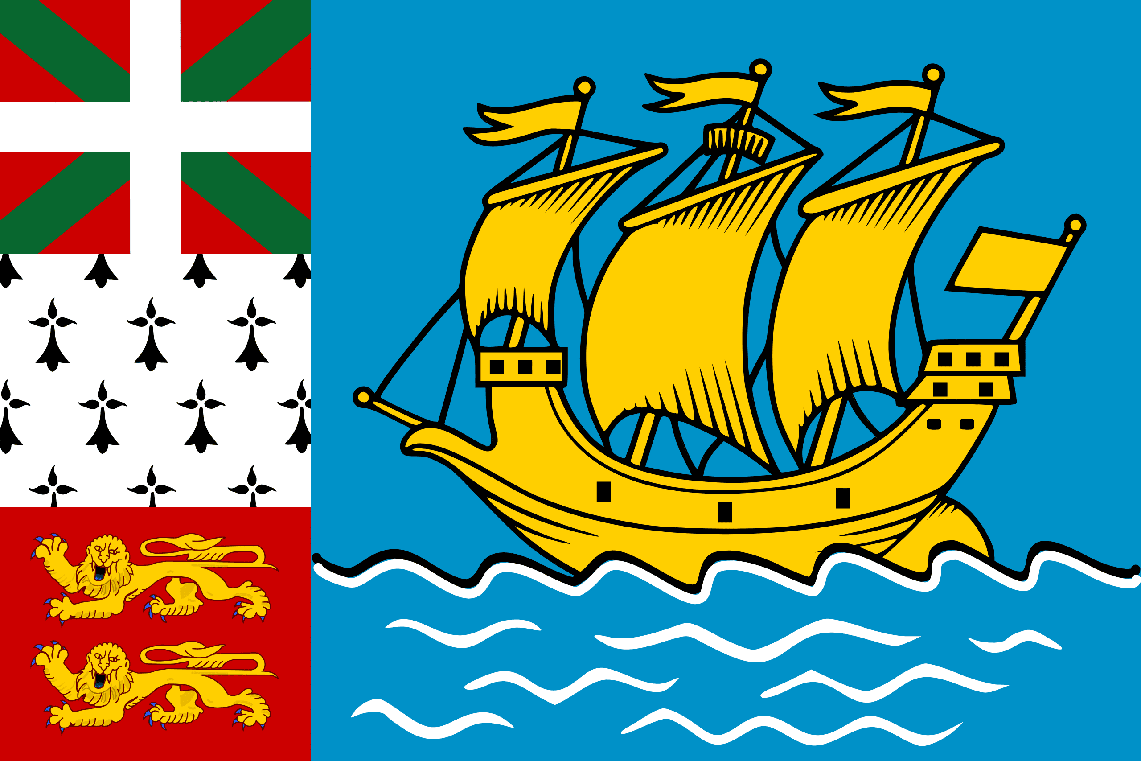
PRAYING FOR
SAINT PIERRE & MIQUELON

Slide 3
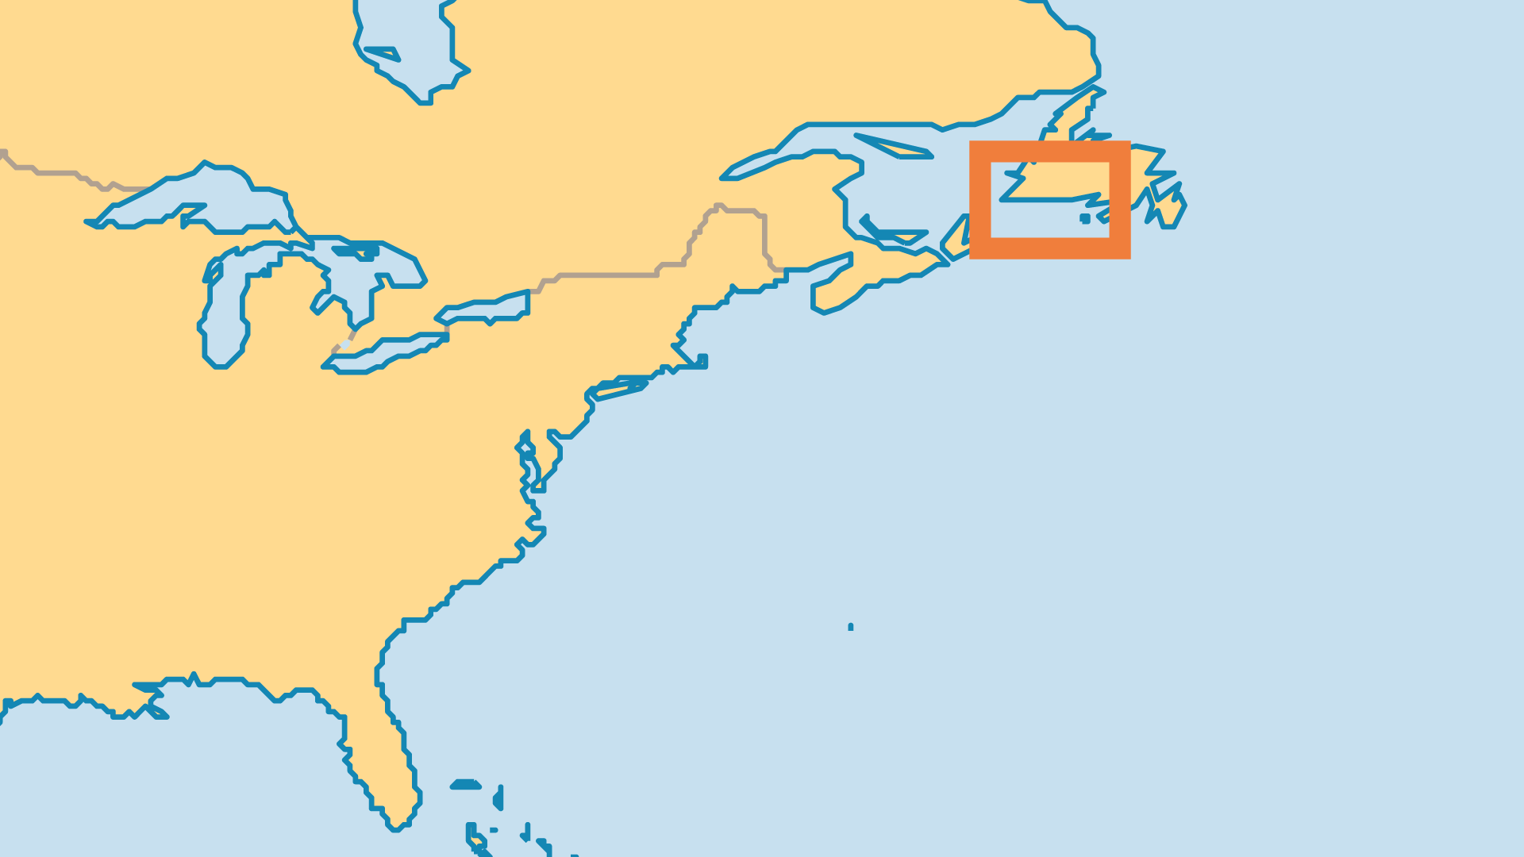
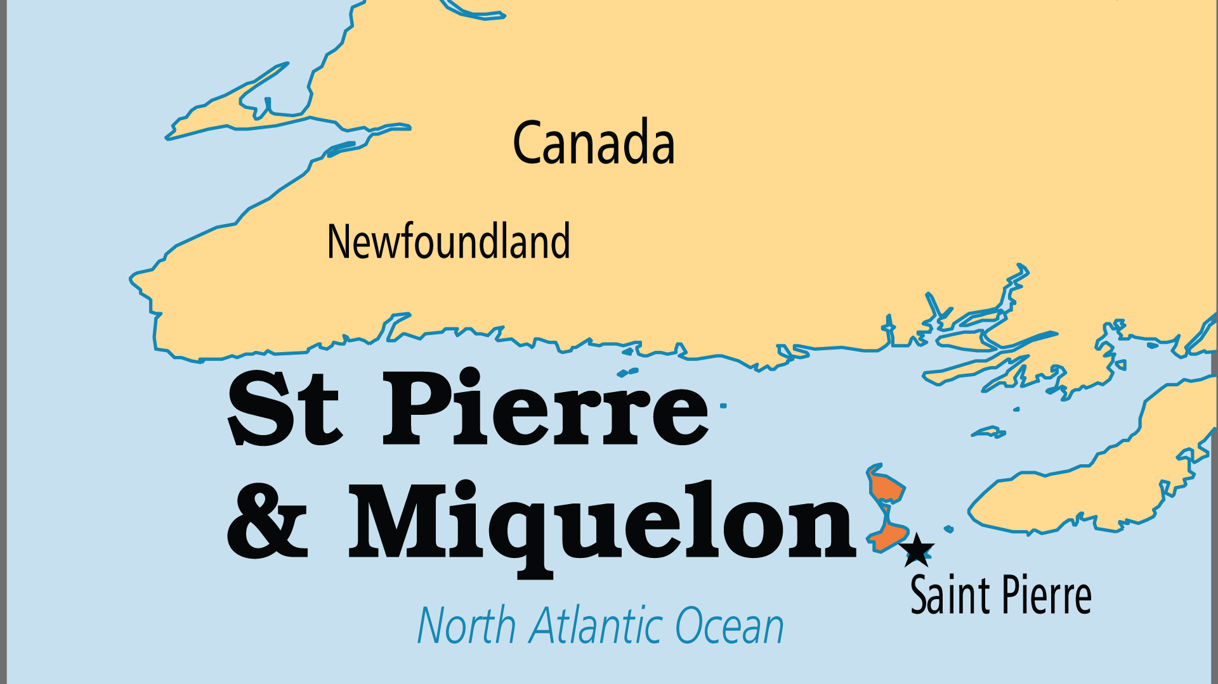
KEY STATS
Continent: | North America
Capital: | St Pierre
Population: | 5,574
Official Language: | French
Languages: | 3
Literacy Rate: | 99 %
% Christian: | 96.9 %
% Evangelical: | 0 %
People Groups: | 2
% Unevangelized: | 1 %

Slide 4

FOR PRAYER
These isolated islands and their people have long been Catholic. Traditions are strong and change has come slowly, despite the economic downturn when the fishing industry all but disappeared. Pray for people to find hope in a living relationship with Christ.
Want to know more? Go to www.operationworld.org

