Slide 1




Slide 2

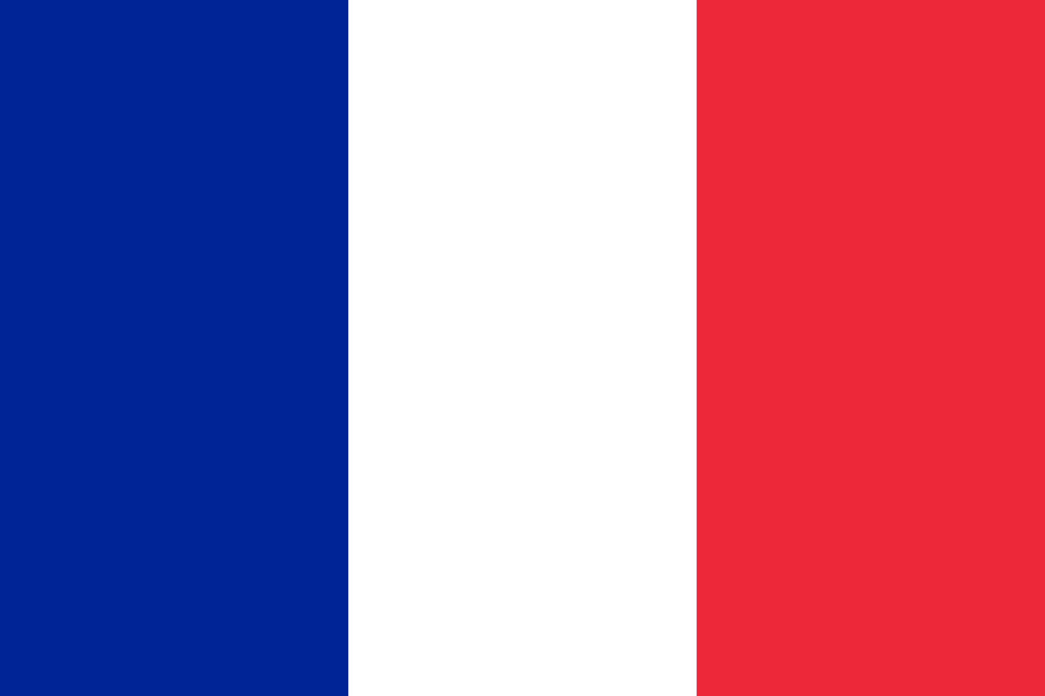
PRAYING FOR
Saint Martin

Slide 3
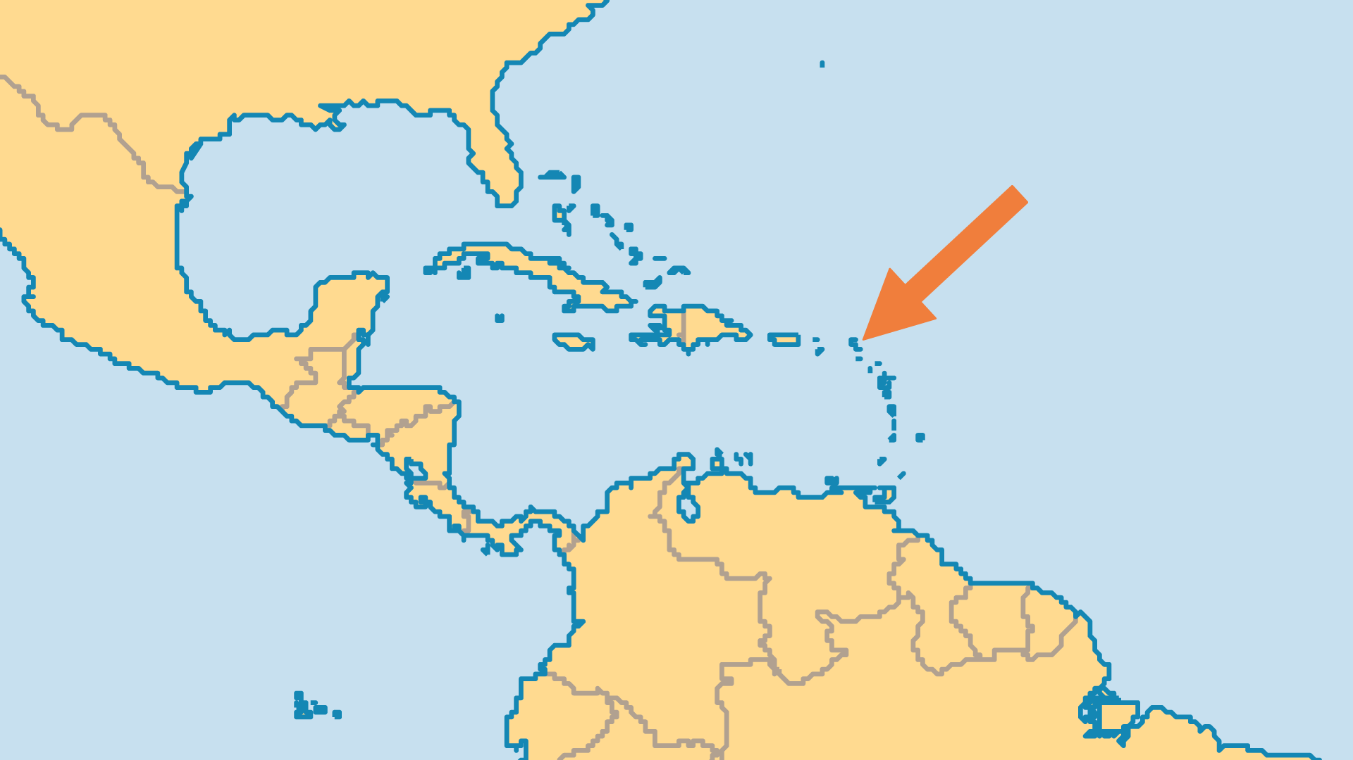
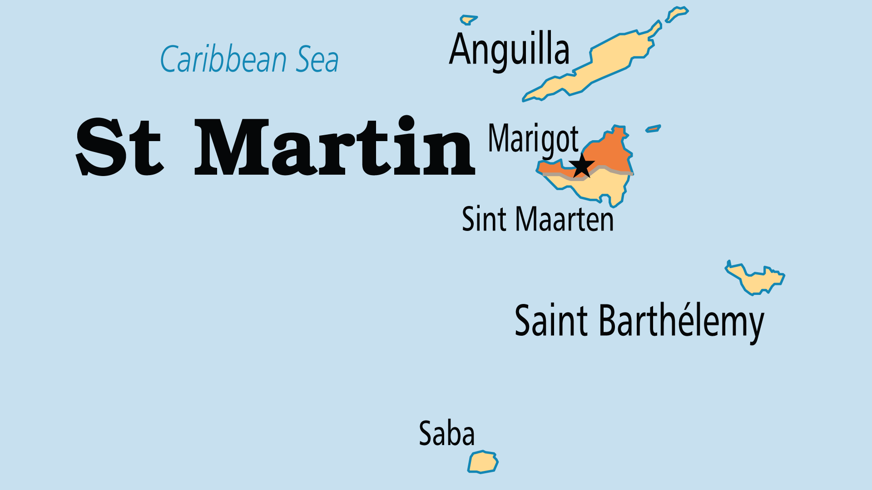
KEY STATS
Capital: | Marigot
Population: | 24,941
Official Language: | French. English, Dutch, Creole, Papiamento
Languages: | 5
% Christian: | 83.9 %
% Evangelical: | 2.5 %

Slide 4

FOR PRAYER
The tropical location and French liberality combine to make this a playground for the most wealthy. Exclusive hotels, clothing-optional beaches, designer-clothing boutiques and cafés typify the island's culture. There is little room for or interest in a life of service to Christ. Pray that in the midst of this elegant but hedonistic paradise, people might gain a hunger for an eternal heaven.
Want to know more? Go to www.operationworld.org

