Slide 1




Slide 2


PRAYING FOR
SAINT LUCIA

Slide 3
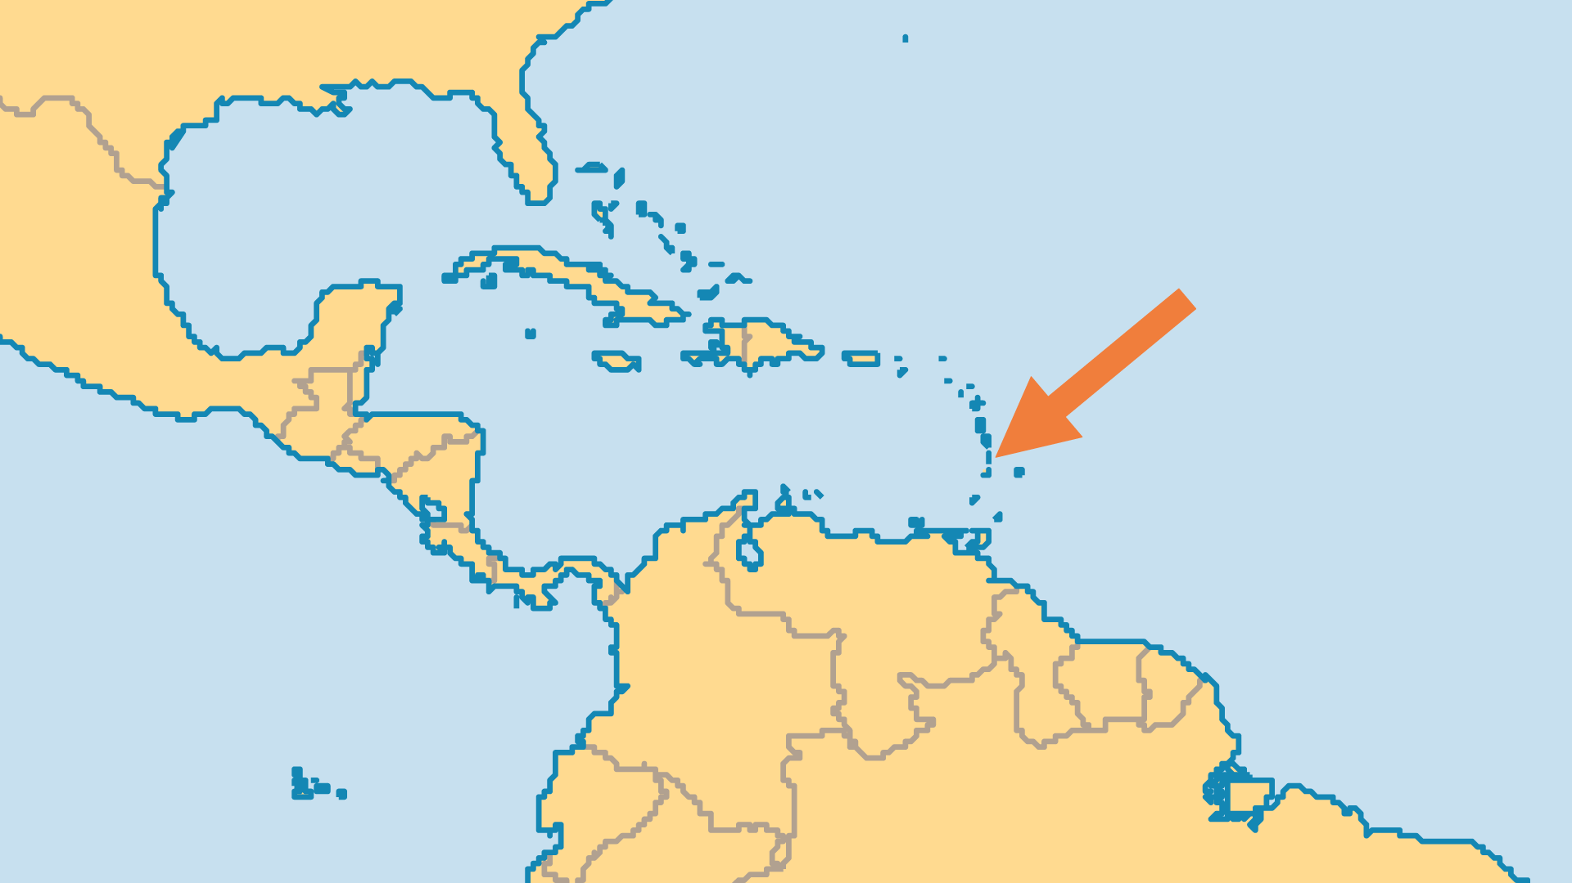
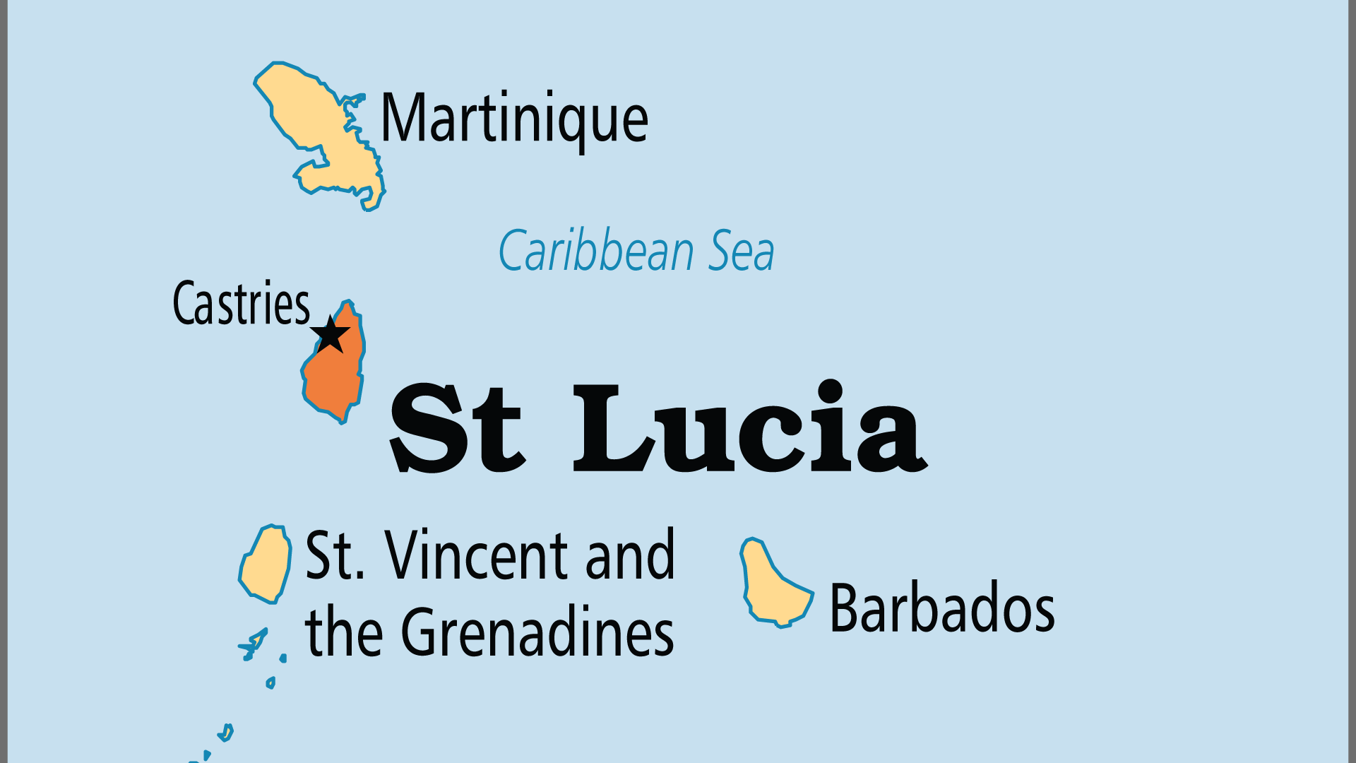
KEY STATS
Capital: | Castries
Population: | 180,149
Official Language: | English, but 80% speak French Creole (Kweyol)
Life Expectancy: | 71.1 yrs (143rd/236)
HDI Ranking: | 106/193
% Christian: | 95.1 %
% Evangelical: | 14.5 %
People Groups: | 5
% Unevangelized: | 1 %

Slide 4

FOR PRAYER
The veneer of religion without true faith is a widespread problem - the more historic churches are in significant decline. Living Christianity decreasingly influences much of society, as increasing materialism undermines spiritual life. A staggering 86% of all children are born out of wedlock and 45% of all households are led by women. Pray for genuine renewal in the churches and for the spiritual and moral transformation of society.
Want to know more? Go to www.operationworld.org

