Slide 1




Slide 2


PRAYING FOR
SAINT KITTS & NEVIS

Slide 3
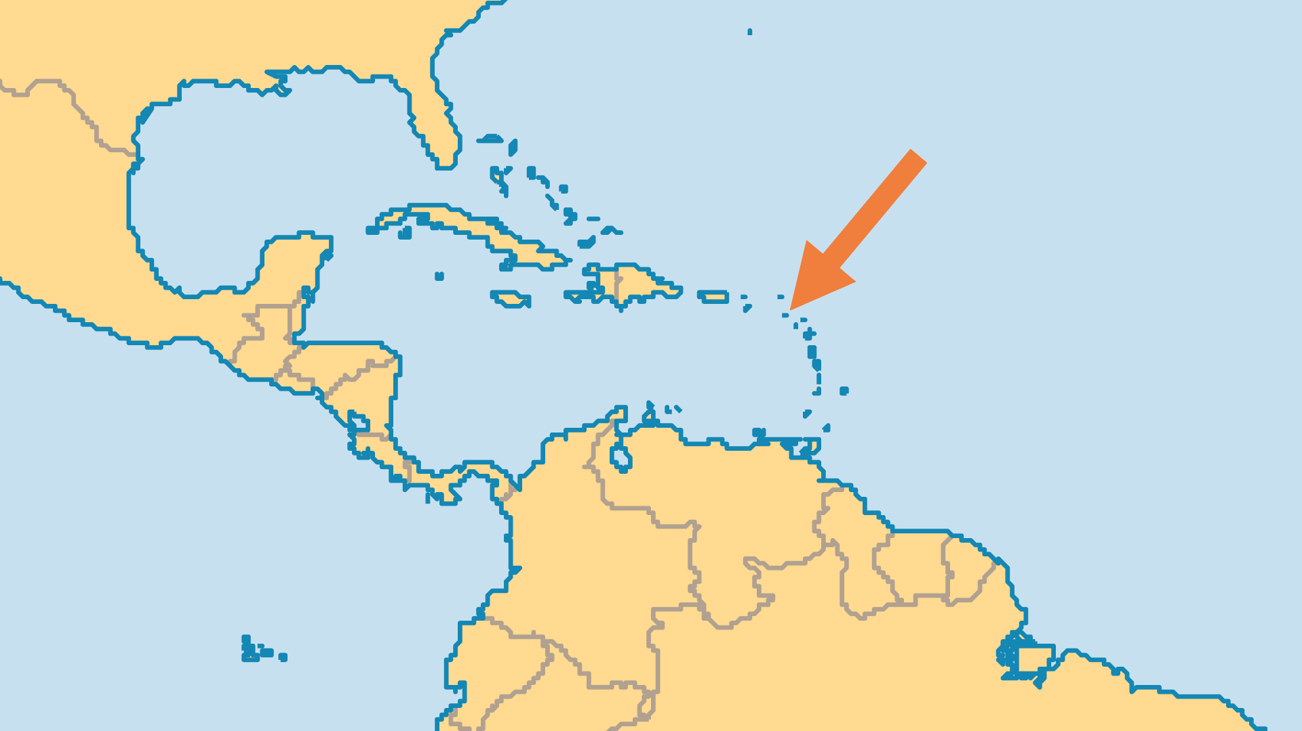
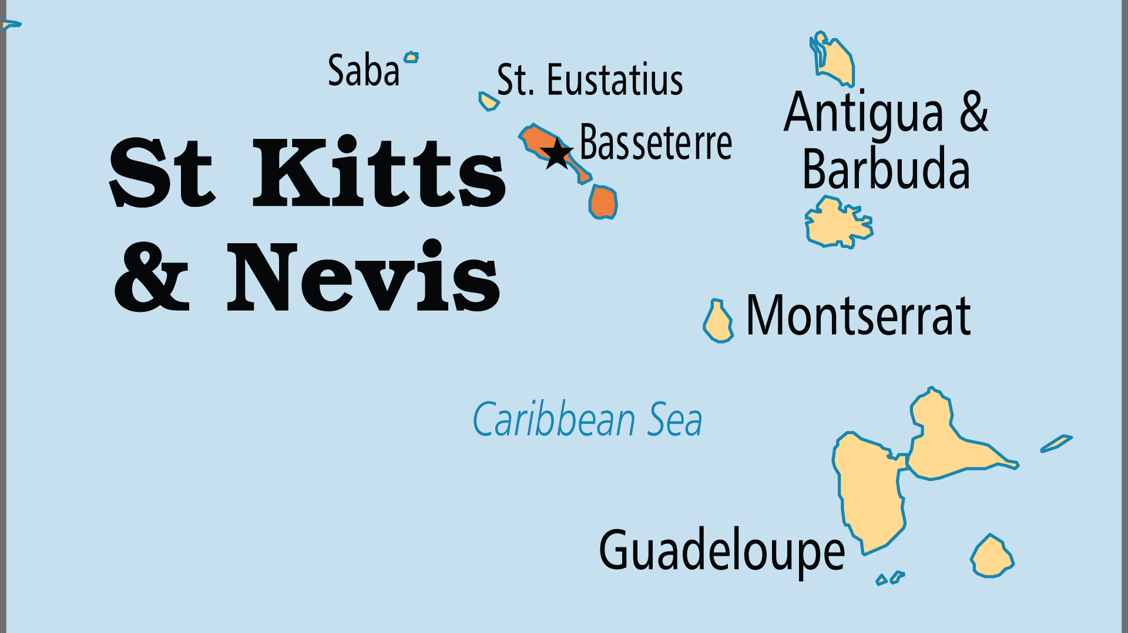
KEY STATS
Capital: | Basseterre
Population: | 46,922
% Urban: | 31.4 %
Official Language: | English
Languages: | 2
Literacy Rate: | 98 %
HDI Ranking: | 75/193
% Christian: | 93 %
% Evangelical: | 21.7 %
People Groups: | 4
% Unevangelized: | 1 %

Slide 4

FOR PRAYER
The shift in economy, from sugar to tourism and offshore finance, has borne unwanted fruit in attracting, along with the money, undesirable elements. Pray for personal and social righteousness to combat this trend.
Want to know more? Go to www.operationworld.org

