Slide 1




Slide 2


PRAYING FOR
SAINT HELENA

Slide 3
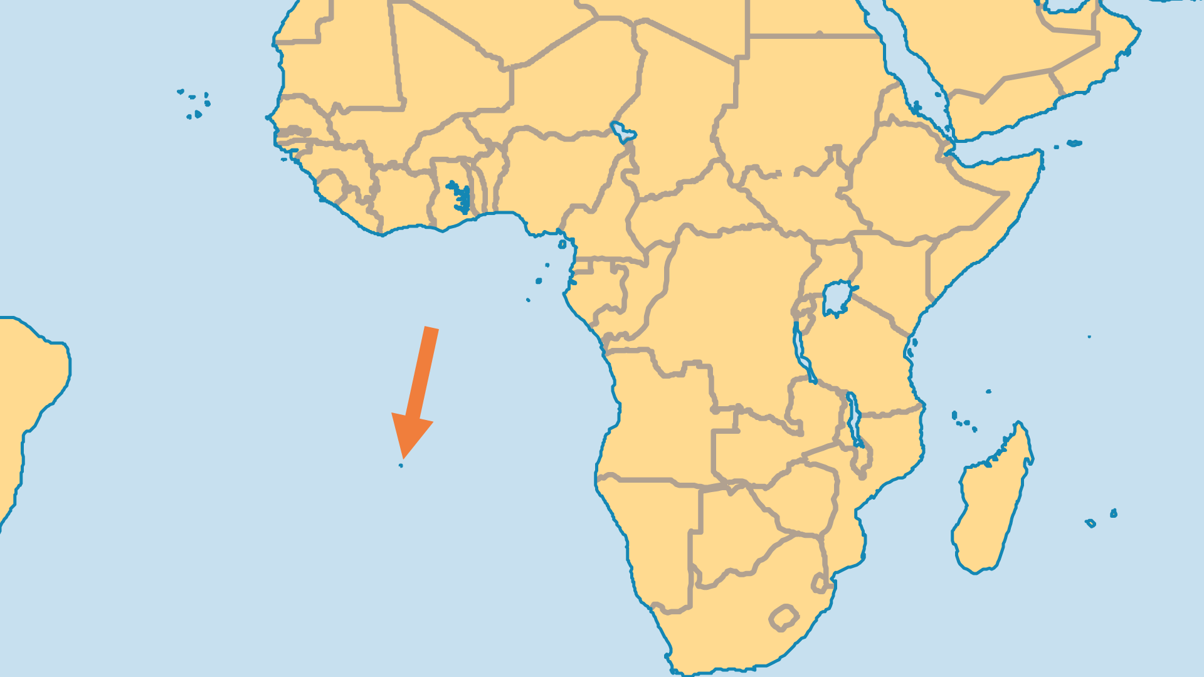
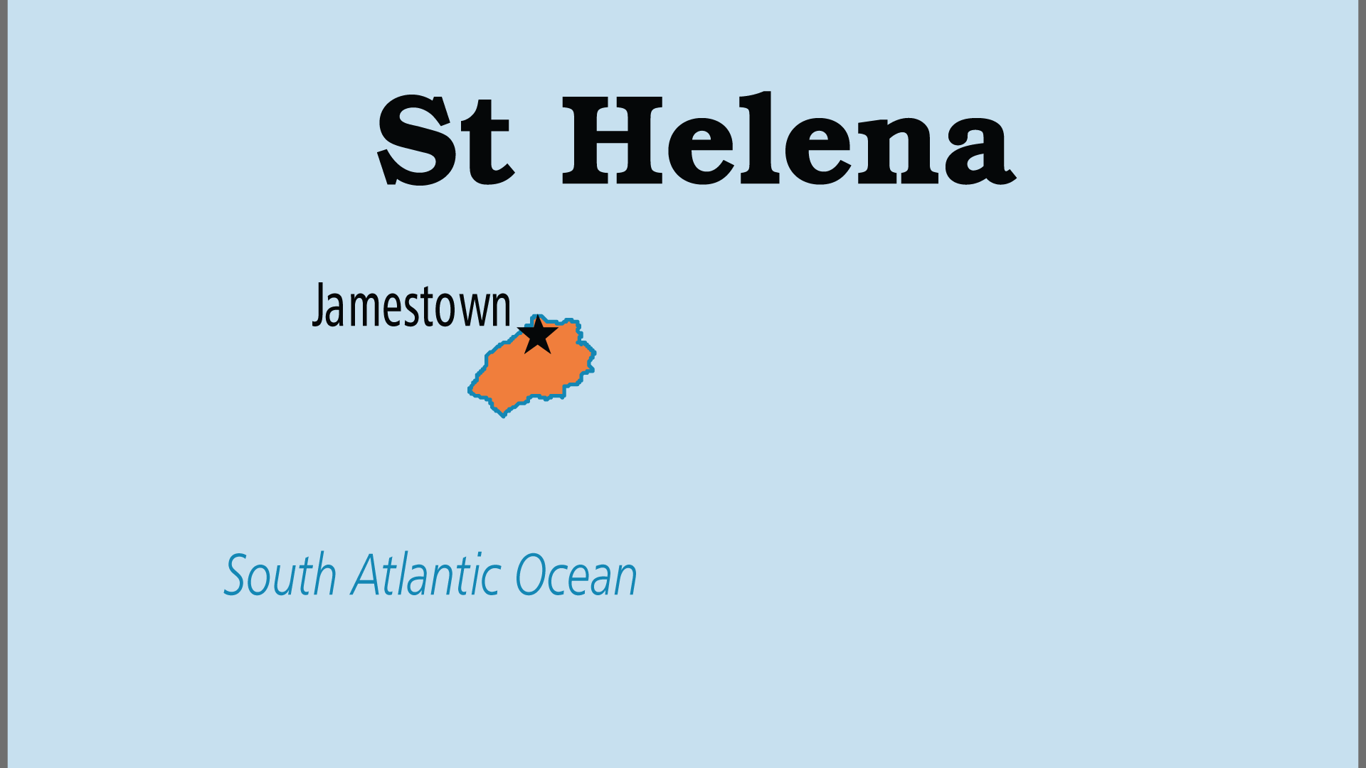
KEY STATS
Continent: | Africa
Capital: | Jamestown
Population: | 5,197
% Urban: | 41.1 %
Official Language: | English
% Christian: | 94.7 %
% Evangelical: | 8.8 %
Largest Religion: | Christian
% Largest Religion: | 94.7 %
People Groups: | 1
% Unevangelized: | 0 %

Slide 4

FOR PRAYER
The Christian heritage of St Helena is strong but islanders' committed to faith are decreasing. Most Christians are nominal, and church attendance continues to decline. A critical mass of evangelicals on the islands is needed to generate spiritual momentum. Pray for Baptists and the Salvation Army, where most evangelicals can be found, and for the Anglican Church - the largest group, but spiritually dormant.
Want to know more? Go to www.operationworld.org

