Slide 1




Slide 2

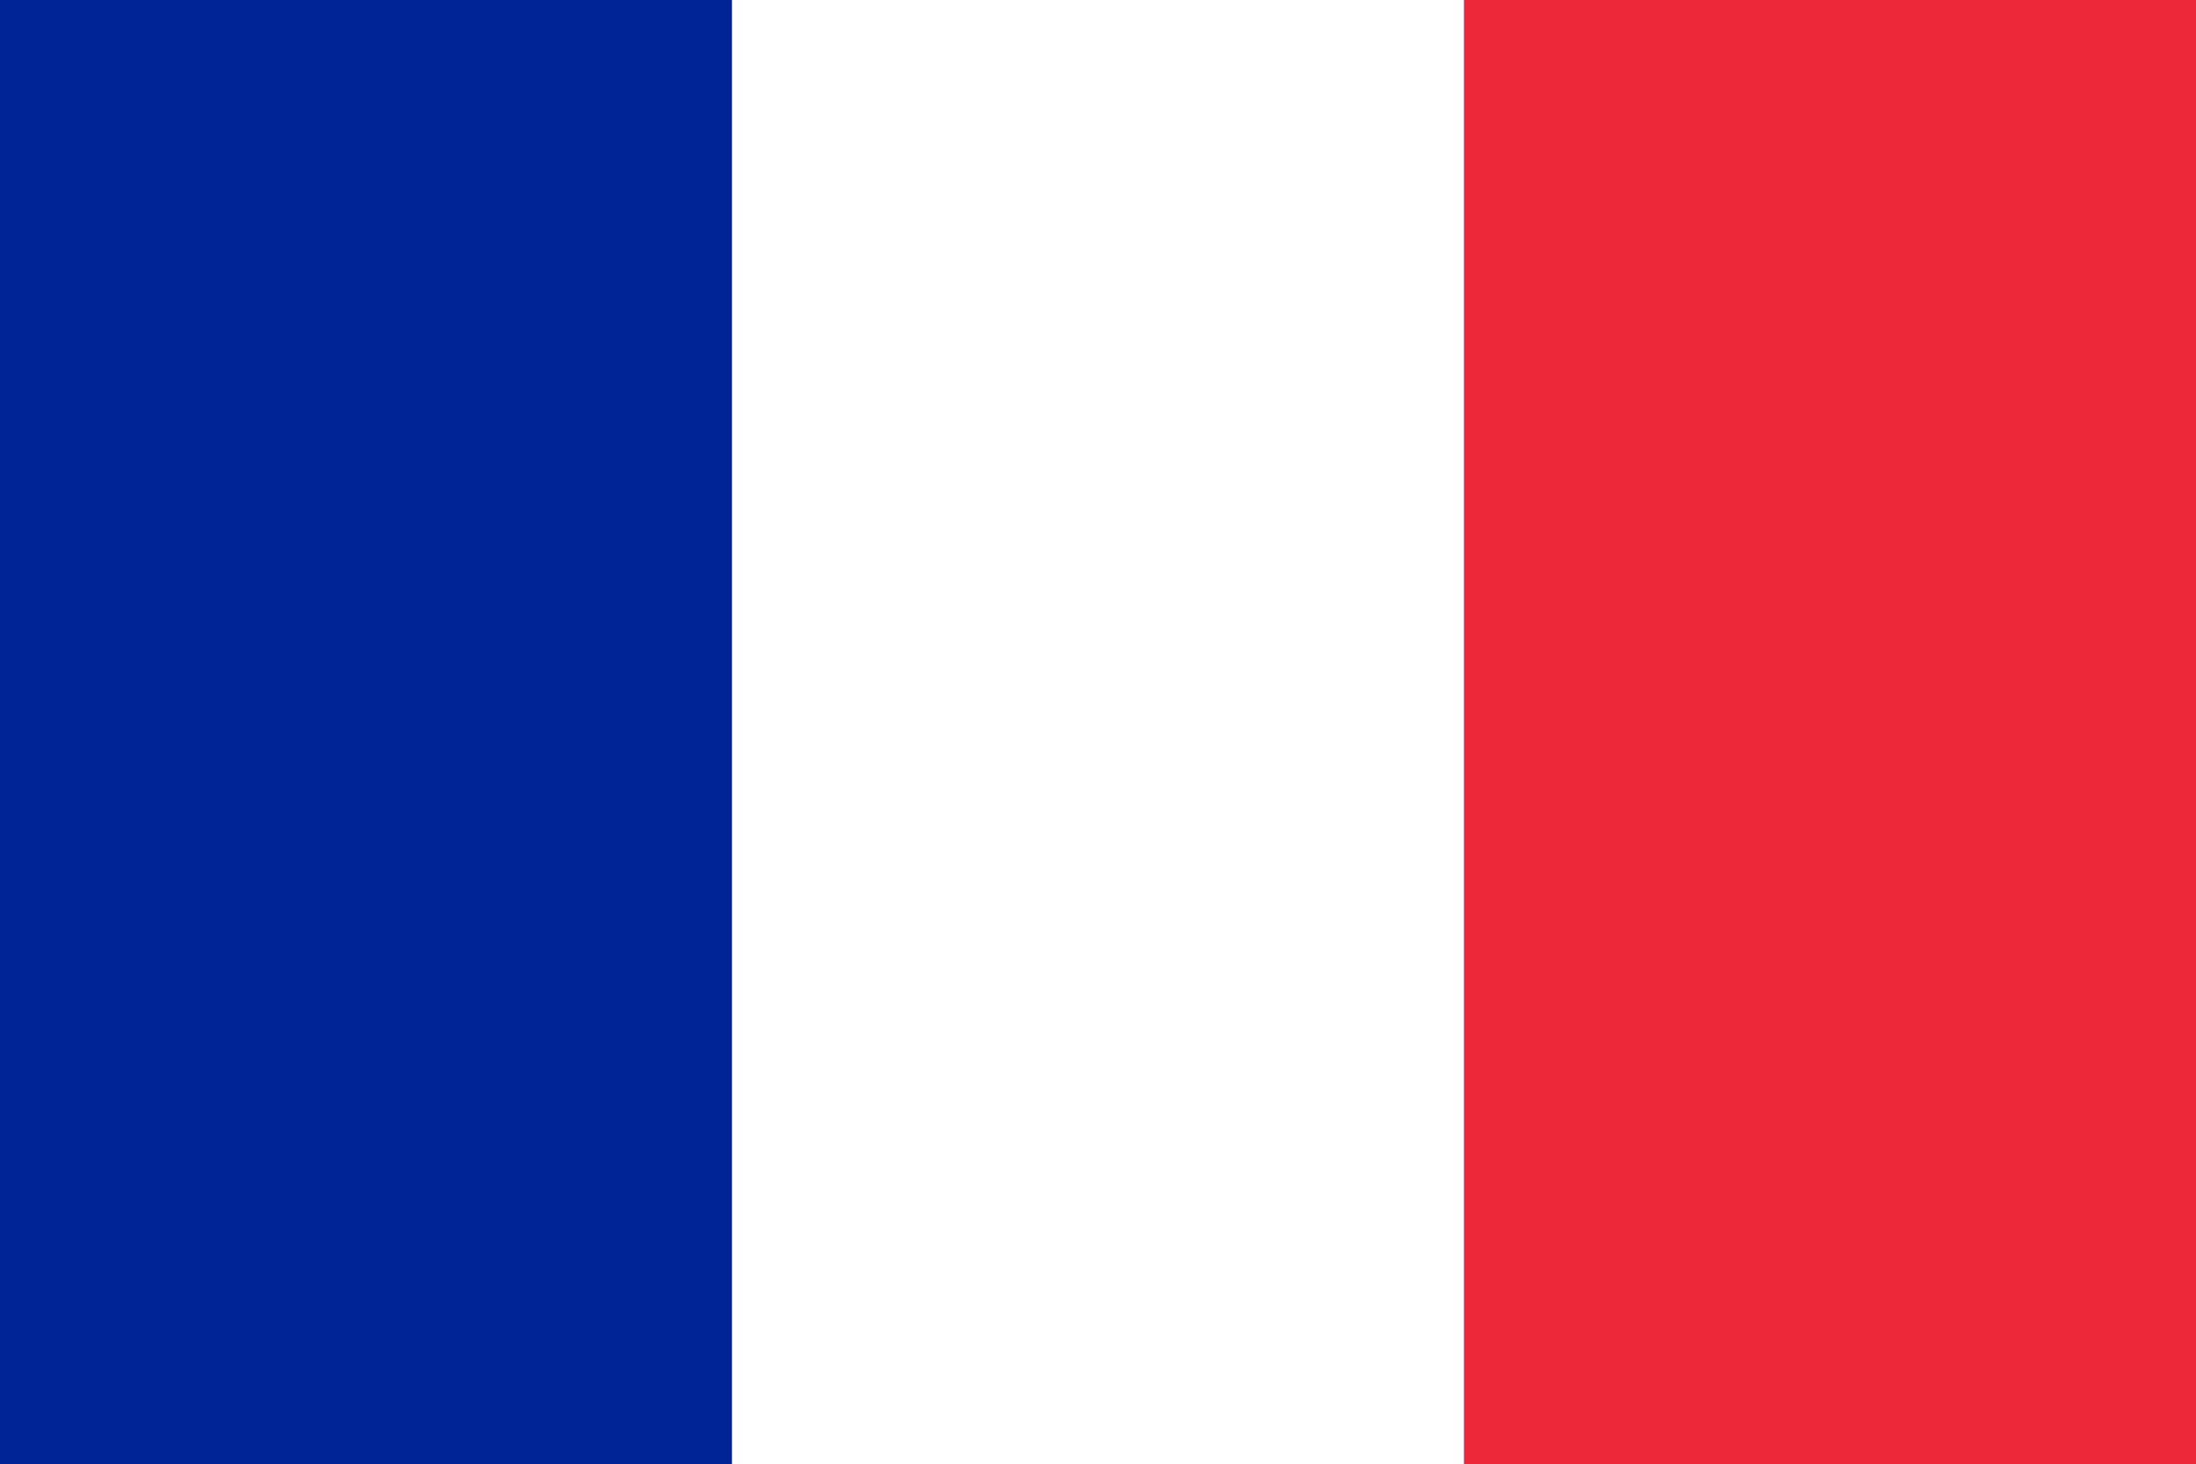
PRAYING FOR
Saint
Barthélemy

Slide 3
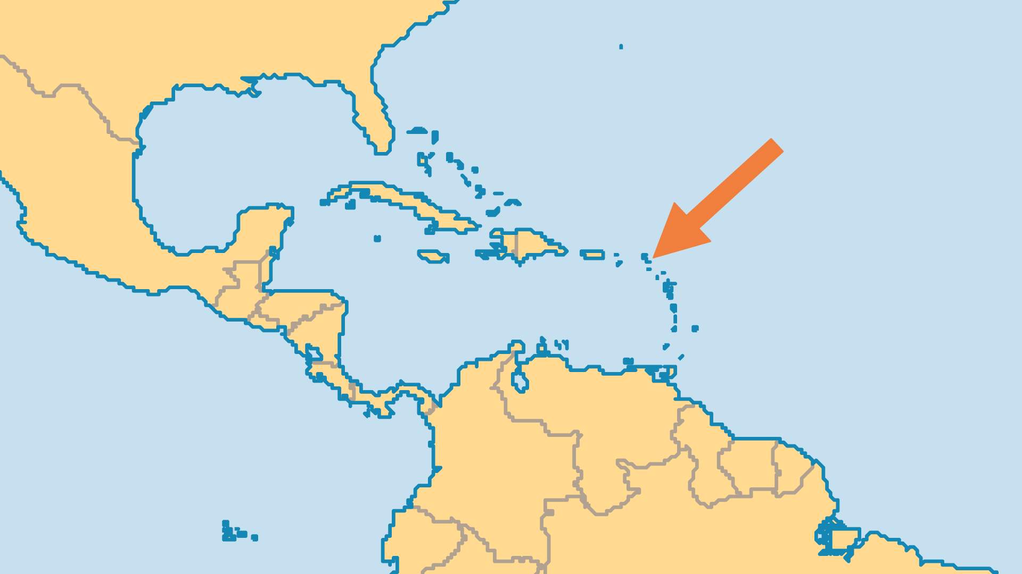
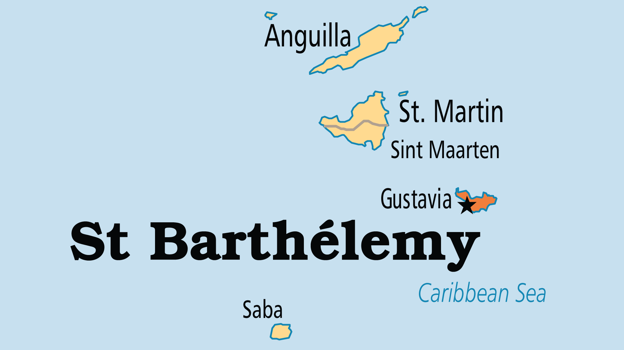
KEY STATS
Capital: | Gustavia
Population: | 11,414
Official Language: | French, English
Languages: | 3
Life Expectancy: | 80.4 yrs (42nd/236)
% Christian: | 61 %
% Evangelical: | 2.3 %

Slide 4

FOR PRAYER
This island caters to the uber-rich, trading on its sophistication and isolation for its exclusivity. There is little interest in spiritual things. Pray that amid the boutiques, cafés and villas there might awaken a hunger for spiritual reality and the opportunity to know God. Pray also that the few churches on the island might minister meaningfully into this unique context.
Want to know more? Go to www.operationworld.org

