Slide 1




Slide 2

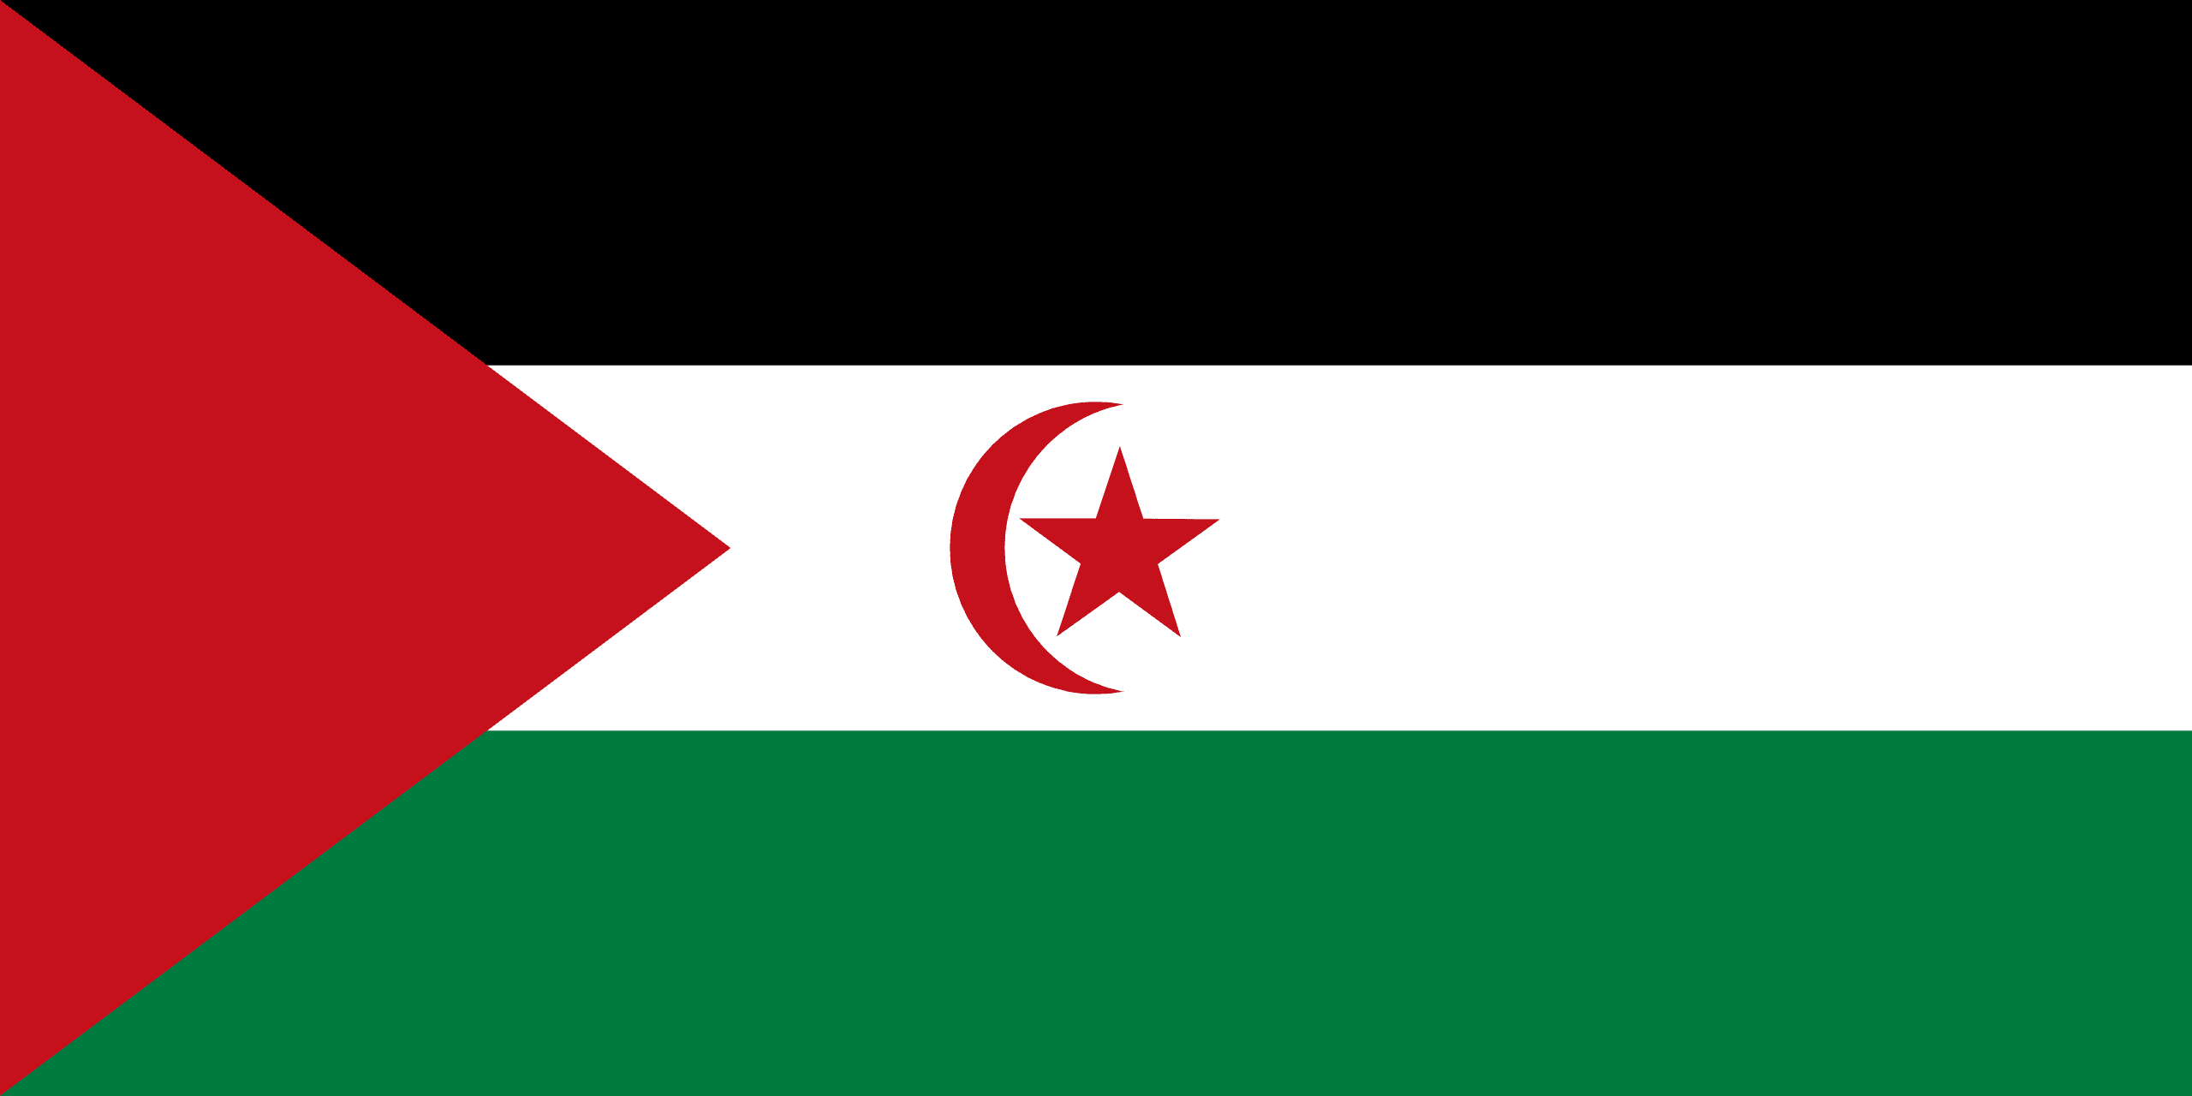
PRAYING FOR
WESTERN SAHARA

Slide 3
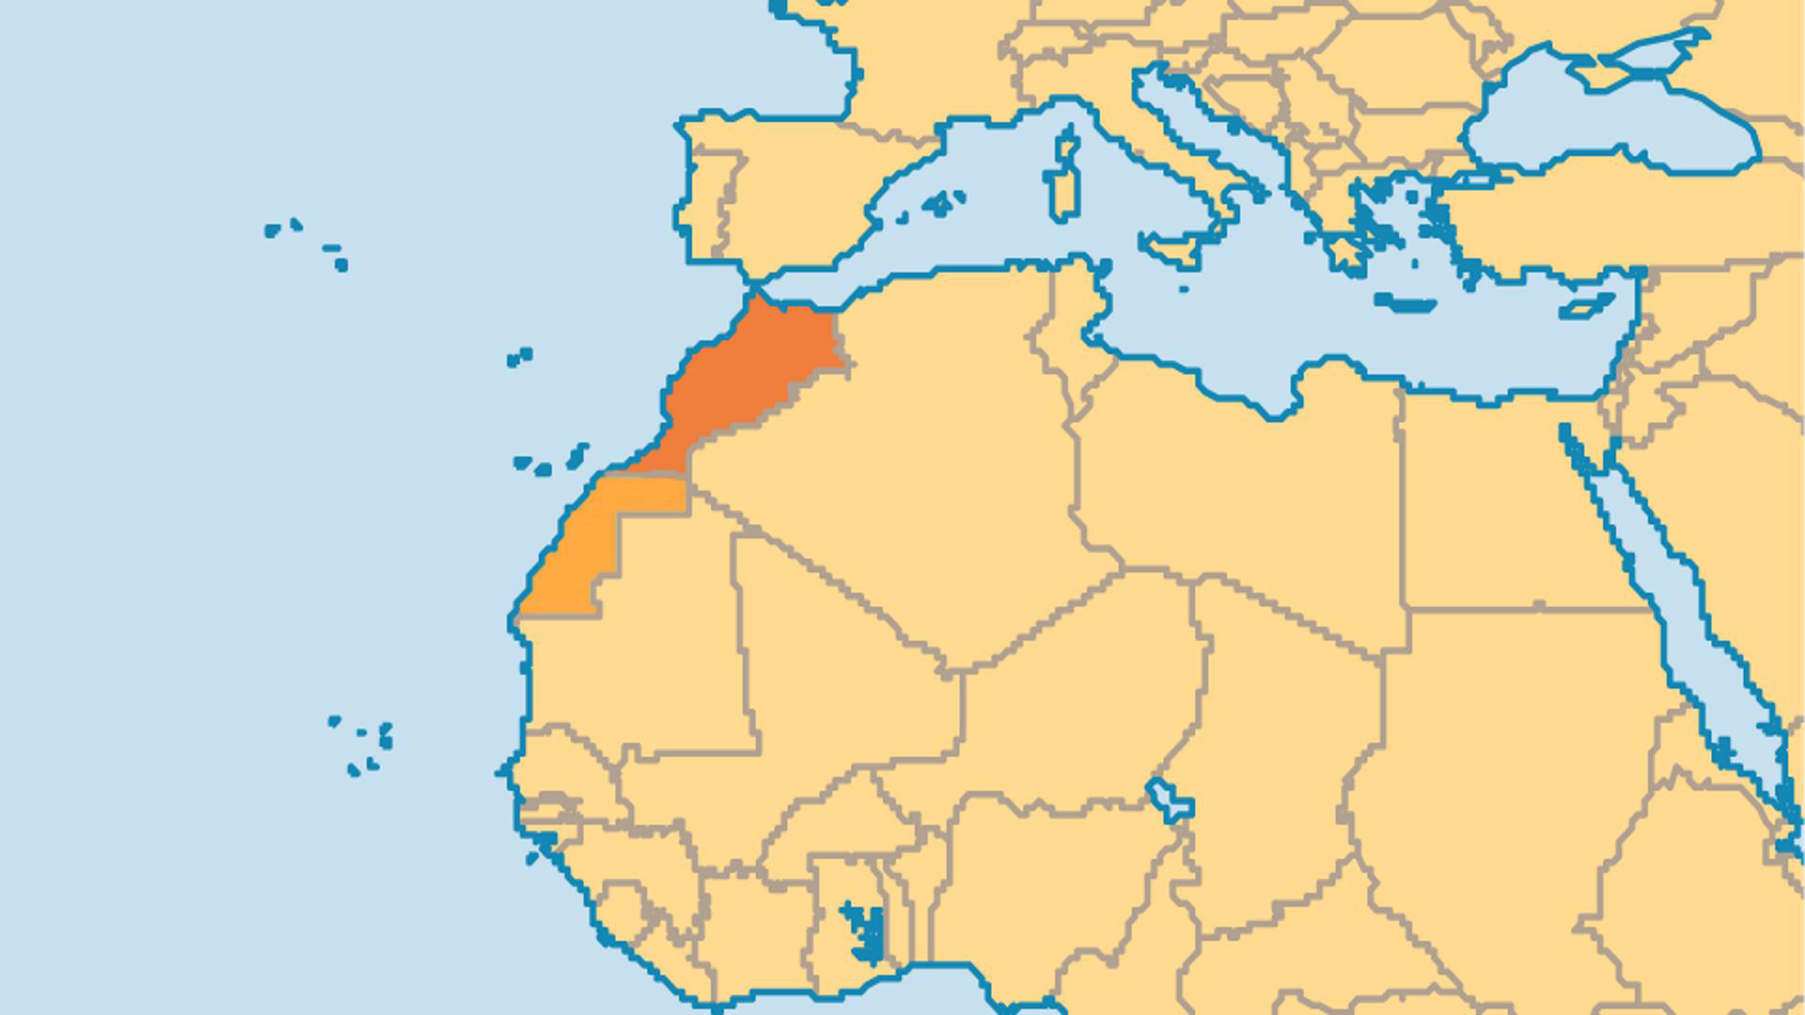
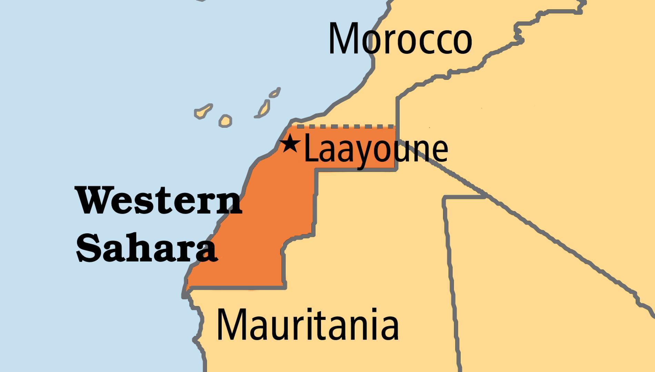
KEY STATS
Capital: | El Aiun
Population: | 600,904
% Christian: | 0 %
% Evangelical: | 0 %
Largest Religion: | Muslim
% Largest Religion: | 99.9 %
People Groups: | 10
Least Reached People Groups: | 10
% Unevangelized: | 79 %

Slide 4

FOR PRAYER
There are only a handful of Christians among the entire Sarahawi people of Western Sahara, but we see a new day of growth and witness through low-key mission work and national believers. There are openings for ministry to refugees through relief and development, and difficult political and living conditions lead to considerable openness. The New Testament, JESUS film, and a number of audio resources are available in Hassaniya Arabic. Pray for those who are, and could be, serving among them. Pray for the Saharawi people to meet Jesus!
Want to know more? Go to www.operationworld.org

