Slide 1




Slide 2


PRAYING FOR
RWANDA

Slide 3
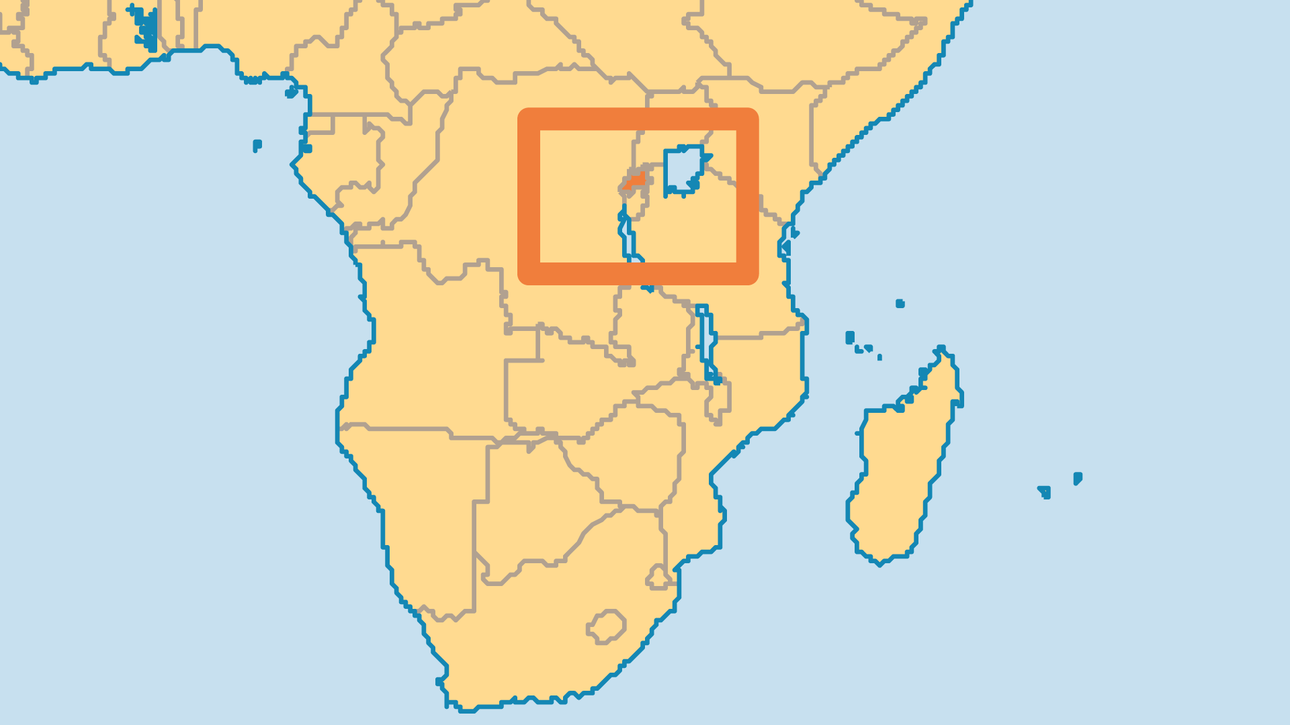
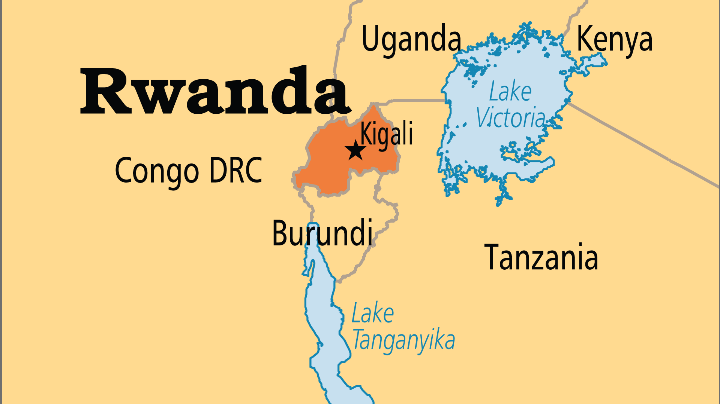
KEY STATS
Capital: | Kigali
Population: | 14,569,341
Official Language: | French, English, Kinyarwanda
Languages: | 5
Literacy Rate: | 66 %
HDI Ranking: | 165/193
% Christian: | 89.1 %
% Evangelical: | 26.9 %
% Unevangelized: | 1 %

Slide 4

FOR PRAYER
The closure of thousands of churches in 2024 brought attention to the relationship of the government to religion. Some Christian leaders argued that the new policies were unnecessarily draconian and that the five-year window was insufficient to meet compliance. The requirements included matters of safety and hygiene, along with registration, doctrinal statements, and qualifications for pastors. Pray that every congregation might have a place to gather, and every Christian ample opportunity for fellowship and worship. May the churches with more resources be a blessing to those with few.
Want to know more? Go to www.operationworld.org

