Slide 1




Slide 2

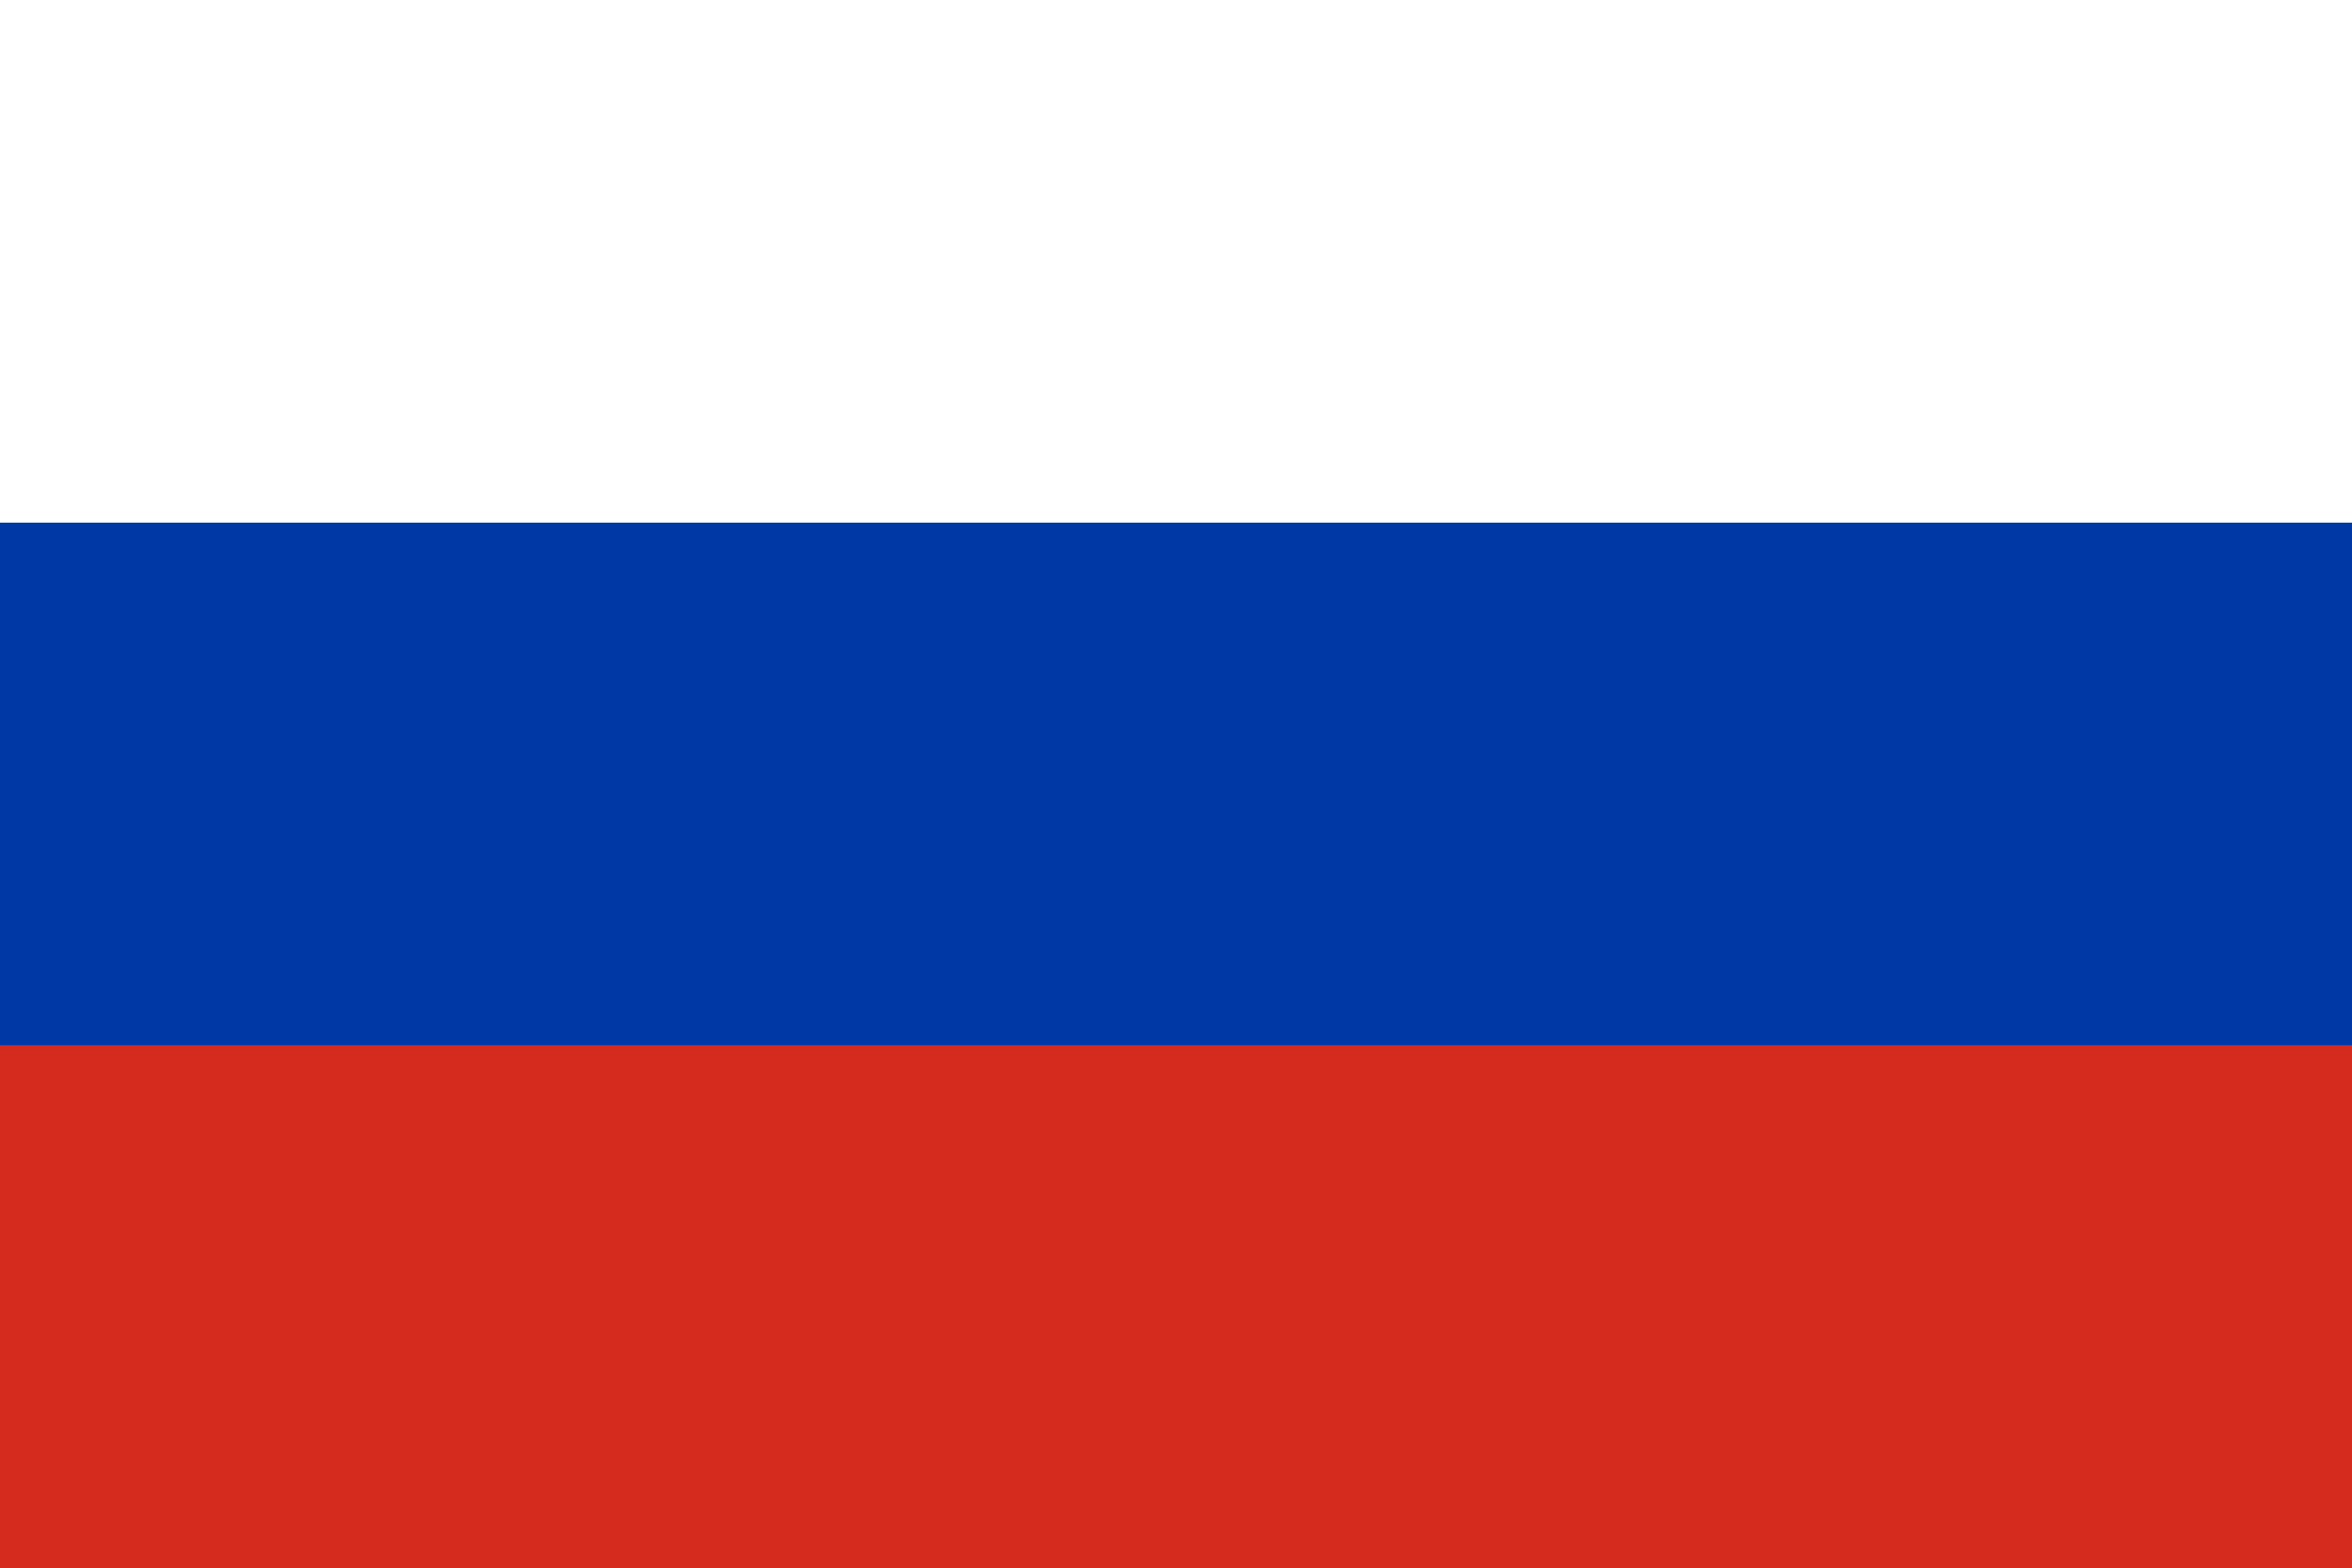
PRAYING FOR
RUSSIA

Slide 3
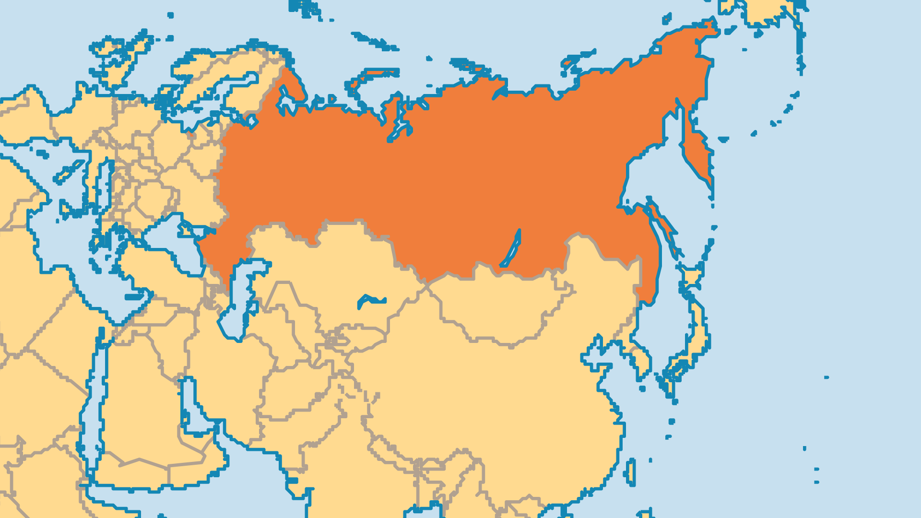
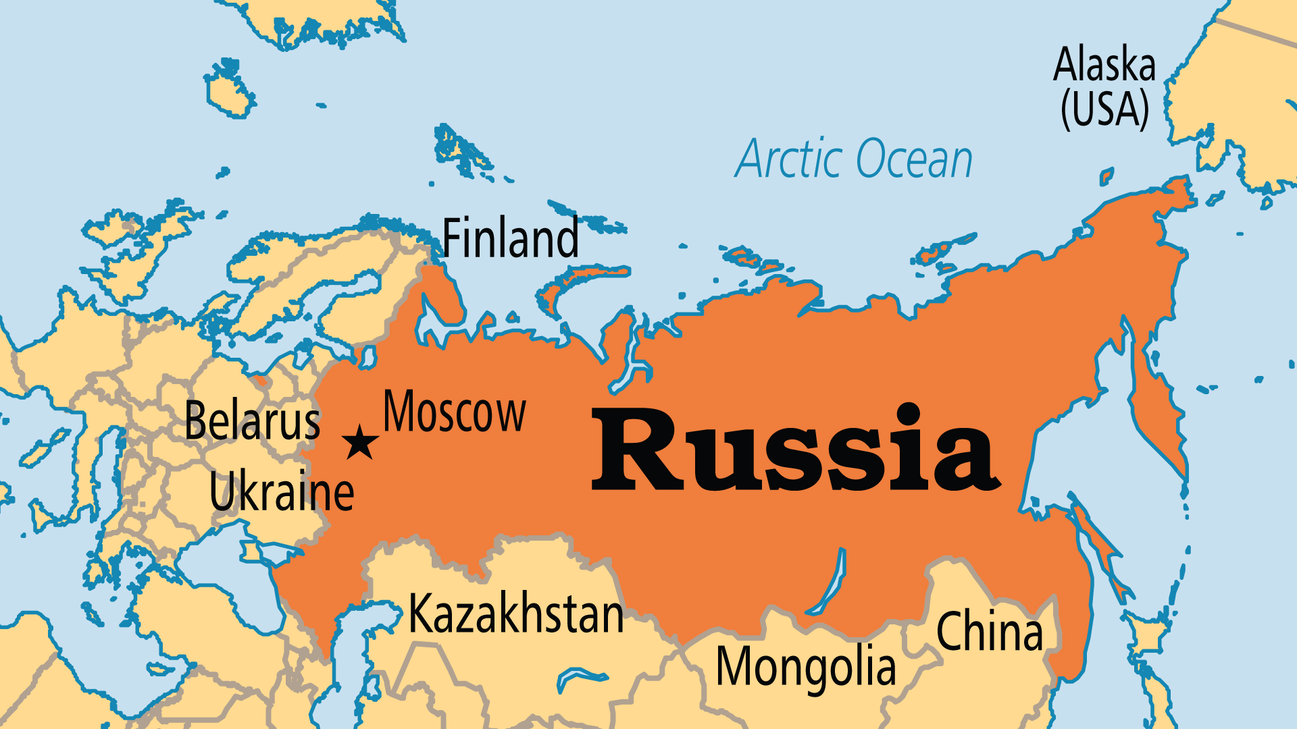
KEY STATS
Continent: | Europe
Capital: | Moscow
Population: | 143,997,393
Official Language: | Russian
Languages: | 135
Literacy Rate: | 100 %
% Christian: | 66.9 %
% Evangelical: | 1.2 %
People Groups: | 186
Least Reached People Groups: | 119
% Unevangelized: | 7 %

Slide 4
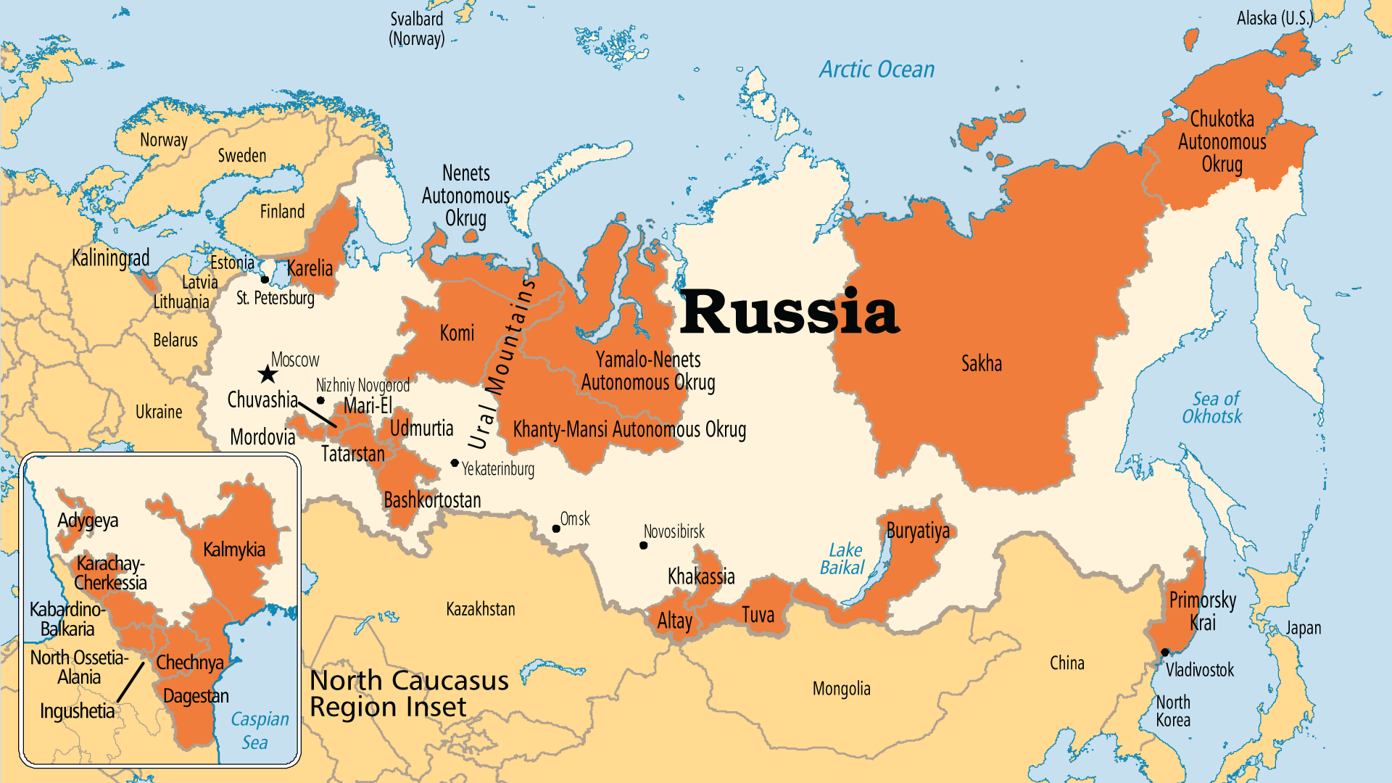

Slide 5

FOR PRAYER
Russia's increasing predations in other former Soviet states fully manifested in the 2022 invasion of Ukraine. Other nations in the region have also felt Russia's heavy hand in years past. Russia is a proud nation with a rich but often tragic history. The state's propaganda machine plays into this history by projecting both victimization and triumphalism. A grim demographic future for Russia is made worse by war and emigration. Add to this the countless billions spent, and a tattered global reputation, recovery may take generations - if it comes at all. For the sake of Russia, its neighbours, and the world, pray for peace, transparency, and truth to prevail in a nation where all three have been in short supply.

Slide 6
FOR PRAYER
The Russian Orthodox Church (ROC) survived Communism, and remained a major symbol of Russian identity. It sees itself as the preserver of a great Christian civilization handed down from Rome and Byzantium. It endured terrible persecution (along with other Christian groups) between 1920 and 1990 when up to 200,000 Christian leaders died as martyrs. Its Patriarch - a former KGB agent and a long-time Putin ally - attempted to politically and theologically justify the invasion of Ukraine. Pray that repentance will come to the ROC, and that God would cleanse it of any corruption and heresy that has taken root. Pray for what renewal movements exist within Russian Orthodoxy.

Slide 7
FOR PRAYER
Millions struggle against poverty and hopelessness. Russia has one of the world's most elderly populations, along with low immigration numbers. Russia's population drops by over 500,000 each year, and its birth rate is among the world's lowest. At the same time, Russia's abortion rate is one of the world's highest. Alcoholism, drug addiction, suicide, and family breakdown ruin many lives. Russia has high infection rates for a number of diseases, but health care costs are also high, and few have access. In peacetime, many youths pursued hedonistic dissipation. The war in Ukraine and the many thousands who fled the country to avoid it are robbing the country of much of its next generation.

Slide 8
FOR PRAYER
The North Caucasus region is the poorest and least stable region in Russia. It has the highest unemployment, the highest birth rates, and widespread corruption. The region's 7 republics contain 50 to 60 ethnic groups of Caucasus, Turkic, and Iranian origin. The North Caucasus peoples are among the least reached on earth, and they live in Europe's least-evangelized region. Pray that somehow, Jesus might be revealed to the peoples of this intensely needy corner of the world.
Want to know more? Go to www.operationworld.org

Slide 9
FOR PRAYER
Tatarstan has many minerals and good farmland, and a large degree of political and religious independence. The Tatar are Russia's largest Muslim people (5.5 million), and Europe's 2nd-largest. More Tatars live outside Tatarstan than inside. Only 10% faithfully practise Islam, though it is a strong part of Tatar identity. Evangelical churches and groups increased among the Tatar, and may now total over 100 congregations! Most are Russian-speaking, but Tatar-speaking believers also increase. Persecution draws evangelicals closer together in fellowship, even those who were historically divided by language and theology. Pray that they might present a beautiful testimony of unity in Christ to wider society.

