Slide 1




Slide 2

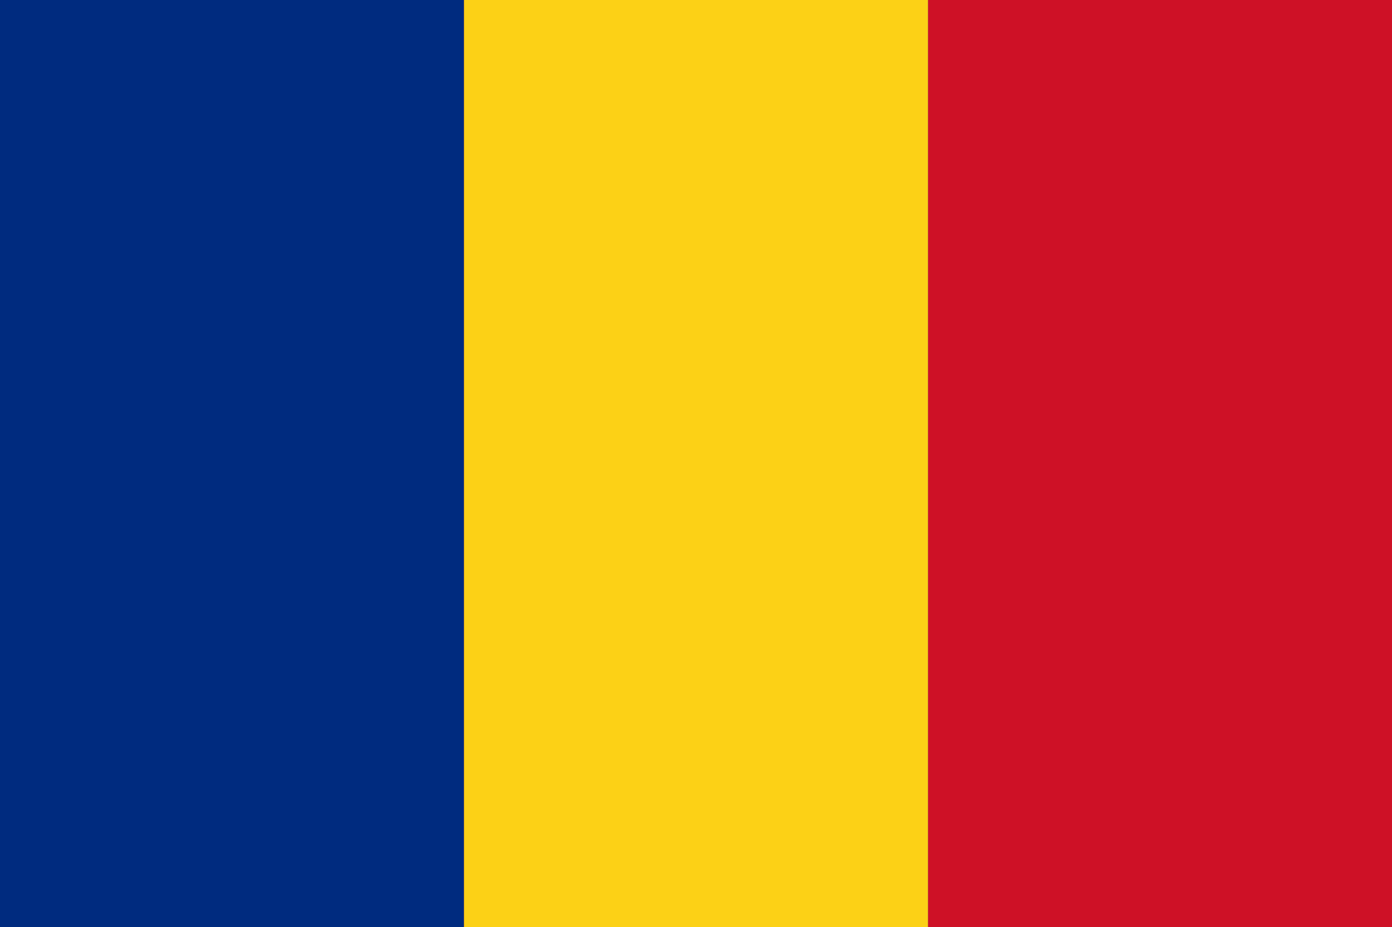
PRAYING FOR
ROMANIA

Slide 3
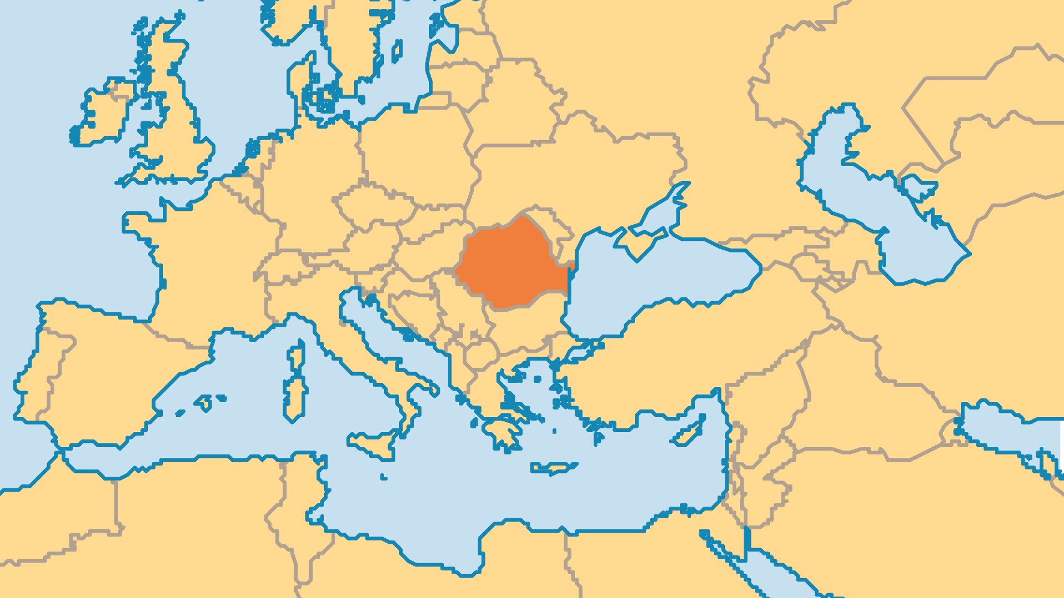
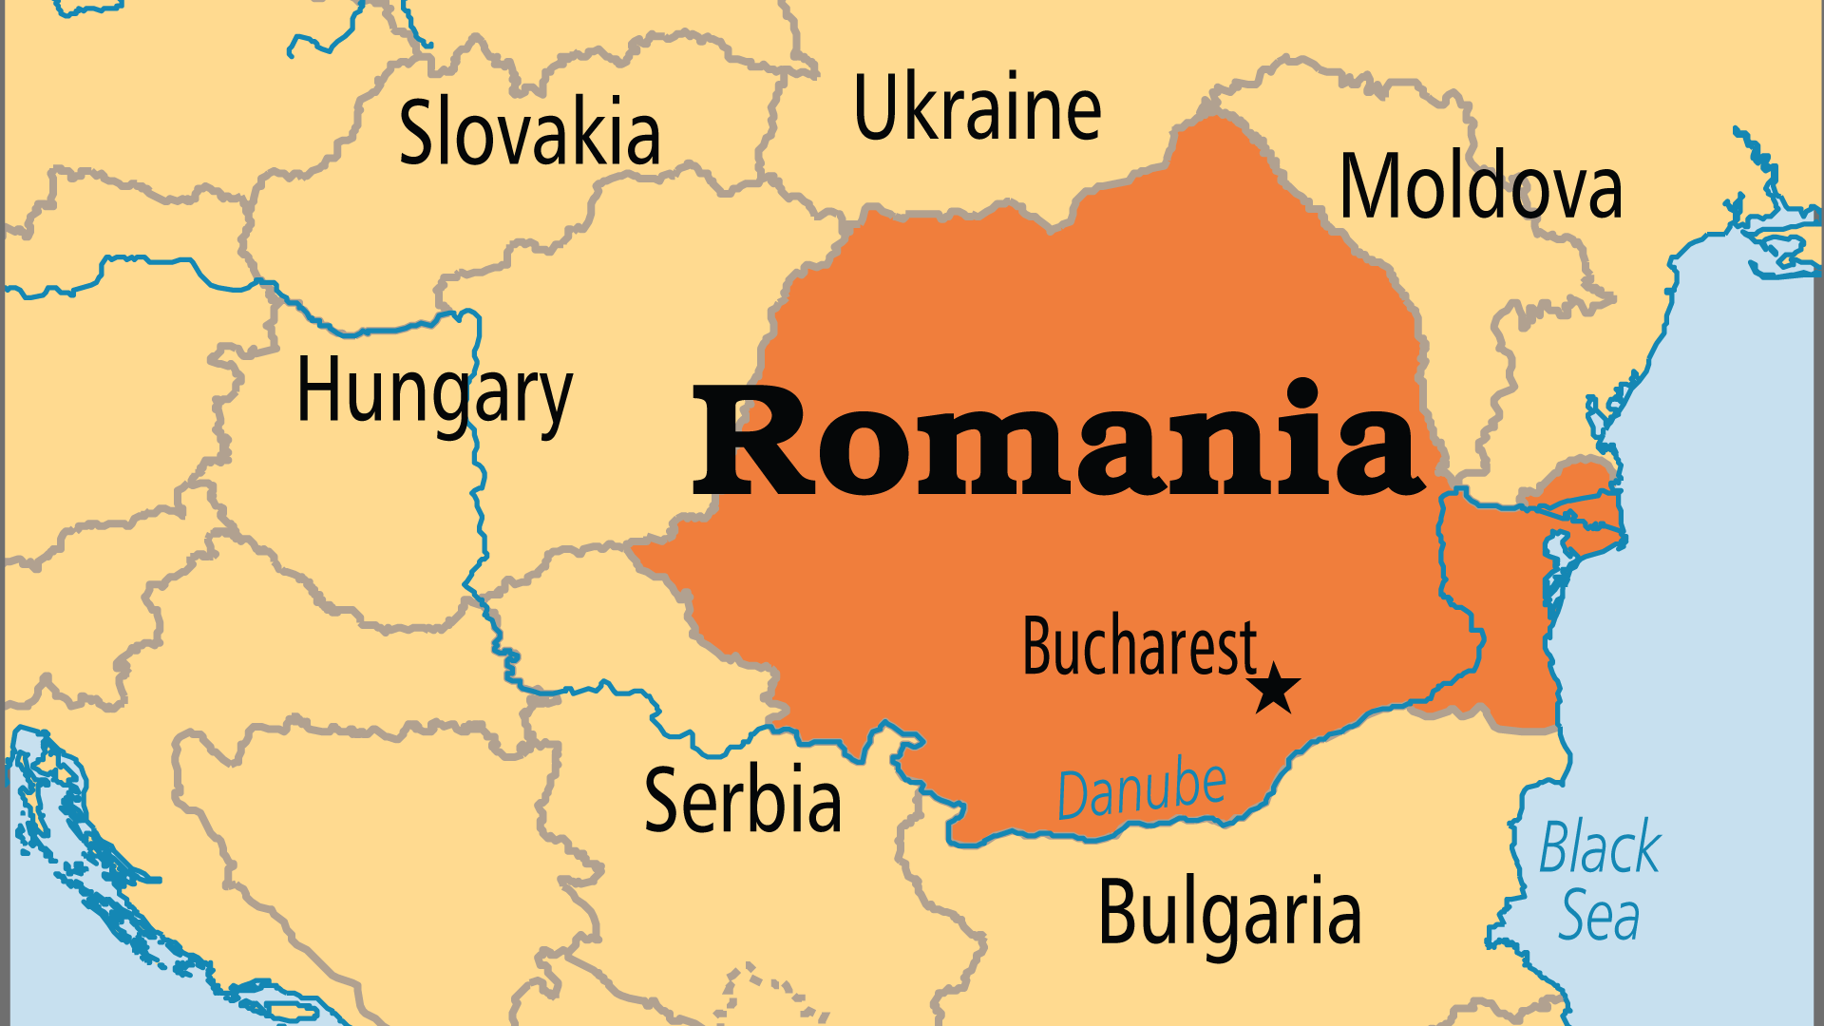
KEY STATS
Capital: | Bucharest
Population: | 18,908,651
Official Language: | Romanian
Languages: | 23
HDI Ranking: | 53/193
% Christian: | 97 %
% Evangelical: | 5.4 %
People Groups: | 32
Least Reached People Groups: | 7
% Unevangelized: | 0 %

Slide 4

FOR PRAYER
Romanians as a mission force are a new and quickly expanding dynamic. At least ten indigenous sending agencies have emerged since 2000, and training programmes are multiplying. Members of Partners in Mission, most notably OC, were instrumental in shaping these changes. Romanians can easily access fields that Westerners cannot, and agencies are interested in Romanians serving with them. Limiting factors are the lack of financial support/sponsorship and the lagging missions vision in many churches. Pray for the removal of every barrier to the full flowering of an indigenous missions movement.

Slide 5
FOR PRAYER
Romania is one of the world's most Christian nations by percentage, but it is difficult to see this in society. The atheistic worldview of Communism persists. Weak faith, hypocrisy, and slander of other denominations cause problems for all Christian groups. This does not glorify Christ and does not build up the Church. Church members and even clergy mix faith with folk religious practices or the occult. Churches neglect many poor people. Pray for a breakthrough of love, holiness, discipleship, and prayer in all denominations.
Want to know more? Go to www.operationworld.org

