Slide 1




Slide 2


PRAYING FOR
REUNION

Slide 3
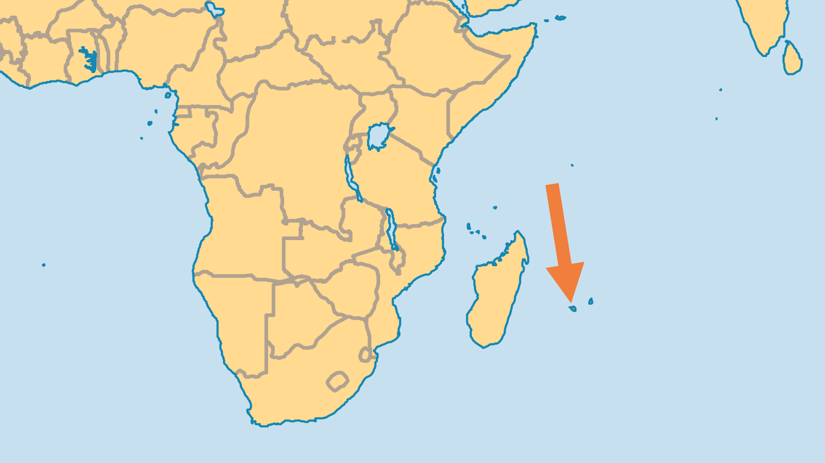
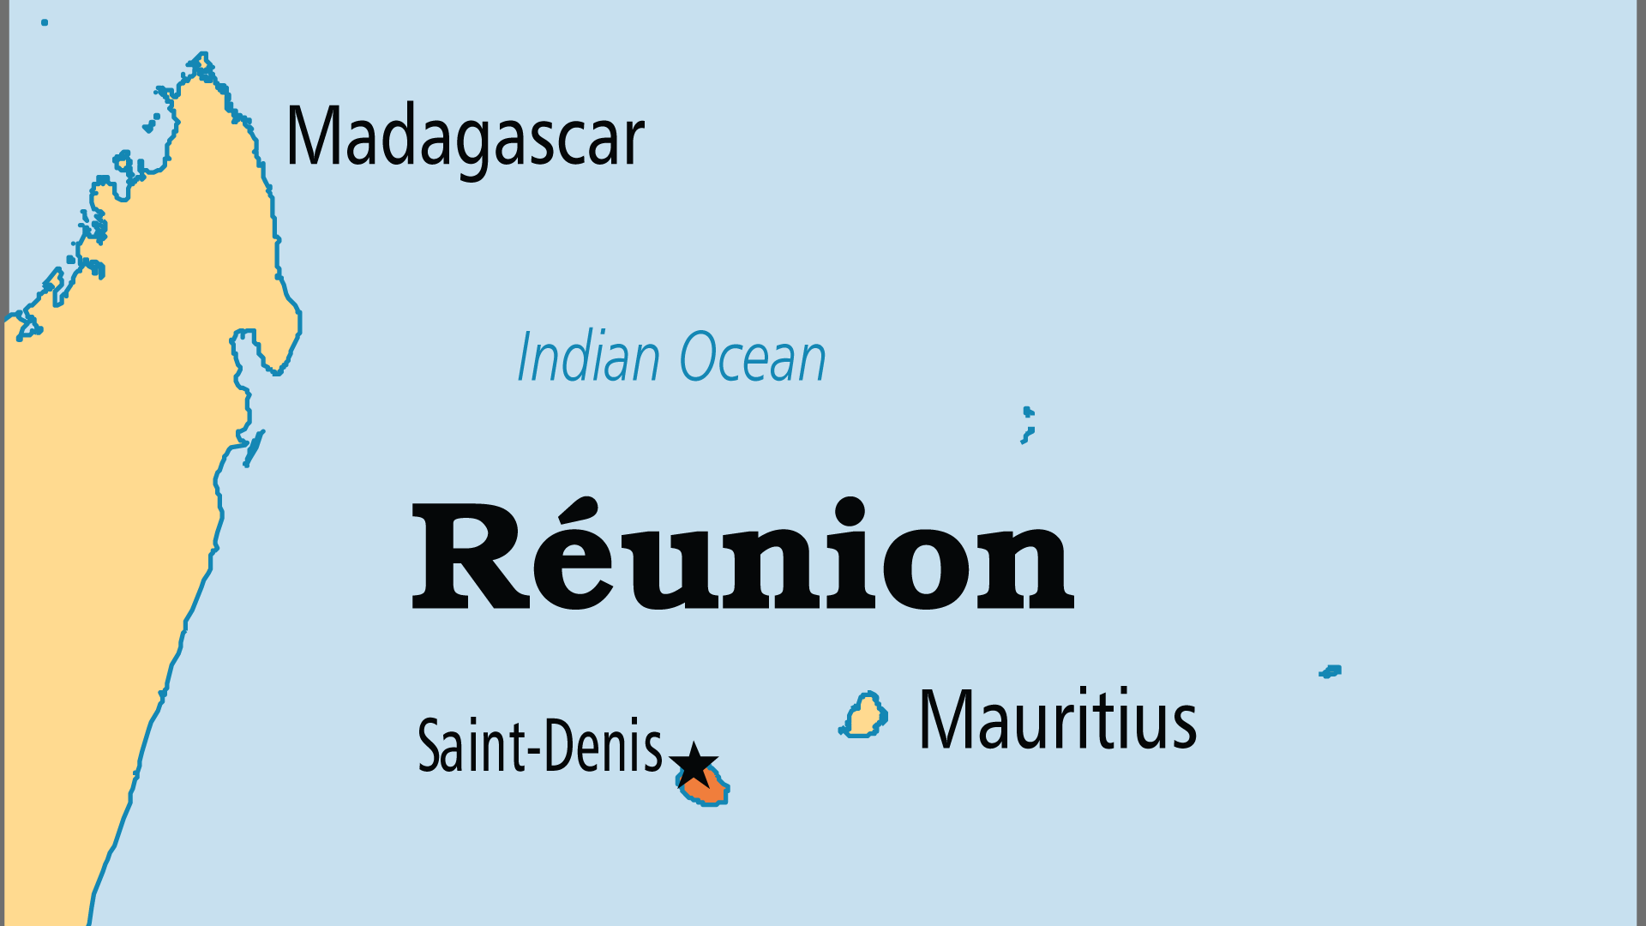
KEY STATS
Capital: | Saint-Denis
Population: | 882,406
Official Language: | French. Common language French Creole
Life Expectancy: | 81.6 yrs (28th/236)
% Christian: | 87 %
% Evangelical: | 5.9 %
People Groups: | 18
Least Reached People Groups: | 7
% Unevangelized: | 3 %

Slide 4

FOR PRAYER
Praise God for dramatic growth since 1966, when the French Assemblies of God (locally called Mission Salut et Guérison) arrived and then after 1970, when Africa Evangelical Fellowship (now part of SIM) missionaries began work here. Many churches have helped people to be freed from occult bondage. The March for Jesus previously and now MANI (Movement for African National Initiatives) have contributed to a greater networking of Reformed, charismatic and evangelical congregations. Pray for growth in grace, numbers and spiritual understanding in these young and enthusiastic churches.
Want to know more? Go to www.operationworld.org

