Slide 1




Slide 2

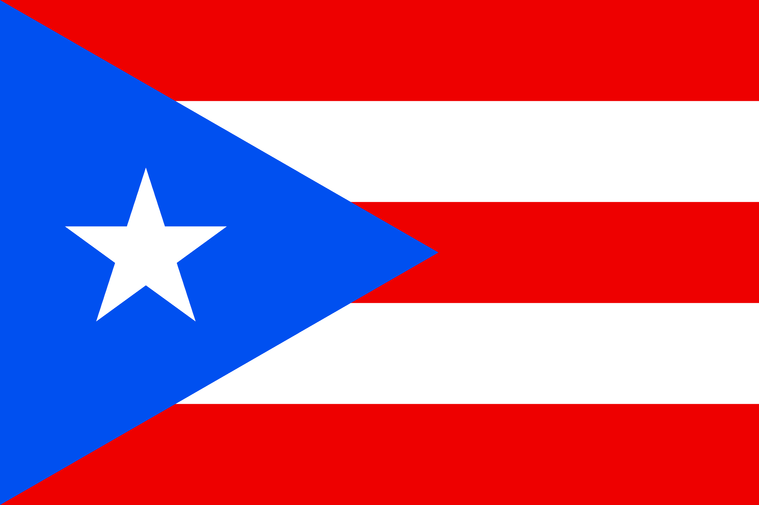
PRAYING FOR
PUERTO RICO

Slide 3
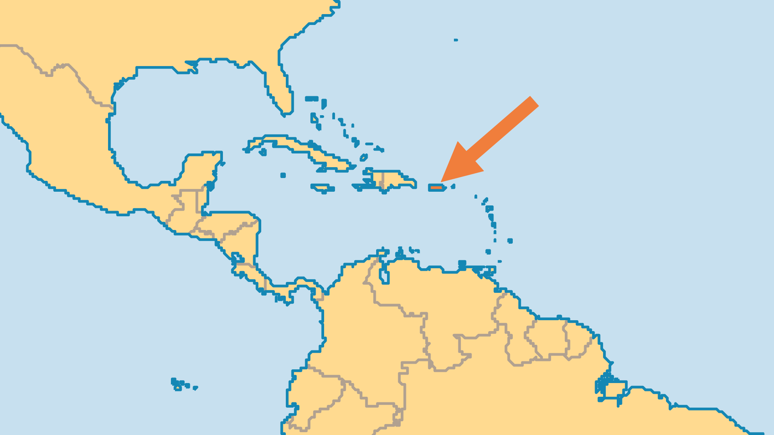
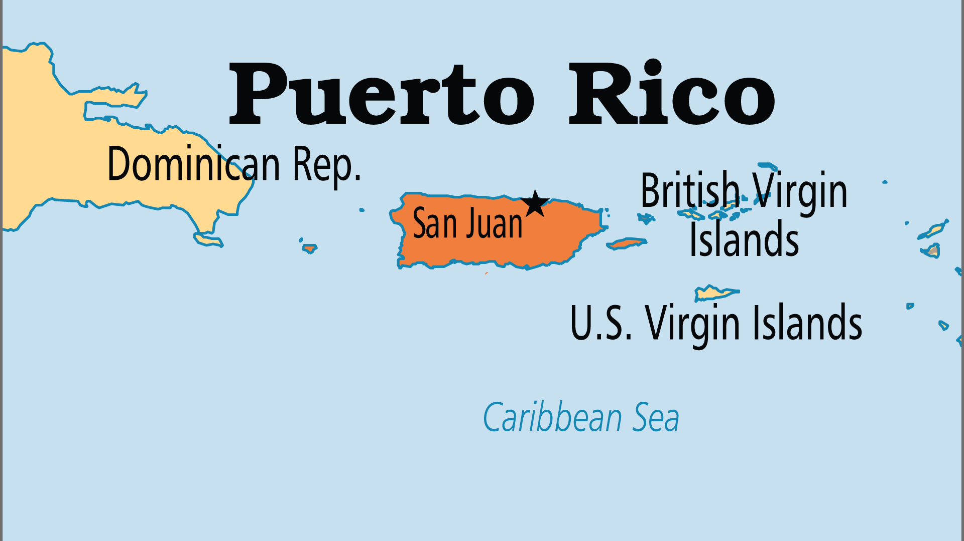
KEY STATS
Capital: | San Juan
Population: | 3,235,290
Official Language: | Spanish; English
Languages: | 13
Literacy Rate: | 99 %
Life Expectancy: | 80.2 yrs (44th/236)
% Christian: | 95.3 %
% Evangelical: | 25.2 %
Least Reached People Groups: | 1
% Unevangelized: | 1 %

Slide 4

FOR PRAYER
Evangelical churches grew from 0.1% in 1900 to over 25% today! Puerto Ricans traditionally follow Catholicism. A large charismatic movement grew inside the Catholic Church, but most new growth is among independent groups. Puerto Rican mission vision also grew. Pray for effective training and support of new mission ventures. IFES (International Federation of Evangelical Students) and indigenous student movements reach most campus students. Pray for ministries to continue shaping future leaders, and for discipleship movements to transform the lives of believers.
Want to know more? Go to www.operationworld.org

