Slide 1




Slide 2


PRAYING FOR
PORTUGAL

Slide 3
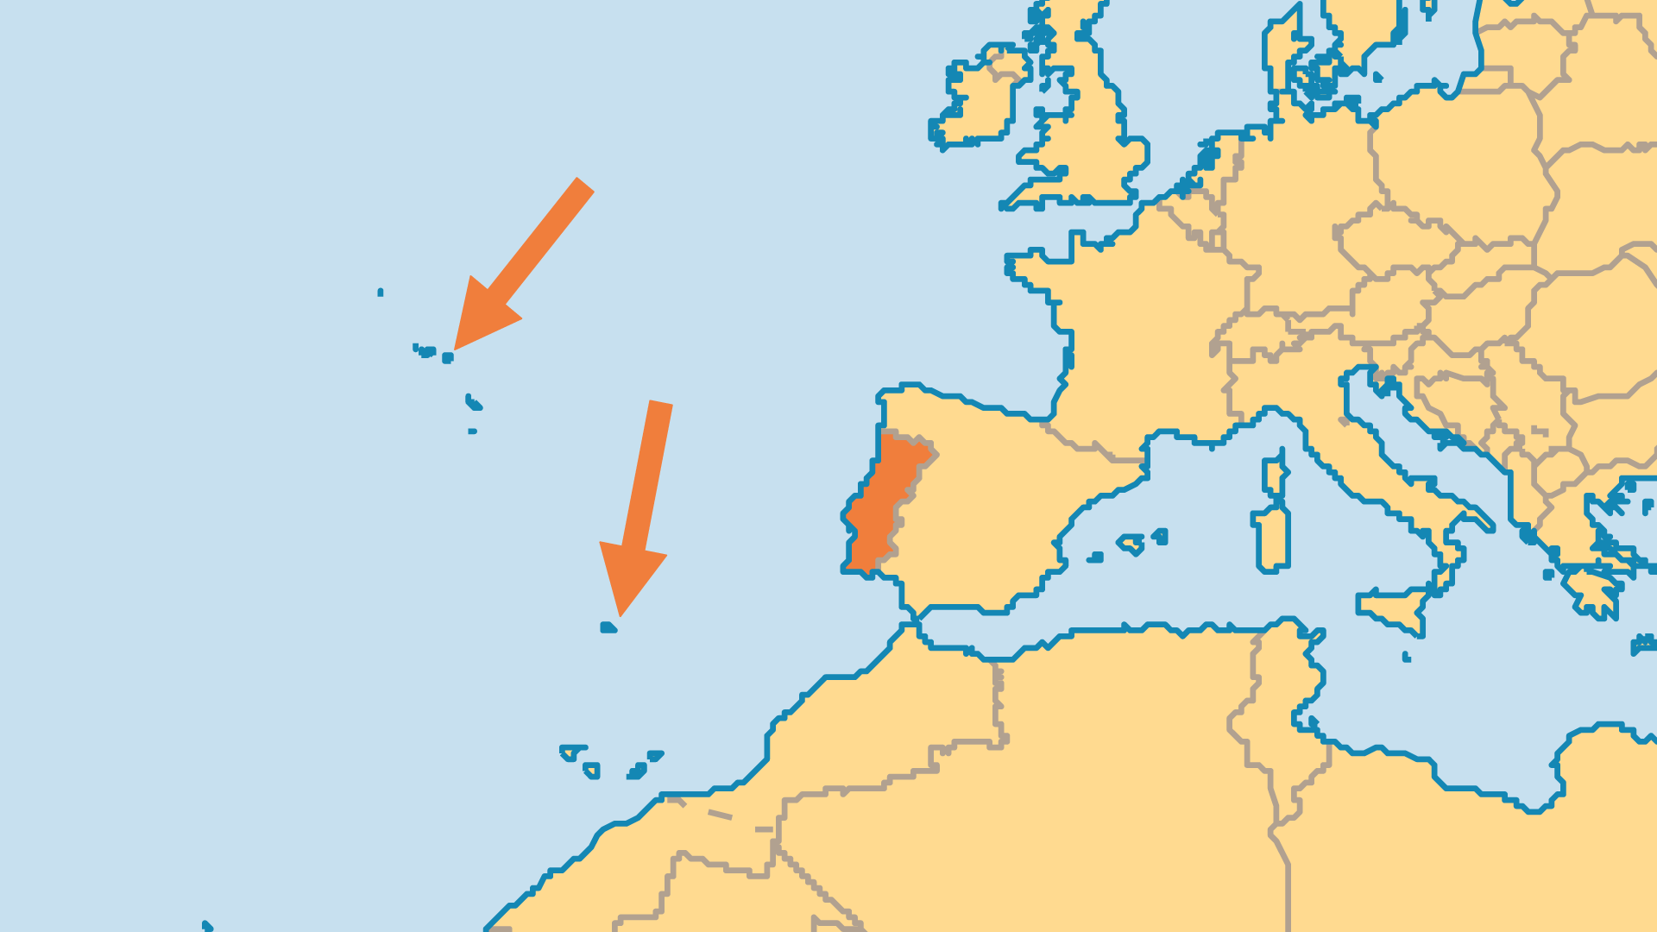
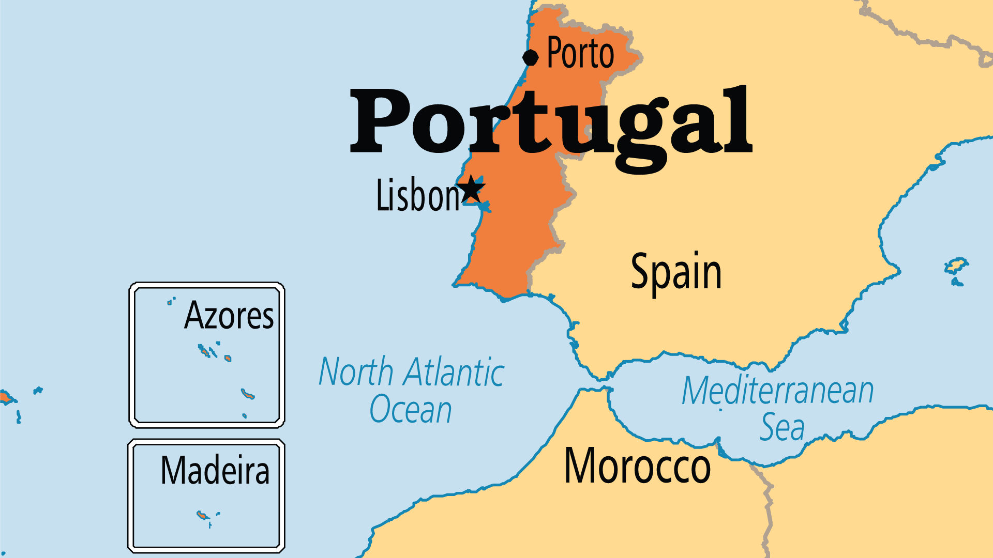
KEY STATS
Capital: | Lisbon
Population: | 10,411,834
% Urban: | 68.9 %
Pop Under 15 Yrs: | 13.3 %
Official Language: | Portuguese
Languages: | 9
Life Expectancy: | 81 yrs (31st/236)
HDI Ranking: | 38/193
% Christian: | 94.4 %
% Evangelical: | 3 %

Slide 4

FOR PRAYER
Evangelical growth is both a source of encouragement and a serious challenge. Pray for church planting efforts in Portugal. Many congregations closed, and many others have appeared. Nearly half of current evangelical fellowships were started since 2001, and the vision to grow and plant more churches is widespread. Several groups adopted cell-church models but face the difficulty that, for many Portuguese, a physical building is what communicates religious legitimacy. Pray for continued church growth, for affordable and appropriate meeting places and for leaders for these future churches.
Want to know more? Go to www.operationworld.org

