Slide 1




Slide 2

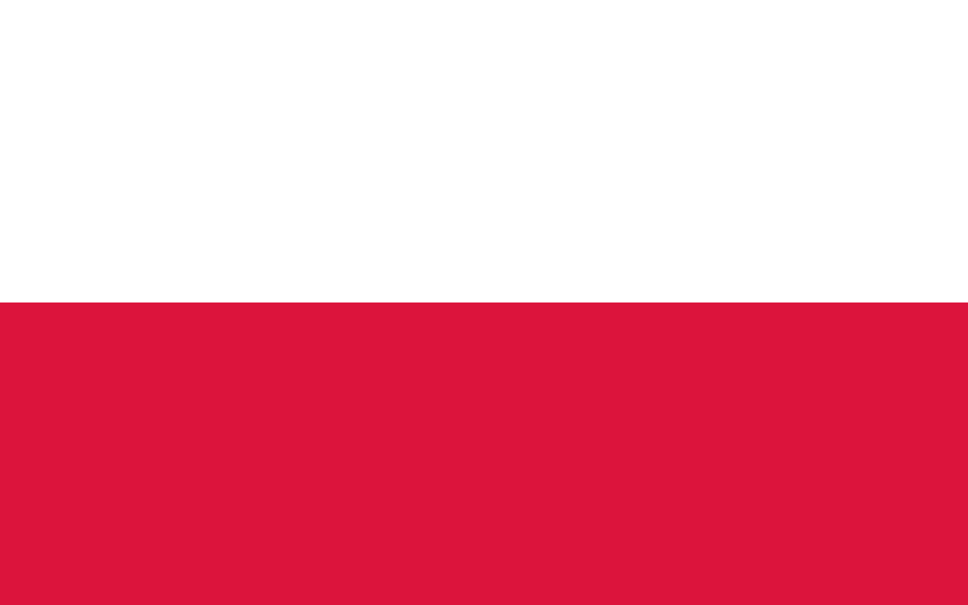
PRAYING FOR
POLAND

Slide 3
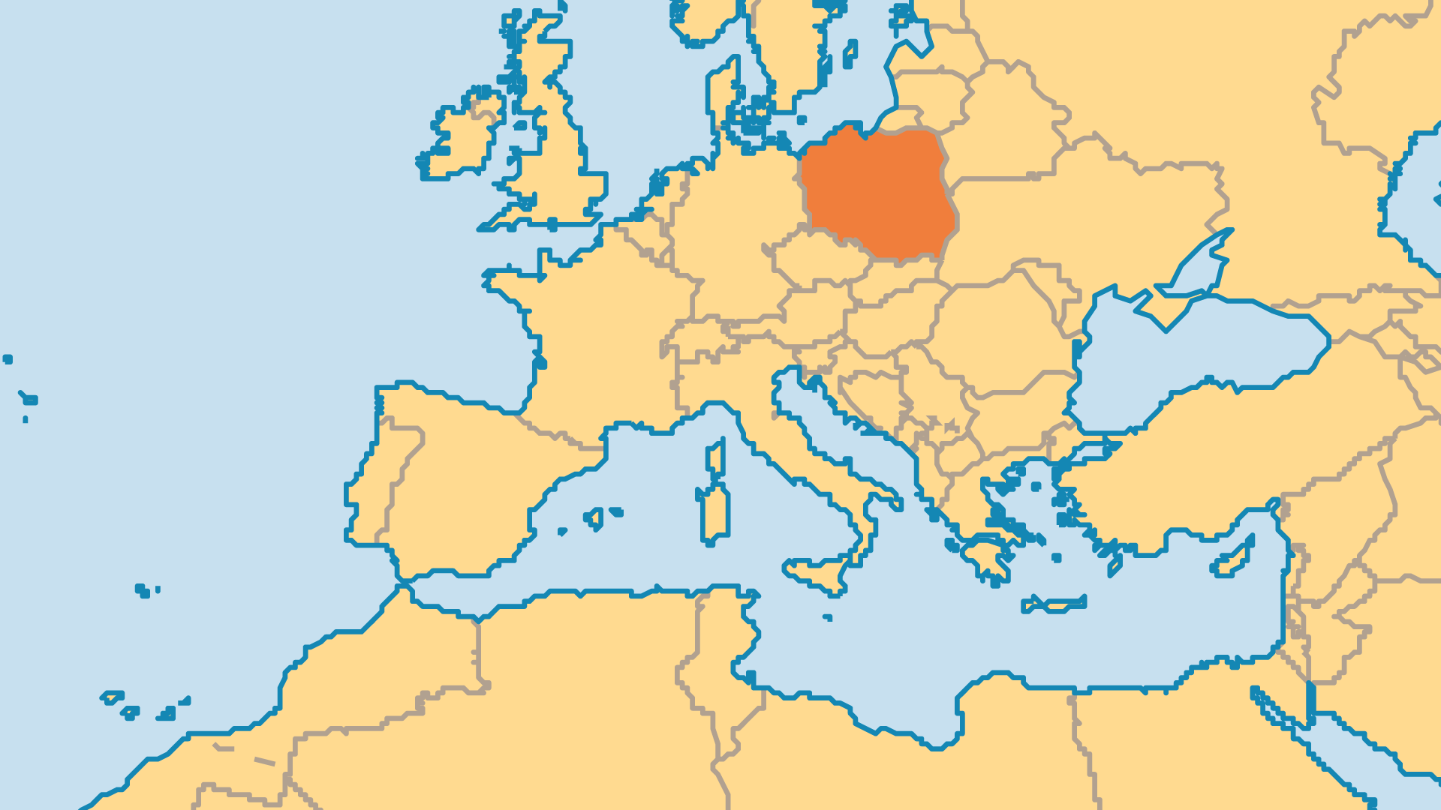
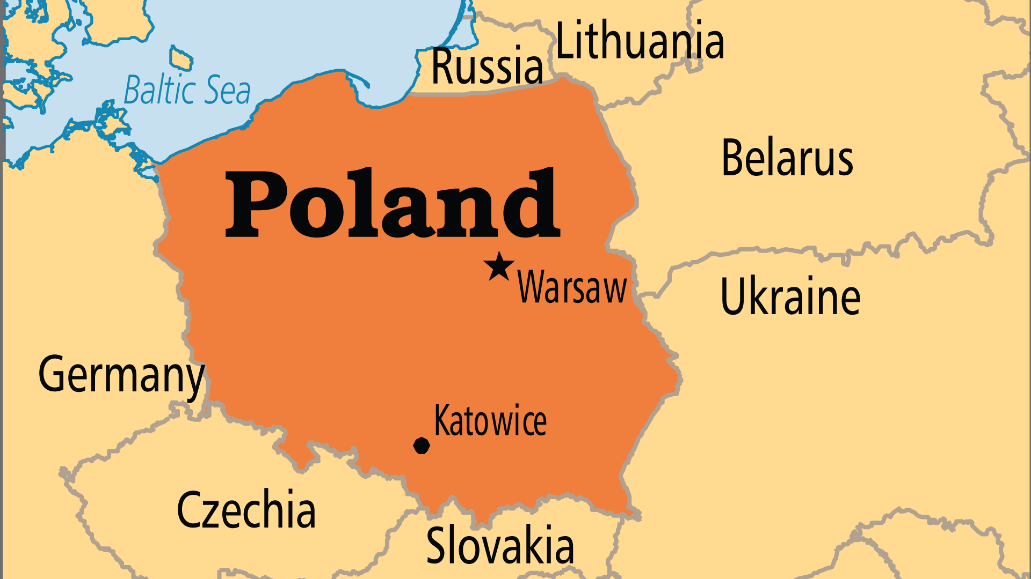
KEY STATS
Capital: | Warsaw
Population: | 38,140,910
% Urban: | 60.5 %
Pop Under 15 Yrs: | 15.2 %
Official Language: | Polish
Languages: | 20
Literacy Rate: | 100 %
Life Expectancy: | 76.5 yrs (75th/236)
% Christian: | 89.6 %
% Evangelical: | 0.3 %
% Unevangelized: | 1 %

Slide 4

FOR PRAYER
Praise God for the stability, progress, and freedom that allows believers to preach the good news! Many Poles dreamed of new wealth after independence from Communist rule. Sadly, unemployment and poverty still affect many, especially in rural areas. Even those who found riches did not find true satisfaction. Young people have more material possessions, but now struggle with violence, immorality, and meaninglessness in society. Pray the people might search first for God, above all other pursuits.
Want to know more? Go to www.operationworld.org

