Slide 1




Slide 2

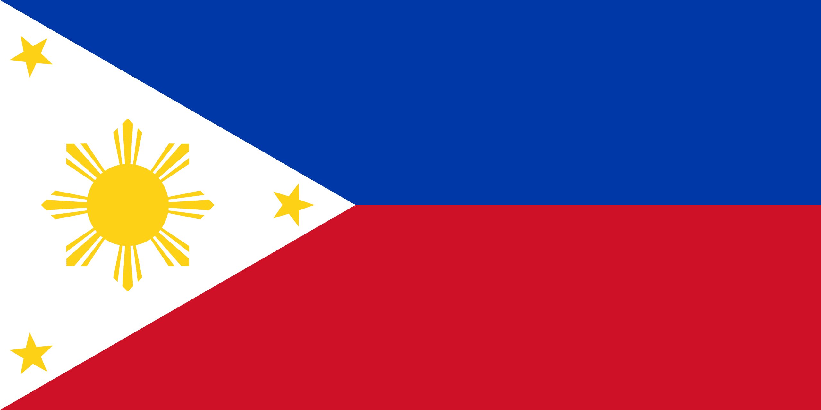
PRAYING FOR
PHILIPPINES

Slide 3
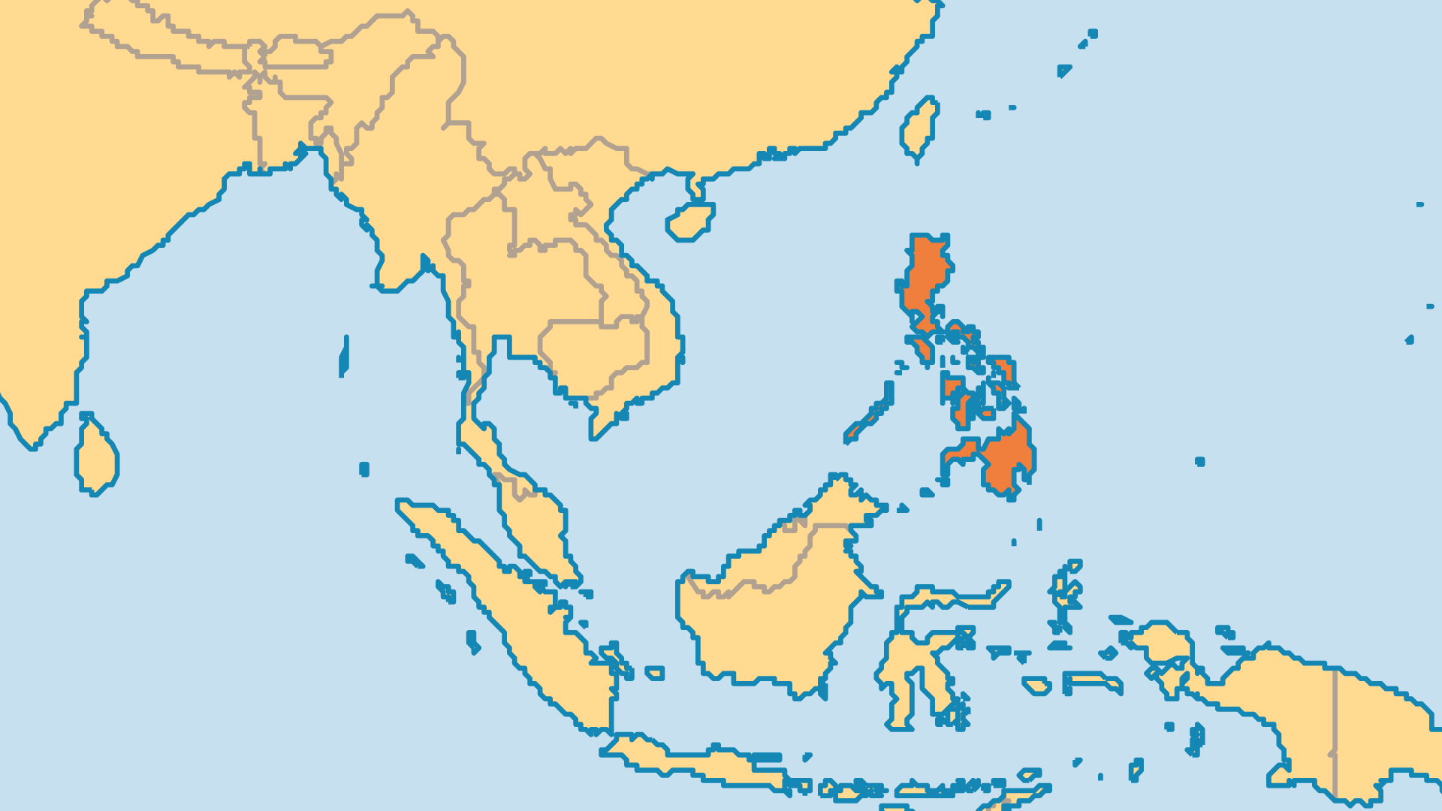
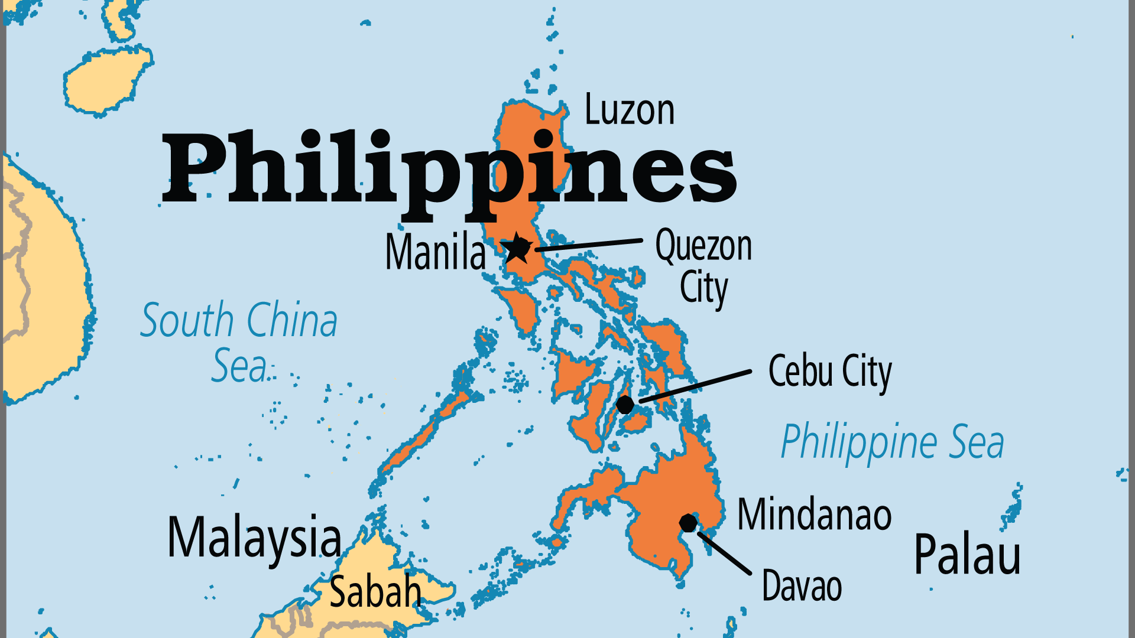
KEY STATS
Capital: | Manila
Population: | 116,786,963,
Official Language: | Filipino (based on Tagalog), English
Languages: | 181
Literacy Rate: | 95 %
HDI Ranking: | 116/193
% Christian: | 92.3 %
% Evangelical: | 12.3 %
% Unevangelized: | 5 %

Slide 4

FOR PRAYER
The Philippines has not yet achieved its economic and political potential. The nation has natural resources, democratic roots, and a well-educated population. But governments routinely fail to address serious economic and social issues that limit development. Half the population live in poverty. Most farmers do not own land. High levels of corruption are scandalous, especially in Asia's most Christianized nation! Pray for the Fellowship of Christians in Government, which promotes biblical standards among Christian public servants.
Want to know more? Go to www.operationworld.org

Slide 5
FOR PRAYER
Metro Manila is a mega-city of 13 million people, with the Greater Manila area up to 26 million. It faces enormous challenges, but God is greatly at work here. Modern ministry to the urban poor began in Manila. Many are open to the gospel, but most evangelical churches are in wealthier areas. Nearly 50% of slums and squatter communities have no evangelical church. At the same time, Manila is home to the country's wealthy elite. Pray that the gospel will impact them also, as they hold much power and the potential to transform Manila and the whole nation.

Slide 6
FOR PRAYER
The Roman Catholic Church retains great influence but needs to change as the country's religious diversity increases. Some Catholics want to preserve the Church's role in politics and society, and a few work to oppose Protestant or Independent movements. Recent surveys show that 15-30% of Catholics identify themselves as charismatic, and several new movements within Catholicism have committed evangelicals among them. Pray for God's grace on these lively communities. For many Catholics, witchcraft or animism holds more influence over their lives than Christianity. They need the power of the true gospel.

