Slide 1




Slide 2


PRAYING FOR
PERU

Slide 3
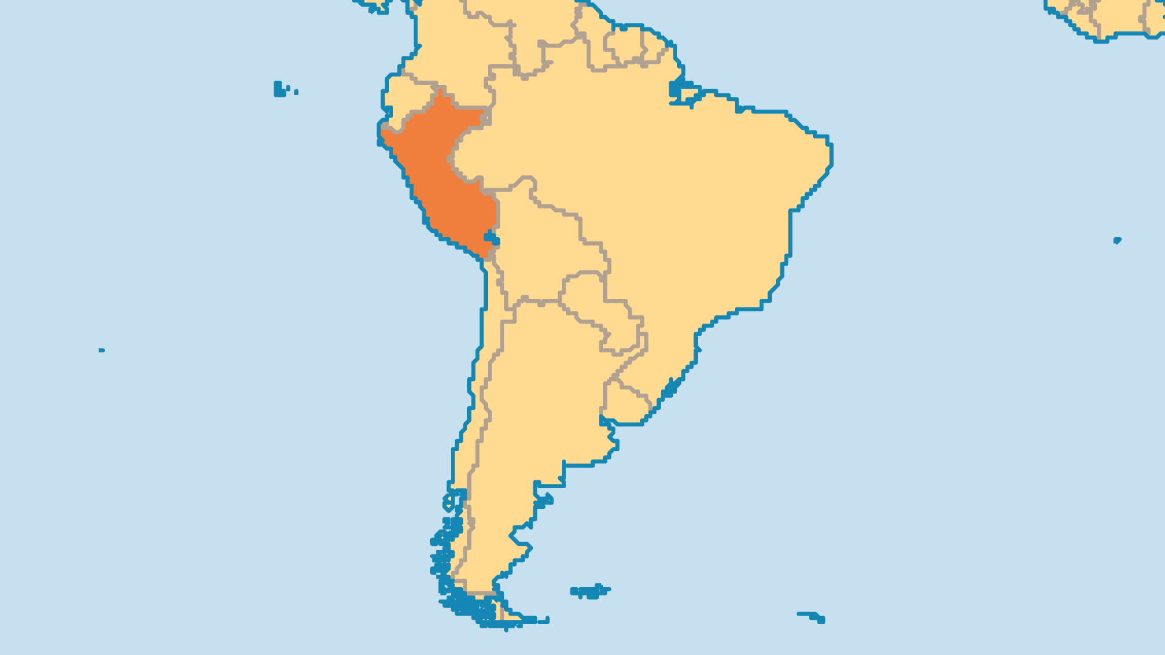
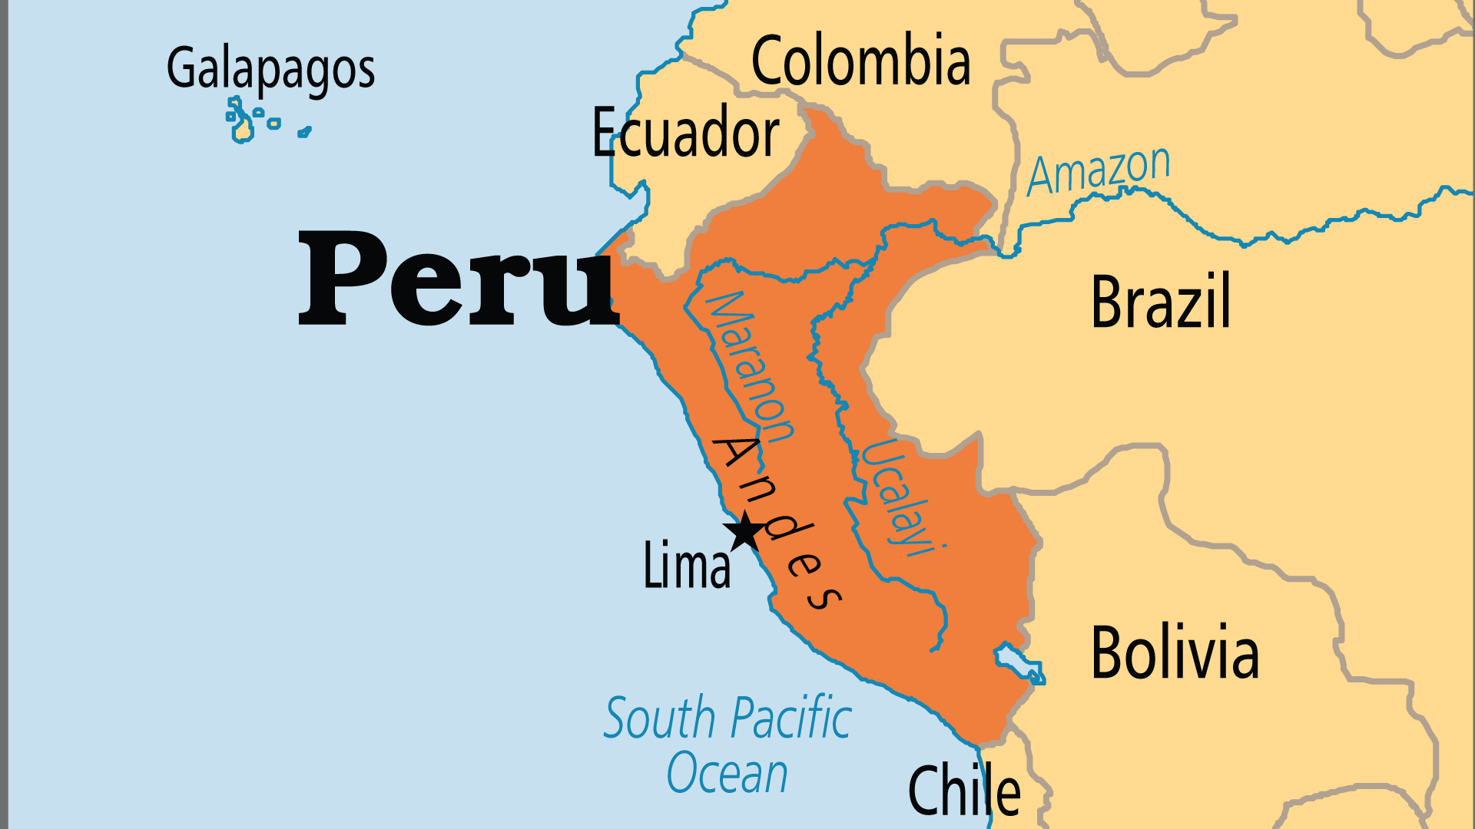
KEY STATS
Capital: | Lima
Population: | 34,576,665
% Urban: | 78.5 %
Official Language: | Spanish, Quechua
Languages: | 93
HDI Ranking: | 84/193
% Christian: | 95.5 %
% Evangelical: | 11.6 %
People Groups: | 104
Least Reached People Groups: | 14
% Unevangelized: | 1 %

Slide 4

FOR PRAYER
Peru's political scene has been a mess for much of the past few decades. In dealing violently with Maoist terrorist groups, the government then brought abusive, corrupt politicians to justice. Since 2017, Peru has been paralyzed by a series of political crises. In 2022-2023, Peru experienced the Presidential self-coup and ensuing political drama, protests, and crackdowns. Over 50% still live in poverty, and 20% in extreme poverty. Amerindian groups face racial injustice, and urbanization brings many poor migrants to urban areas. Pray for justice and righteousness for the oppressed.
Want to know more? Go to www.operationworld.org

