Slide 1




Slide 2

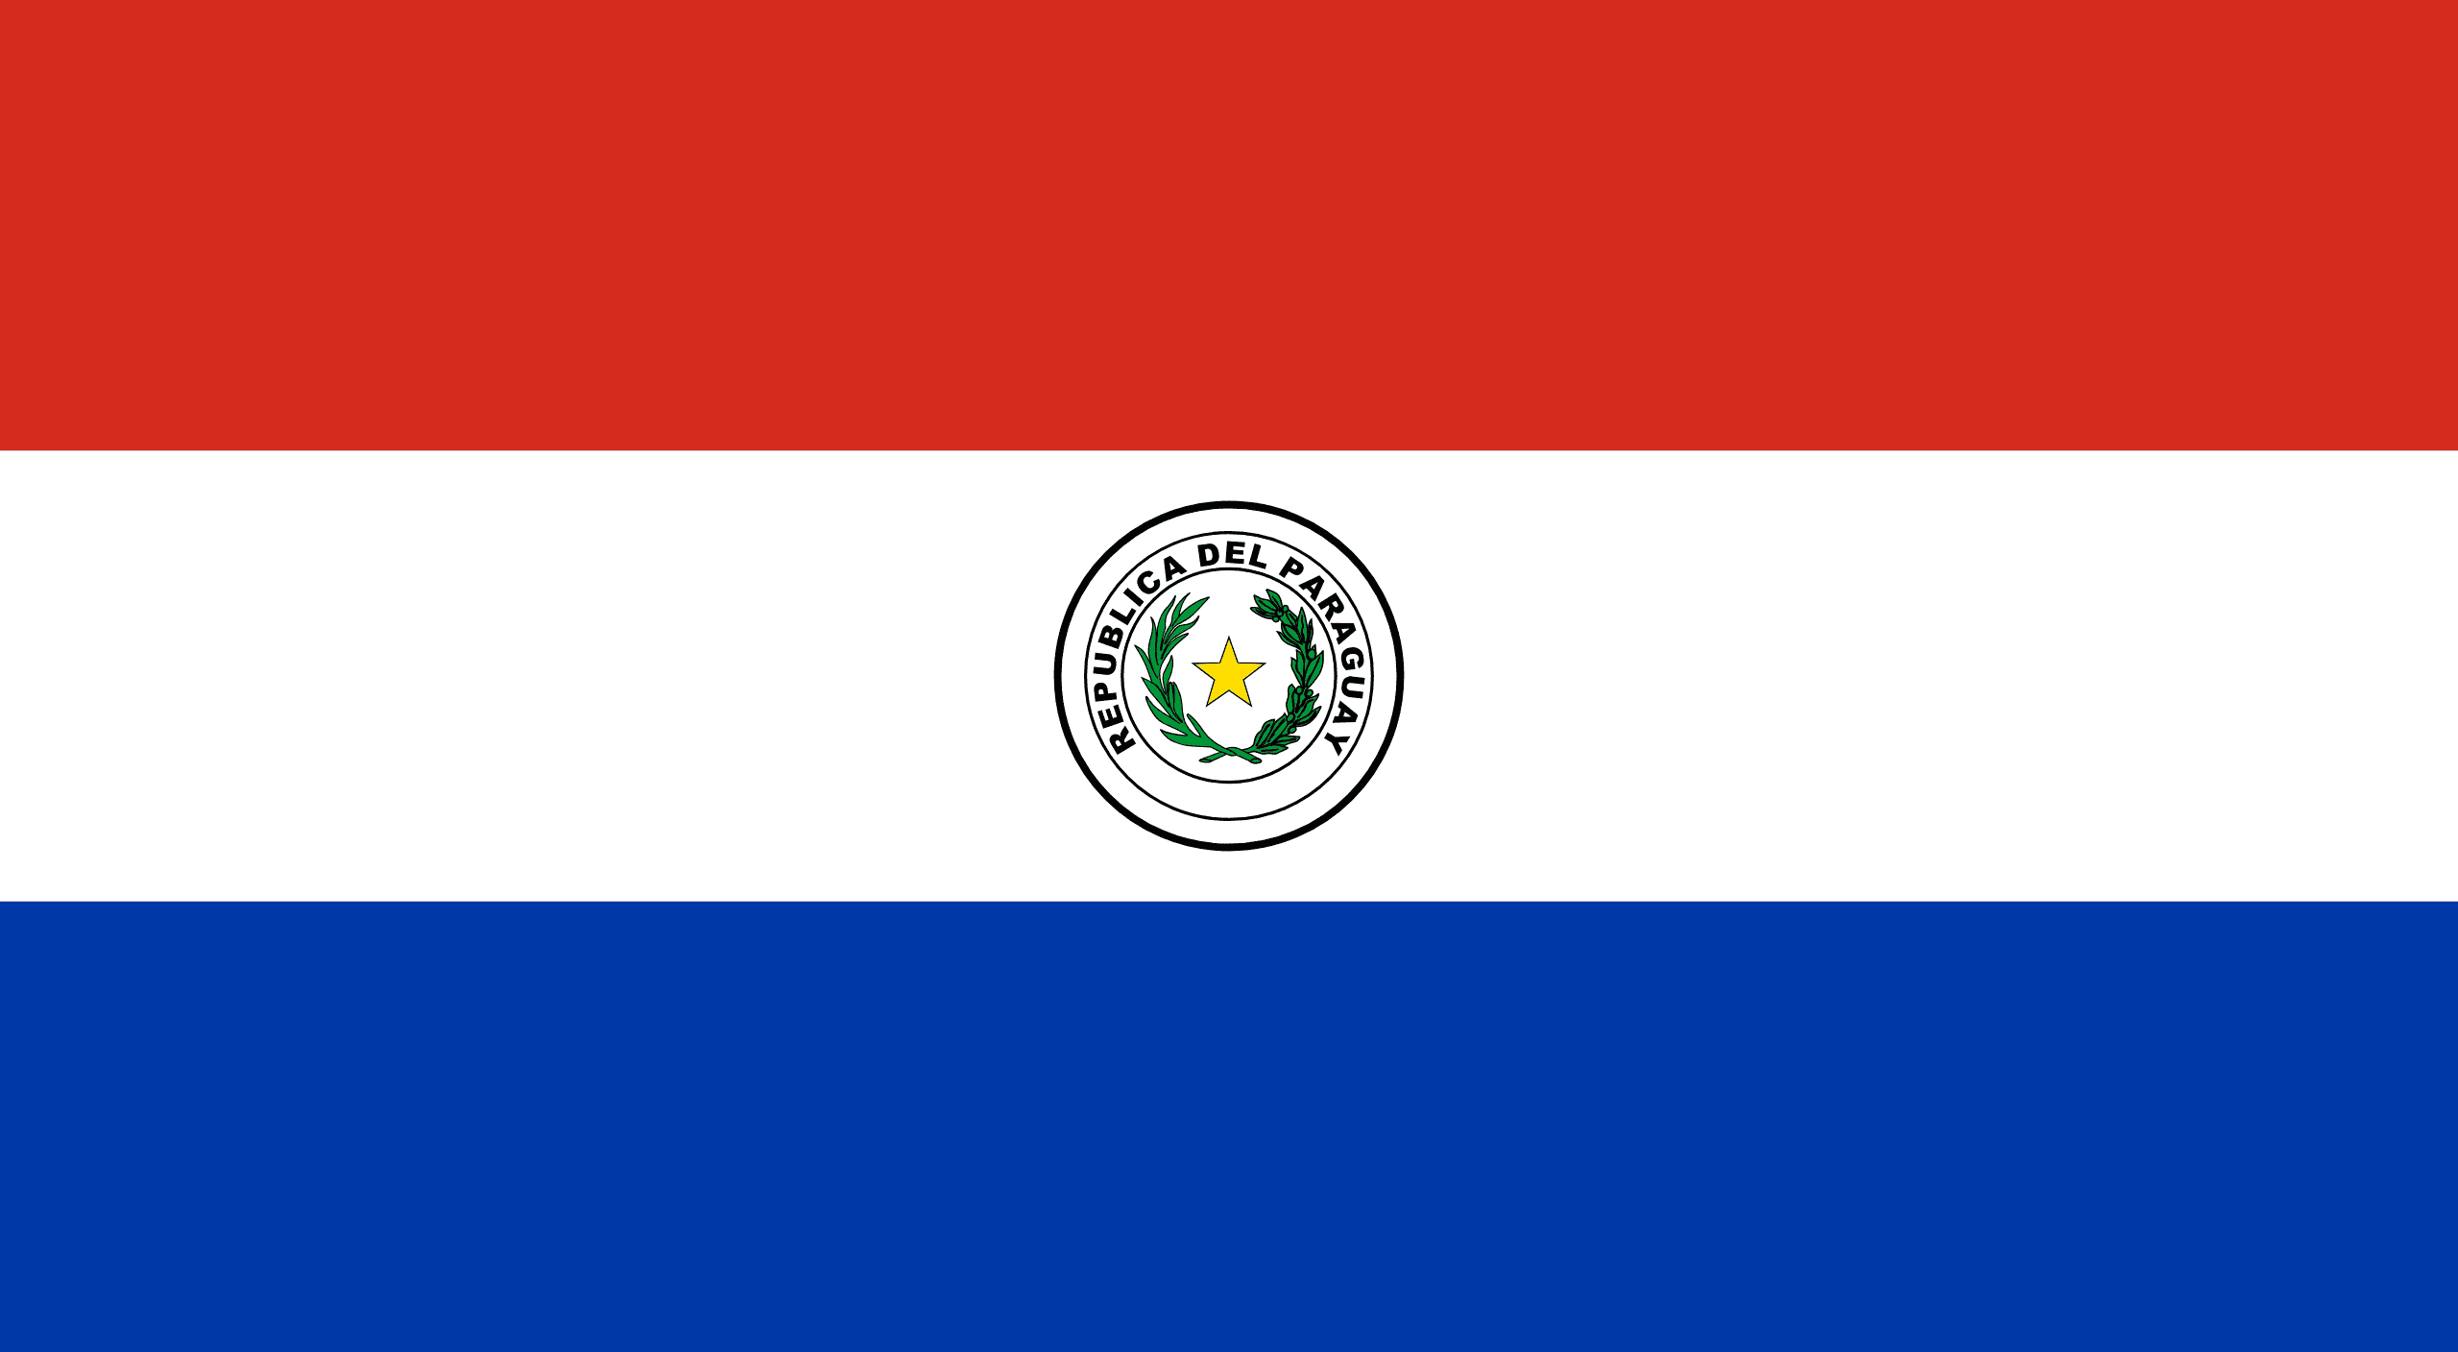
PRAYING FOR
PARAGUAY

Slide 3
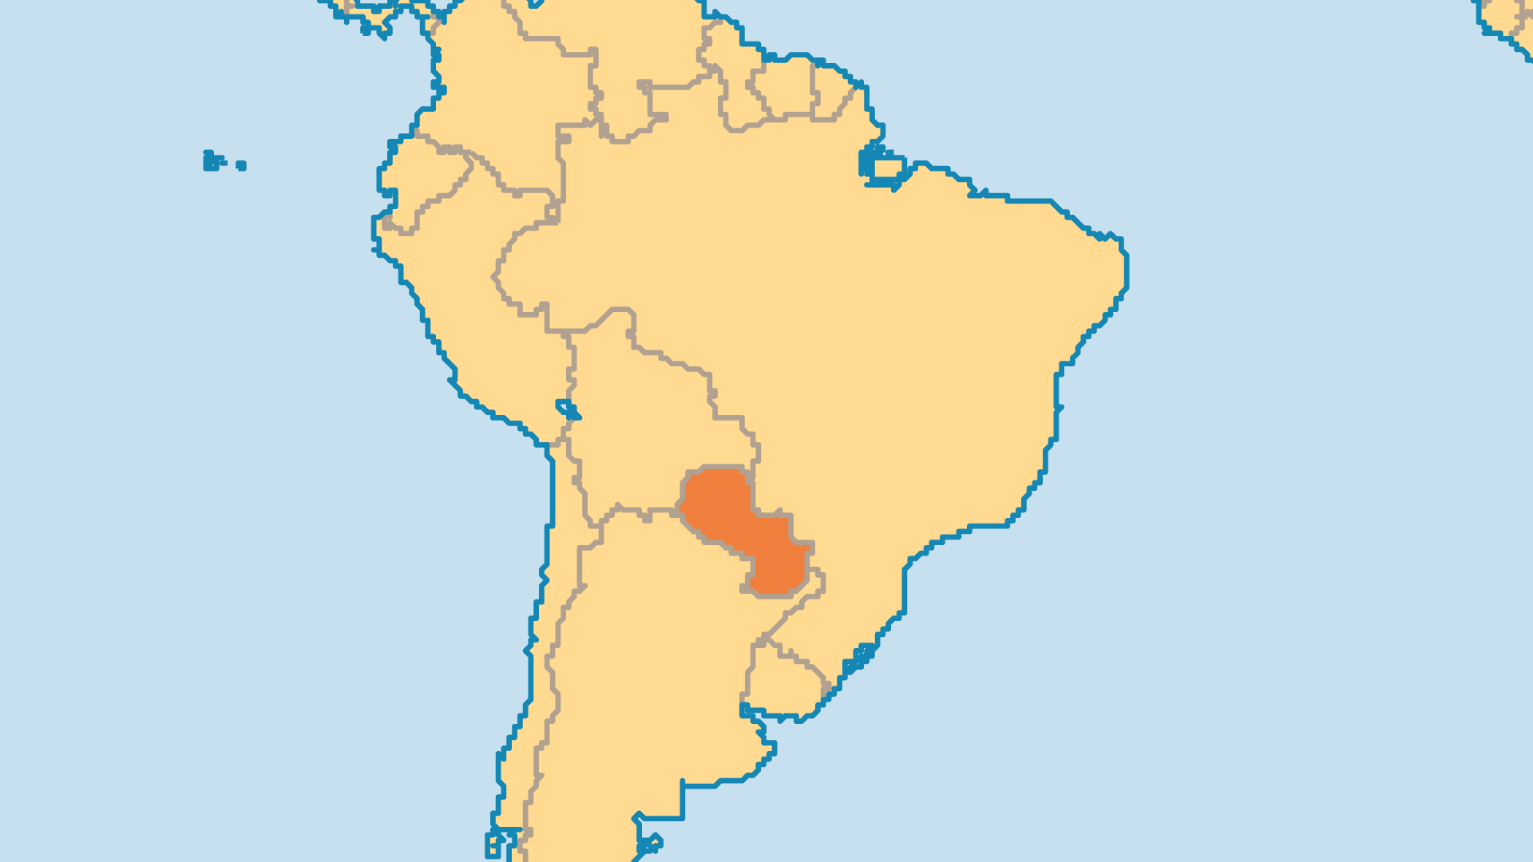
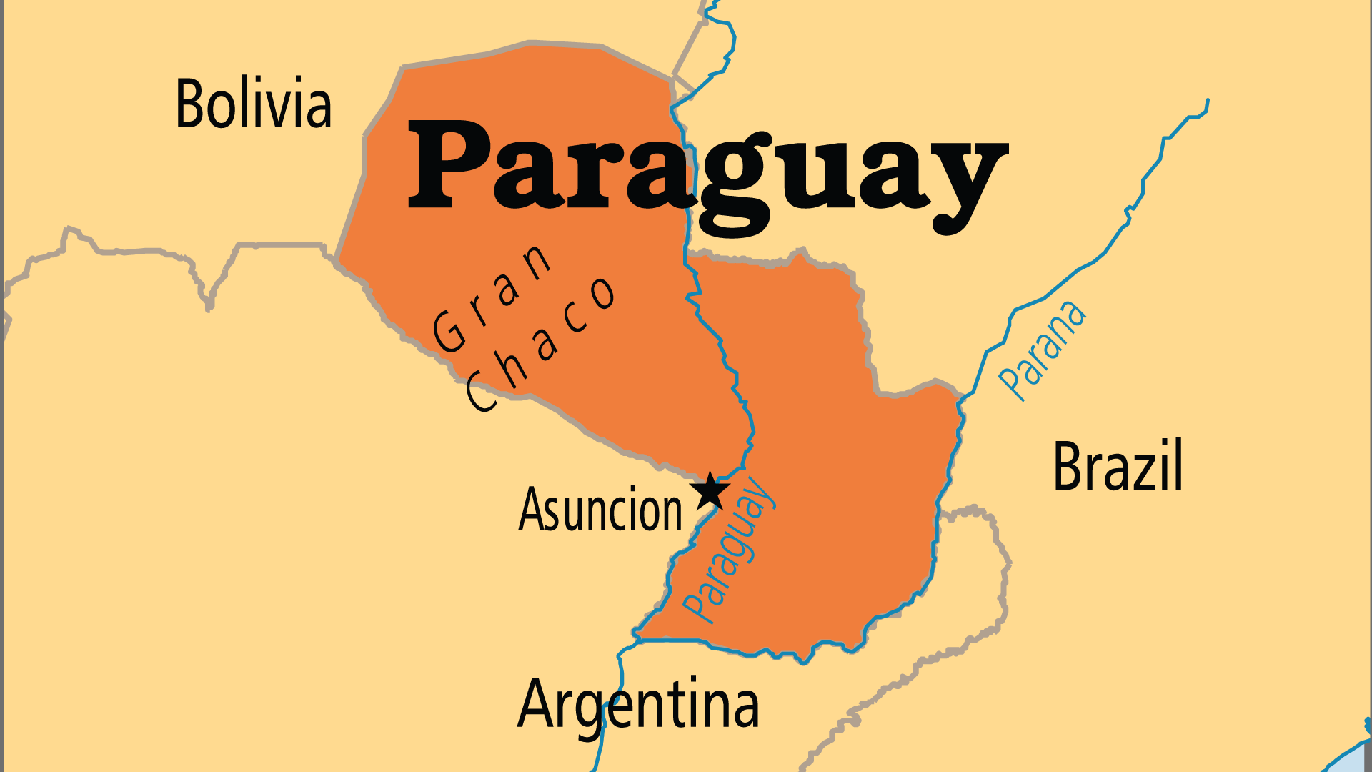
KEY STATS
Capital: | Asuncion
Population: | 7,013,078
Official Language: | Spanish, Guaraní
Languages: | 27
Literacy Rate: | 95 %
HDI Ranking: | 105/193
% Christian: | 96.3 %
% Evangelical: | 6.1 %
People Groups: | 42
Least Reached People Groups: | 5
% Unevangelized: | 1 %

Slide 4

FOR PRAYER
Thank the Lord for evangelical church growth. Pentecostal and charismatic churches from Brazil, Chile, and Argentina especially grew well. Pray for Christian unity and collaboration among many different evangelical denominations. An association of pastors works to promote national strategies to evangelize the whole country, and to assist isolated rural churches. Pray that local churches will embrace the challenge of the unreached and needy within Paraguay and beyond. Workers planted churches among many of the 21 indigenous Amerindian groups. Pray for the gospel to root and grow in these and the remaining minority groups.
Want to know more? Go to www.operationworld.org

