Slide 1




Slide 2

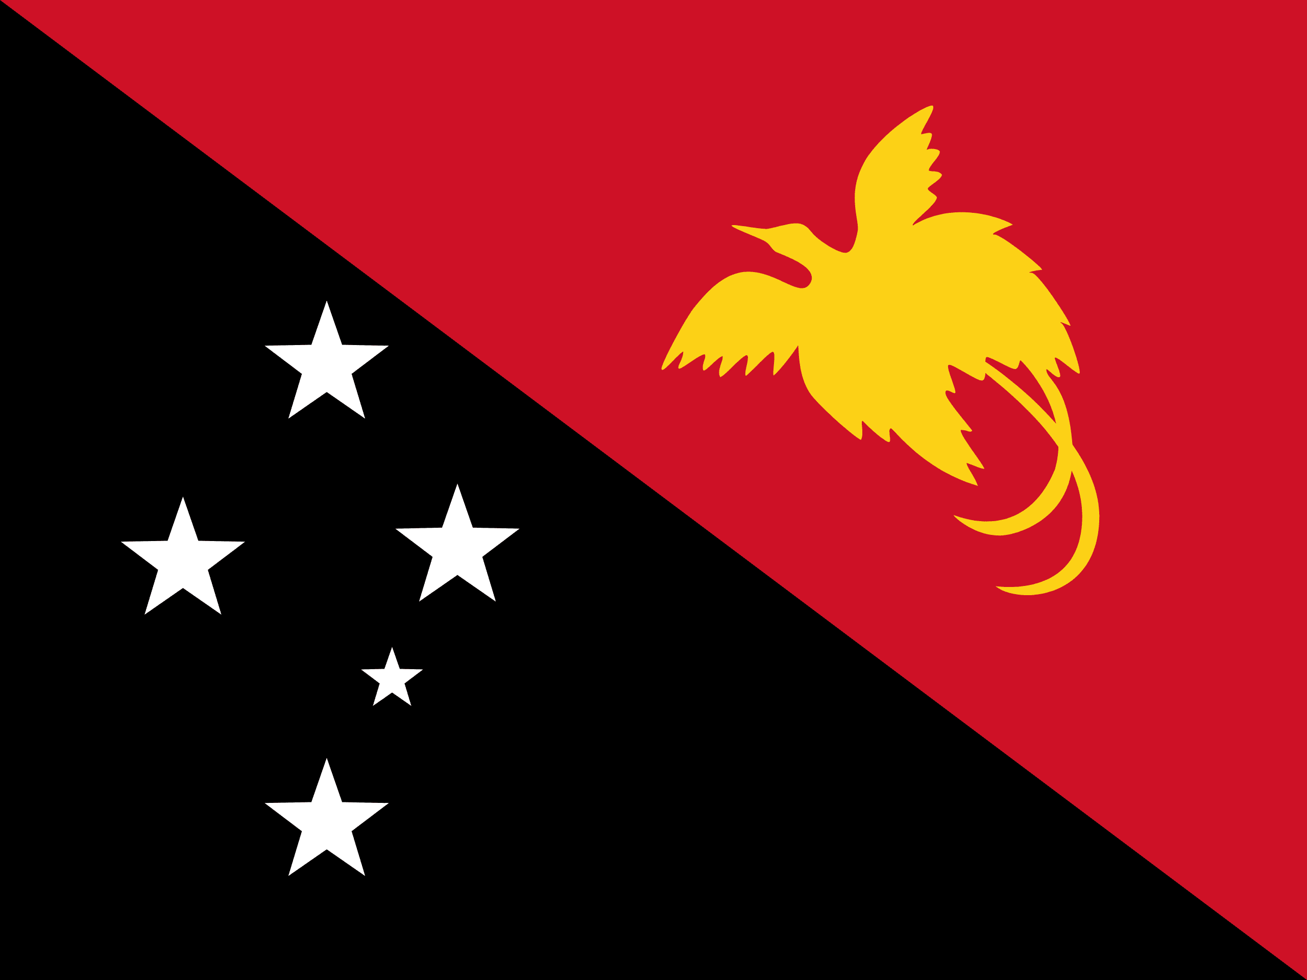
PRAYING FOR
PAPUA NEW GUINEA

Slide 3
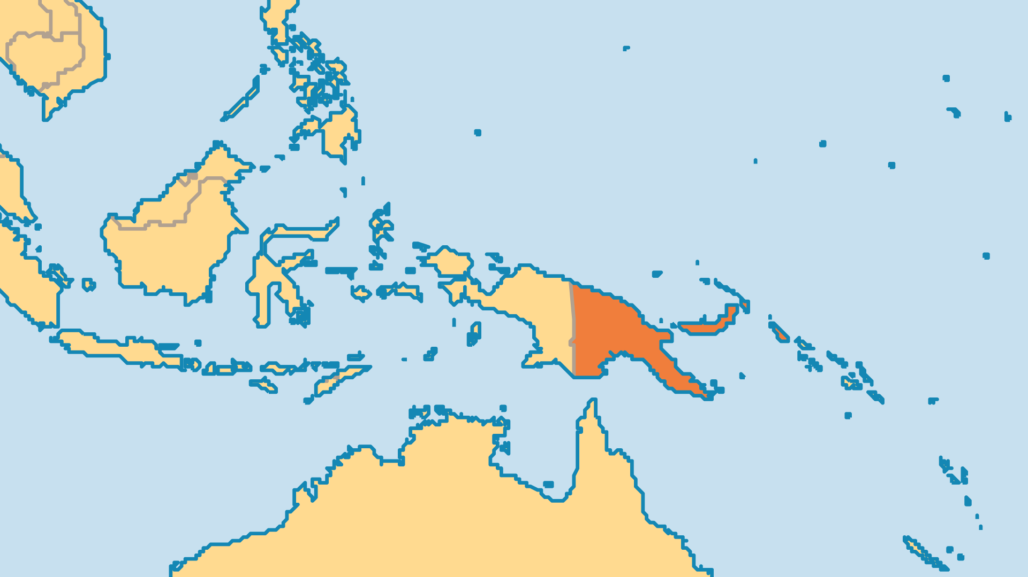
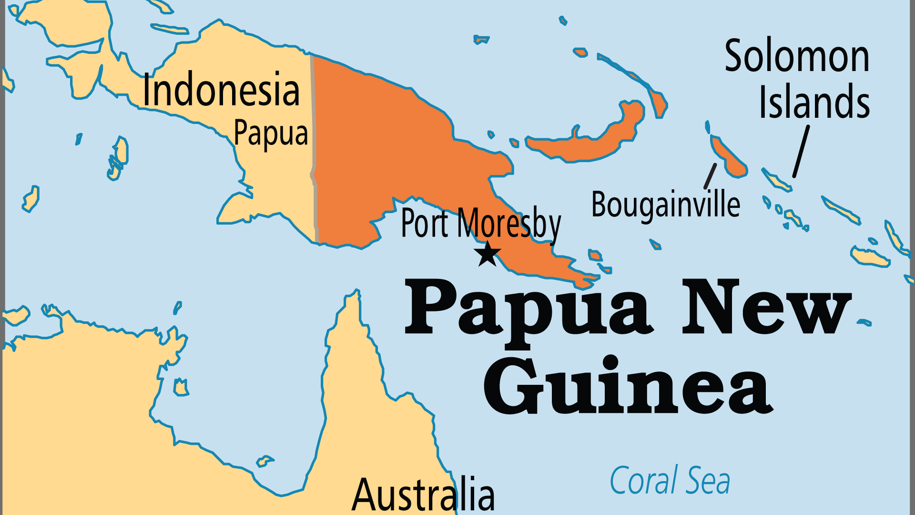
KEY STATS
Capital: | Port Moresby
Population: | 10,762,817
Official Language: | English, Tok Pisin and Hiri Motu
Languages: | 830
HDI Ranking: | 156/193
% Christian: | 95.8 %
% Evangelical: | 25.7 %
People Groups: | 885
Least Reached People Groups: | 1
% Unevangelized: | 1 %

Slide 4

FOR PRAYER
PNG has over 800 languages, and the majority still do not have a single verse of Scripture. Bible translation workers participate in over 260 translation projects; about 210 languages have a NT, but only 12 or so have a complete Bible. Translation teams are needed for 160 languages and possibly for a further 250. Pray for translators, for means of making the arduous task faster and more accurate and for indigenous translators/language assistants. Pray also for literacy training - the written, translated Word of God is of little help if no one is reading it. Praise God that local governments are supporting Bible translation work.
Want to know more? Go to www.operationworld.org

