Slide 1




Slide 2

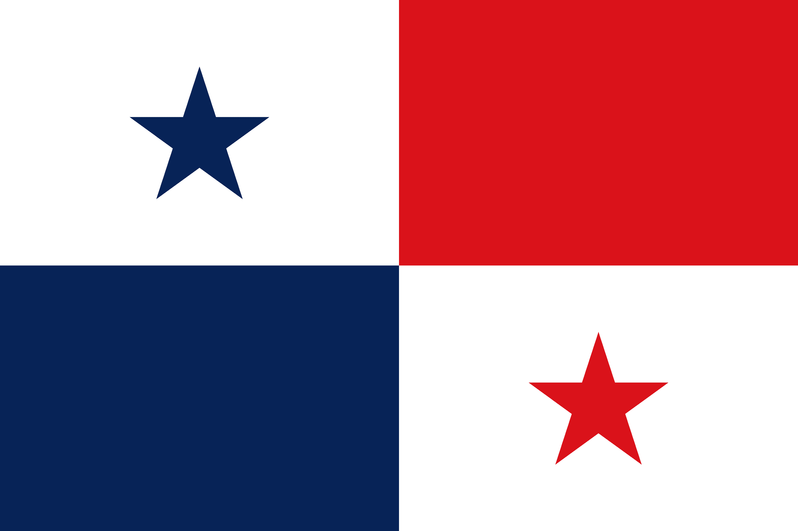
PRAYING FOR
PANAMA

Slide 3
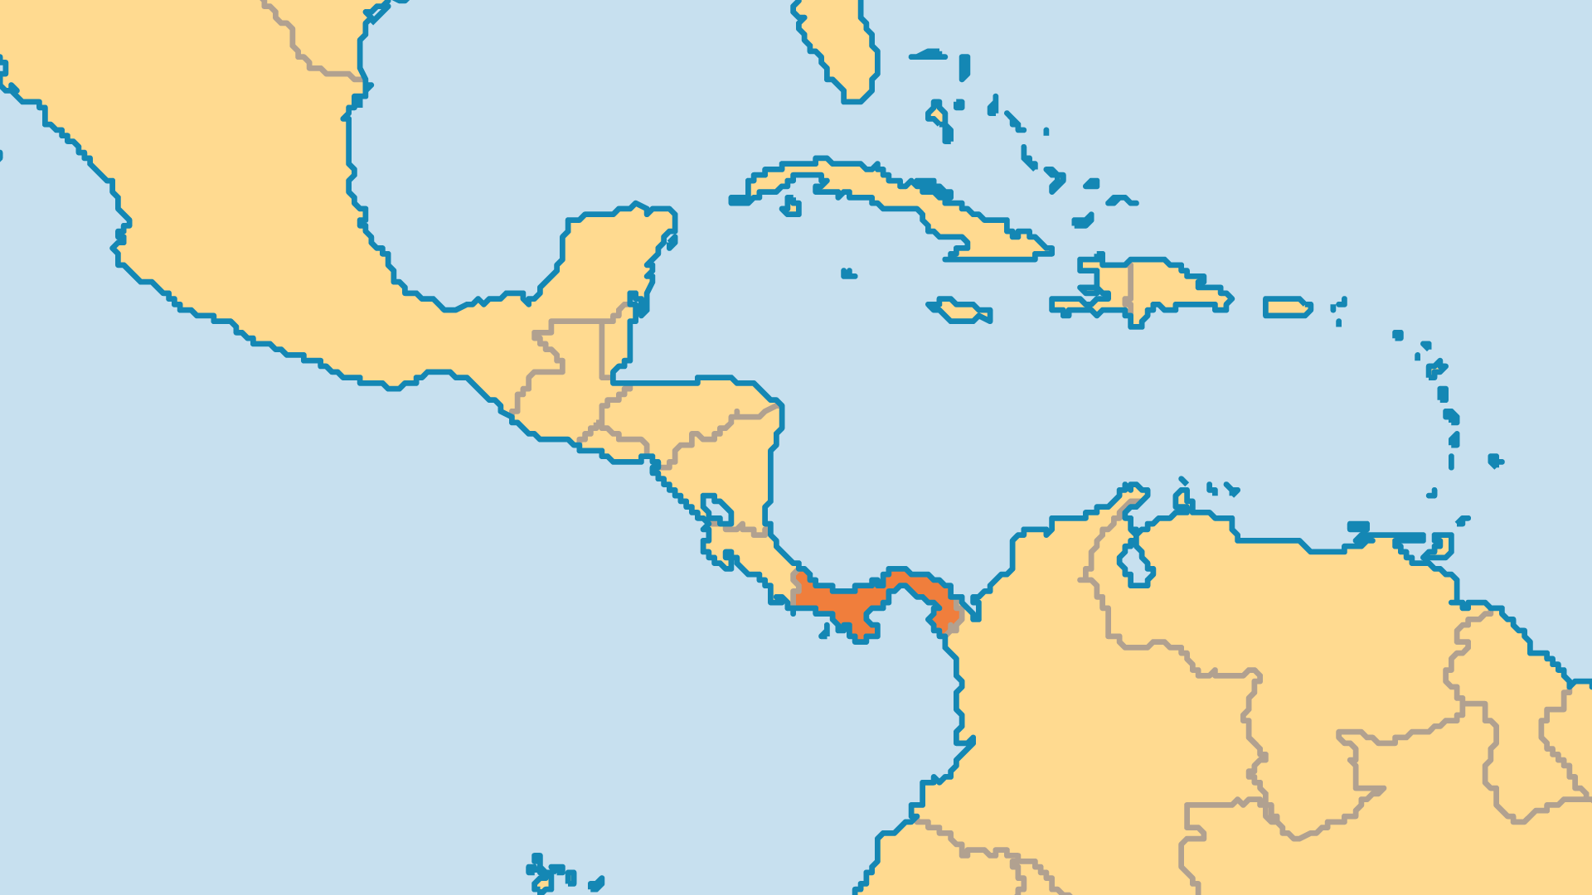
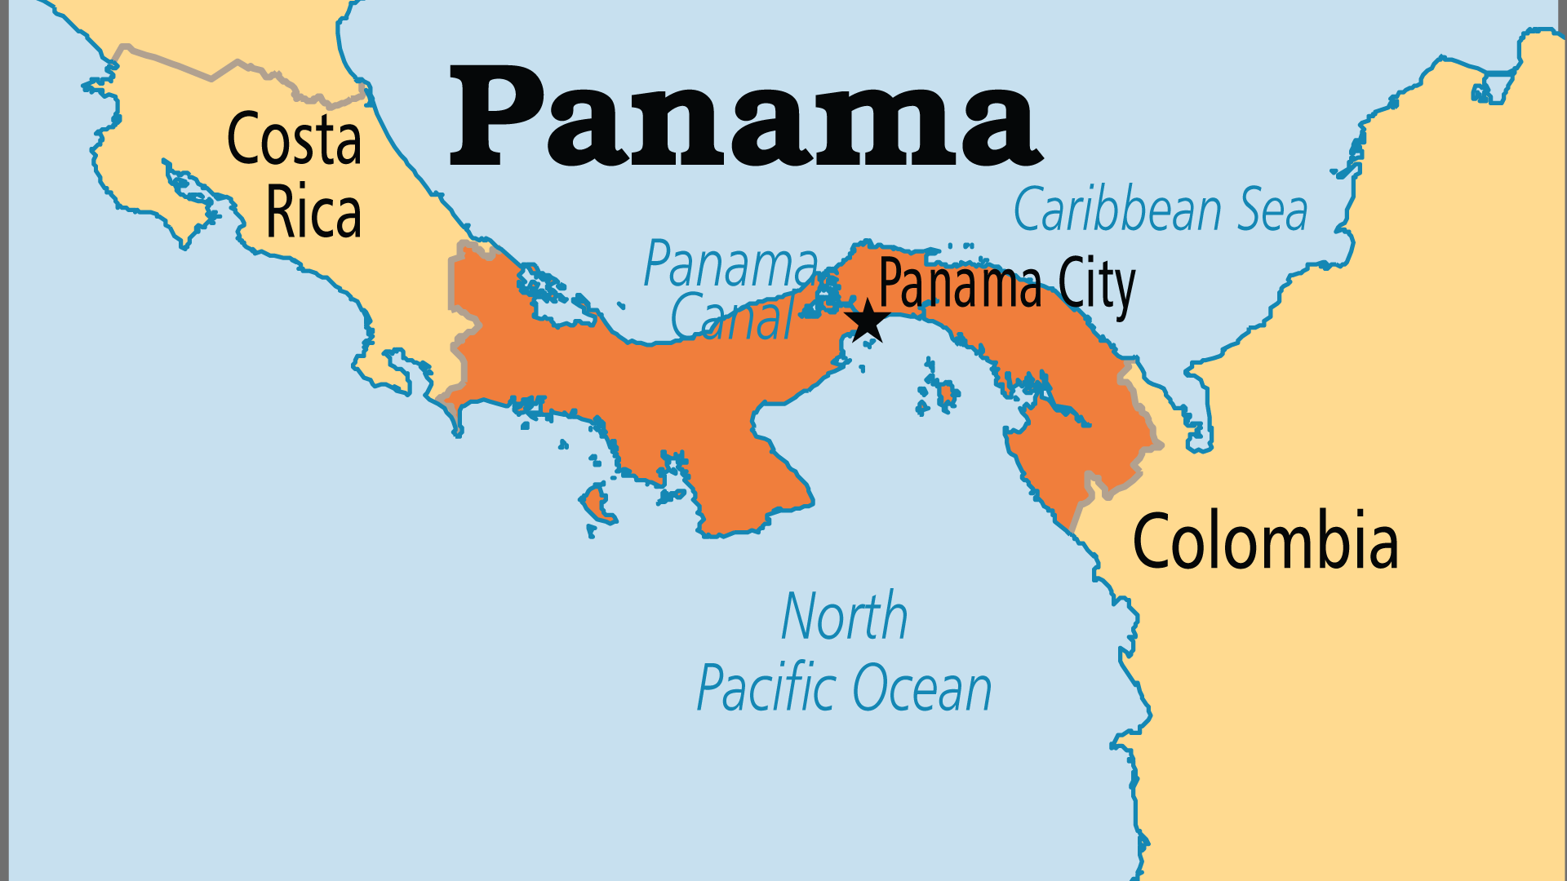
KEY STATS
Capital: | Panama City
Population: | 4,571,189
% Urban: | 68.8 %
Pop Under 15 Yrs: | 26.8 %
Official Language: | Spanish
Languages: | 18
Literacy Rate: | 94 %
% Christian: | 90.5 %
% Evangelical: | 19.3 %
% Unevangelized: | 1 %

Slide 4

FOR PRAYER
Panama's strategic location and socio-political stability also attract many other forces to the area. Proximity to Colombia and the prevalence of offshore finance in Panama mean that drug cartels and other undesirables have a strong presence. Much of Panama's economy is in service to either these offshore banks or is used to launder money. In 2016, the leak of the Panama Papers exposed massive scales of international tax evasion and fraud facilitated through Panama-based services. Pray for a government that will root out corruption, oppose wickedness, and uphold righteousness.
Want to know more? Go to www.operationworld.org

