Slide 1




Slide 2


PRAYING FOR
PALESTINE

Slide 3
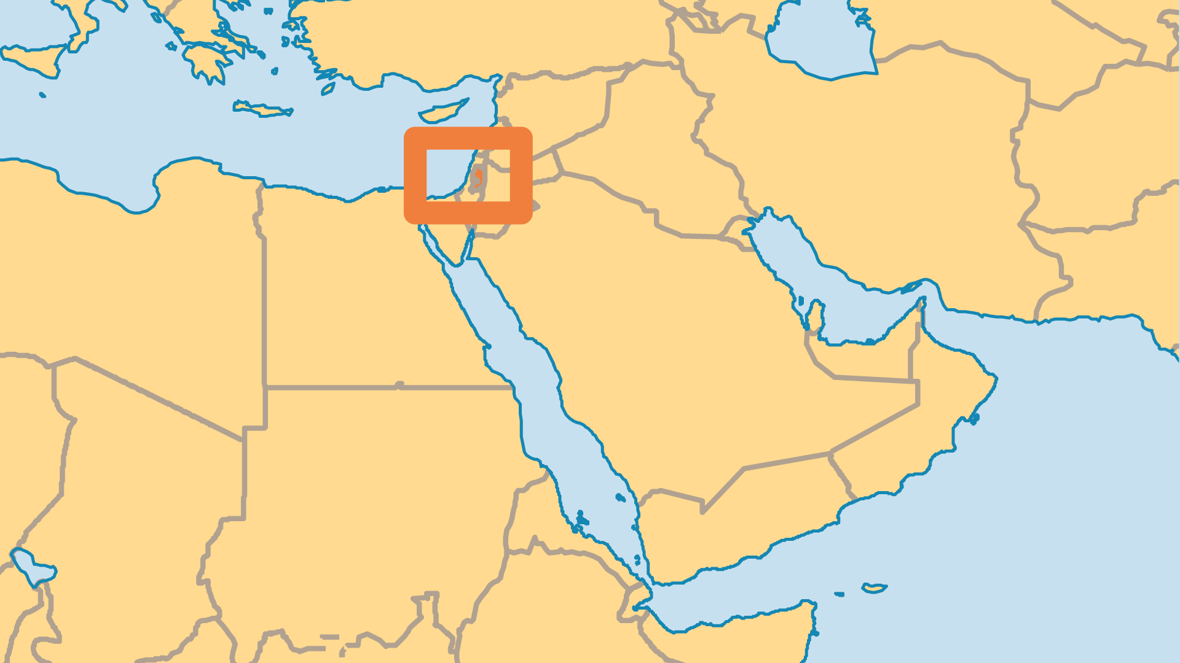
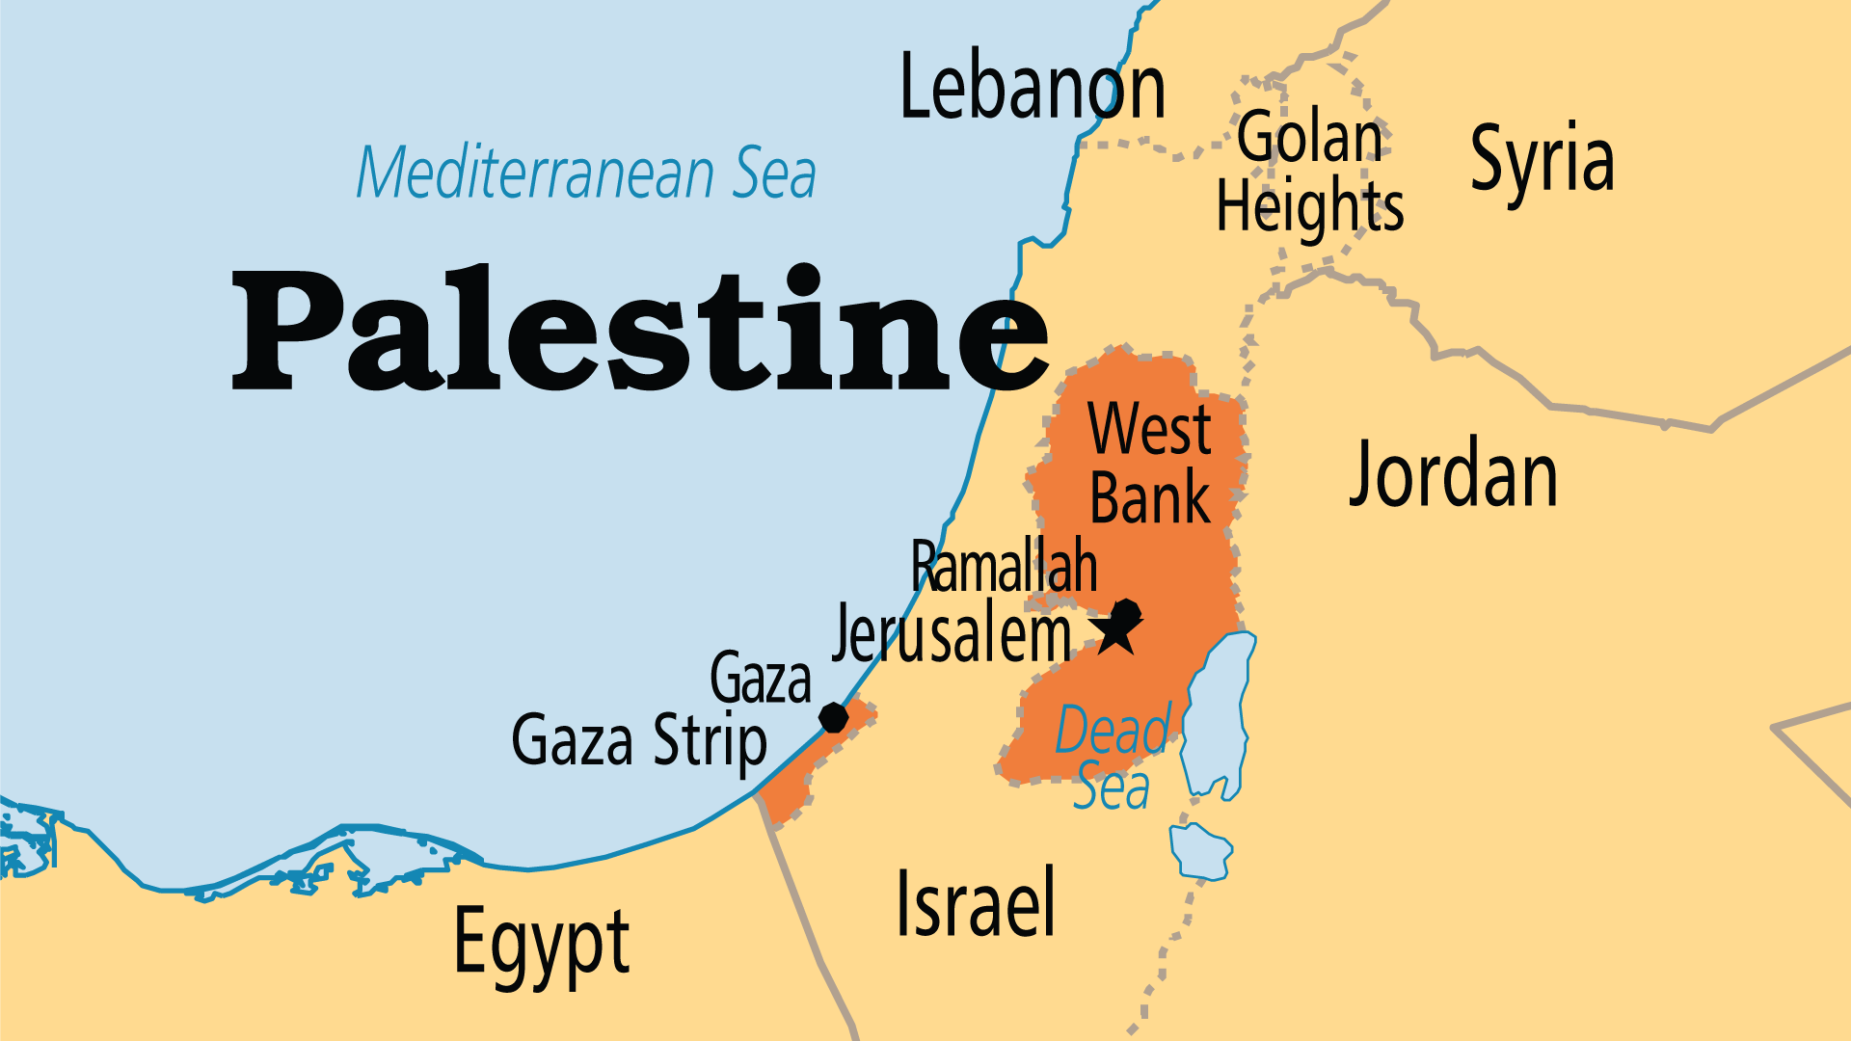
KEY STATS
Capital: | Jerusalem (claimed); Ramallah (admin)
Population: | 5,589,623
Official Language: | Arabic
Languages: | 6
% Christian: | 1.6 %
% Evangelical: | 0.1 %
Largest Religion: | Muslim
% Largest Religion: | 87.7 %
% Unevangelized: | 50 %

Slide 4

FOR PRAYER
The horrific Hamas attacks of 7 October 2023 not only escalated murderous violence in the region, but provoked deep division on the Israel-Palestine situation globally. The vast majority of those in Gaza have been displaced. What little infrastructure and economic activity existed was flattened by Israel's bombings. Debate over the causes and where fault lies does not change the fact that there is much suffering with thousands of non-combatants, women, and children killed. God longs to bless and show kindness to all nations and peoples. May we pray that Gazans might know it, too.
Want to know more? Go to www.operationworld.org

