Slide 1




Slide 2


PRAYING FOR
PALAU

Slide 3
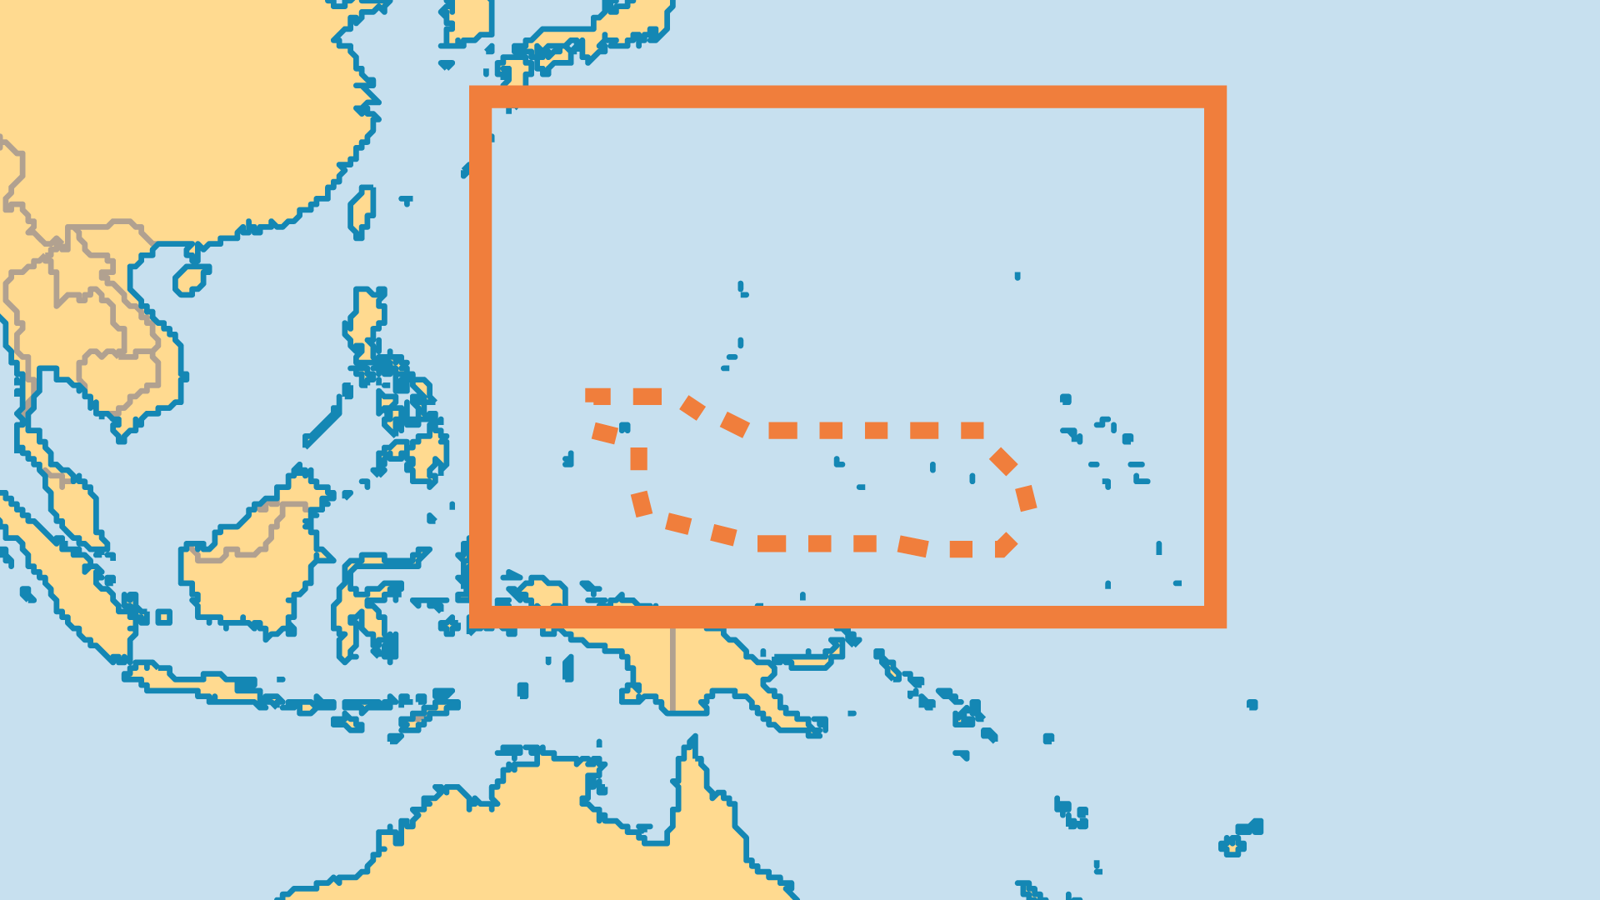
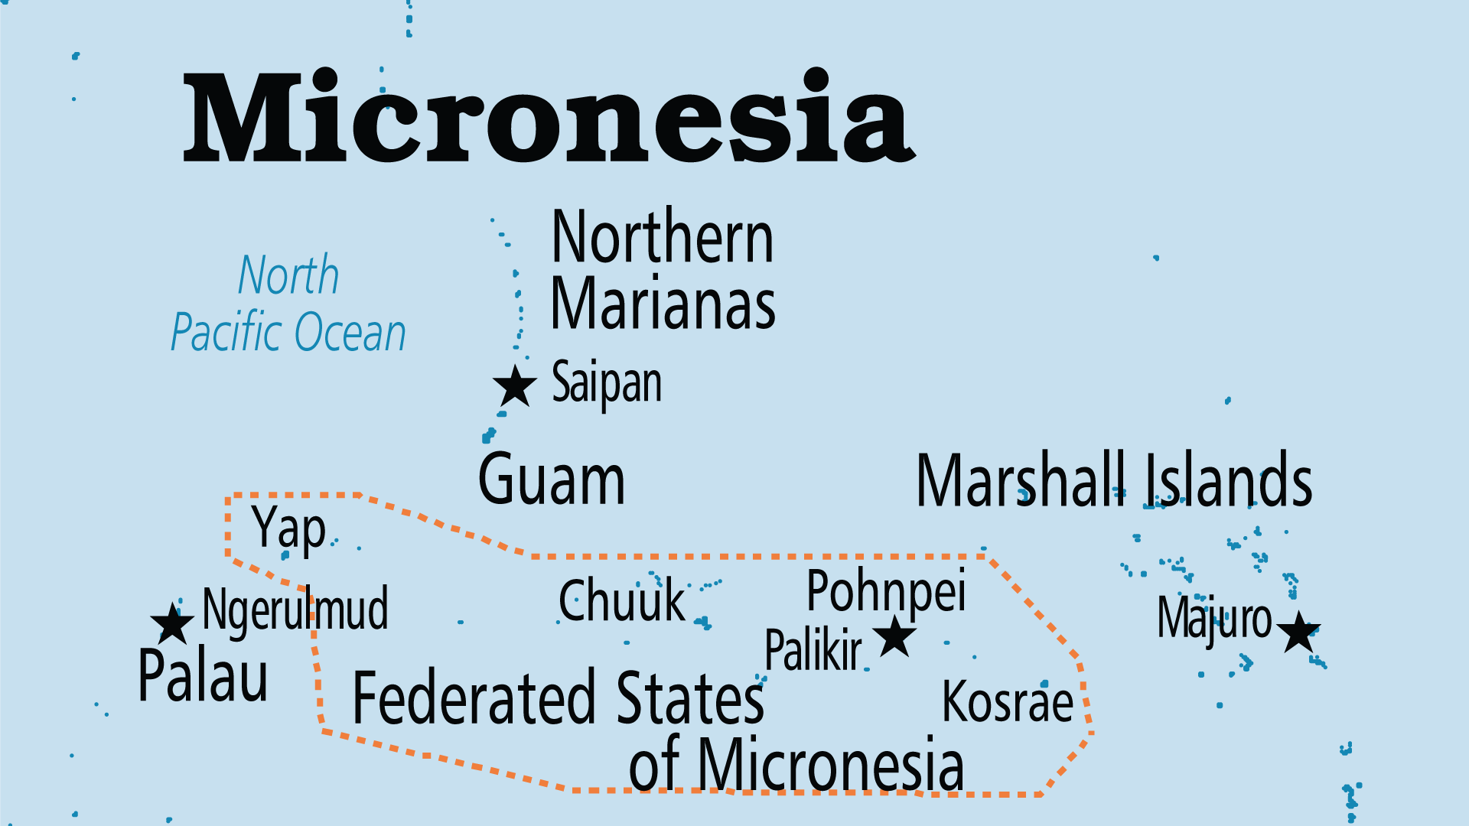
KEY STATS
Capital: | Ngerulmud
Population: | 17,663
Official Language: | Palauan; English
Languages: | 5
Literacy Rate: | 97 %
HDI Ranking: | 80/193
% Christian: | 95.9 %
% Evangelical: | 23.9 %
People Groups: | 7
% Unevangelized: | 2 %

Slide 4

FOR PRAYER
Christianity is generally professed, but nominalism is widespread, the most ardent Catholics being the Filipinos. Many older people are followers of the Modekngei movement, a religion unique to Palau that is a mixture of Christianity and magic; materialism and pluralism are the greater threats to the younger generation. Pray for the revival of the Koror Evangelical Church - the fruit of the work of the Liebenzell Mission. The AoG have a small but growing work.
Want to know more? Go to www.operationworld.org

