Slide 1




Slide 2


PRAYING FOR
PAKISTAN

Slide 3
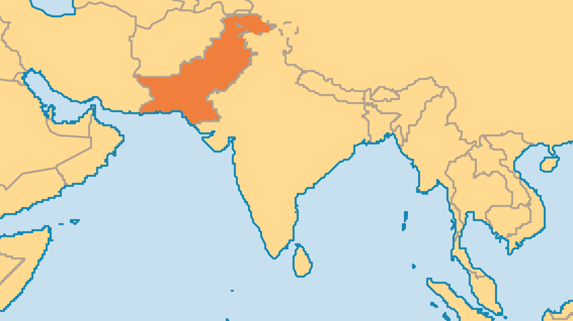
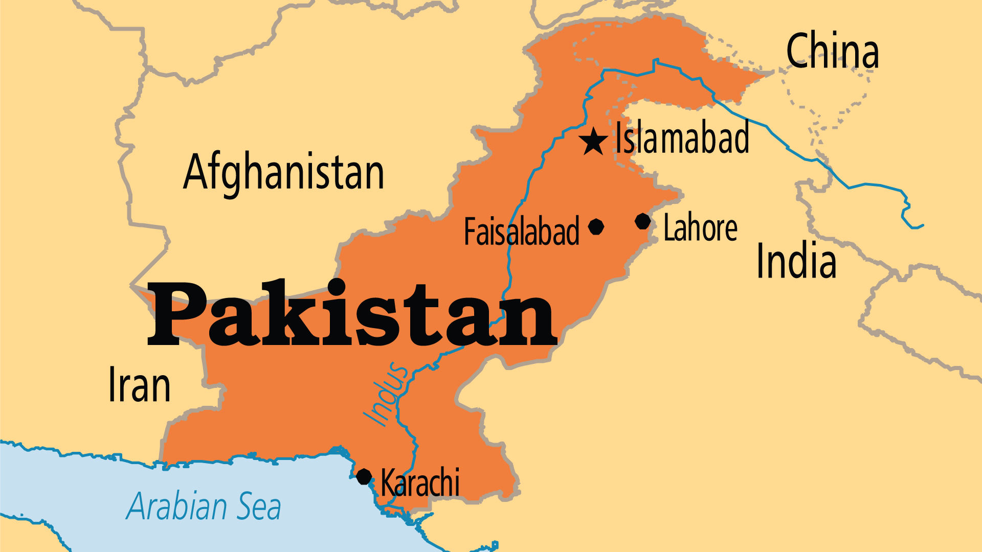
KEY STATS
Capital: | Islamabad
Population: | 255,219,555
Official Language: | English, Urdu
Literacy Rate: | 58 %
HDI Ranking: | 161/193
% Christian: | 2.5 %
% Evangelical: | 0.6 %
Largest Religion: | Muslim
% Unevangelized: | 53 %
Persecution Ranking: | 8/50

Slide 4

FOR PRAYER
Pakistan's government normally alternates between inefficient, corrupt political parties and authoritarian military dictatorships. Power and wealth are concentrated in too few hands. This hinders economic and social development. Pakistan's economic prospects are grim as it faces inflation, high unemployment, increasing dependence on IMF bailouts, and constant emigration, in addition to widespread corruption. The country faces pressure from Islamist forces, and from troubles with India over the Kashmir region. Pray that the Lord would free Pakistan from spirits of lawlessness and violence that harm the nation. Pray for government that will move the nation forward.

Slide 5
FOR PRAYER
Fundamentalist Islam (driven by many different factors) impacts the whole nation. There are dozens of Islamic terrorist organizations operating in Pakistan. Political parties appease radical Muslims, which empowers Islamism ever further. It causes violence against religious minorities. Hundreds are murdered every year in terrorism-linked violence. Social and economic progress is difficult for non-Muslims (and non-Sunnis). Women who live under fundamentalist Islam have very few freedoms or rights. Education is minimal, and domestic abuse is widespread. Pray that the true nature of this type of Islam might become clear for all to see, so that it might lose its power.

Slide 6
FOR PRAYER
Religious minorities face discrimination and persecution in many forms. Christians, Hindus, and minority Muslim groups (Shi'a, Ahmaddiya) suffer the most. The famous "blasphemy law" allows the death penalty on anyone who insults Mohammed, and life in prison for anyone who damages a Quran. Extremists use this law to falsely accuse innocent people and stir up religious frenzy and mob justice. Enemies of Christ vandalize or destroy churches. They beat, murder, abduct, rape, or force conversion on religious minorities. Even amidst persecution, Pakistani Christians love their nation and want it to prosper. Pray that believers might always be ready to share about Jesus, and to repay violence with love.

Slide 7
FOR PRAYER
The Church continues to grow, despite many obstacles. Poverty, illiteracy, and lack of teaching opened the door to corruption, immorality, and low spiritual standards among Christians. Some Christians live devoted lives, committed to God, but the majority have a weak, immature faith. Common problems in churches include leadership struggles, greed, court cases, substance abuse, and divisions. Ask God to raise up humble, committed spiritual leaders with passion to serve the Church. Pray for more students in Bible and leadership training, wise and godly leaders, and adequate financial resources for Christian work.
Want to know more? Go to www.operationworld.org

