Slide 1




Slide 2


PRAYING FOR
OMAN

Slide 3
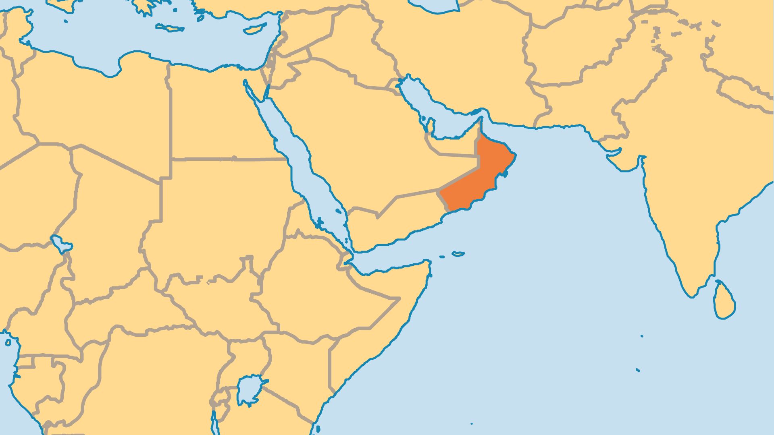
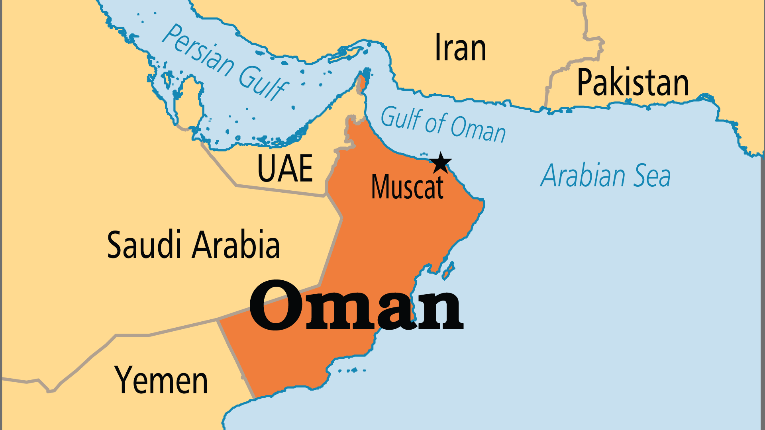
KEY STATS
Capital: | Muscat
Population: | 5,494,691
Official Language: | Arabic
Languages: | 21
Literacy Rate: | 99 %
HDI Ranking: | 54/193
% Christian: | 2.8 %
% Evangelical: | 0.8 %
Largest Religion: | Muslim
% Unevangelized: | 56 %
Persecution Ranking: | 32/50

Slide 4

FOR PRAYER
Praise God that Oman enjoys an open and modern society compared to others in the region. All residents may practise their faith, and the government gave land to build places of worship! Wealth from the oil industry allowed a greater level of education and economic balance. Pray now for spiritual openness to the gospel among all peoples of Oman.
Want to know more? Go to www.operationworld.org

