Slide 1




Slide 2

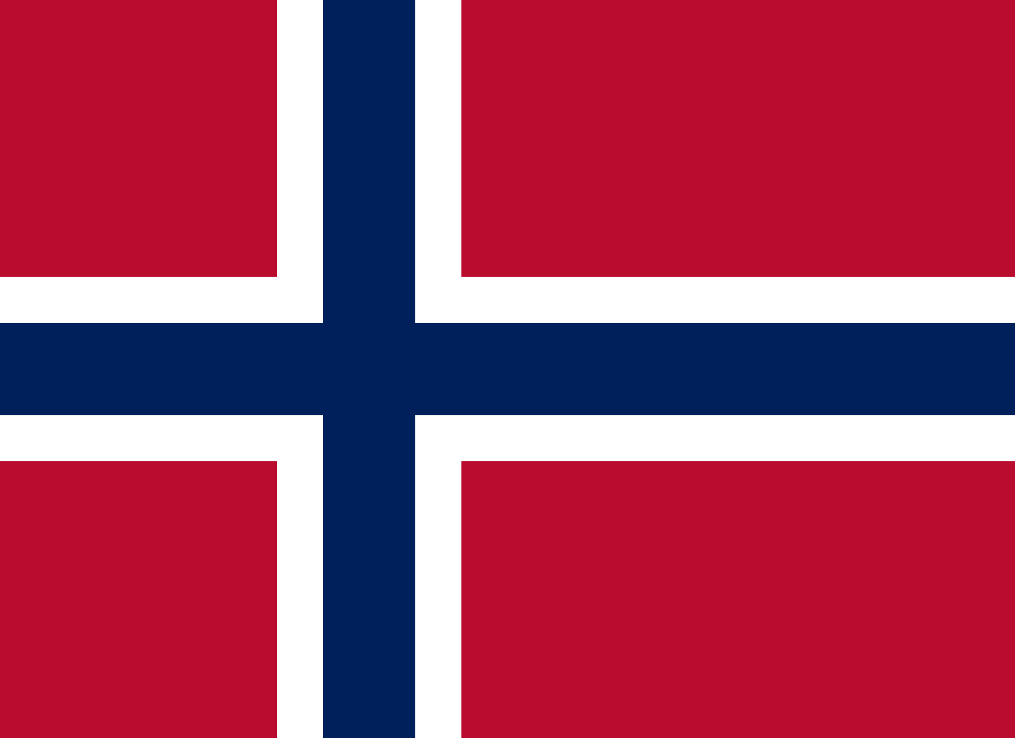
PRAYING FOR
NORWAY

Slide 3
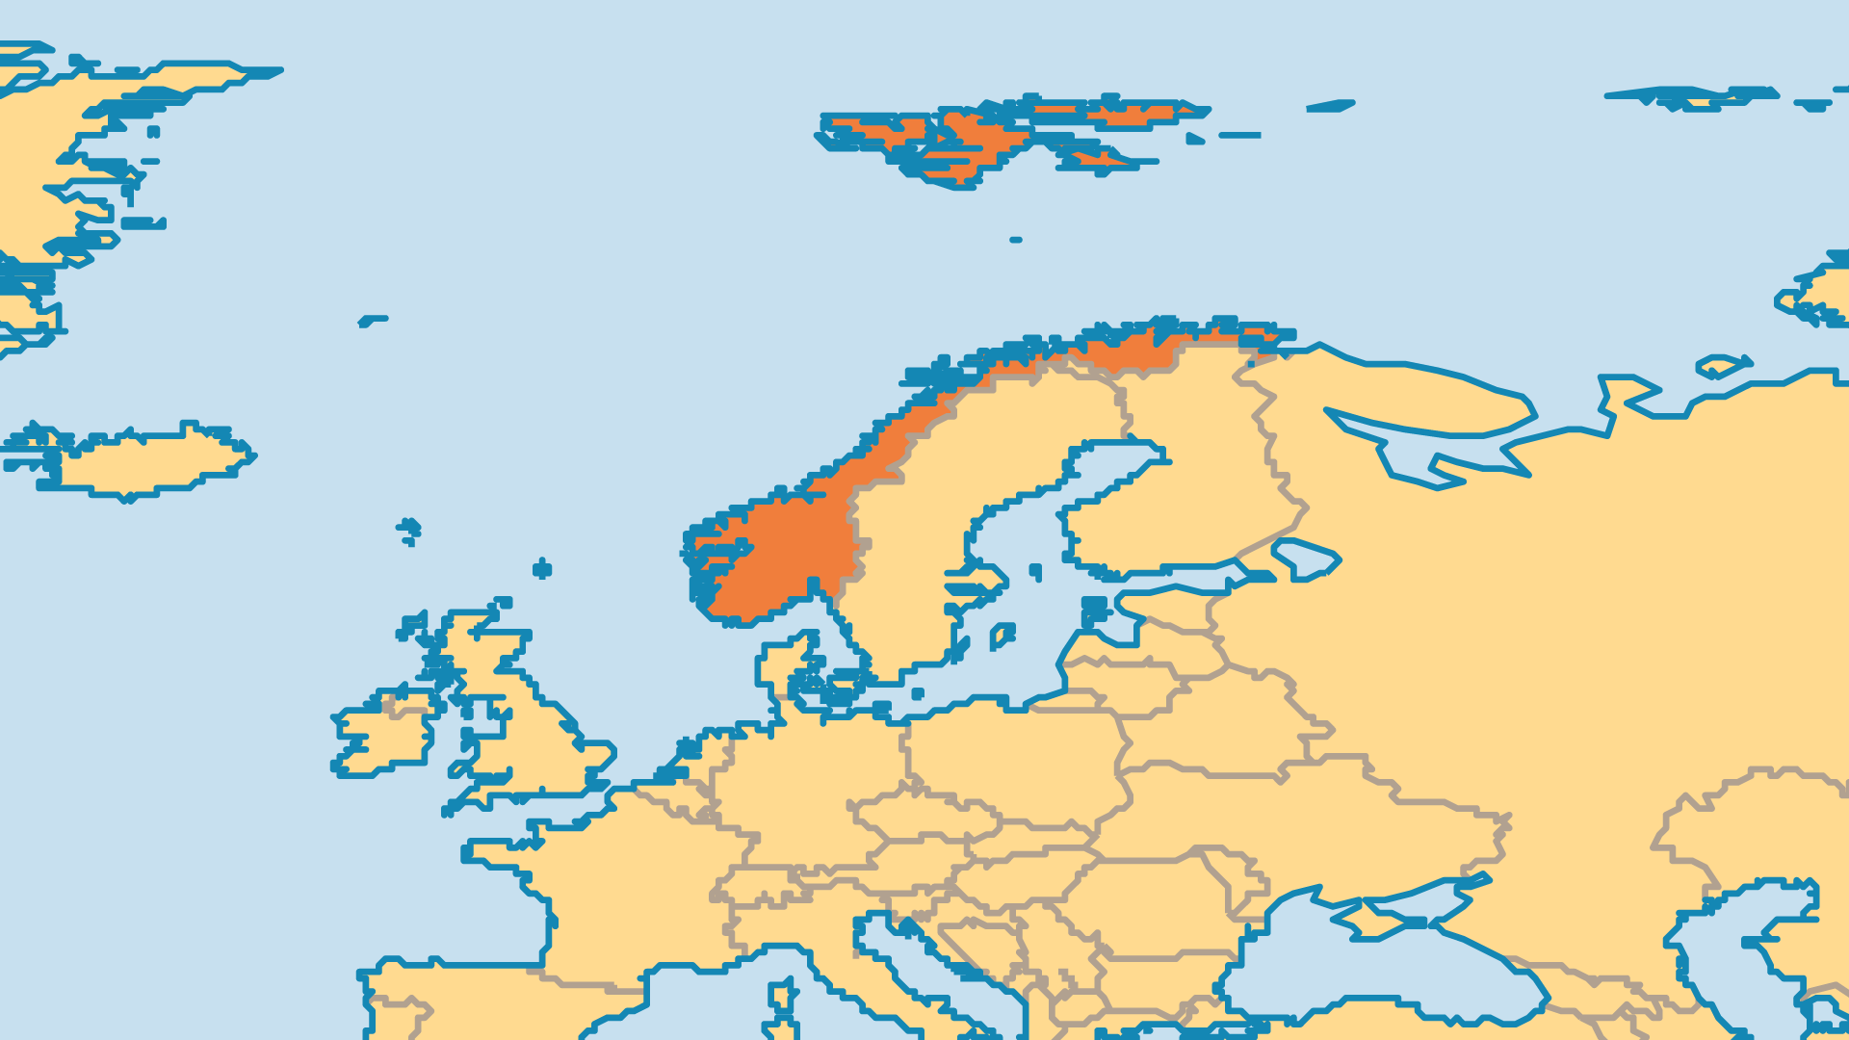
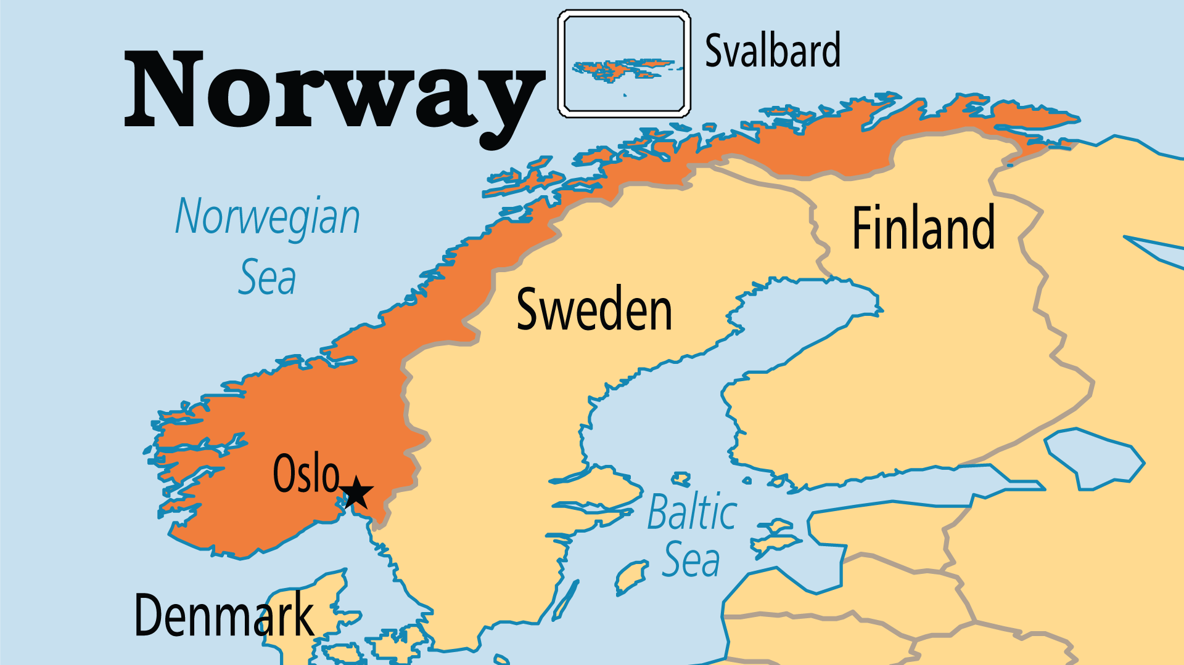
KEY STATS
Capital: | Oslo
Population: | 5,623,071
% Urban: | 84.6 %
Pop Under 15 Yrs: | 17.4 %
Official Language: | Norwegian
Languages: | 20
Literacy Rate: | 100 %
HDI Ranking: | 2/193
% Christian: | 91.1 %
% Evangelical: | 8.4 %
% Unevangelized: | 4 %

Slide 4

FOR PRAYER
Norway has a strong spiritual heritage, and influence from past prayer and revival movements remains clear. The Lutheran Church is the most evangelical of all the state churches in Europe. Other denominations (Free Churches) also contribute to church life, and of these, Pentecostal and charismatic groups have the most members. But Norway faces the same battles as other European societies, where people believe that different religions or moral practices can be true for different people, or in different situations. Pray for a new revival, and for a deep commitment to biblical faith and practice.
Want to know more? Go to www.operationworld.org

