Slide 1




Slide 2

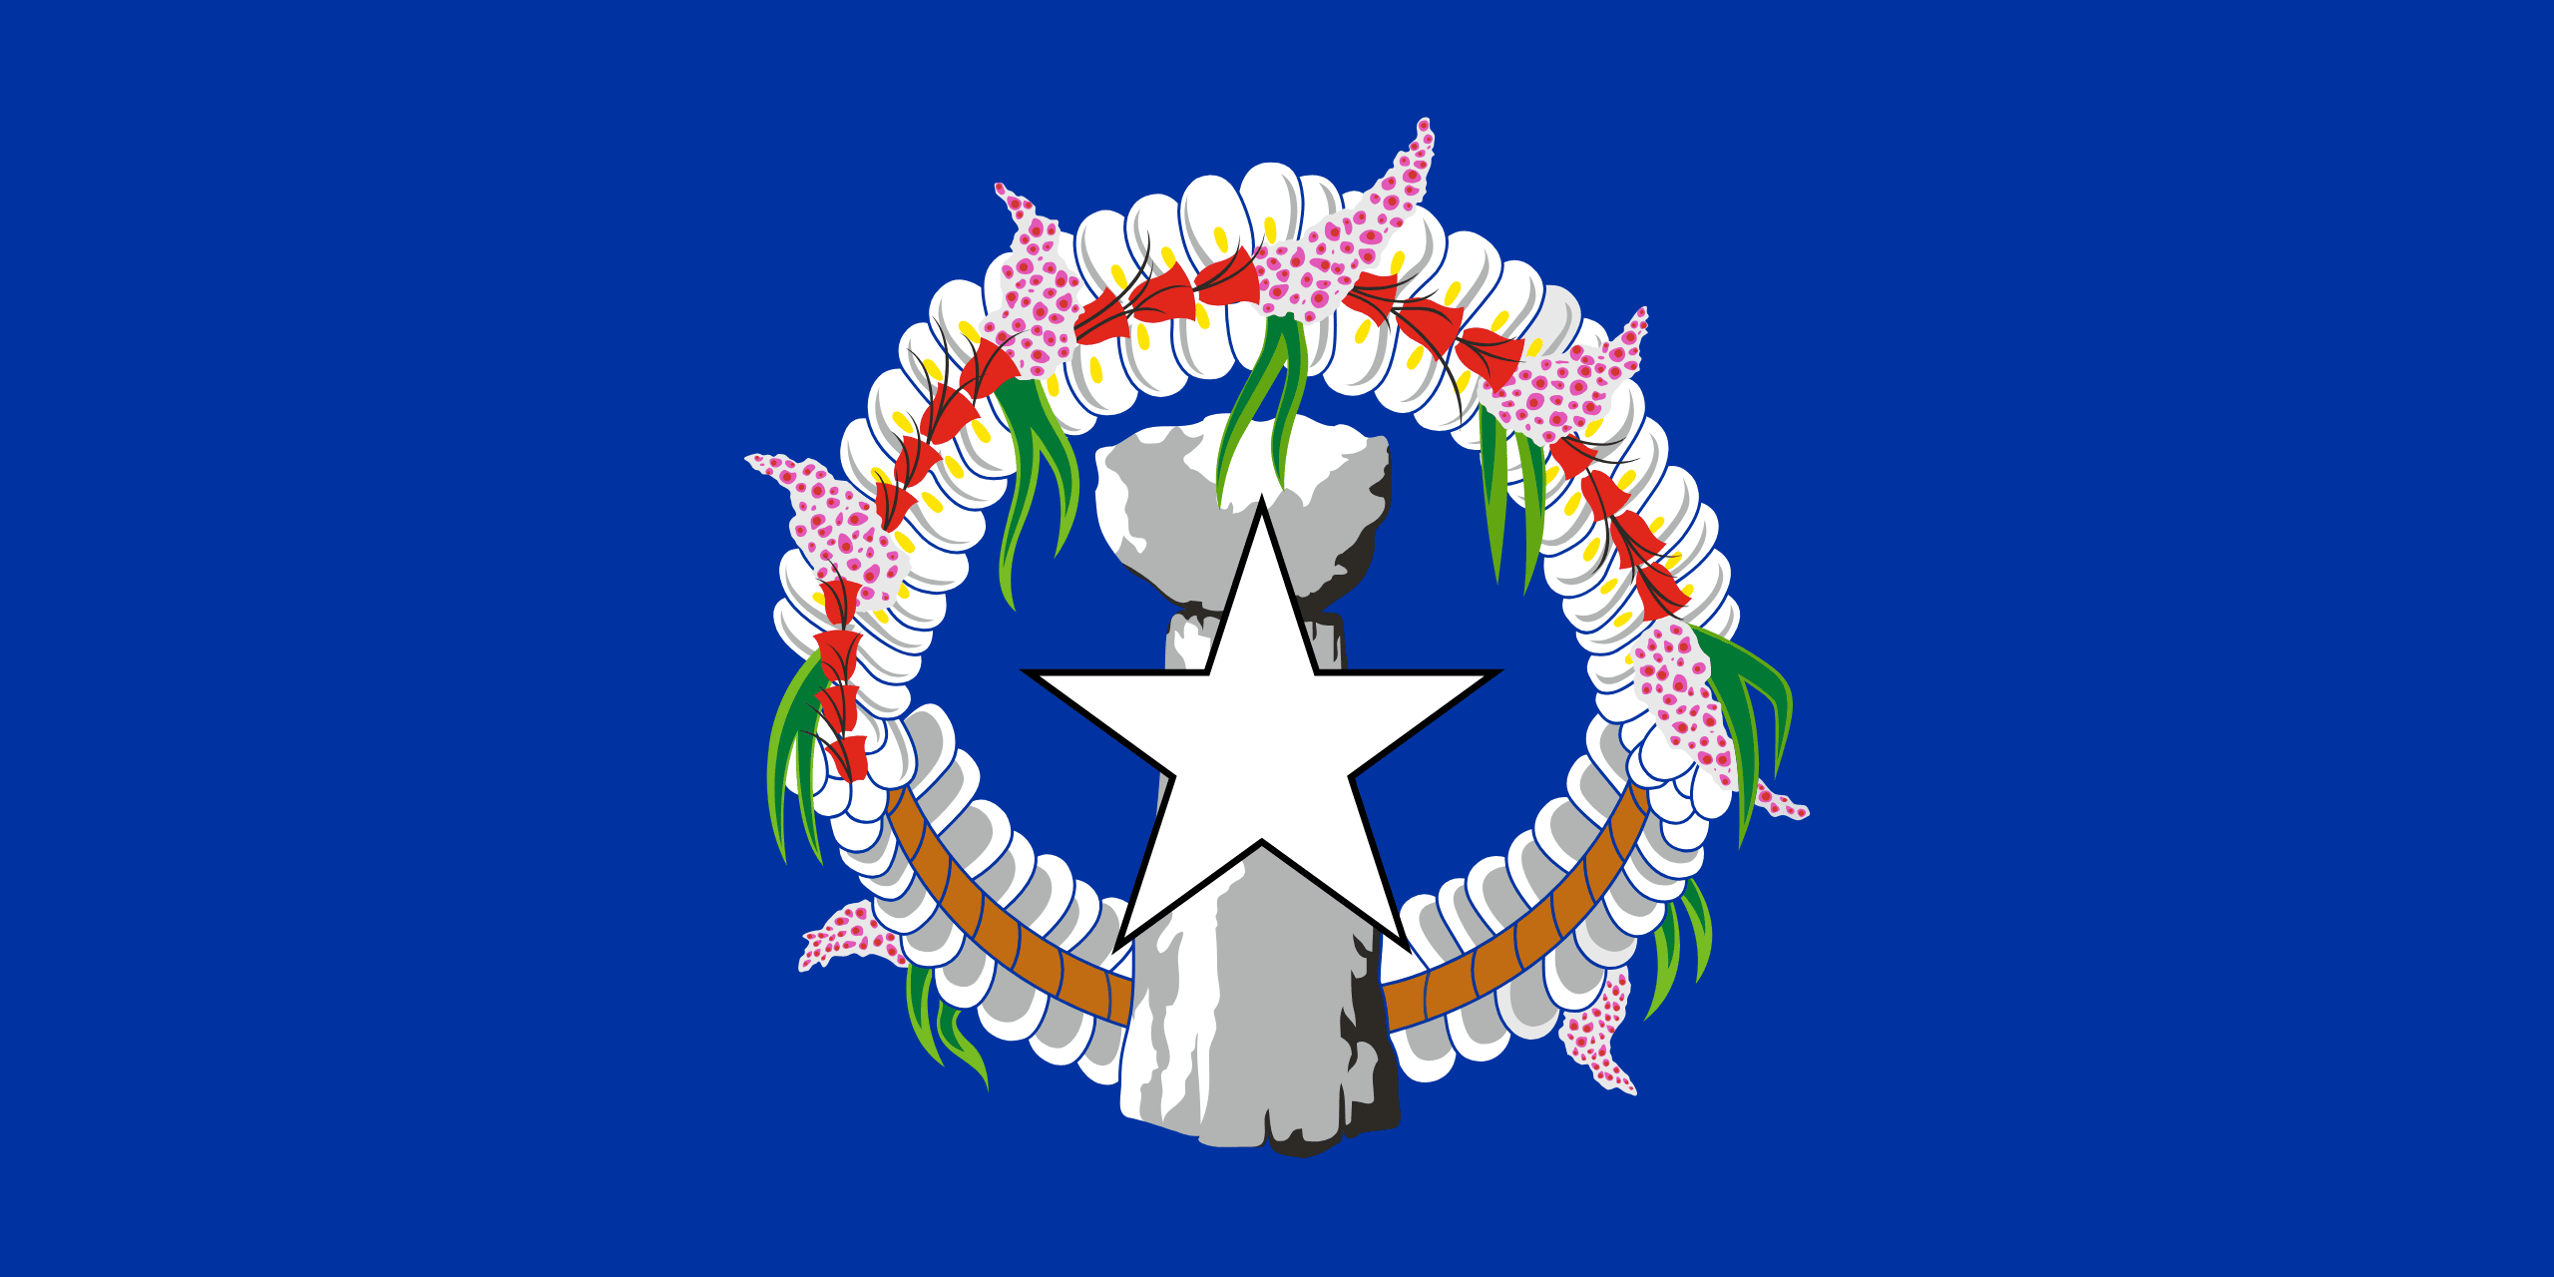
PRAYING FOR
NORTHERN MARIANA ISLANDS

Slide 3
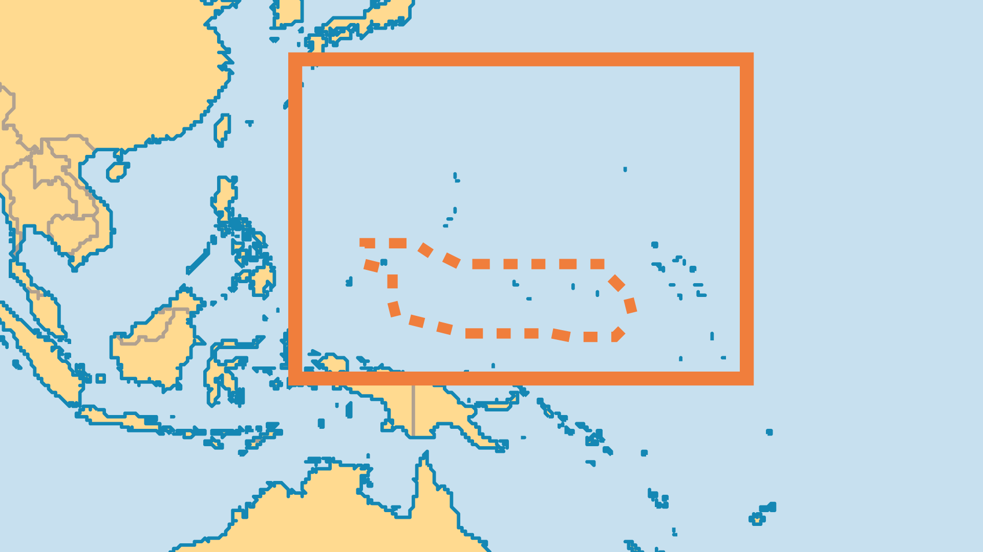
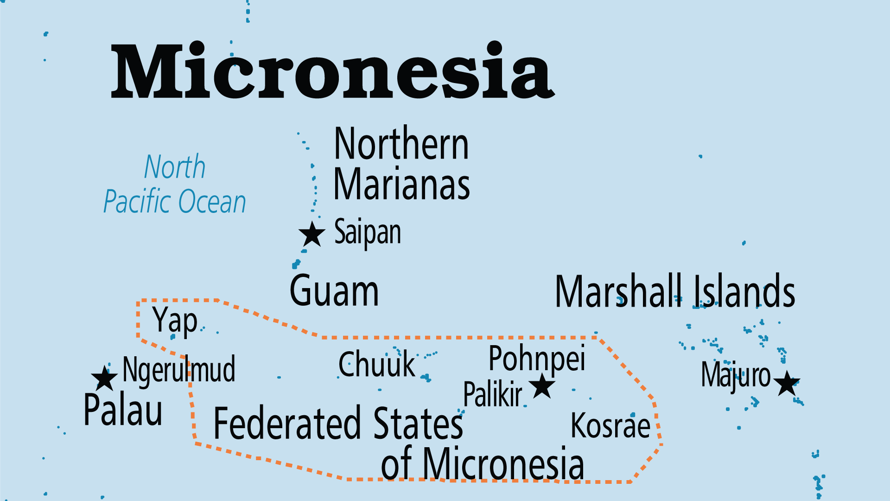
KEY STATS
Capital: | Saipan
Population: | 43,541
% Urban: | 92.3 %
Official Language: | Chamorro; Carolinian; English
Languages: | 7
% Christian: | 85.2 %
% Evangelical: | 12.7 %
People Groups: | 11
Least Reached People Groups: | 1
% Unevangelized: | 1 %

Slide 4

FOR PRAYER
The indigenous Chamorro majority were baptized as Catholics, but their deeper beliefs and worldview betray an underlying animist outlook. Pray that the light of the gospel may shine on this people. Although Catholicism's influence is waning, evangelical outreach is only recent. Pray for the ministry of the numerous Bible-believing churches from various denominations and from the YWAM base in Saipan.
Want to know more? Go to www.operationworld.org

