Slide 1




Slide 2

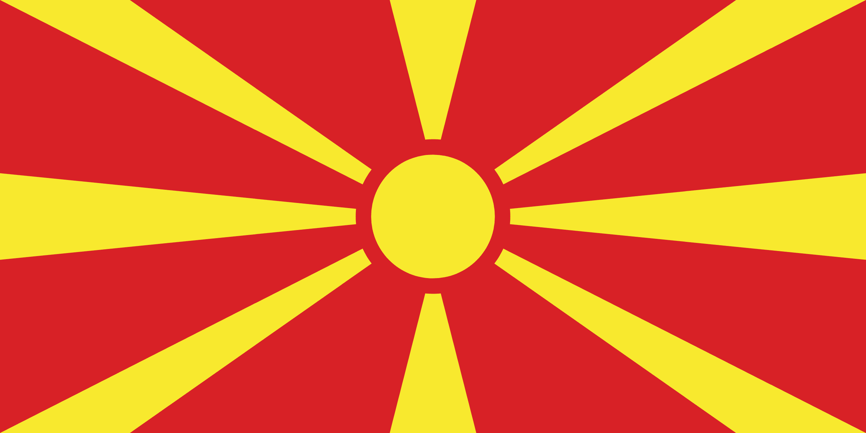
PRAYING FOR
NORTH MACEDONIA

Slide 3
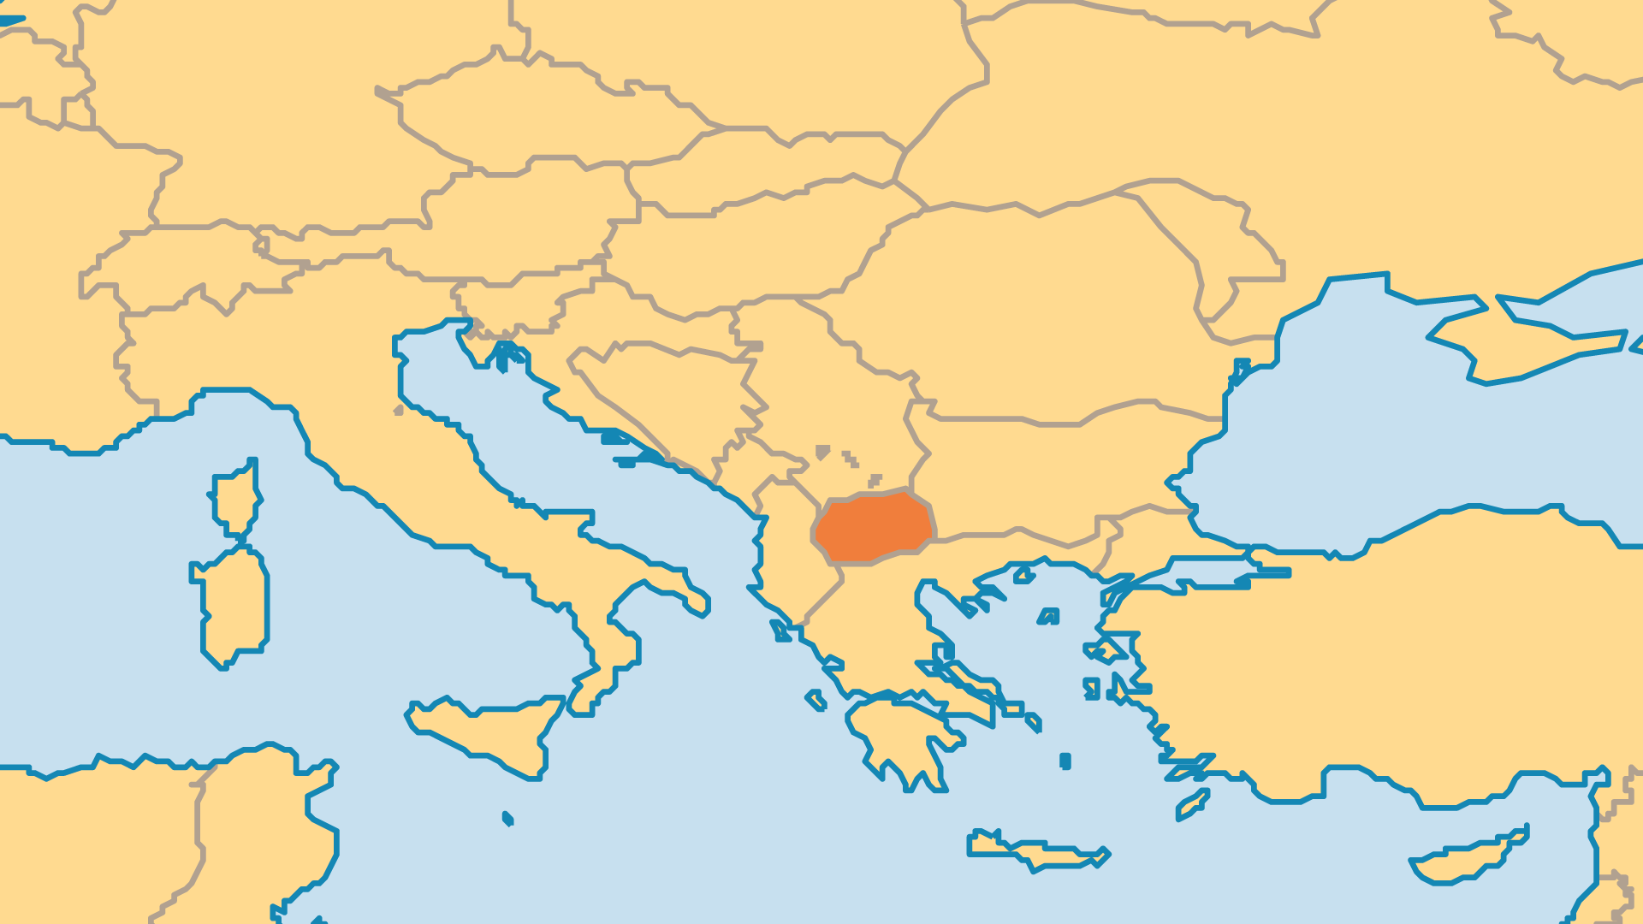
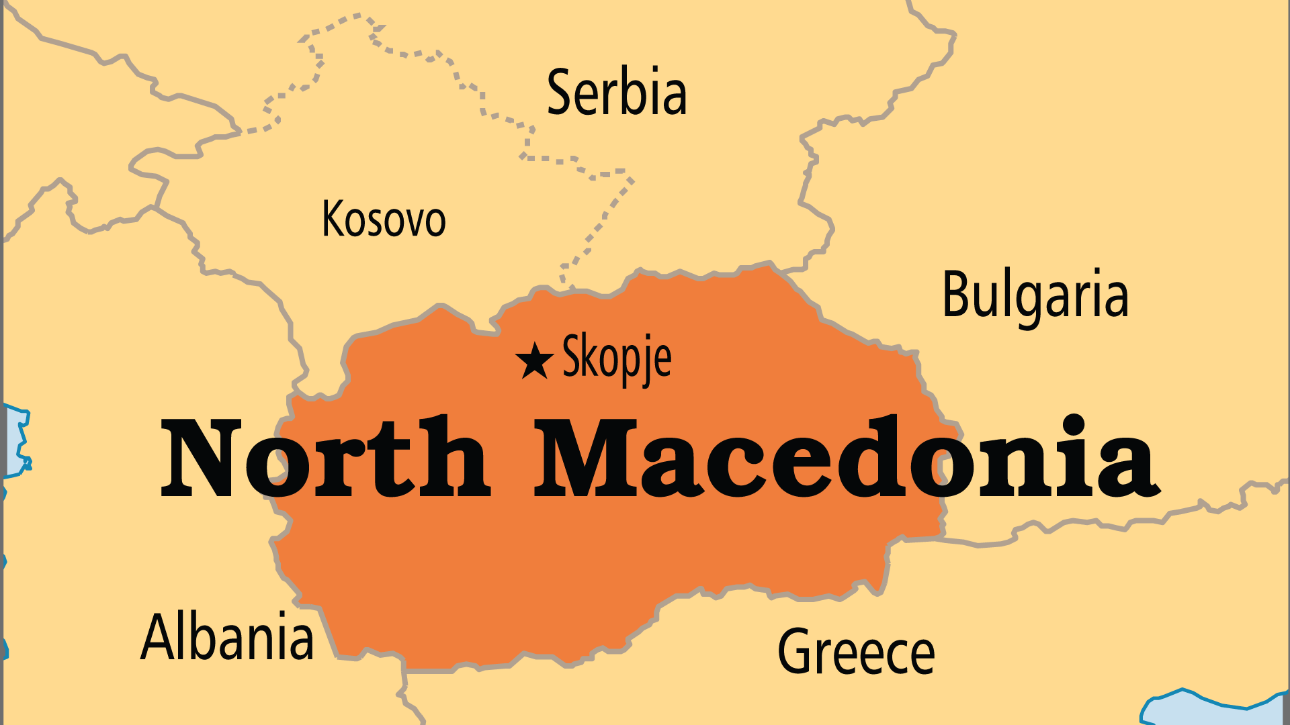
KEY STATS
Capital: | Skopje
Population: | 1,813,791
% Urban: | 60.3 %
Pop Under 15 Yrs: | 16.4 %
Official Language: | Macedonian, Albanian
% Christian: | 65.5 %
% Evangelical: | 0.2 %
People Groups: | 22
Least Reached People Groups: | 9
% Unevangelized: | 15 %

Slide 4

FOR PRAYER
Ethnic divisions dominate politics and society. The large Albanian population feels more connected with Albania and Kosovo than with other groups in North Macedonia. Nearby Greece, Bulgaria, and Serbia each have plans for North Macedonia. Economic struggles lead many to leave the country, or to migrate to cities. Many of the 2,000 villages have disappeared. Pray for wisdom for the government, and pray that divided communities might find ways to build their nation together.
Want to know more? Go to www.operationworld.org

