Slide 1




Slide 2


PRAYING FOR
NIGERIA

Slide 3
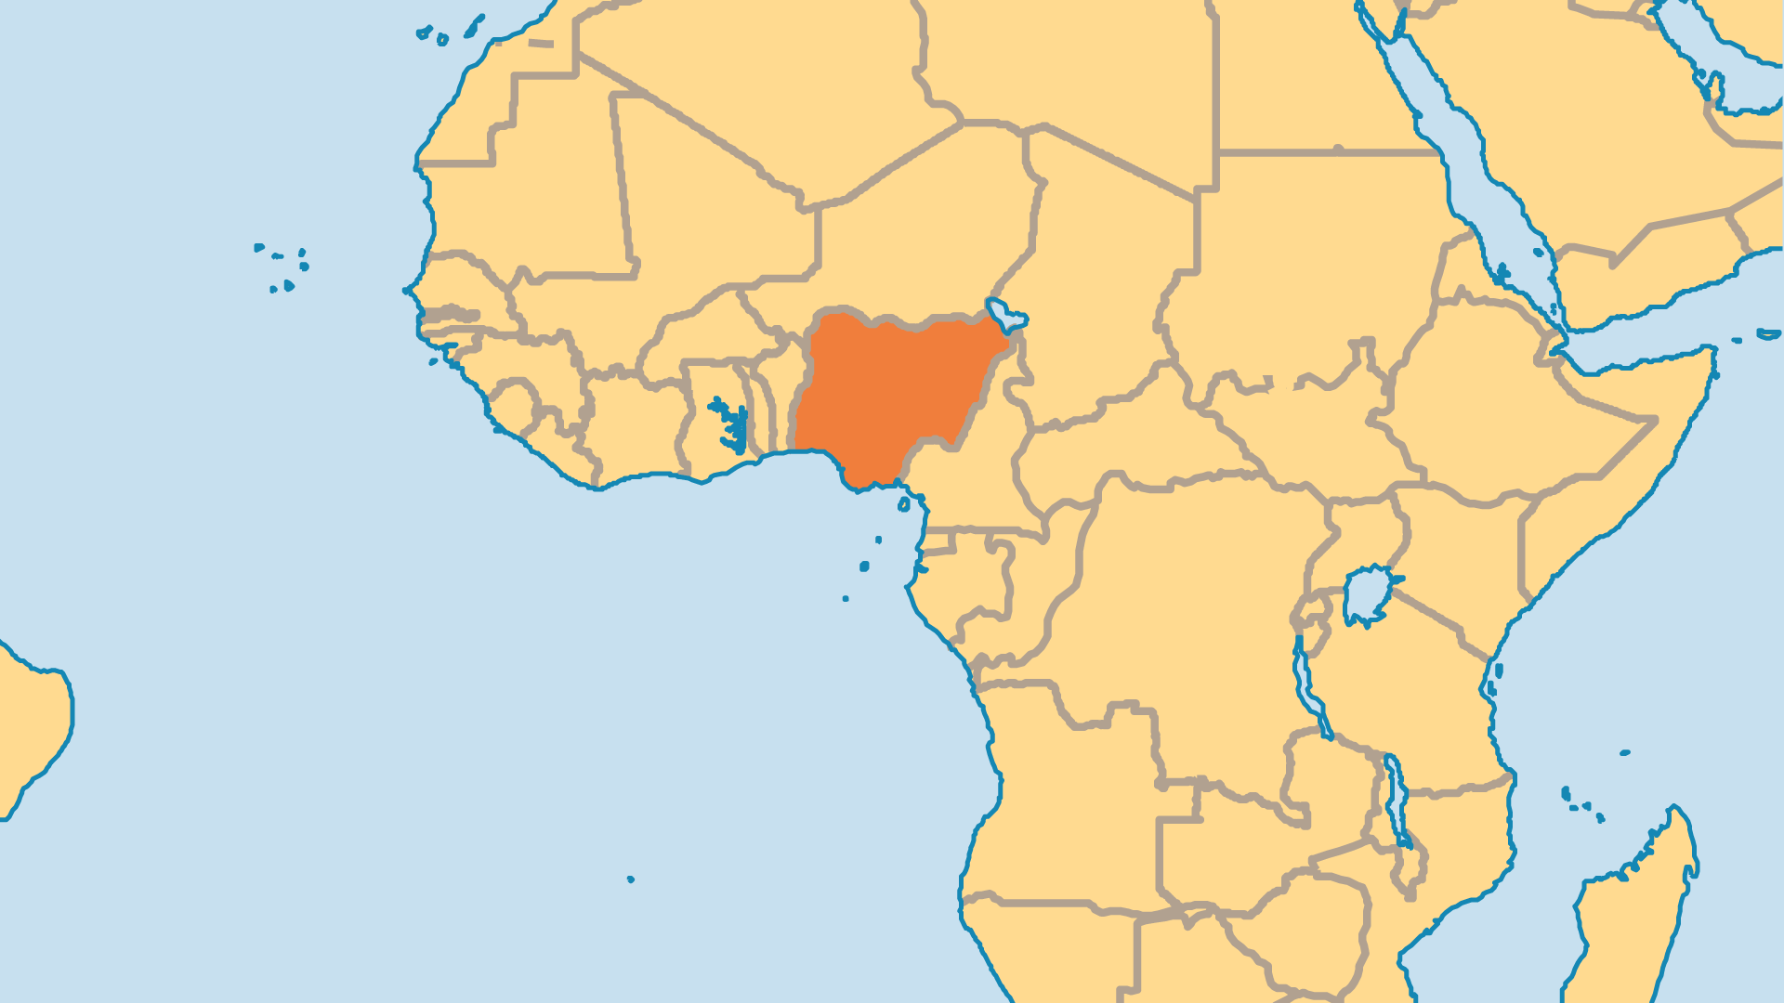
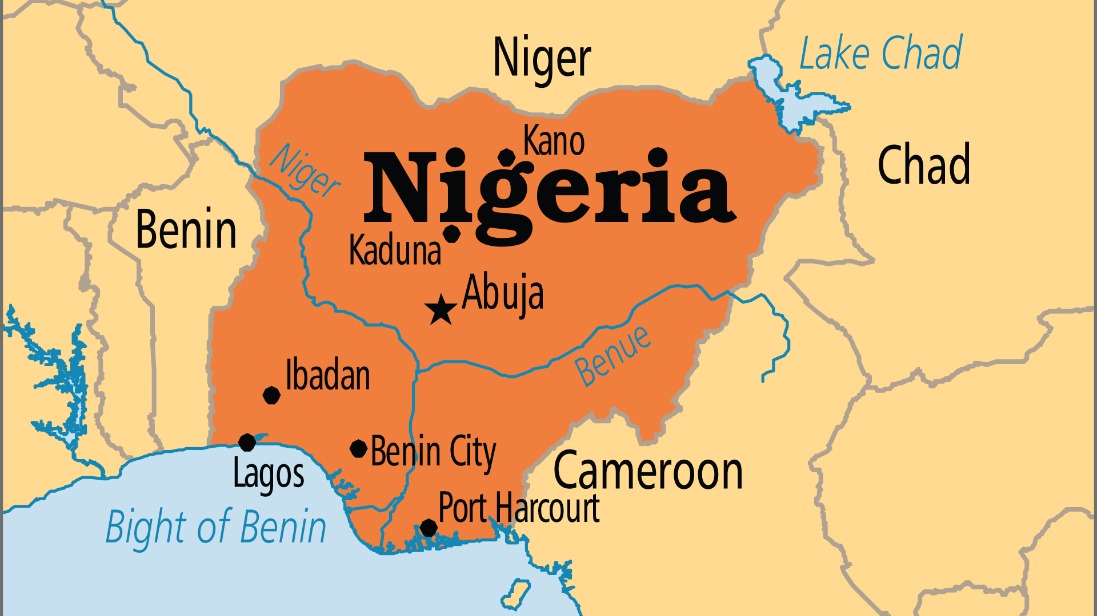
KEY STATS
Capital: | Abuja
Population: | 237,527,782
Official Language: | English. Hausa, Yoruba, Igbo and Pidgin English widely used.
Languages: | 521
Life Expectancy: | 52.7 yrs (235th/236)
HDI Ranking: | 163/193
% Christian: | 51.3 %
% Evangelical: | 30.8 %
Persecution Rank: | 7/50

Slide 4

FOR PRAYER
Church growth has been massive and remains so. A large majority of West Africa's evangelicals live in Nigeria. Nigeria has the world's 4th, and possibly 3rd, highest number of evangelicals in the world. Catholics, Anglicans, traditional Protestant groups, and newer Pentecostal and charismatic groups all grow. Much growth comes from among Muslims and those who follow tribal religions. This growth often happened quietly, in less obvious ways. Praise God for the millions who have come to know Him in Nigeria!
Want to know more? Go to www.operationworld.org

Slide 5
FOR PRAYER
Nigeria's greatest spiritual challenge is discipleship, not Islam, not corruption, and not even the need for missions. The Church grew so fast that many new believers have little chance to be discipled. Much division and false teaching enters into churches. Prosperity teaching distorts the gospel. A form of Christianity mixed with African tribal religious practices is common. The Church needs a balanced and biblical approach to spiritual warfare, to healing and miracles, and to outreach towards other religions. Many Christians seem to live by other values than what the Bible clearly teaches. Pray that humility, simplicity, and holiness might become the motto of the Nigerian Church.

Slide 6
FOR PRAYER
Persecution of Christians continues to increase, especially in the north. Some extremist Muslim groups have killed thousands of people, and have destroyed hundreds or even thousands of churches. Persecution unites Christians and drives them to the Lord in prayer, but it also threatens the very core of Nigerian society and statehood. Pray for restoration and recovery for those who suffer from loss, or from rape. Pray for forgiveness, and for deliverance from a spirit of revenge. Pray for believers to respond in the most Christ-like way possible. Finally, pray that the enemies of Christ who commit these terrible acts would become His followers!

