Slide 1




Slide 2

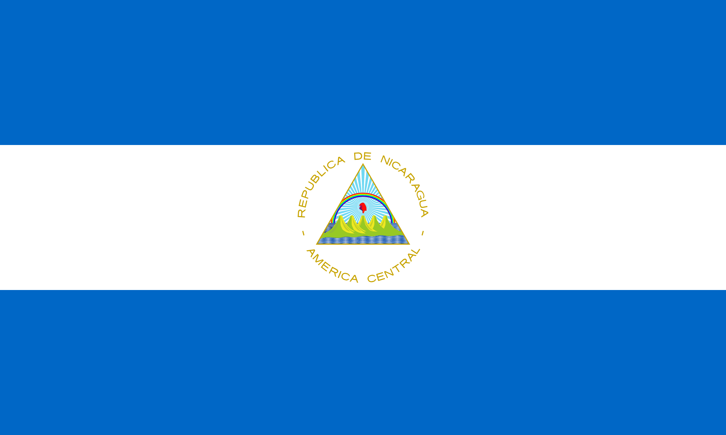
PRAYING FOR
NICARAGUA

Slide 3
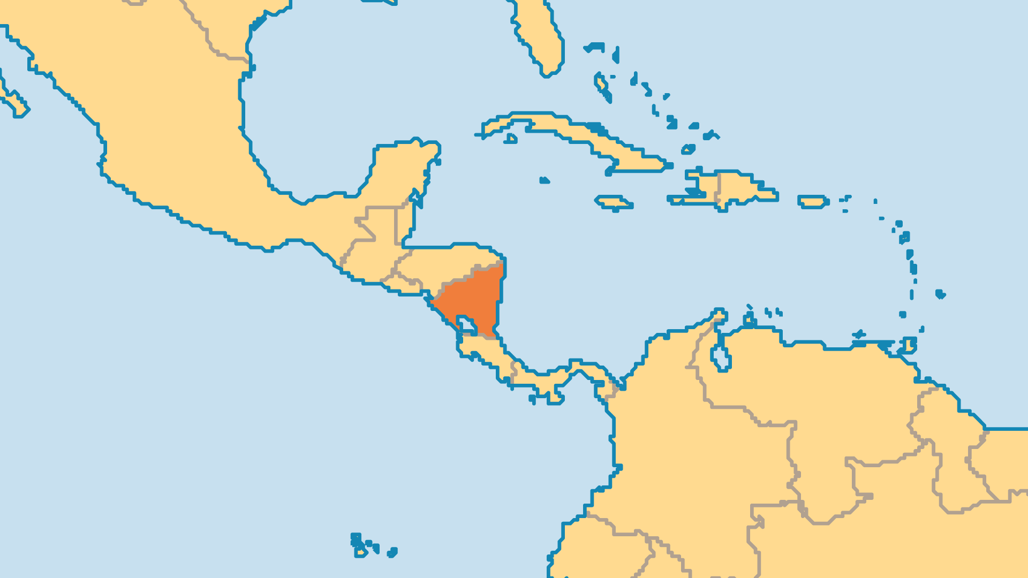
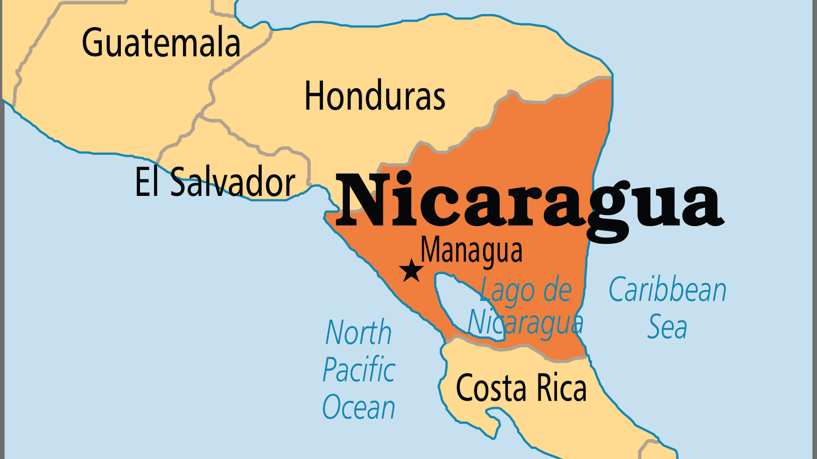
KEY STATS
Capital: | Managua
Population: | 7,007,502
Official Language: | Spanish
Languages: | 7
HDI Ranking: | 126/193
% Christian: | 97.3 %
% Evangelical: | 29.8 %
People Groups: | 18
% Unevangelized: | 1 %
Persecution Ranking: | 30/50

Slide 4

FOR PRAYER
Nicaragua's authoritarian president is taking aim at many churches and mission organizations, shutting down hundreds of them in recent years. The nation has become one of the more difficult places to be a Christian. This came on the back of a season when evangelicals - over a quarter of the population - began to wield considerable influence in the public sphere. Despite these challenges, the church continues to grow, and Nicaraguans remain spiritually open. Pray that believers might have the wisdom and determination to be a righteous influence on the nation.
Want to know more? Go to www.operationworld.org

