Slide 1




Slide 2

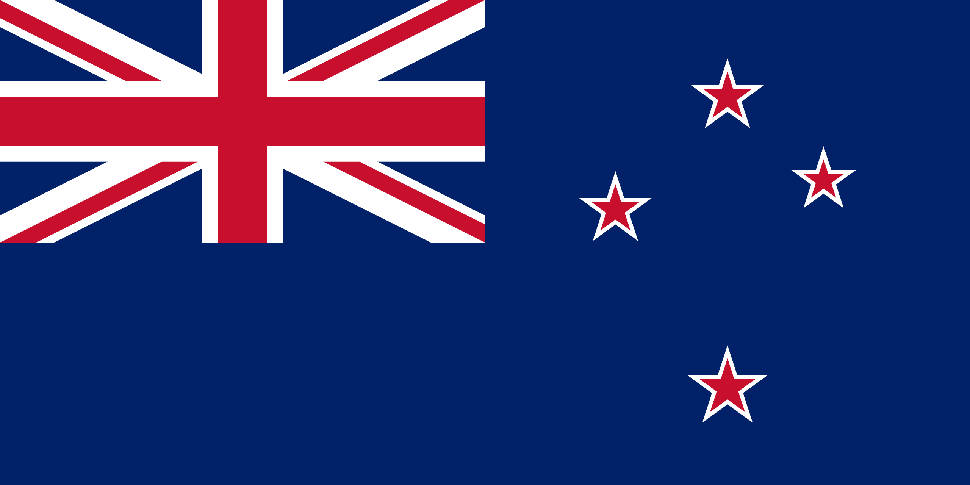
PRAYING FOR
NEW ZEALAND

Slide 3
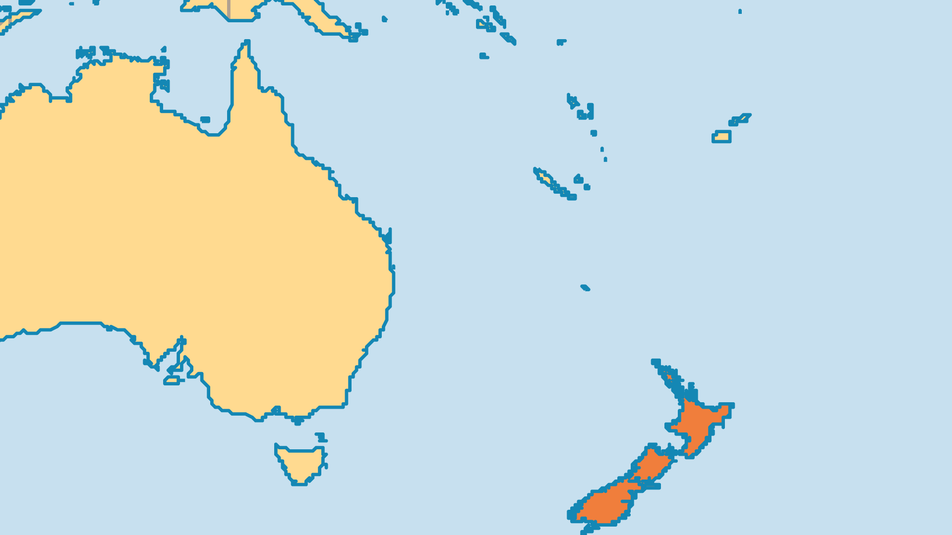
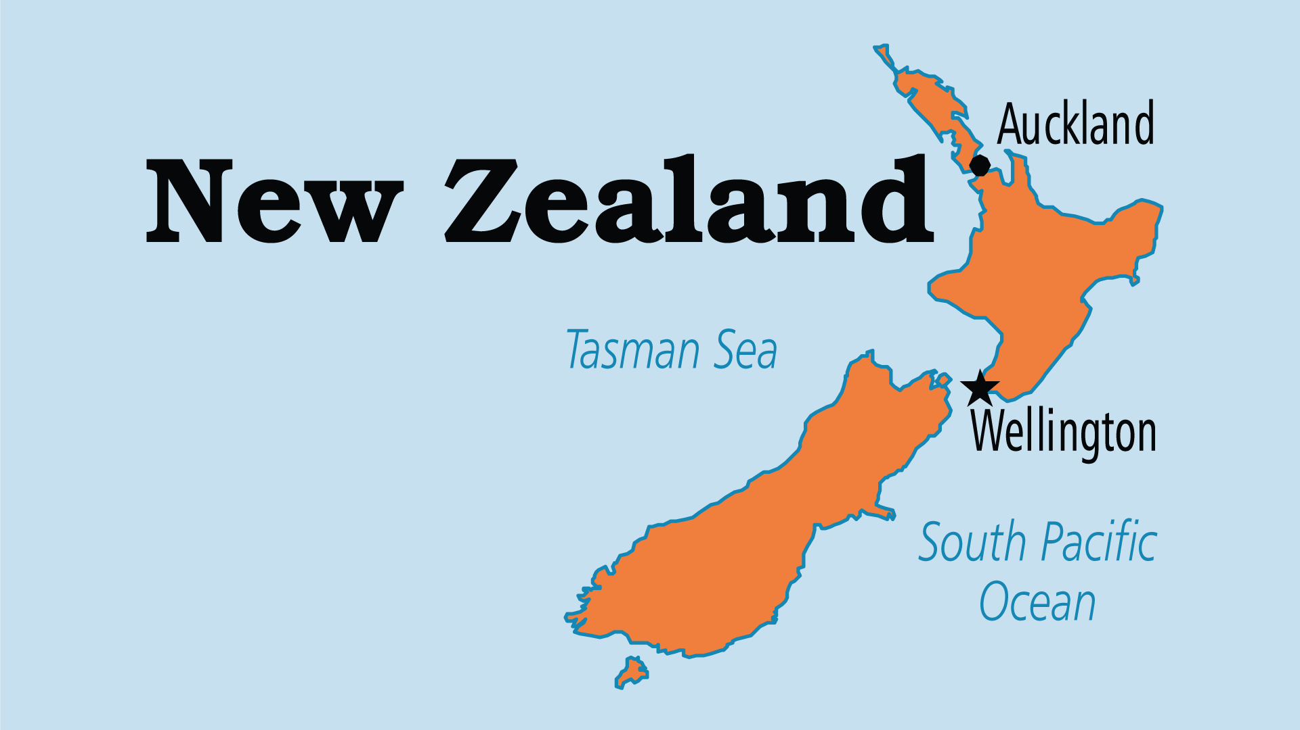
KEY STATS
Capital: | Wellington
Population: | 5,251,899
Official Language: | English, Maori
Life Expectancy: | 82.5 yrs (19th/236)
HDI Ranking: | 13/193
% Christian: | 53.2 %
% Evangelical: | 18.2 %
People Groups: | 92
Least Reached People Groups: | 28
% Unevangelized: | 3 %

Slide 4

FOR PRAYER
Christianity is on a precipitous decline in New Zealand (37% in the 2018 census). The largest group is now "no religion" at 48%. But 24/7 prayer rooms and other recent prayer groups prove that God still moves in the Kiwi Church! The recent decline is more a case of the pruning of nominal Christianity - what remains is much more alive. Praise God for new growth in charismatic and Pentecostal groups, and new evangelical movements in mainline denominations. Pray that God will pour His Holy Spirit into the Church and draw back the many who have left.
Want to know more? Go to www.operationworld.org

