Slide 1




Slide 2

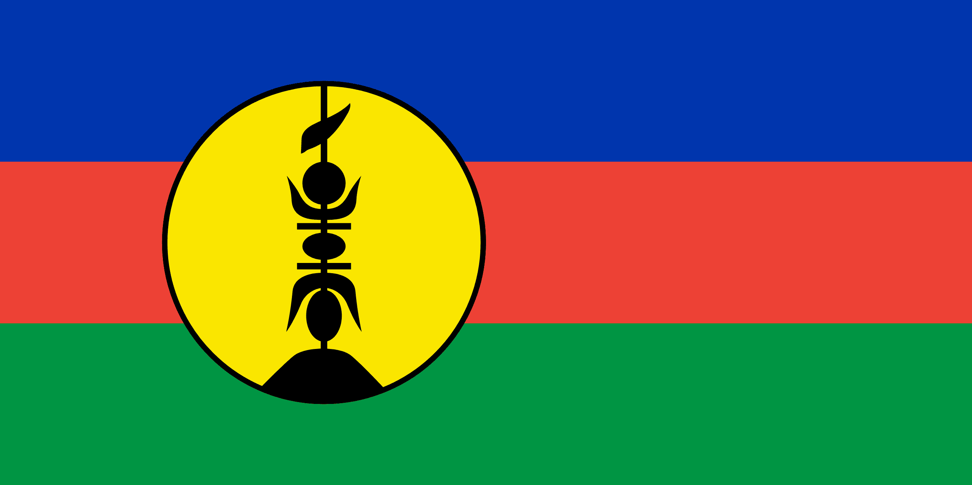
PRAYING FOR
NEW CALEDONIA

Slide 3
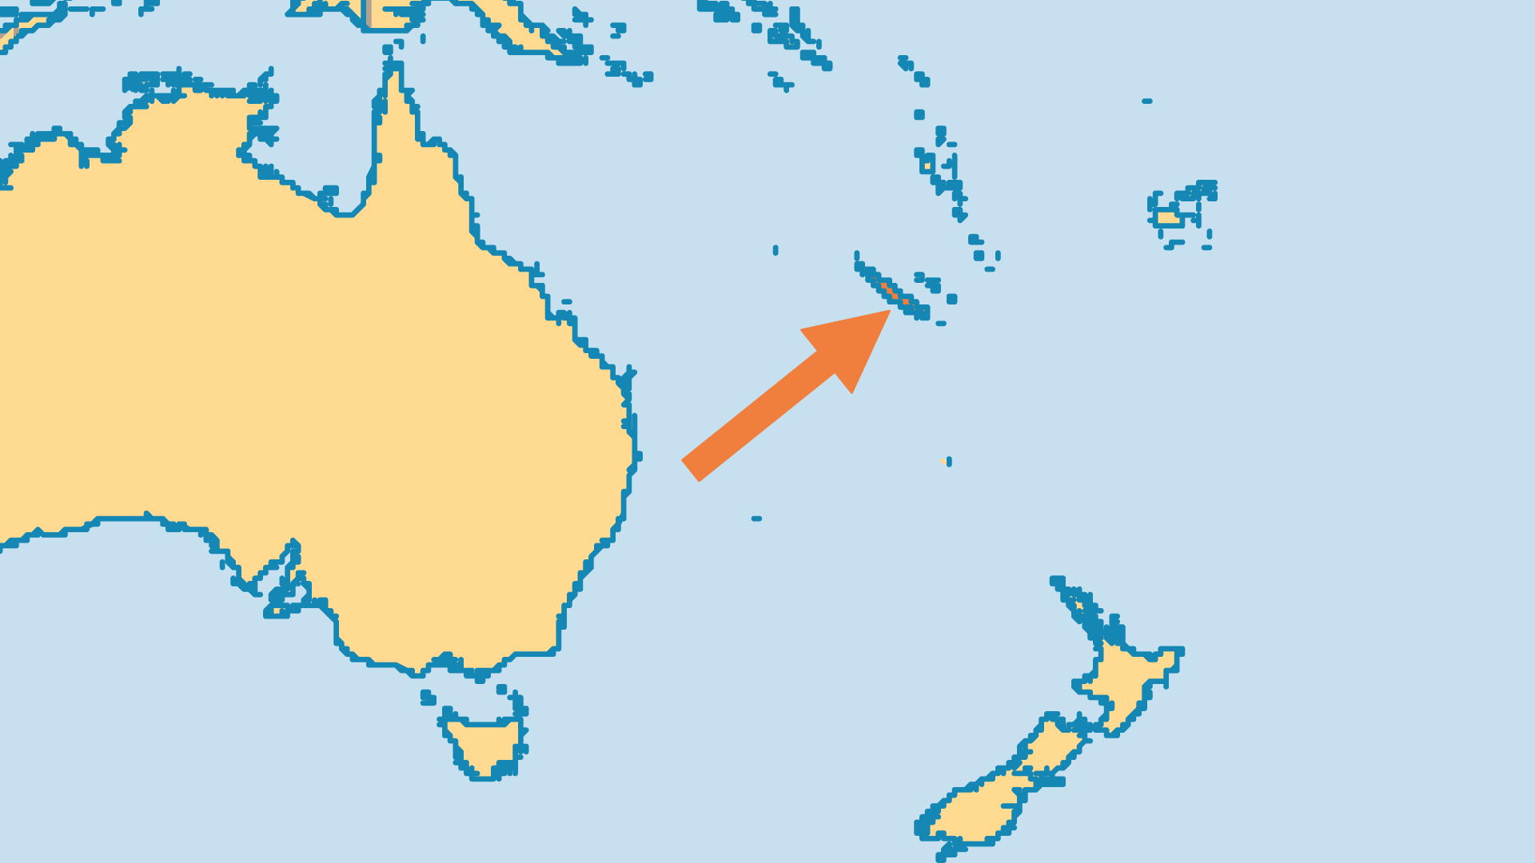
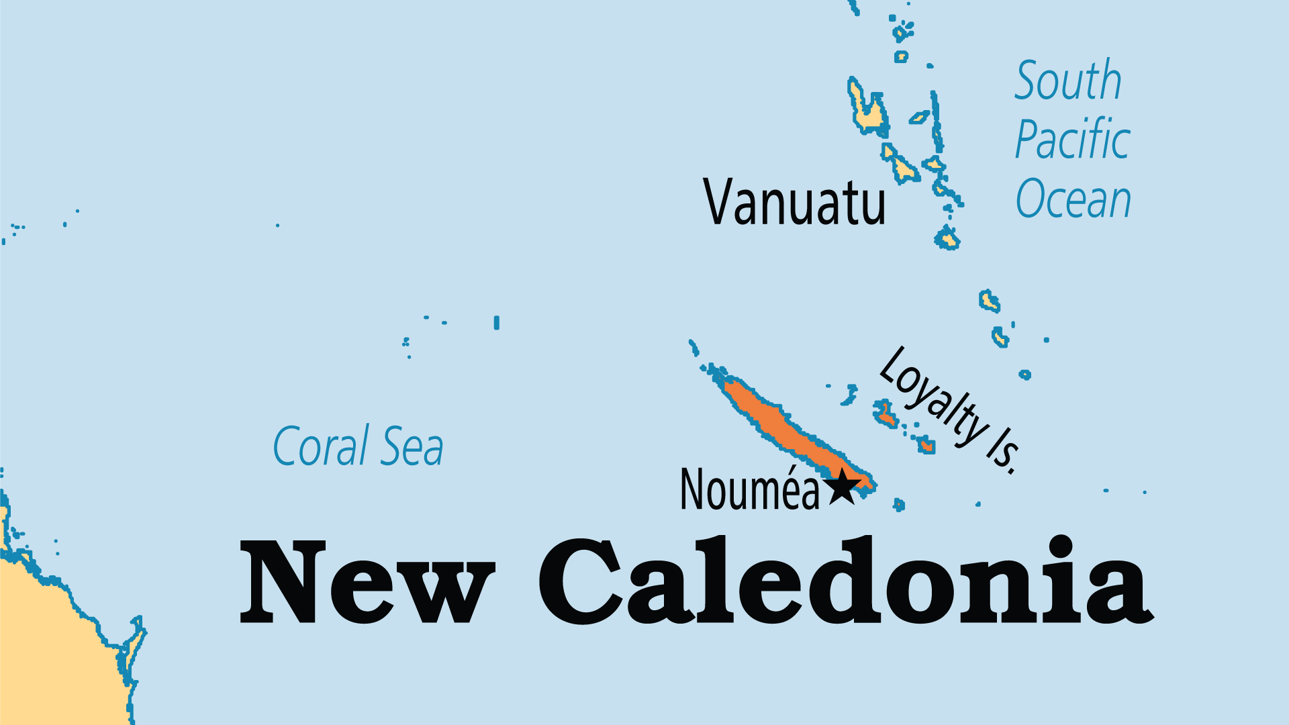
KEY STATS
Capital: | Noumea
Population: | 295,333
Official Language: | French
Languages: | 41
Literacy Rate: | 99 %
Life Expectancy: | 79 yrs (51st/236)
% Christian: | 80.7 %
% Evangelical: | 7 %
People Groups: | 44
% Unevangelized: | 2 %

Slide 4

FOR PRAYER
Most Kanaks (the indigenous people of New Caledonia) are Christianized and most villages have a church, but the gospel is often confused with Western culture. Animist practices usually underlie a Christian veneer. Pray for pastors to discern between tradition and the pure gospel, and that a truly biblical, truly Kanak church may continue to grow and demonstrate the power of Jesus over the evil one.
Want to know more? Go to www.operationworld.org

