Slide 1




Slide 2

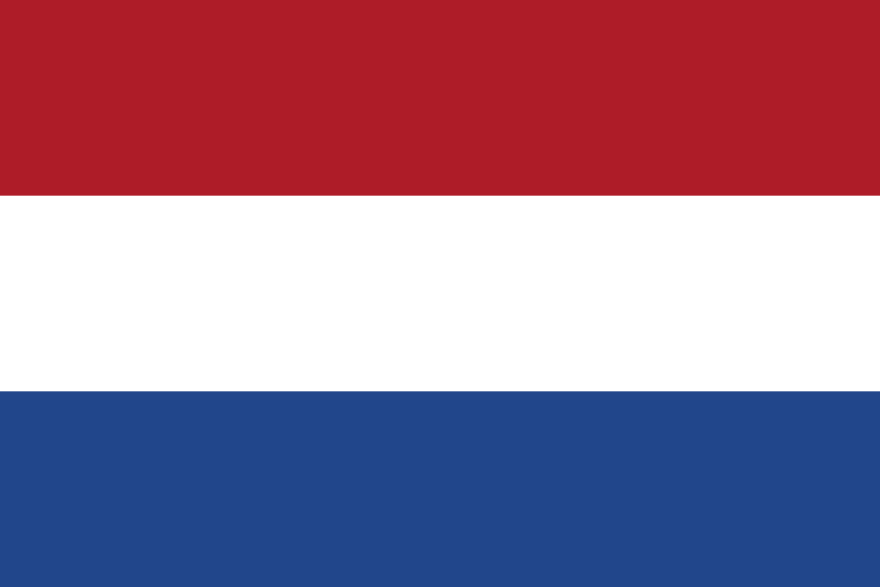
PRAYING FOR
NETHERLANDS

Slide 3
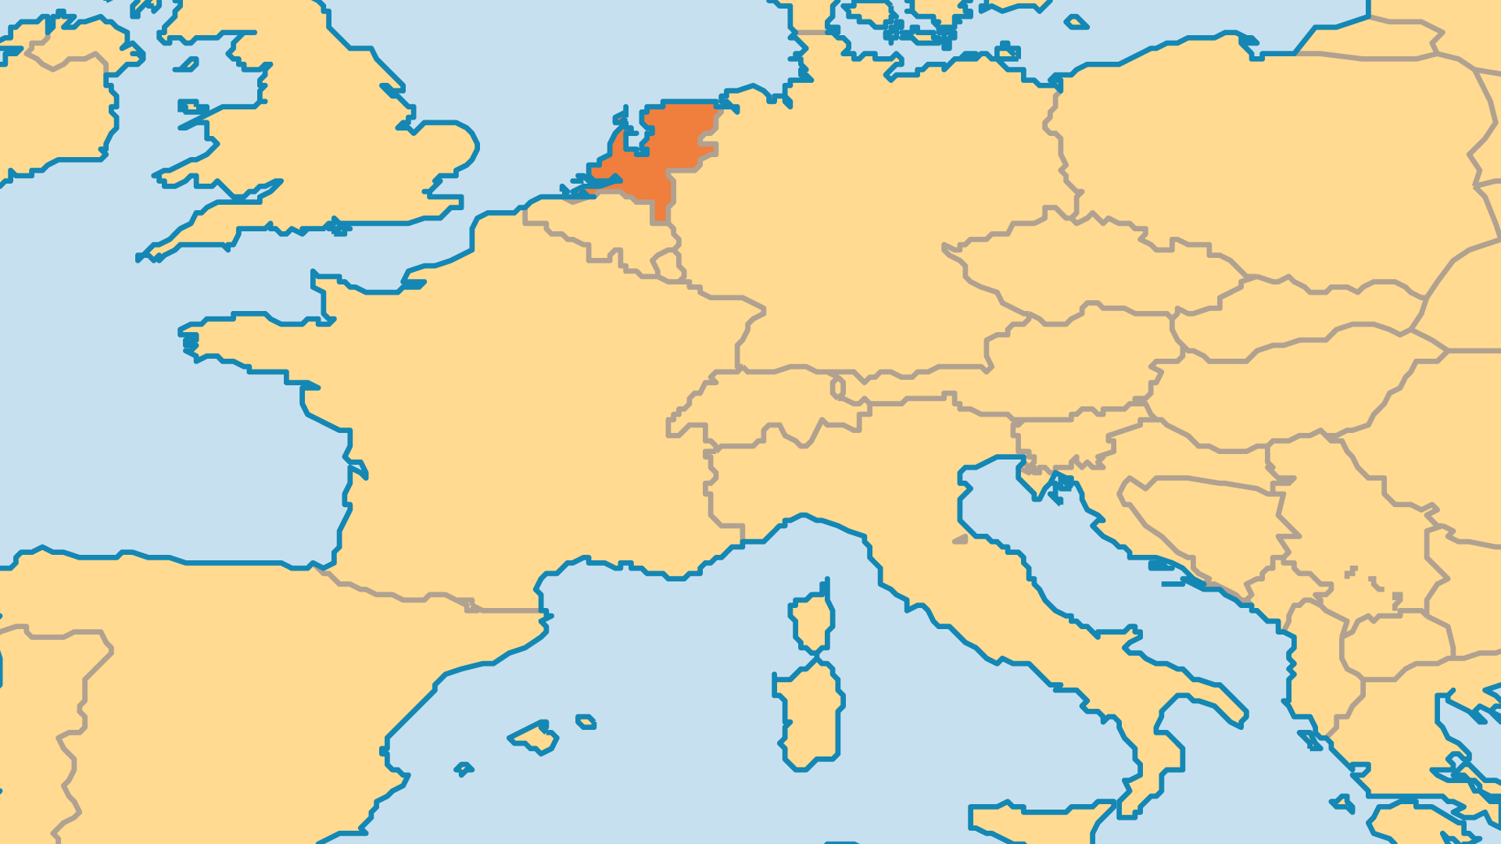
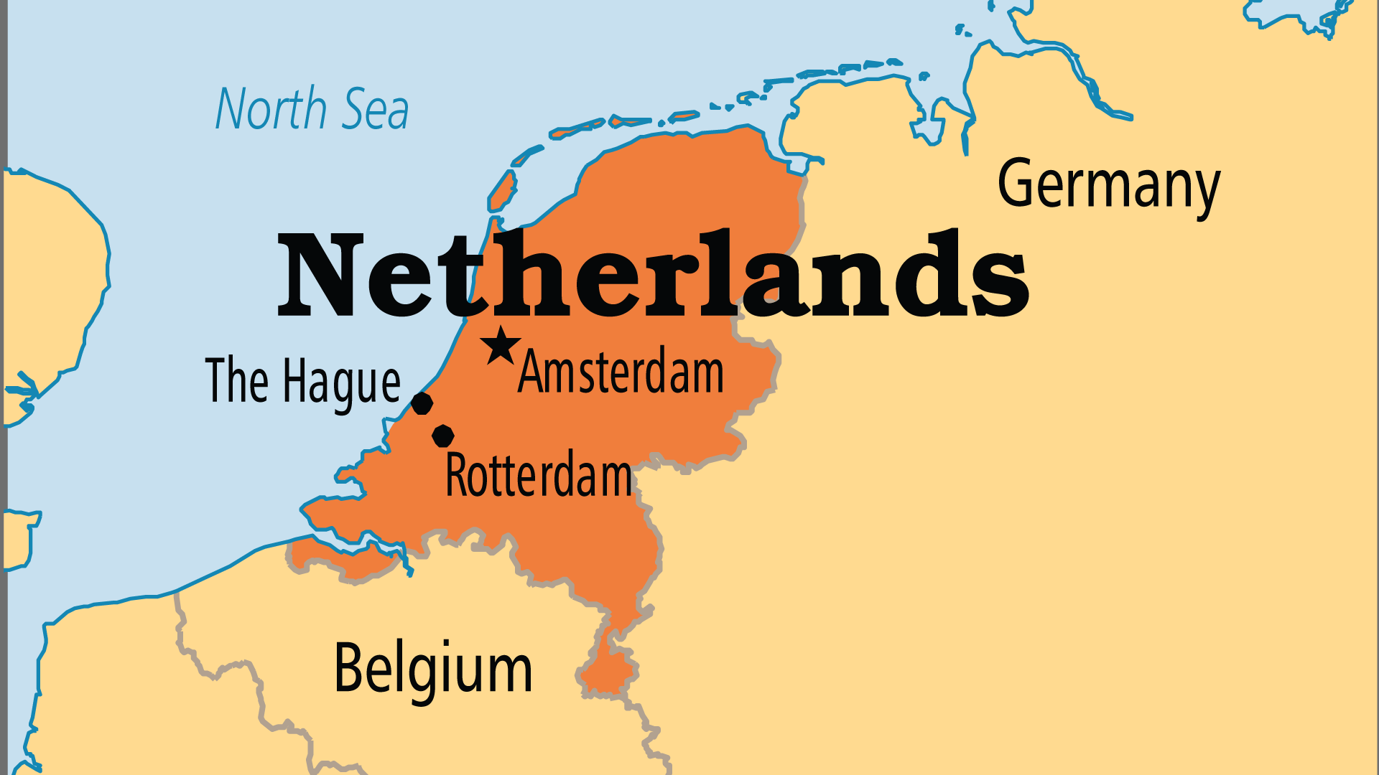
KEY STATS
Capital: | Amsterdam; The Hague
Population: | 18,346,819
Official Language: | Dutch, Frisian
Languages: | 38
HDI Ranking: | 10/193
% Christian: | 46.6 %
% Evangelical: | 4.3 %
Largest Religion: | Non-religious
% Largest Religion: | 46.9 %
% Unevangelized: | 4 %

Slide 4

FOR PRAYER
Christianity in the Netherlands seems to have reached a low point. Secular society today turns its back on its rich Christian heritage. Less than 10% of the population now attend church weekly. The Netherlands leads the world in promotion of secular and New Age views or values. Few restrictions exist for drug use, deviant lifestyles, prostitution, euthanasia, and abortion. Half the nation's church buildings are now either destroyed or converted for other uses such as bars and mosques. Pray for revival that restores the nation spiritually.
Want to know more? Go to www.operationworld.org

