Slide 1




Slide 2

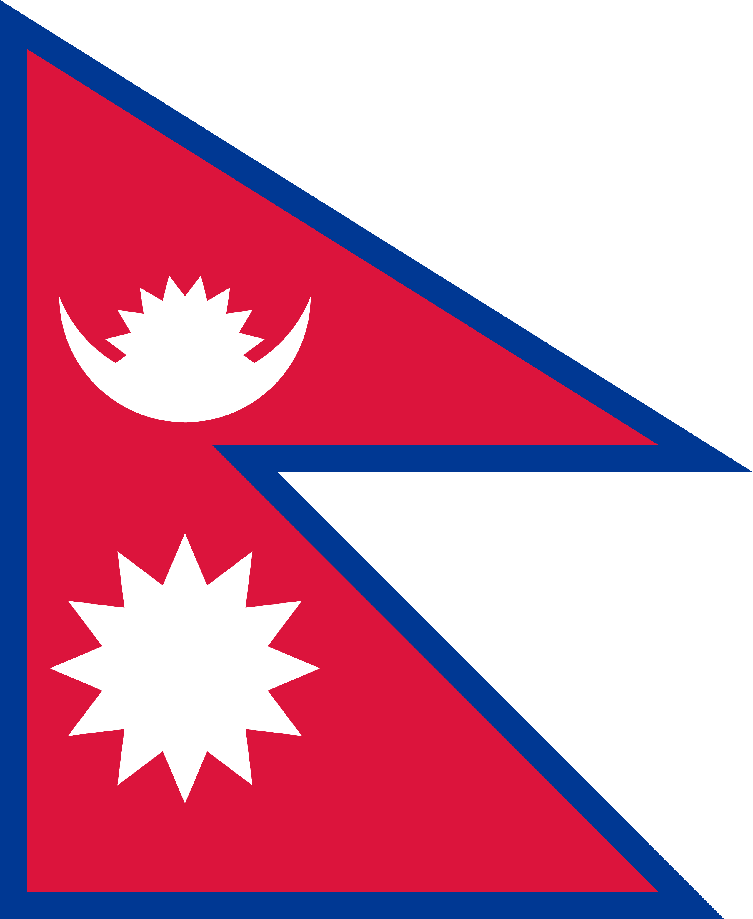
PRAYING FOR
NEPAL

Slide 3
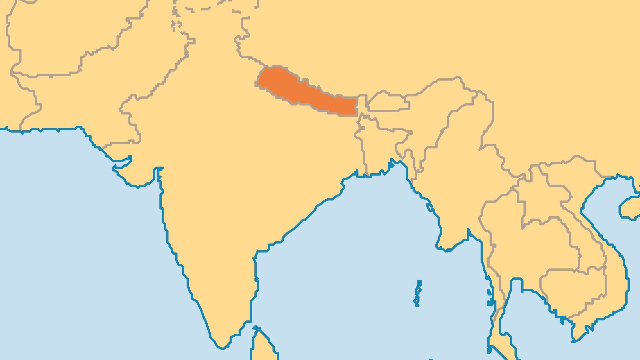
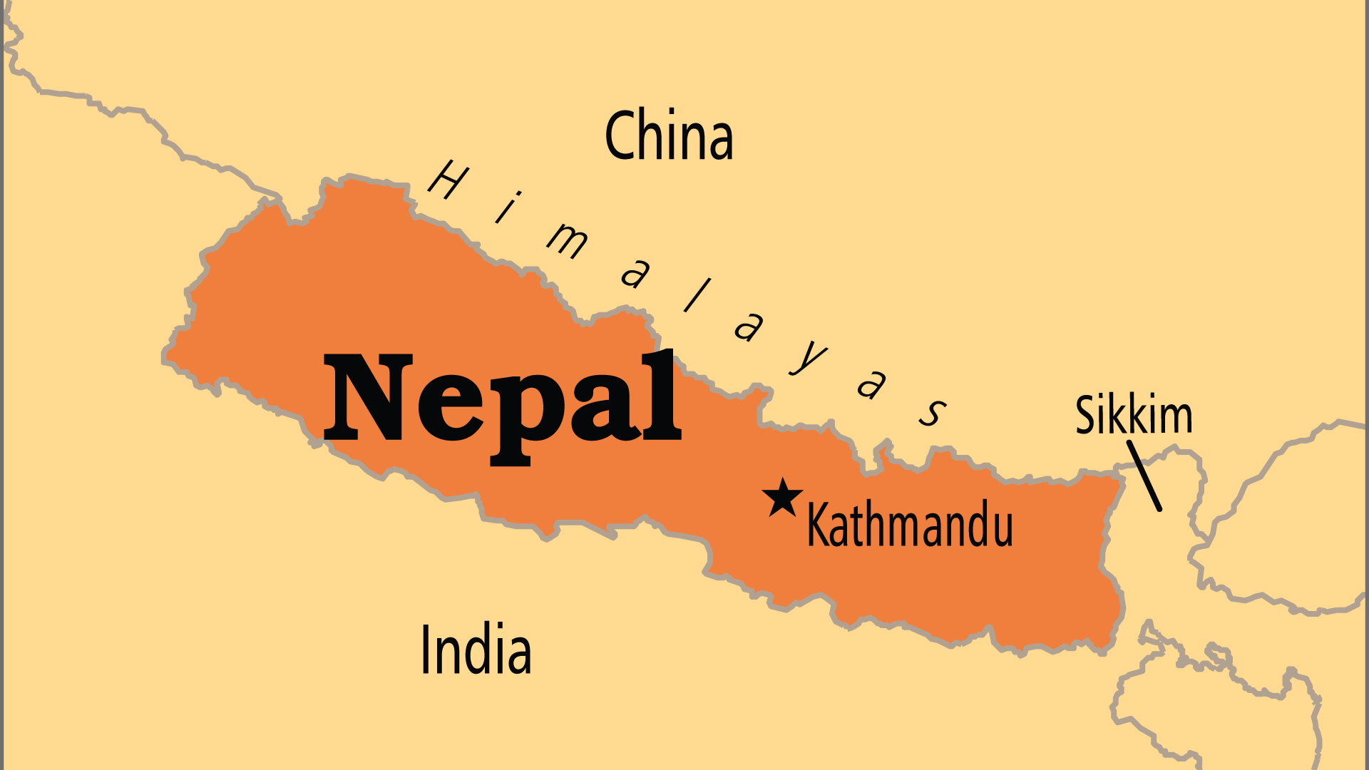
KEY STATS
Capital: | Kathmandu
Population: | 29,618,118
Official Language: | Nepali
Languages: | 127
HDI Ranking: | 143/193
% Christian: | 2.9 %
% Evangelical: | 2.8 %
Largest Religion: | Hinduism
Least Reached People Groups: | 215
% Unevangelized: | 55 %

Slide 4

FOR PRAYER
Nepal has experienced huge changes in the last 20 years. The absolute power of the Hindu monarchy ended in 2008, and a tumultuous decade followed that eventually saw the establishment of a federal republic as a secular state. This was an answer to the prayers of most Christians in Nepal! Although Nepal is a secular country, an anti-conversion law was passed in 2017, primarily intended to limit Christian evangelism. It has not succeeded in slowing the spread of the gospel; Nepal's Christians continue to share the good news. Pray for wisdom and courage for all who wish to be witnesses for Christ in Nepal.

Slide 5
FOR PRAYER
The Church in Nepal is growing in numbers, diversity and maturity, but prayer is still needed. The public image of Christianity in Nepal is as a foreign, mostly Western, intrusion that undermines traditional culture and society and appeals only to lower castes. Despite this, Nepal's Christians are, with increasing confidence, defending their rights and building a fully Nepali, fully Christian identity. Pray for discernment, courage and faithfulness for those seeking to overturn two generations of negative opinion.
Want to know more? Go to www.operationworld.org

