Slide 1




Slide 2


PRAYING FOR
NAURU

Slide 3
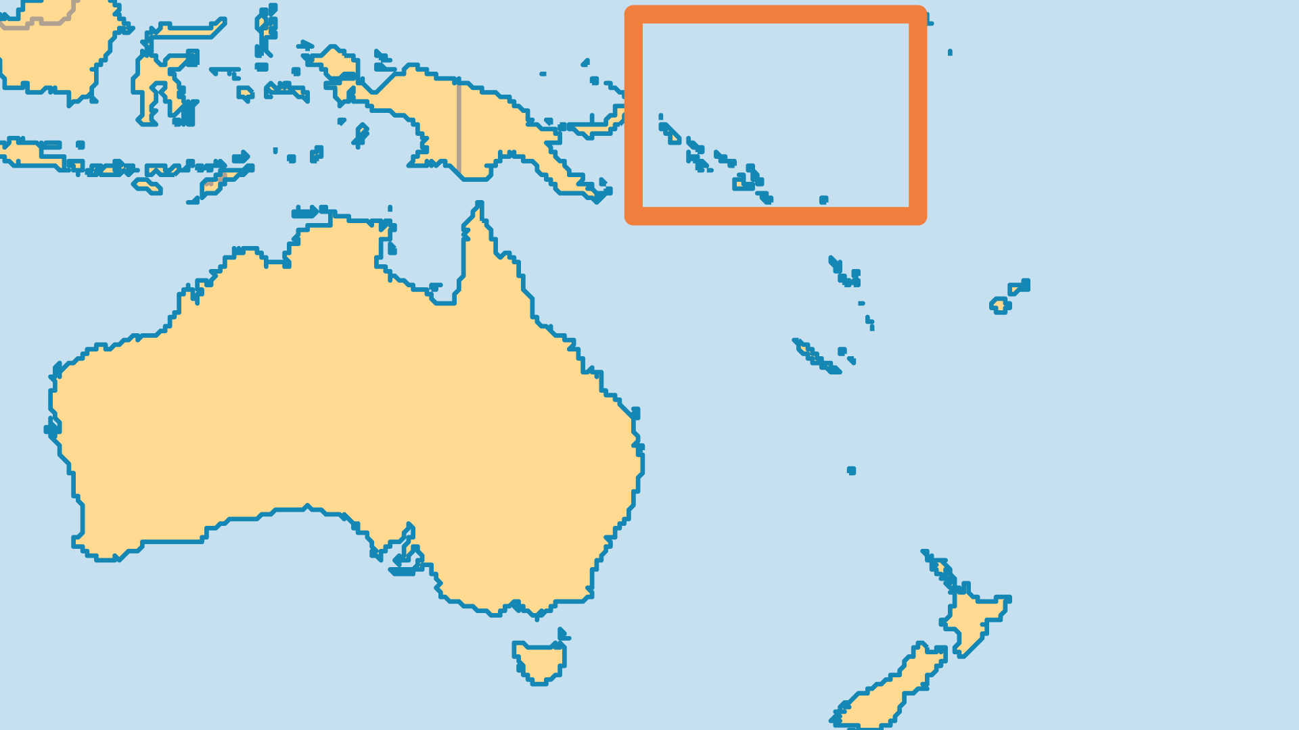
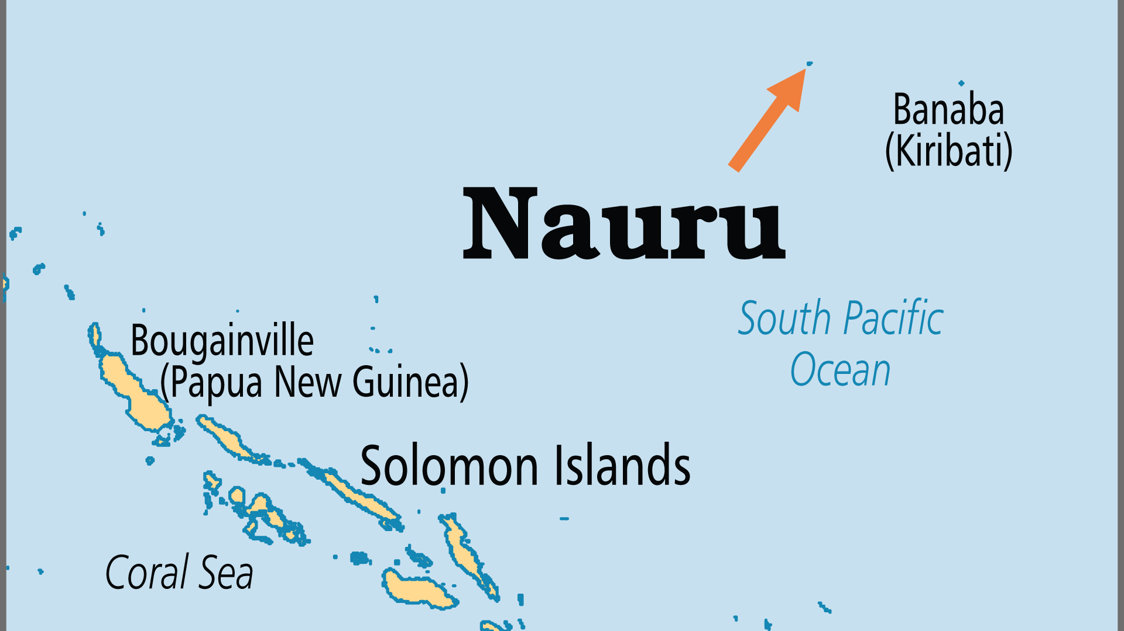
KEY STATS
Capital: | Administrative centre in Yaren
Population: | 12,026
% Urban: | 100 %
Official Language: | Nauruan, English
Languages: | 9
Literacy Rate: | 97 %
% Christian: | 91.5 %
% Evangelical: | 12.1 %
People Groups: | 7
% Unevangelized: | 4 %

Slide 4

FOR PRAYER
Spiritual awareness grows as the economy shrinks. Materialism's decline is faith's gain. Church life is reawakening and evangelical numbers are growing. The Nauru Independent Church is the largest evangelical group, but there are believers in the other denominations as well. Small island nations have a precarious existence; pray for Nauru's 12,000 people to put its future in God's hands.
Want to know more? Go to www.operationworld.org

