Slide 1




Slide 2

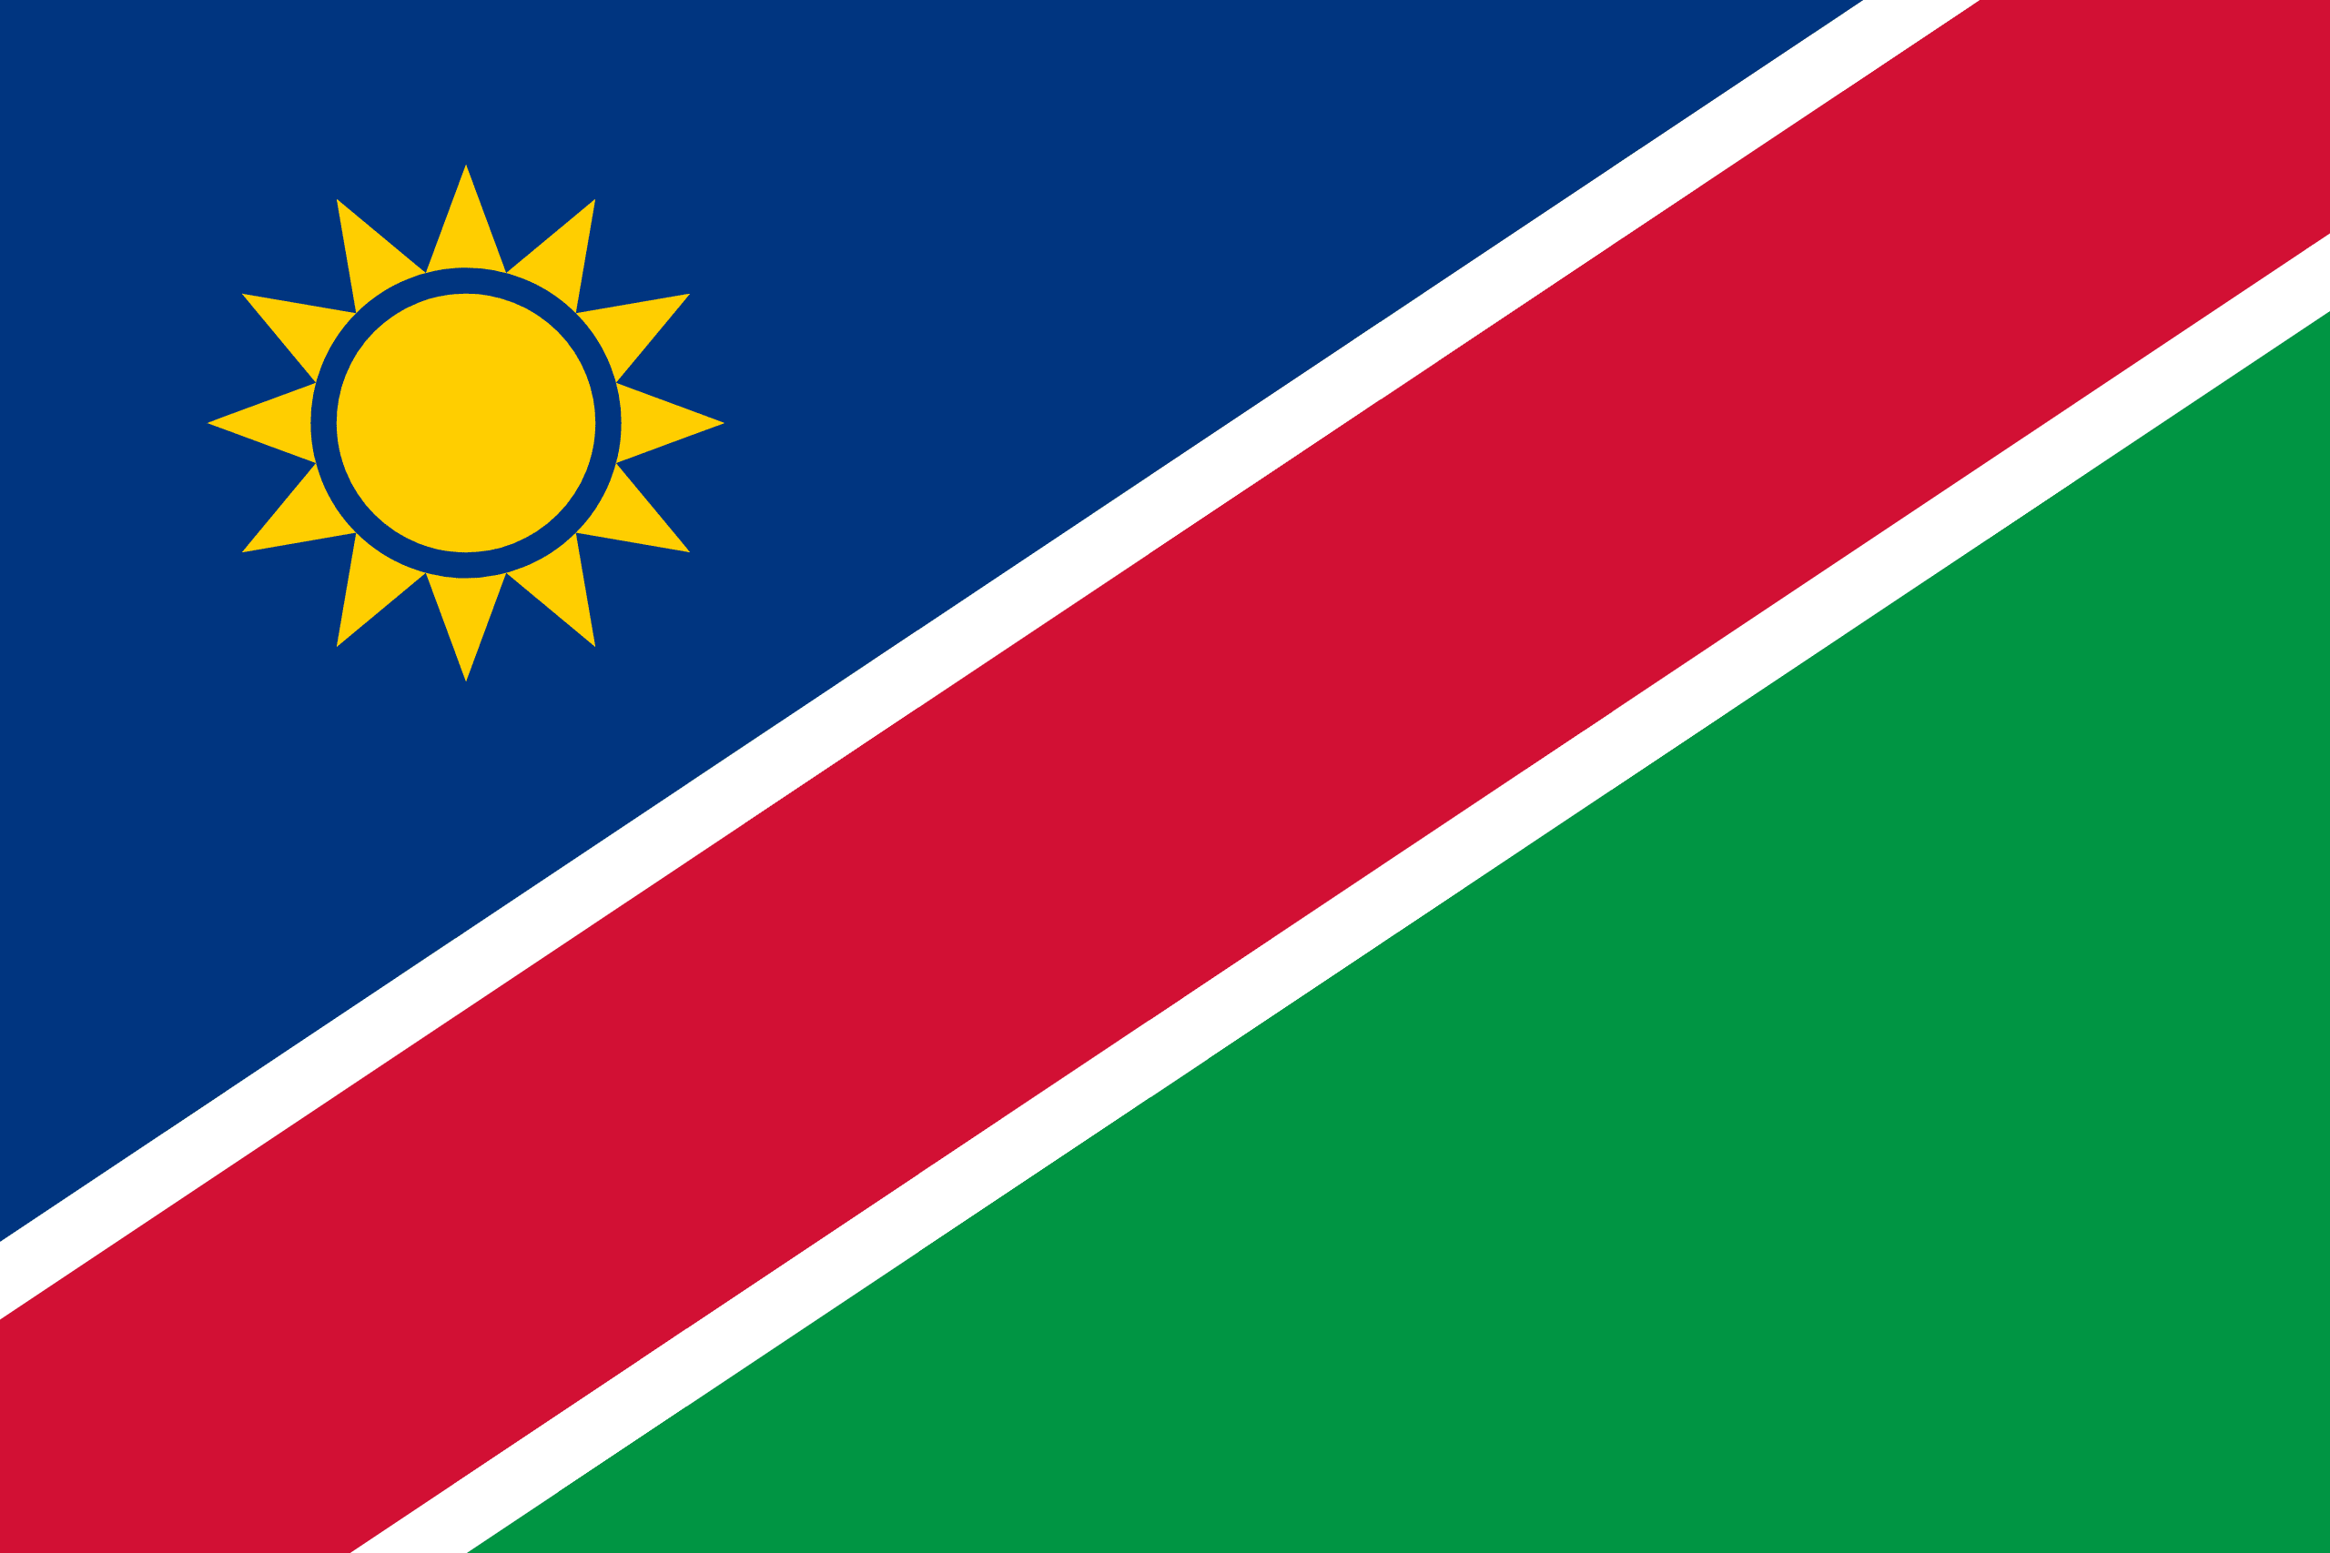
PRAYING FOR
NAMIBIA

Slide 3
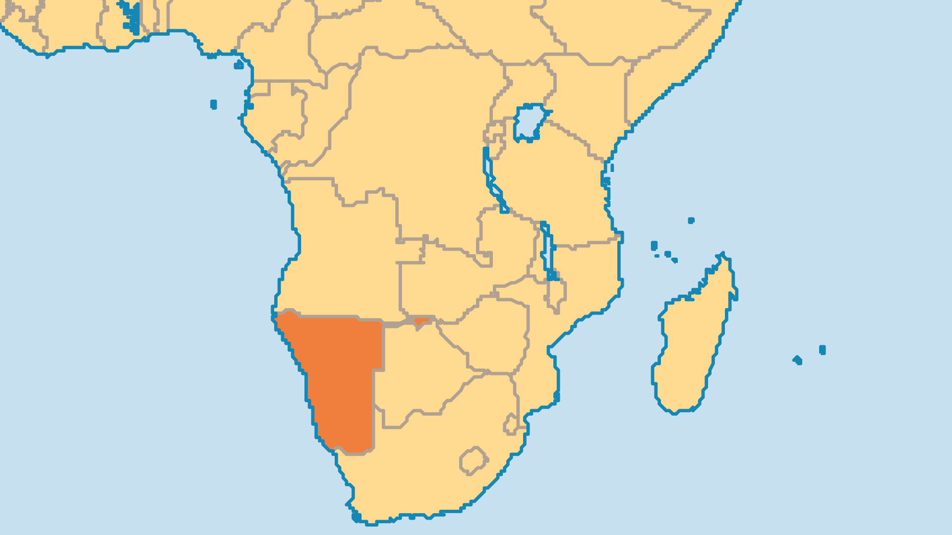
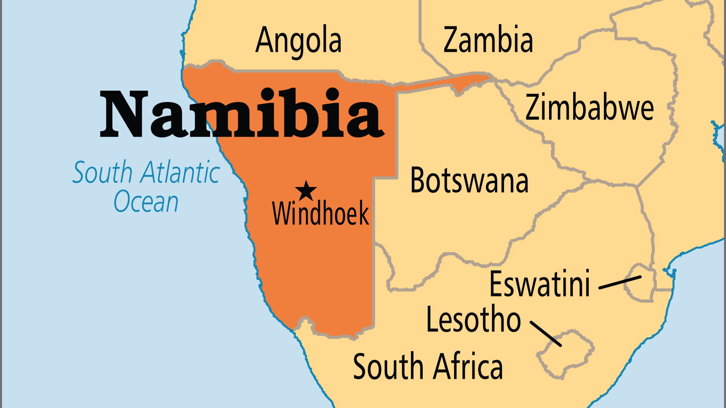
KEY STATS
Capital: | Windhoek
Population: | 3,092,817
Official Language: | English
Languages: | 37
Literacy Rate: | 91 %
Life Expectancy: | 59.3 yrs (224th/236)
% Christian: | 91.4 %
% Evangelical: | 12.2 %
People Groups: | 34
% Unevangelized: | 3 %

Slide 4

FOR PRAYER
New life in the churches has come recently through Reformed, Baptist and Pentecostal groups as well as through new mission activity by SIM/AIM, YWAM, particularly to under-reached areas and peoples. Several strategic groups formed to see Namibia transformed for Christ, the Evangelical Fellowship most notable among these. Pray for all to hear the gospel once again and many to turn back to Christ. Pray for unity and cooperation among all groups seeking to uplift Christ in this nation.
Want to know more? Go to www.operationworld.org

