Slide 1




Slide 2

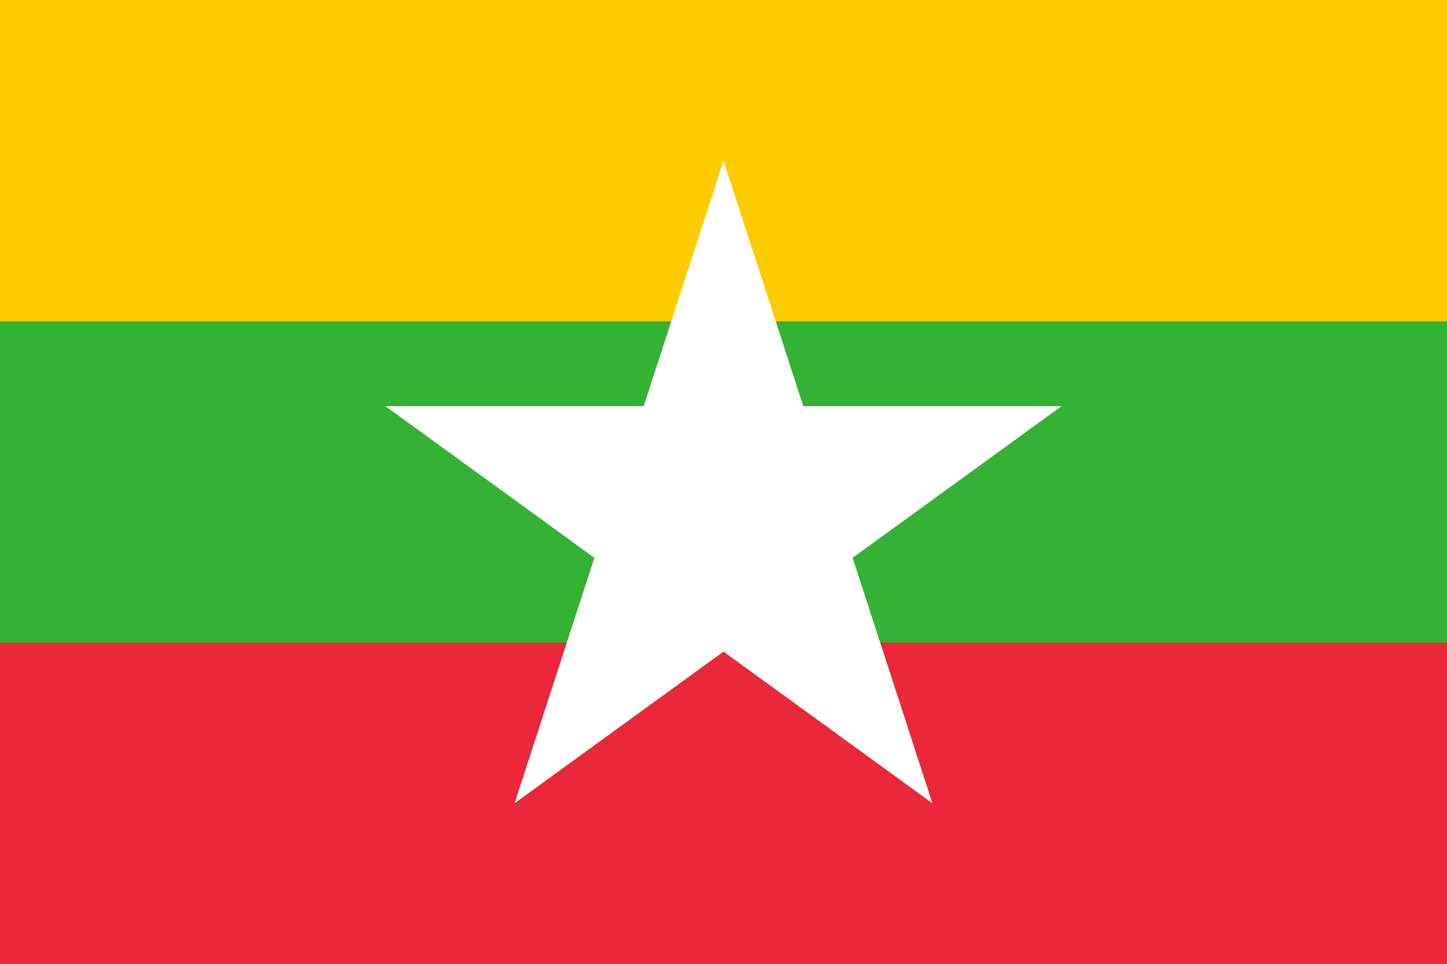
PRAYING FOR
MYANMAR

Slide 3
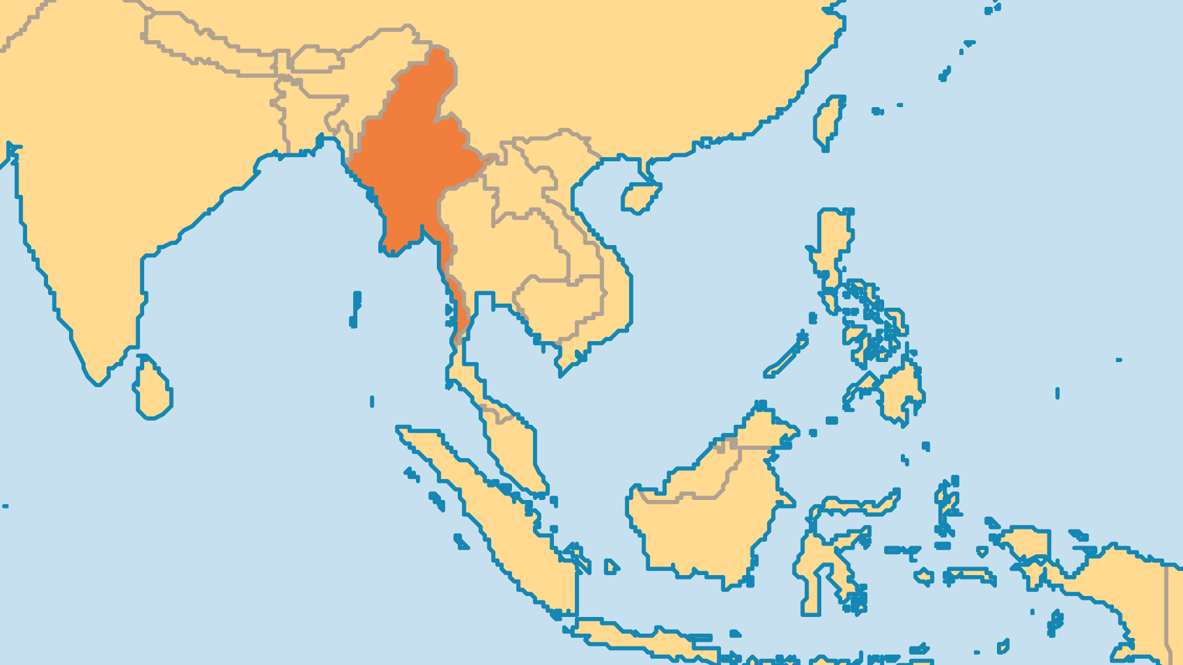
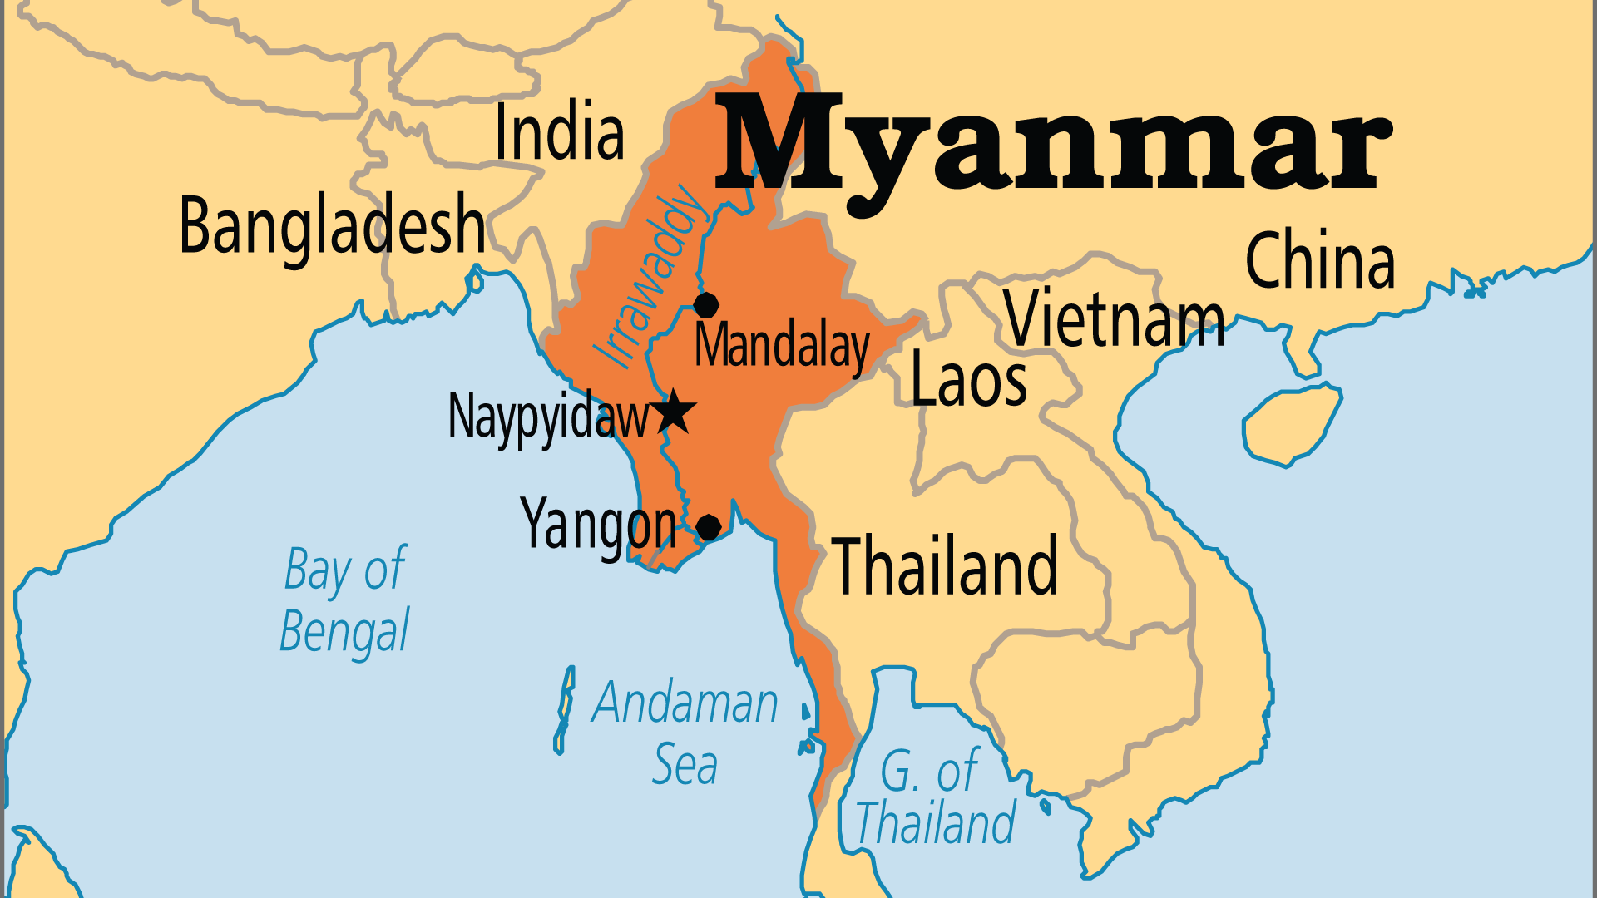
KEY STATS
Capital: | Naypyidaw
Population: | 54,850,648
Official Language: | Burmese
Languages: | 116
HDI Ranking: | 149/193
% Christian: | 9 %
% Evangelical: | 5 %
Largest Religion: | Buddhist
% Unevangelized: | 40 %
Persecution Ranking: | 13/50

Slide 4

FOR PRAYER
Myanmar's military junta (1962-2011, 2021-) is a ruthless power. A policy of cruel violence against certain minorities led to destroyed villages, rape, torture, displaced populations, and international condemnation. After an era of greater democratic governance, the military performed the third coup of Myanmar's short history, on 1 February 2021. Now, coalitions of anti-regime militias, many of them comprised of ethnic minorities, have made significant progress in the fight against the junta's armed forces. Pray for what seems impossible except through Christ: unity, peace, and courage.
Want to know more? Go to www.operationworld.org

Slide 5
FOR PRAYER
Buddhism has a strong hold on the Burmese majority, as well as over the Shan, the Rakhine, and the Mon peoples. Most children receive education in Buddhist monasteries. Burmese Buddhism mixes in occult beliefs, superstition, and fear of the spirits. The Church must learn to understand the Buddhist mindset, and must also minister in spiritual power, in order to see a breakthrough among the majority. Reportedly, thousands of Buddhist monks have quietly become believers and many study the gospel and listen to Christian radio. Pray for this quiet movement of Buddhists to Christ to keep spreading, growing, and deepening.

