Slide 1




Slide 2

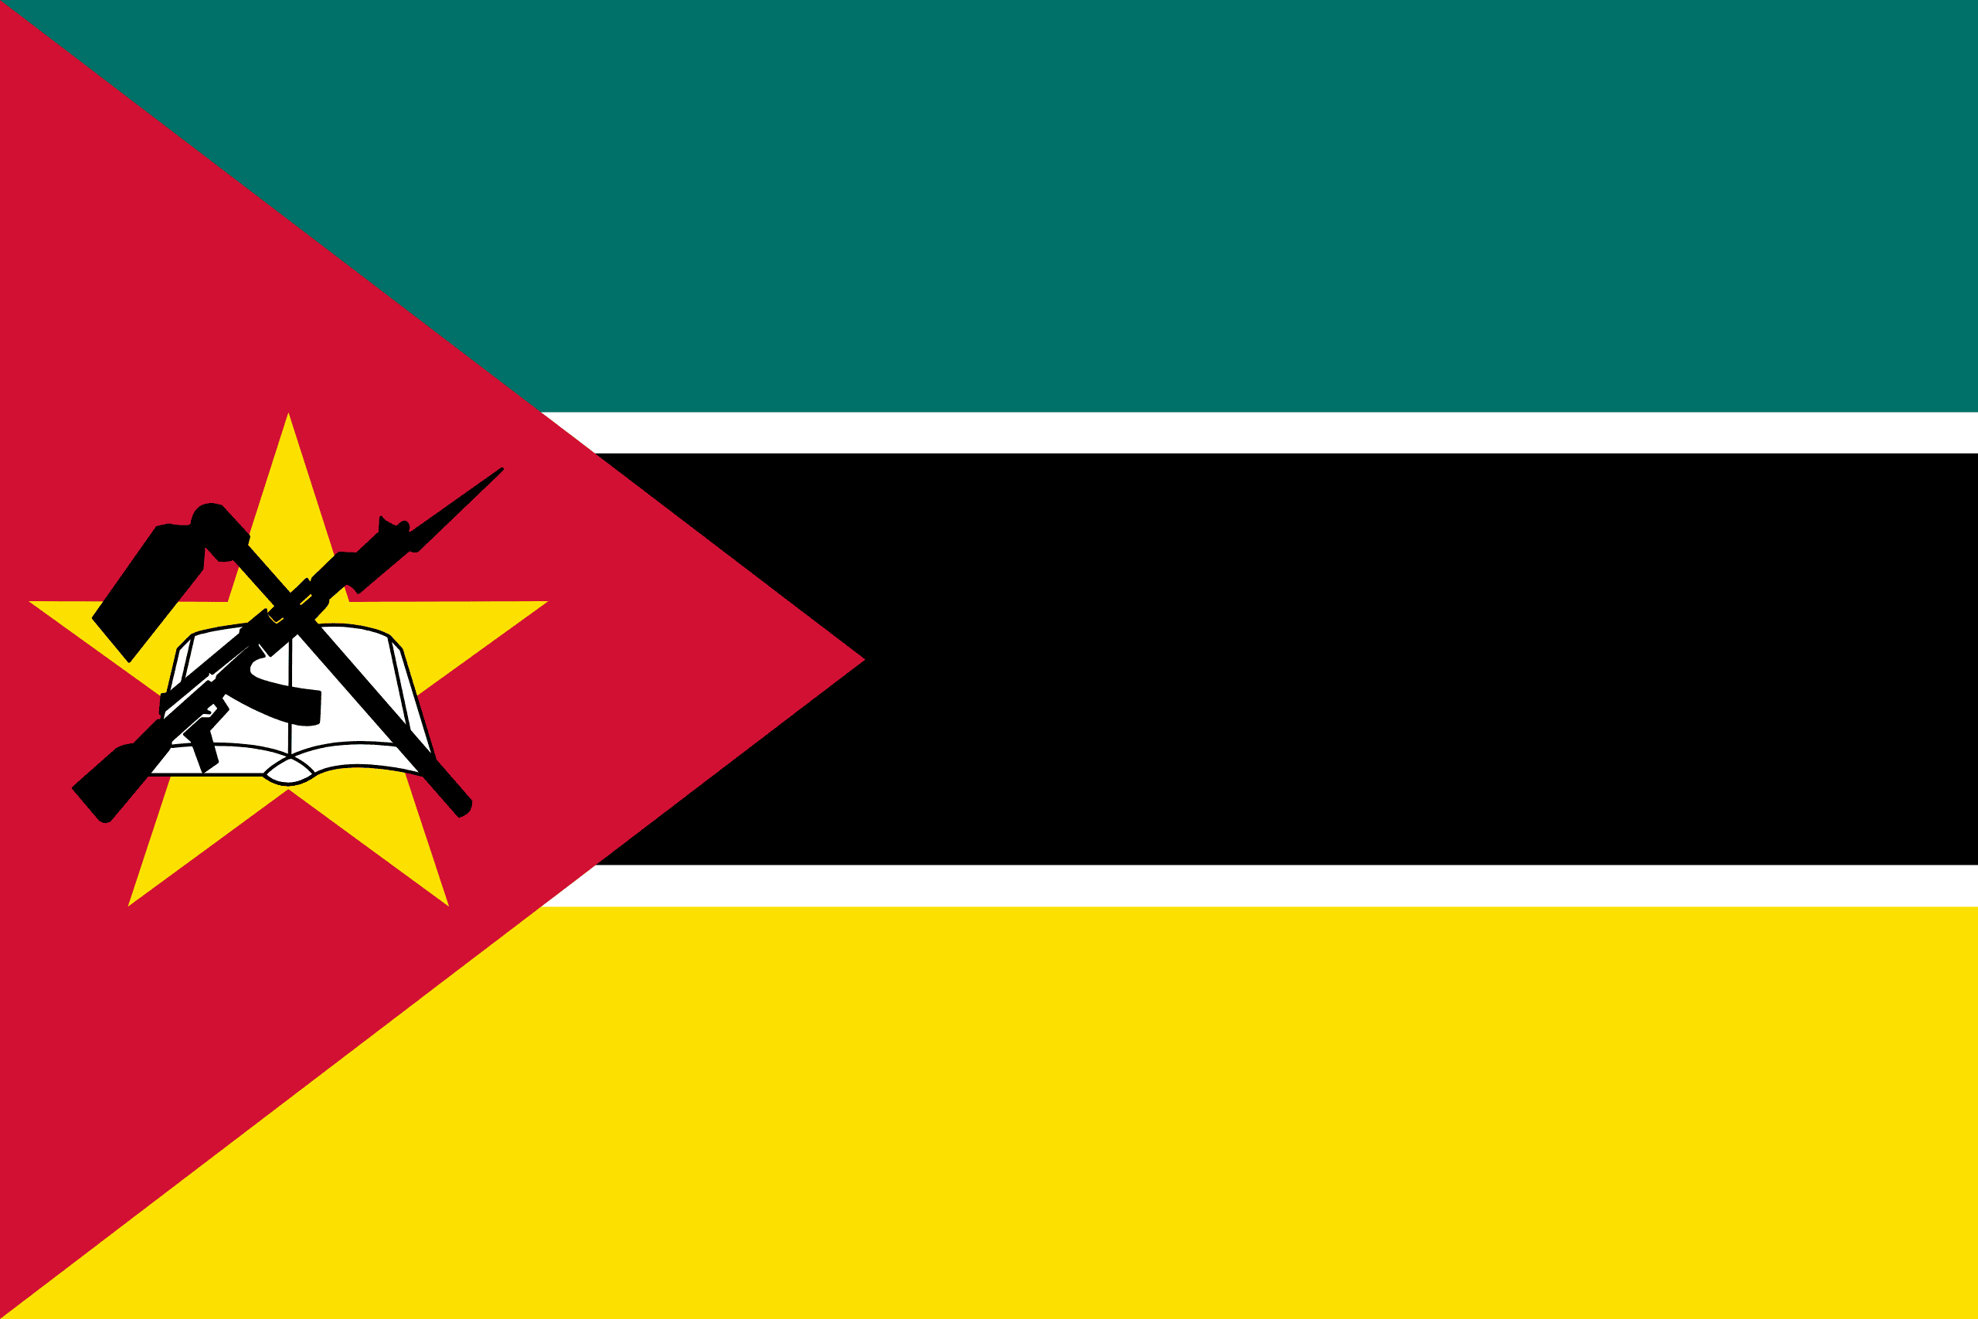
PRAYING FOR
MOZAMBIQUE

Slide 3
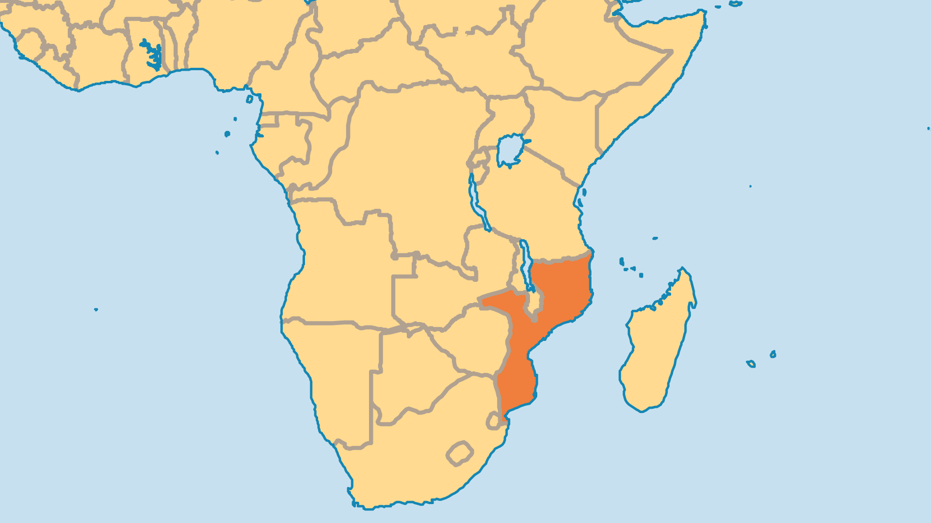
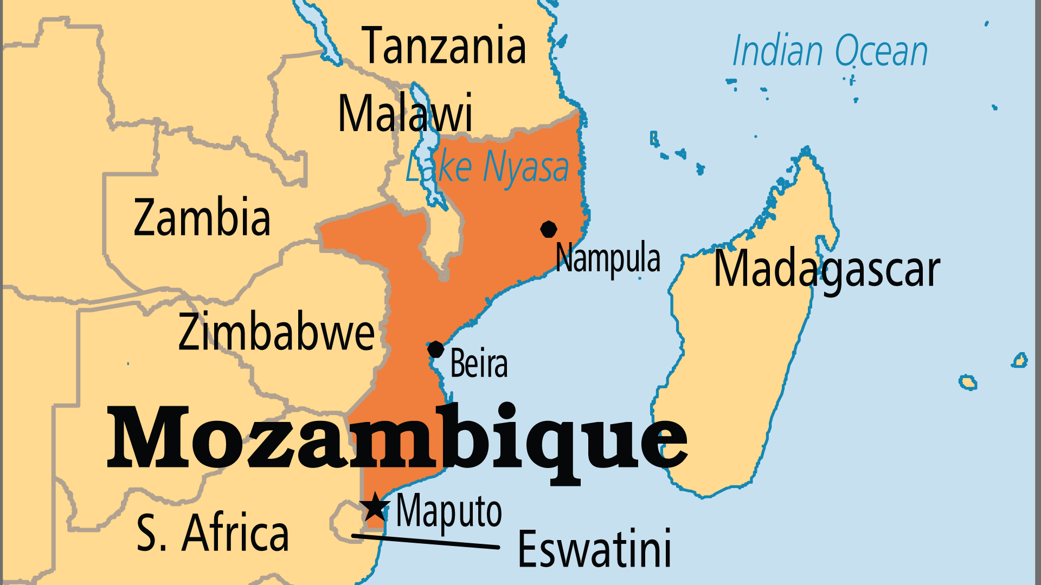
KEY STATS
Capital: | Maputo
Population: | 35,631,653
Official Language: | Portuguese
Languages: | 53
HDI Ranking: | 185/193
% Christian: | 46.5 %
% Evangelical: | 11.1 %
Largest Religion: | Christian
% Unevangelized: | 9 %
Persecution Ranking: | 37/50

Slide 4

FOR PRAYER
Thank God for a nation where the government works to advance democracy, and economic and religious freedom. Multiple elections have been held since the end of the vicious civil war in 1992. Years of suffering led to spiritual responsiveness. After harsh persecution under the Marxist-oriented regime, Christian faith spread rapidly. There are great opportunities for fruitful ministry in most of the country. Mozambique was highly unevangelized, but now many people from all faiths and regions have begun to follow Christ!
Want to know more? Go to www.operationworld.org

Slide 5
FOR PRAYER
Mozambique’s development needs remain widespread and deep. Pray for effective, practical programmes to assist those who live in the most severe poverty. HIV/AIDS is a major challenge; 12% of adults are HIV-positive. With over 5 million cases a year, malaria is even worse. Additionally, the trauma of violence and extreme poverty left many people emotionally or psychologically broken. The Islamist terror group IS-CAP (Islamic State Central Africa Province) sows murder and havoc upon a predominantly Muslim region in the north, targeting Christians. Meanwhile, increasingly intense cyclones and droughts exacerbate the nation's suffering. Pray for God's mercy upon this long-suffering land!

