Slide 1

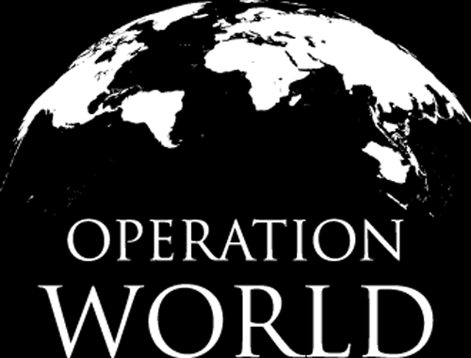


Slide 2

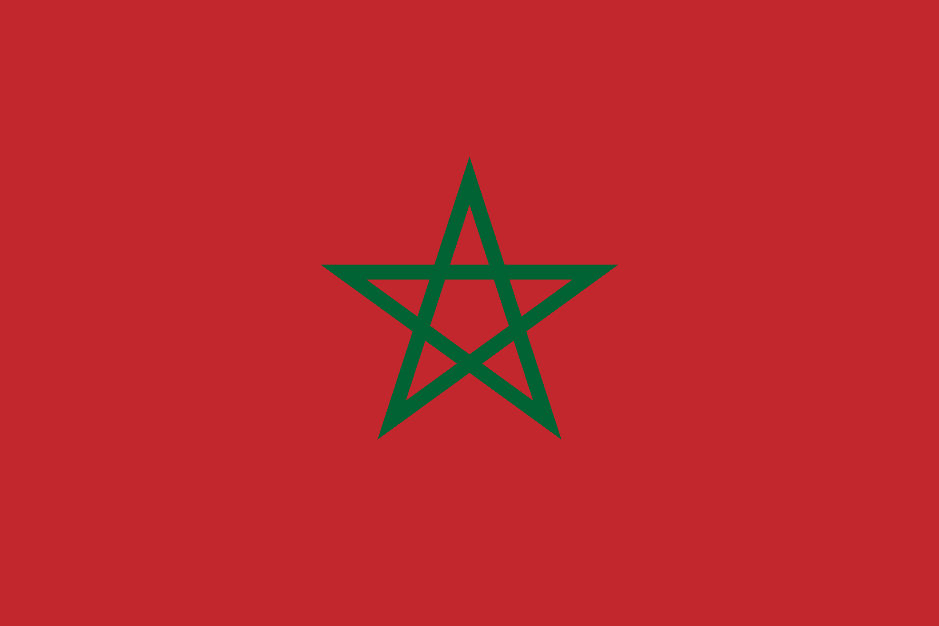
PRAYING FOR
MOROCCO

Slide 3
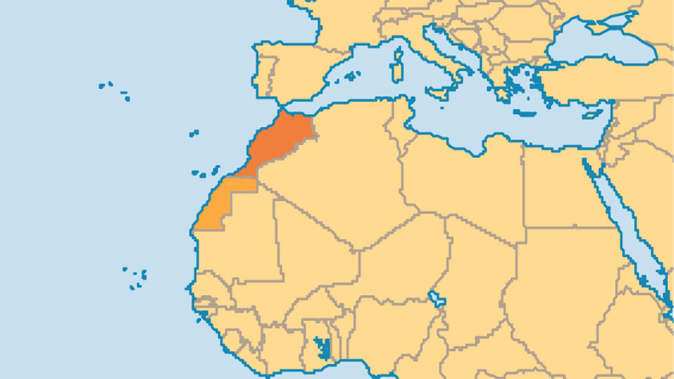
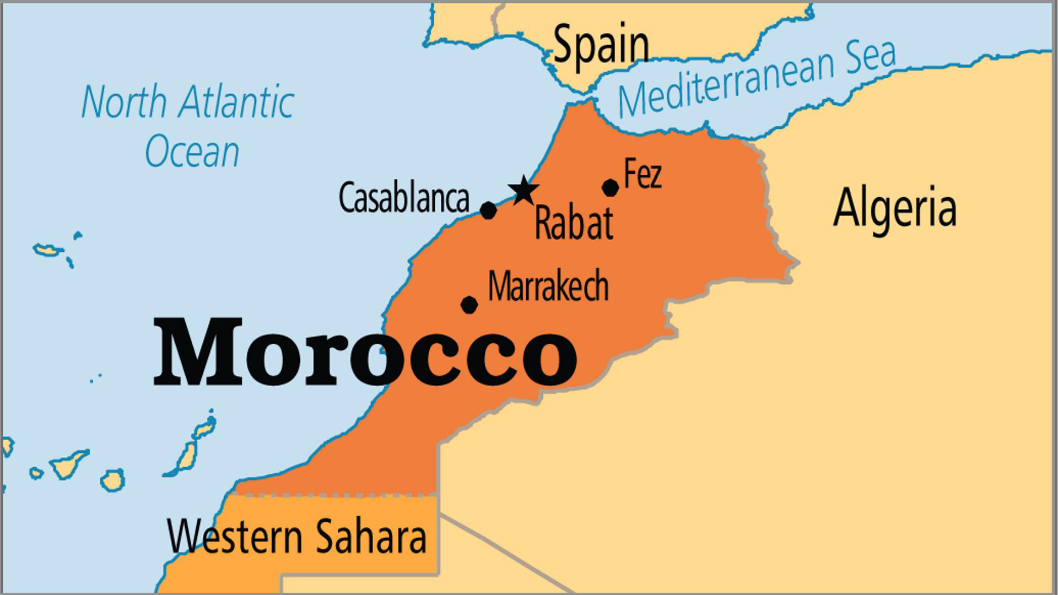
KEY STATS
Capital: | Rabat
Population: | 38,430,770
Official Language: | Arabic and Tamazight
Languages: | 10
% Christian: | 0.1 %
% Evangelical: | 0 %
Largest Religion: | Muslim
% Largest Religion: | 99.9 %
% Unevangelized: | 61 %
Persecution Ranking: | 21/50

Slide 4

FOR PRAYER
The earthquake in the Marrakesh region in September 2023 was shocking and destructive. Around 3,000 people died, countless buildings collapsed, and nearly 3 million people were affected. Many believers in Morocco and beyond did what they could to help, which assisted in overcoming a common prejudice against Christians. Pray that this might be a wake-up call to many Moroccans that life is fleeting, and that those who follow Jesus are people that they can trust and turn to in times of need.

Slide 5
FOR PRAYER
Moroccans became aware of the indigenous Church when the media broadcasted negative and inaccurate reports about a large number of converts to Christianity. There may be about 2,000 Moroccan Christians, with 20 to 30 small house fellowships. New believers feel pressure from family, police, or religious authorities. Pray that believers might grow amid such persecution, as with the early Church, through faith, witness, mutual support, and encouragement!
Want to know more? Go to www.operationworld.org

