Slide 1




Slide 2


PRAYING FOR
MONTSERRAT

Slide 3
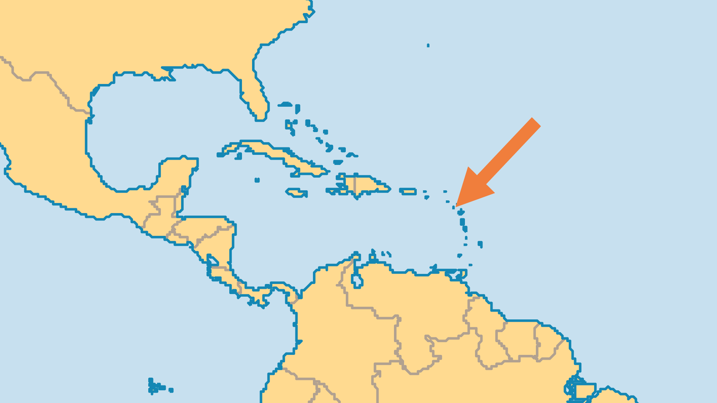
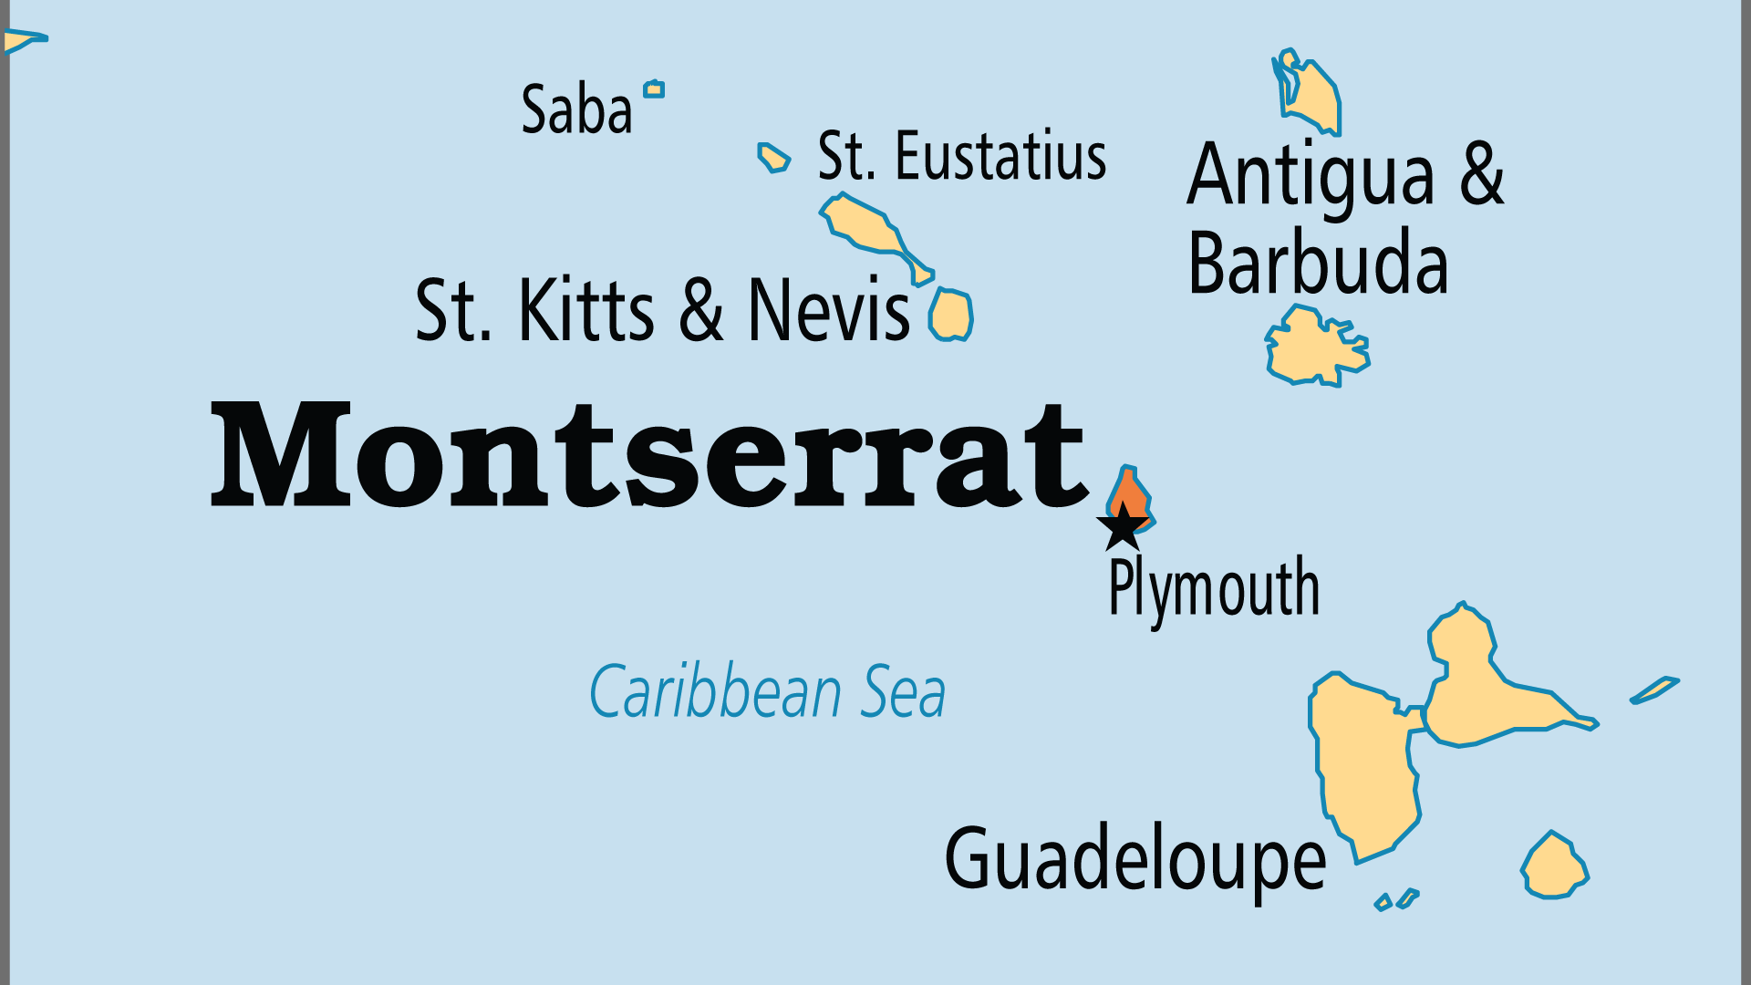
KEY STATS
Capital: | Brades
Population: | 4,360
% Urban: | 9.4 %
Official Language: | English
Literacy Rate: | 94 %
Life Expectancy: | 75.6 yrs (81st/236)
% Christian: | 95.3 %
% Evangelical: | 23.4 %
% Unevangelized: | 1 %

Slide 4

FOR PRAYER
The massive devastation caused by the volcanic eruptions in the late 1990s nearly destroyed Montserrat as a habitable island. It will never completely recover. Pray for a new start, with Christ placed at the centre of island life rather than nominal Christianity, which largely prevailed in the past.
Want to know more? Go to www.operationworld.org

