Slide 1




Slide 2

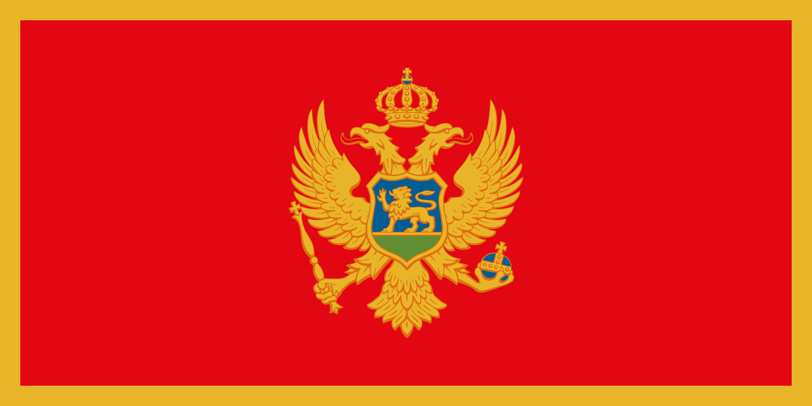
PRAYING FOR
MONTENEGRO

Slide 3
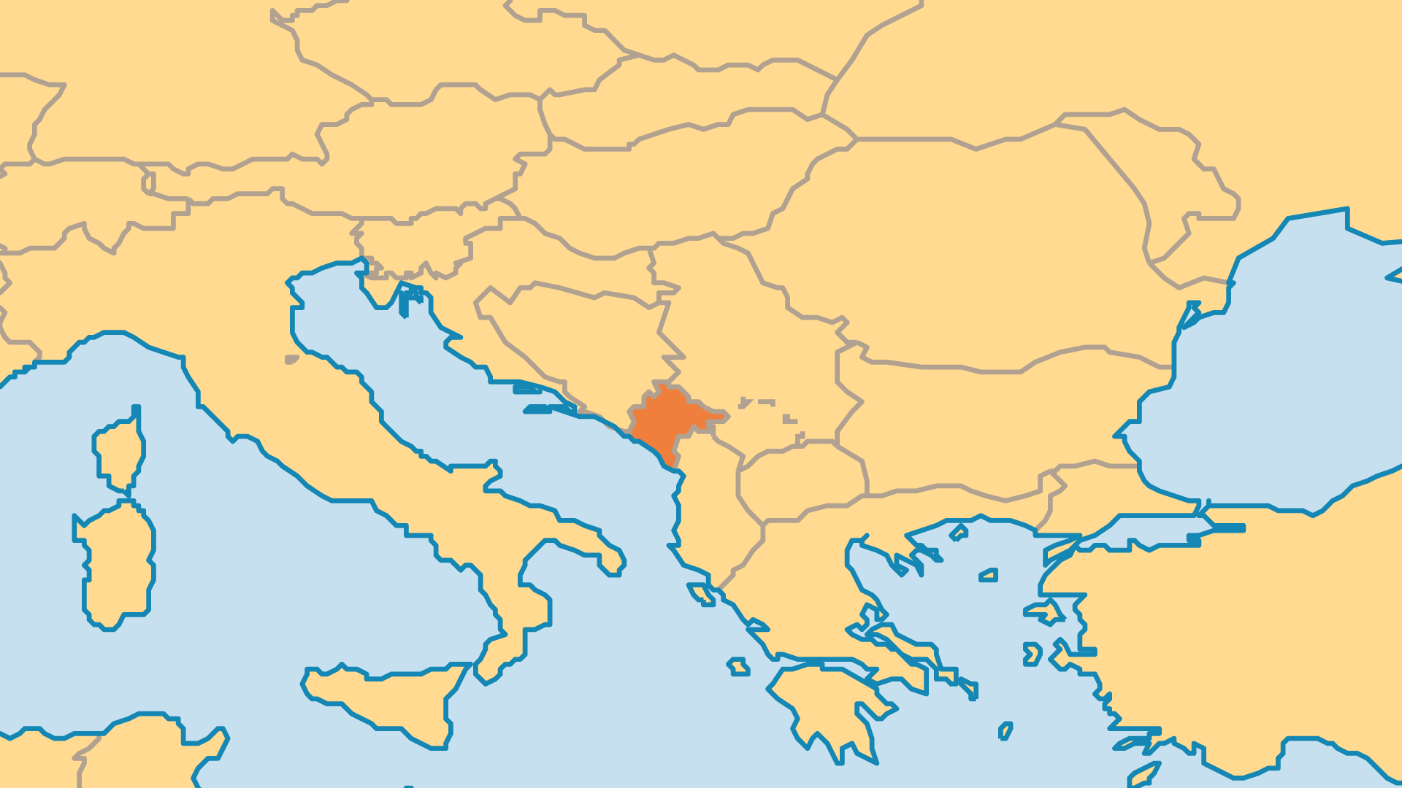
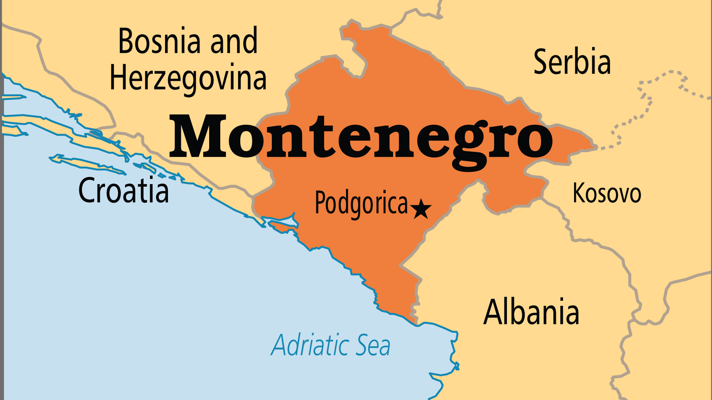
KEY STATS
Capital: | Podgorica
Population: | 632,729
Official Language: | Montenegrin
Languages: | 6
HDI Ranking: | 49/193
% Christian: | 77.1 %
% Evangelical: | 0.1 %
People Groups: | 16
Least Reached People Groups: | 3
% Unevangelized: | 8 %

Slide 4

FOR PRAYER
Independence brought optimism and hope. Montenegro is a small country, but it has great potential. However, it must avoid the hatred among ethnic/religious communities that cripples most nations of the Balkan region. Pray for Montenegro to be a just, peaceful, and corruption-free nation which enjoys ethnic harmony! Pray that people will seek the truth of Christ in the midst of their newfound nationhood.
Want to know more? Go to www.operationworld.org

