Slide 1




Slide 2

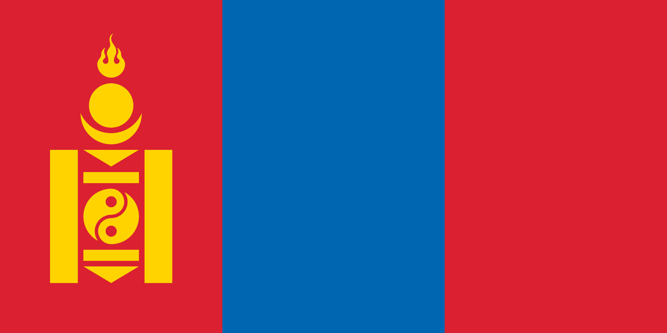
PRAYING FOR
MONGOLIA

Slide 3
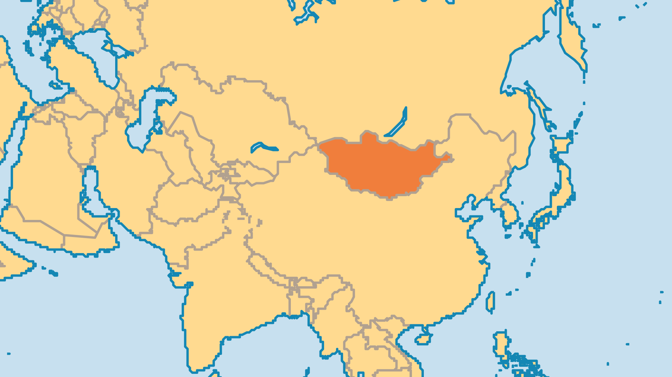
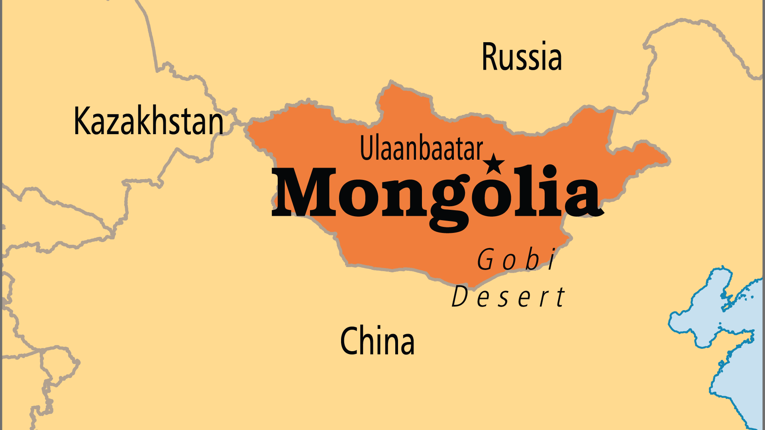
KEY STATS
Capital: | Ulaanbataar (Ulan Bator)
Population: | 3,517,100
Official Language: | Mongolian
Languages: | 15
Literacy Rate: | 97 %
% Christian: | 1.7 %
% Evangelical: | 1.2 %
Largest Religion: | Buddhist
% Largest Religion: | 35.3 %
% Unevangelized: | 51 %

Slide 4

FOR PRAYER
The growth of Christianity in modern Mongolia is truly an answer to prayer! Perhaps only 4 Mongolian believers existed in 1989, but by 2010 over 40,000 believers worshipped in hundreds of churches and groups around the country! Today, that number is larger still, and the Mongolian Church is growing not just in numbers but in maturity and contextualized expression. The Church is less than one generation old, but it already sends missionaries to unreached areas, runs national ministries, and develops its own Mongolian-style worship music.
Want to know more? Go to www.operationworld.org

