Slide 1




Slide 2

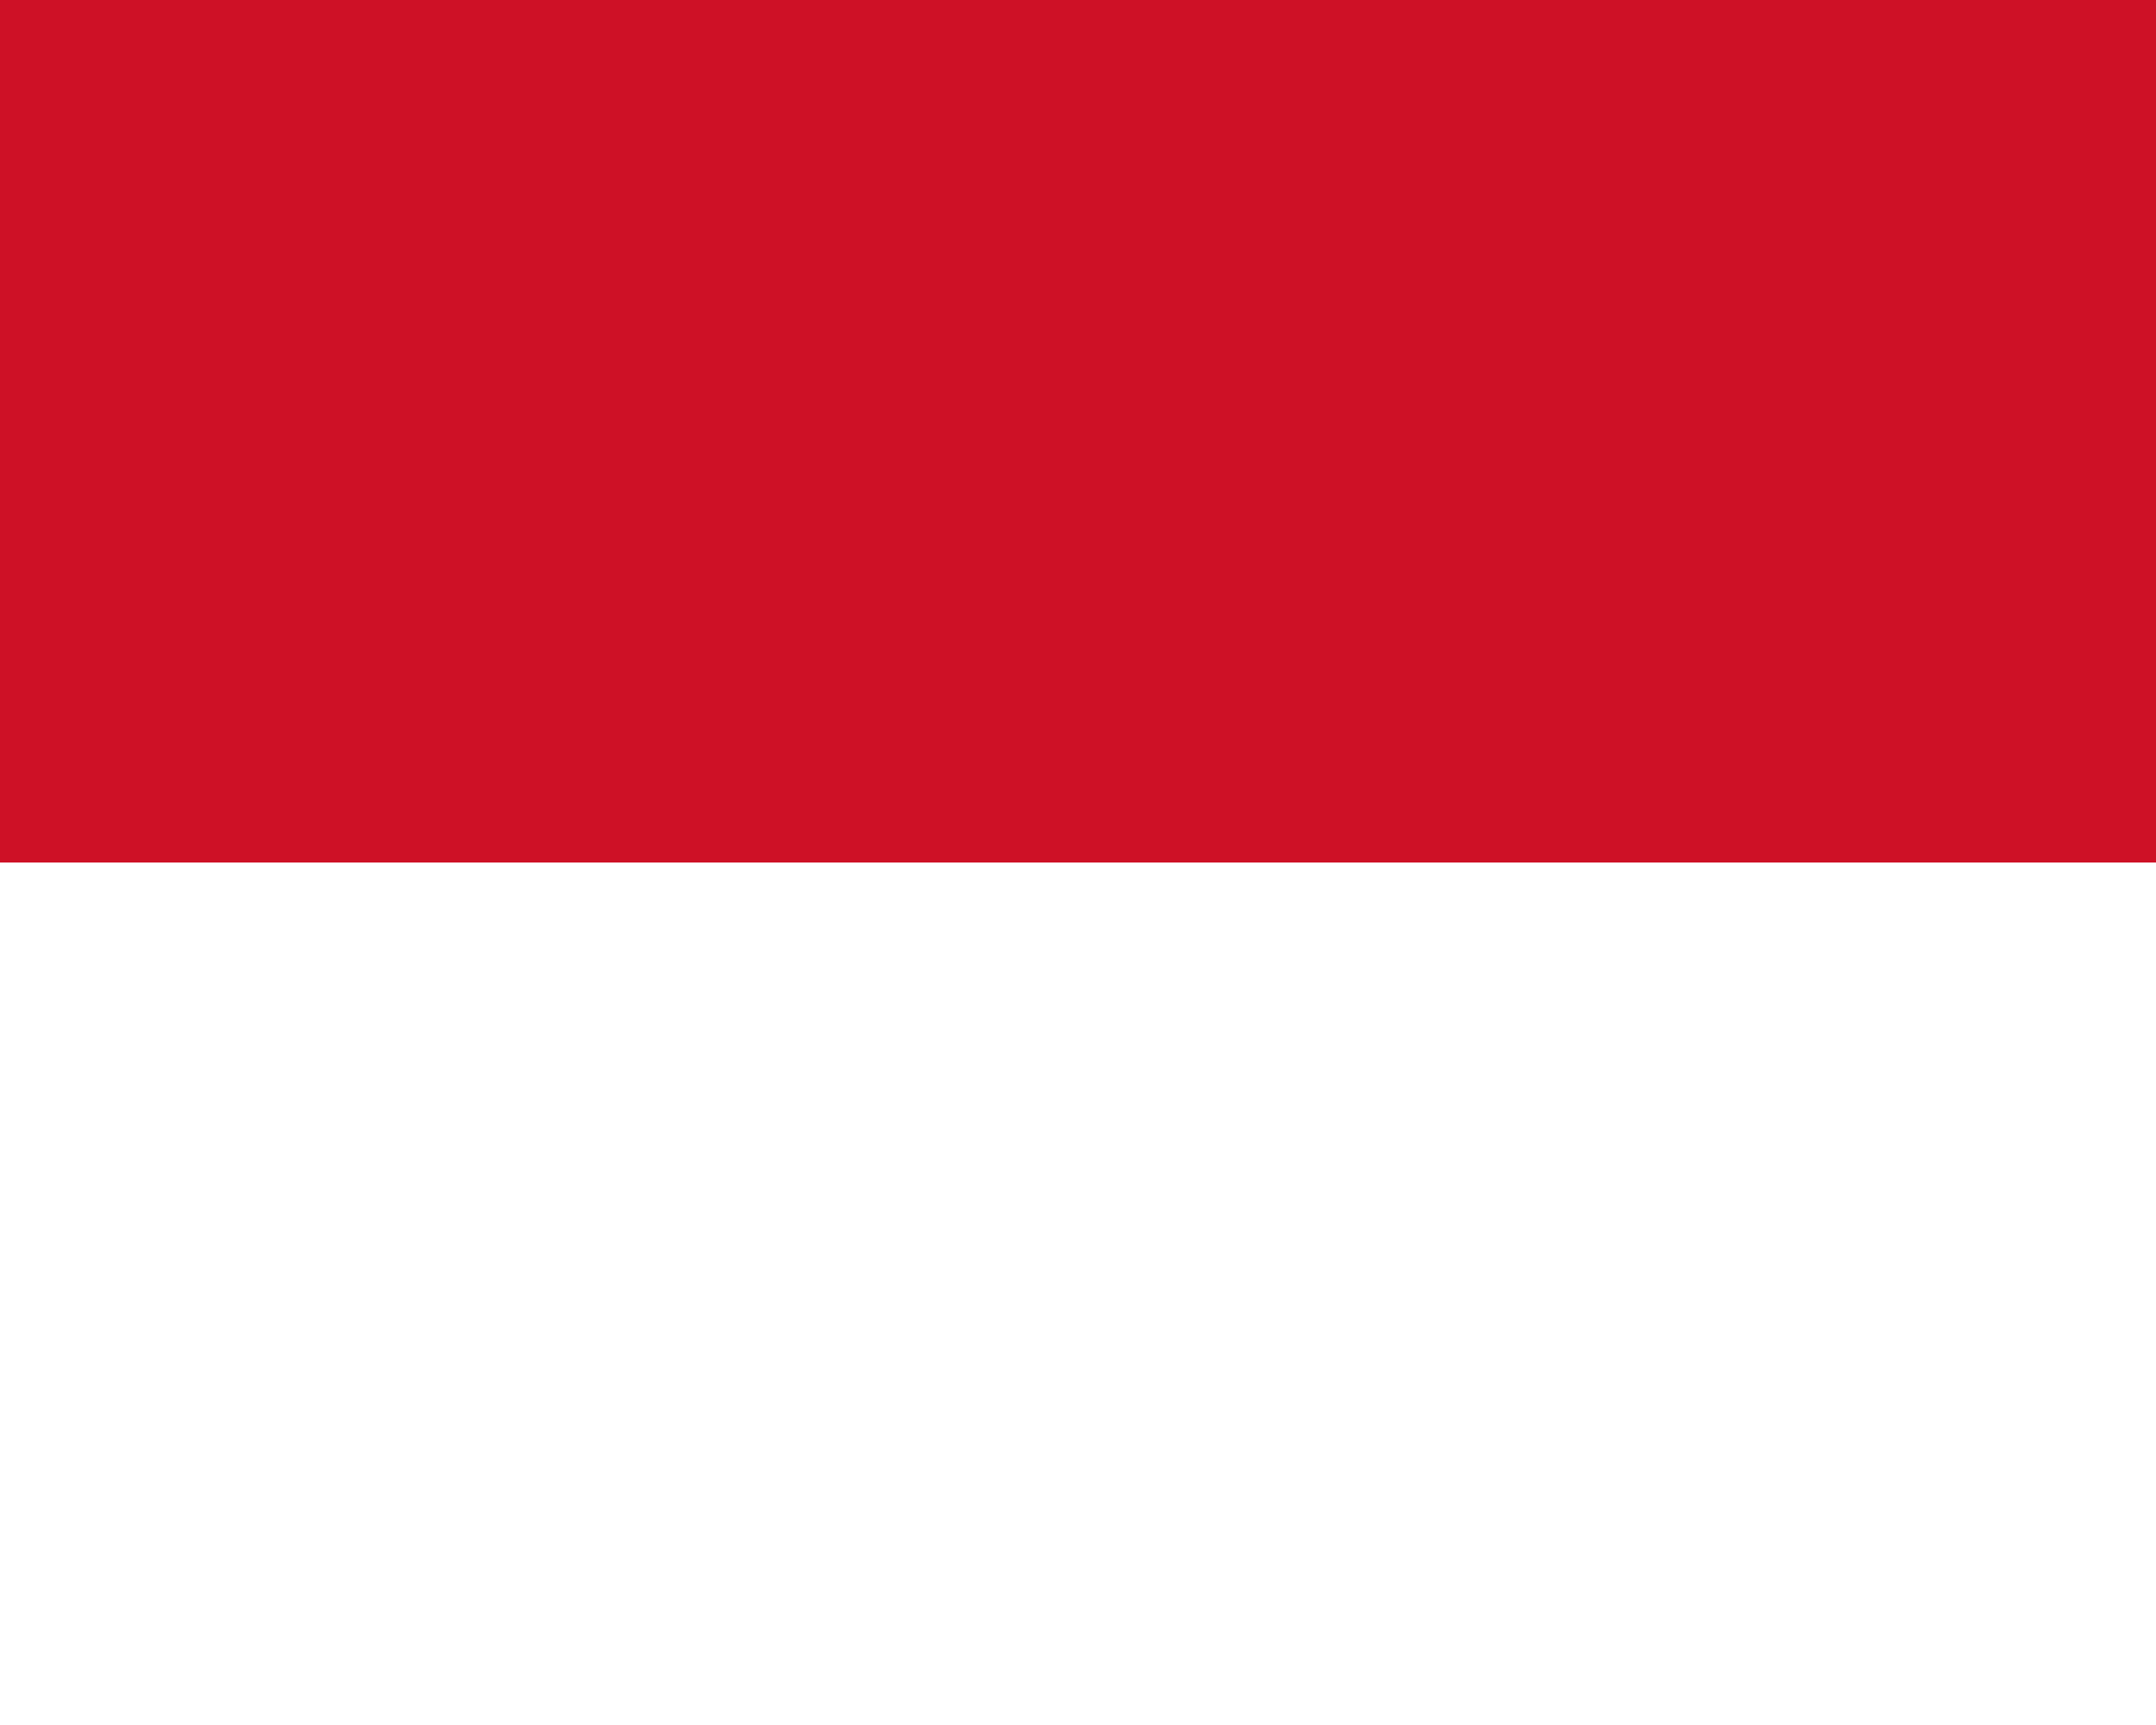
PRAYING FOR
MONACO

Slide 3
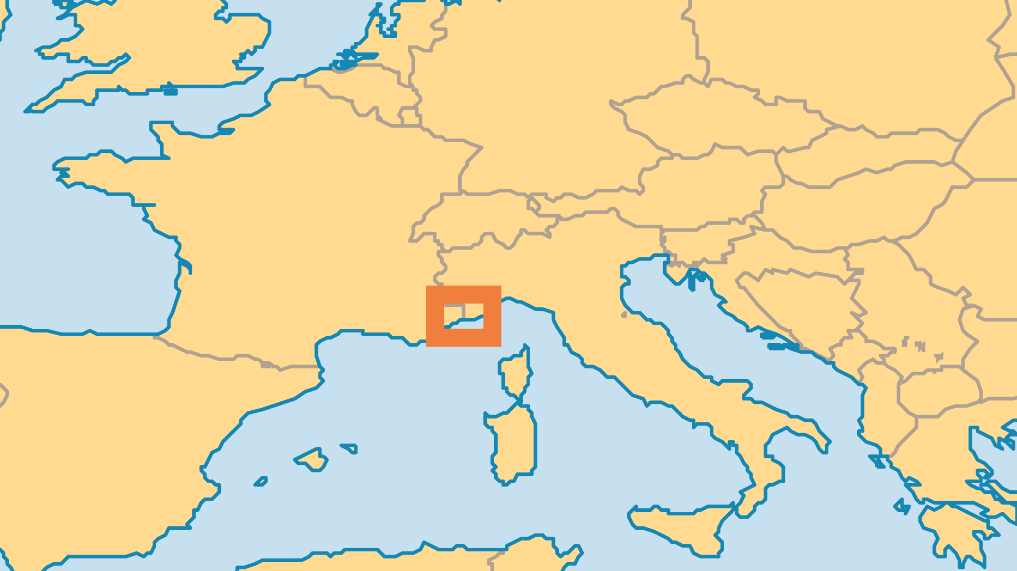
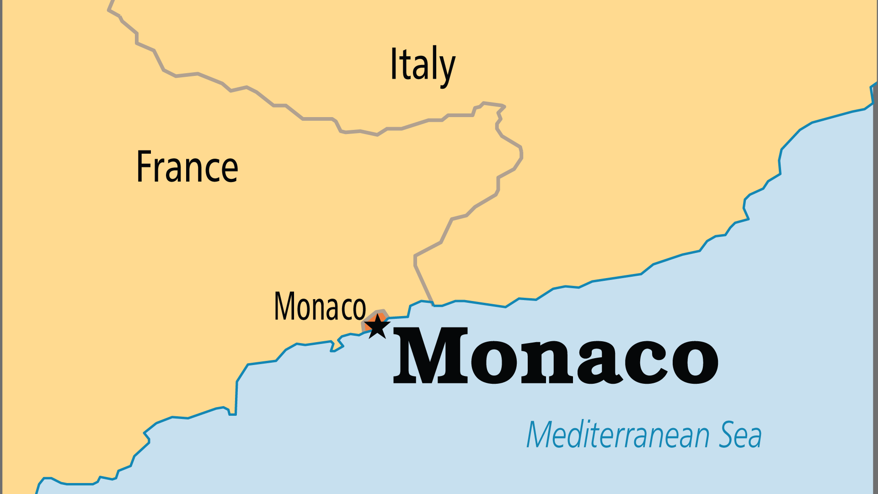
KEY STATS
Capital: | Monaco
Population: | 38,341
% Urban: | 100 %
Official Language: | French
Languages: | 3
Literacy Rate: | 99 %
Life Expectancy: | 85.9 yrs (1st/236)
% Christian: | 84.8 %
% Evangelical: | 1.2 %
% Unevangelized: | 2 %

Slide 4

FOR PRAYER
Monaco attracts the rich and famous, who come for its self-indulgent, luxurious lifestyle. Over 75% of the population are expatriates, with great wealth. The country has a Catholic tradition, but it is very difficult for people to find interest in spiritual things. Few evangelicals live here, so their influence is small. But praise God that for the first time a small group of Monégasque evangelical believers exists! Pray that committed believers from the Catholic, Anglican, French Reformed Churches, and the bilingual Monaco Christian Fellowship might impact the whole of society.
Want to know more? Go to www.operationworld.org

