Slide 1




Slide 2

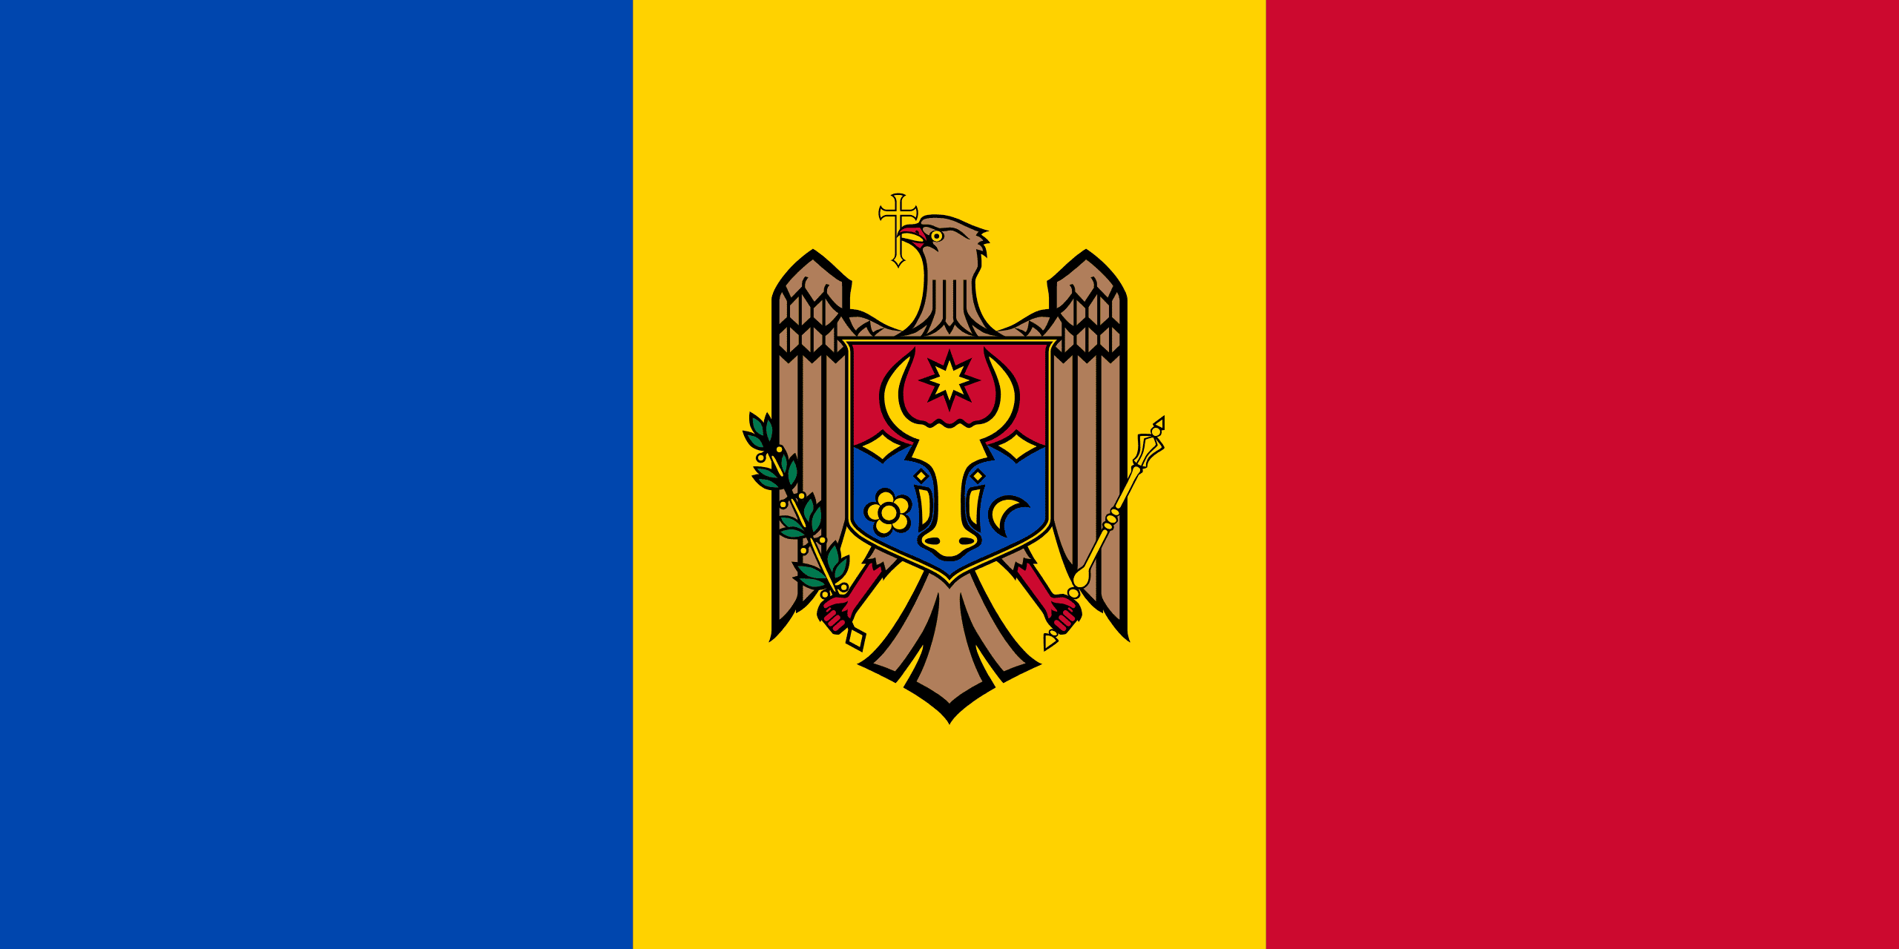
PRAYING FOR
MOLDOVA

Slide 3
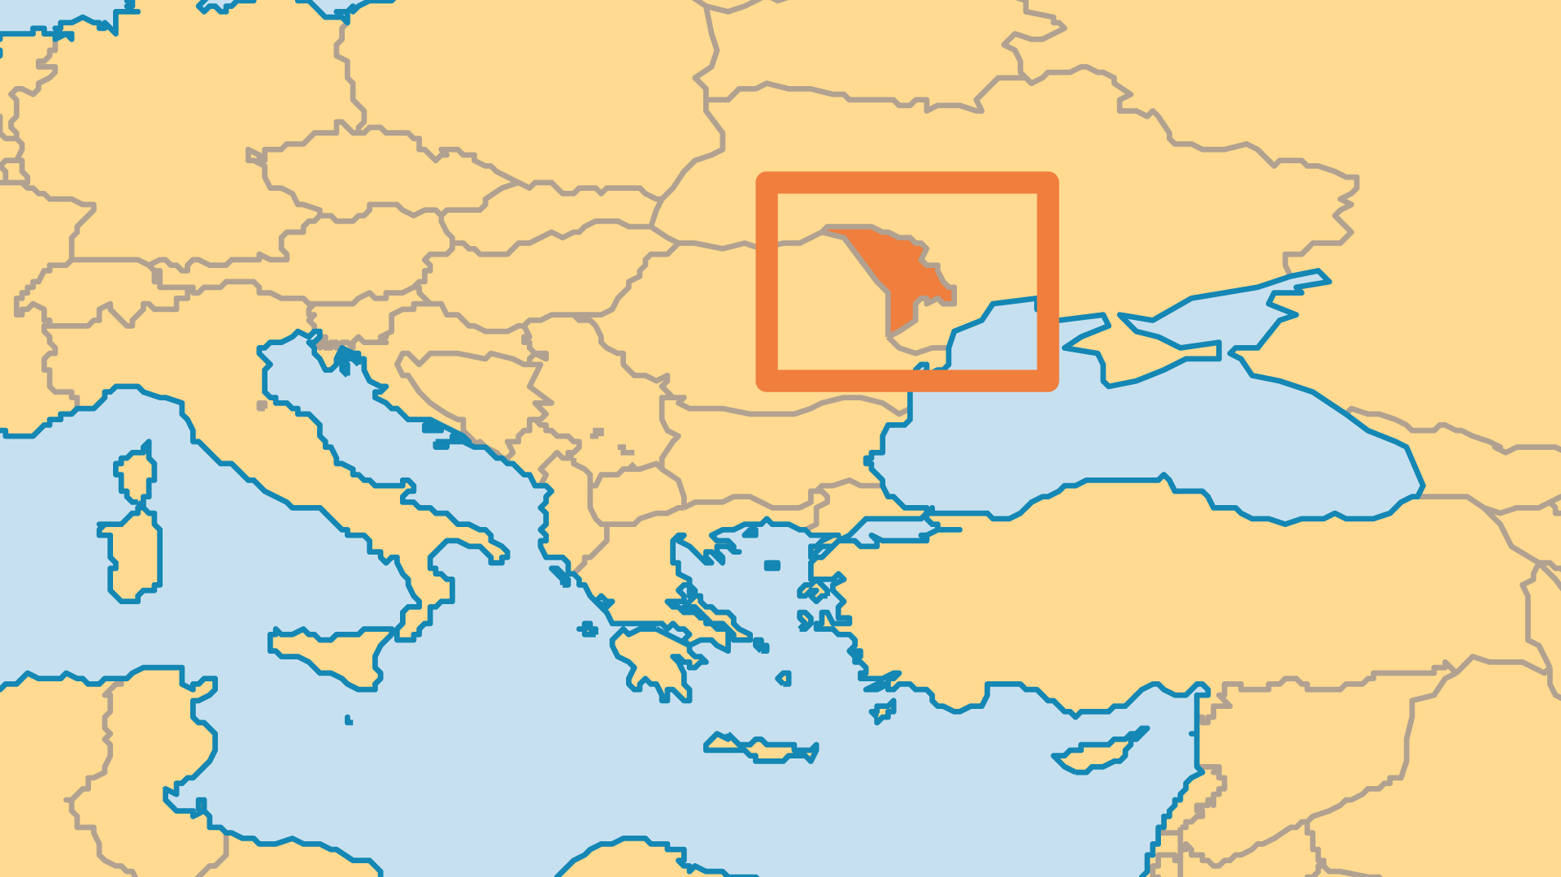
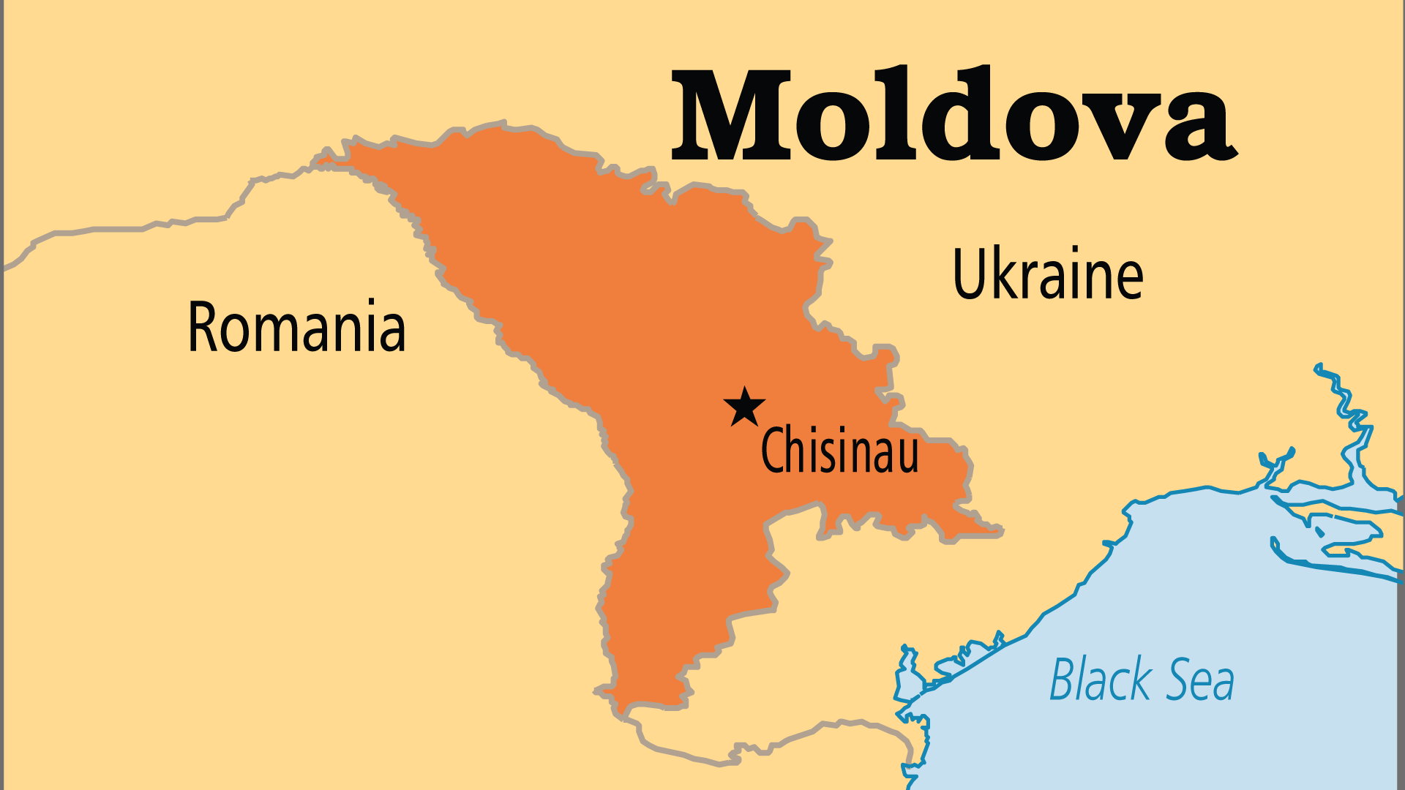
KEY STATS
Capital: | Chisinau
Population: | 2,996,106
Pop Under 15 Yrs: | 15.9 %
Official Language: | Moldovan Romanian
Languages: | 13
% Christian: | 73.4 %
% Evangelical: | 3.7 %
People Groups: | 23
Least Reached People Groups: | 6
% Unevangelized: | 1 %

Slide 4

FOR PRAYER
Moldova cannot move forward until it solves several major issues. Transnistria functions almost as a separate state (with support from Russia), and makes the country unstable. It has become a centre for organized crime and smuggling. The depressed economy forces 1 out of every 4 people to seek work outside the country. Moldova has the largest proportion of women lured abroad into human trafficking rings. Many people struggle with alcohol and drug abuse. Pray for a government that wisely and effectively addresses these devastating challenges.
Want to know more? Go to www.operationworld.org

