Slide 1




Slide 2


PRAYING FOR
MARSHALL ISLANDS

Slide 3
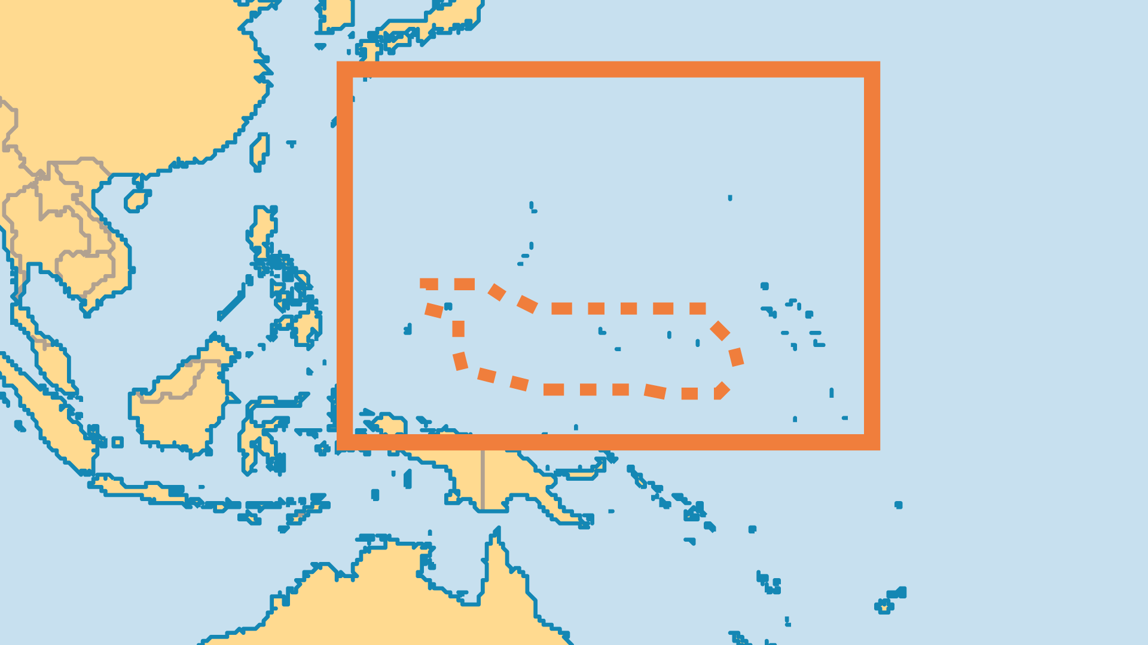
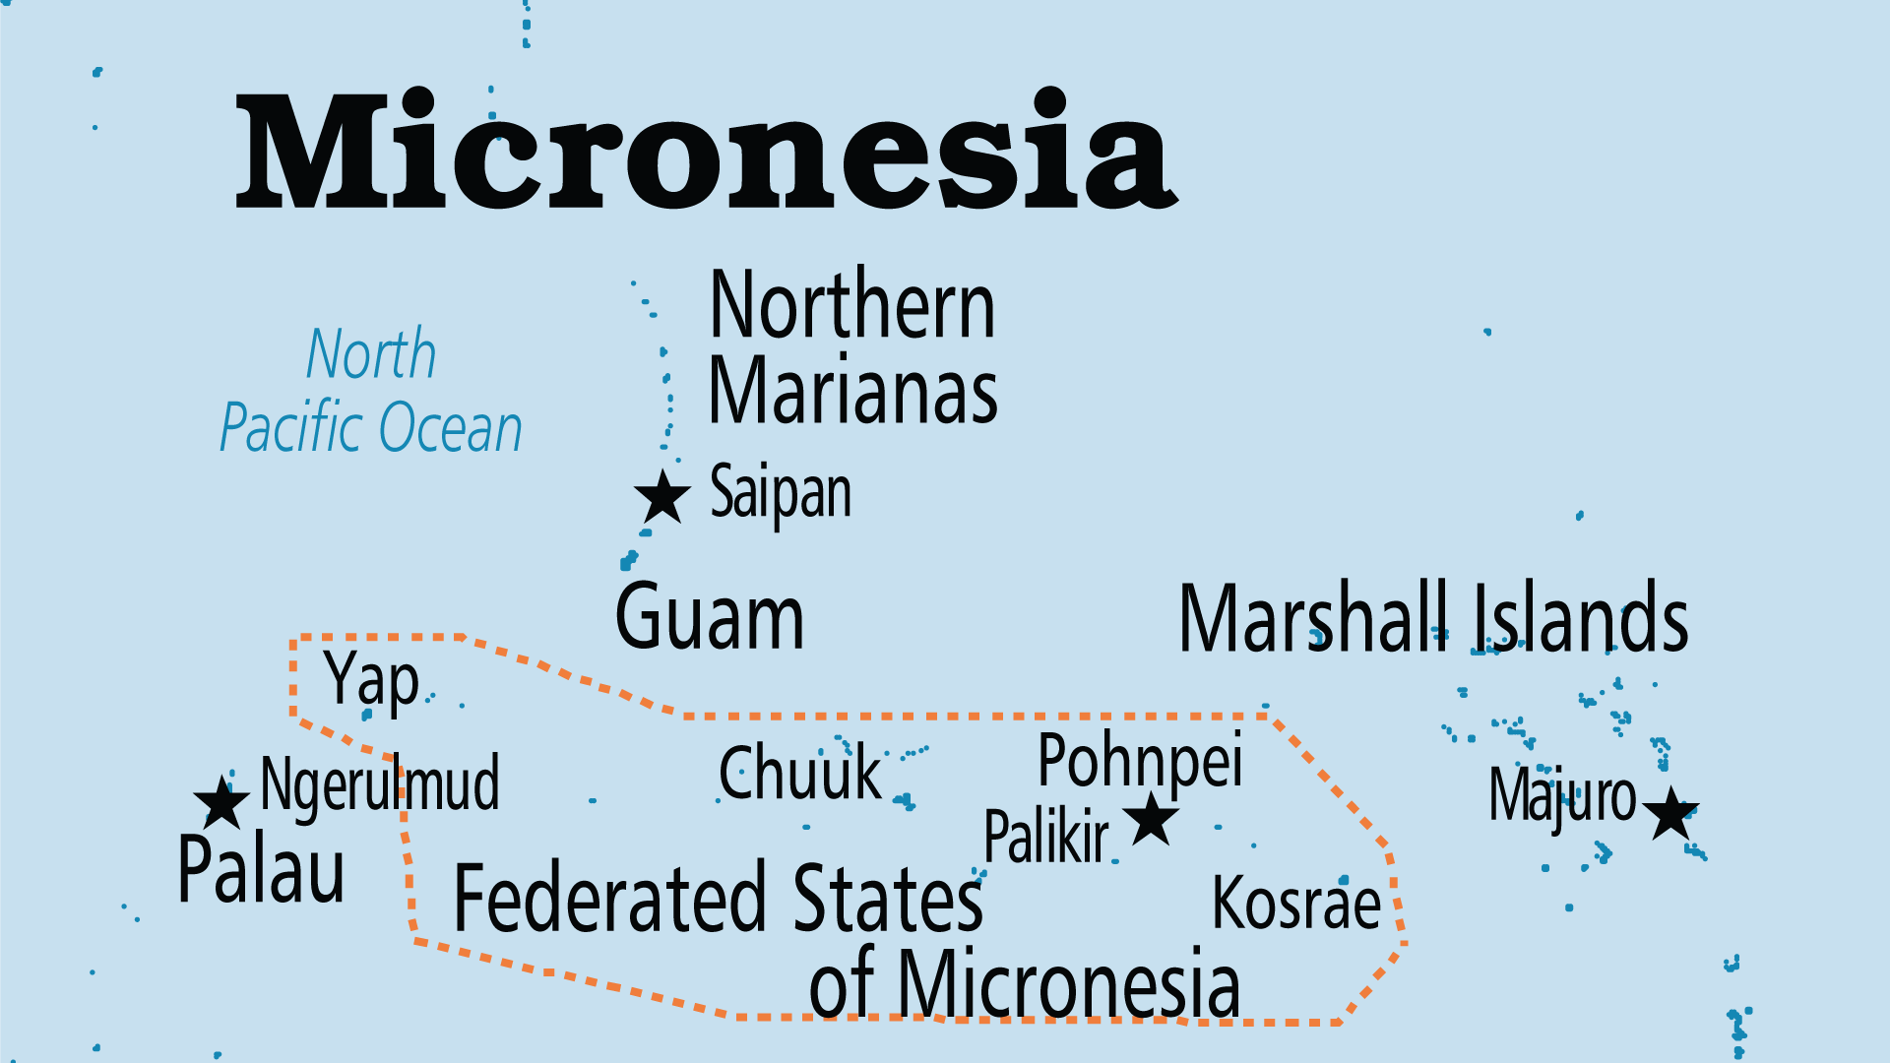
KEY STATS
Capital: | Majuro
Population: | 36,282
Official Language: | Marshallese; English
HDI Ranking: | 131/193
% Christian: | 97.1 %
% Evangelical: | 44.5 %
People Groups: | 6
Least Reached People Groups: | 1
% Unevangelized: | 1 %

Slide 4

FOR PRAYER
The traumatic history of occupation, exploitation and war, as well as the impact of US nuclear bomb testing, have all had a devastating effect on the Marshallese. Traditional values of land, family, and community are being undermined. Many inhabitants suffer the effects of nuclear radiation, including genetic disorders and high rates of cancer. Pray for leaders who will govern wisely and bravely, for economic dependency to be broken, and for the positive aspects of Marshallese traditional culture to be restored and upheld.
Want to know more? Go to www.operationworld.org

