Slide 1




Slide 2

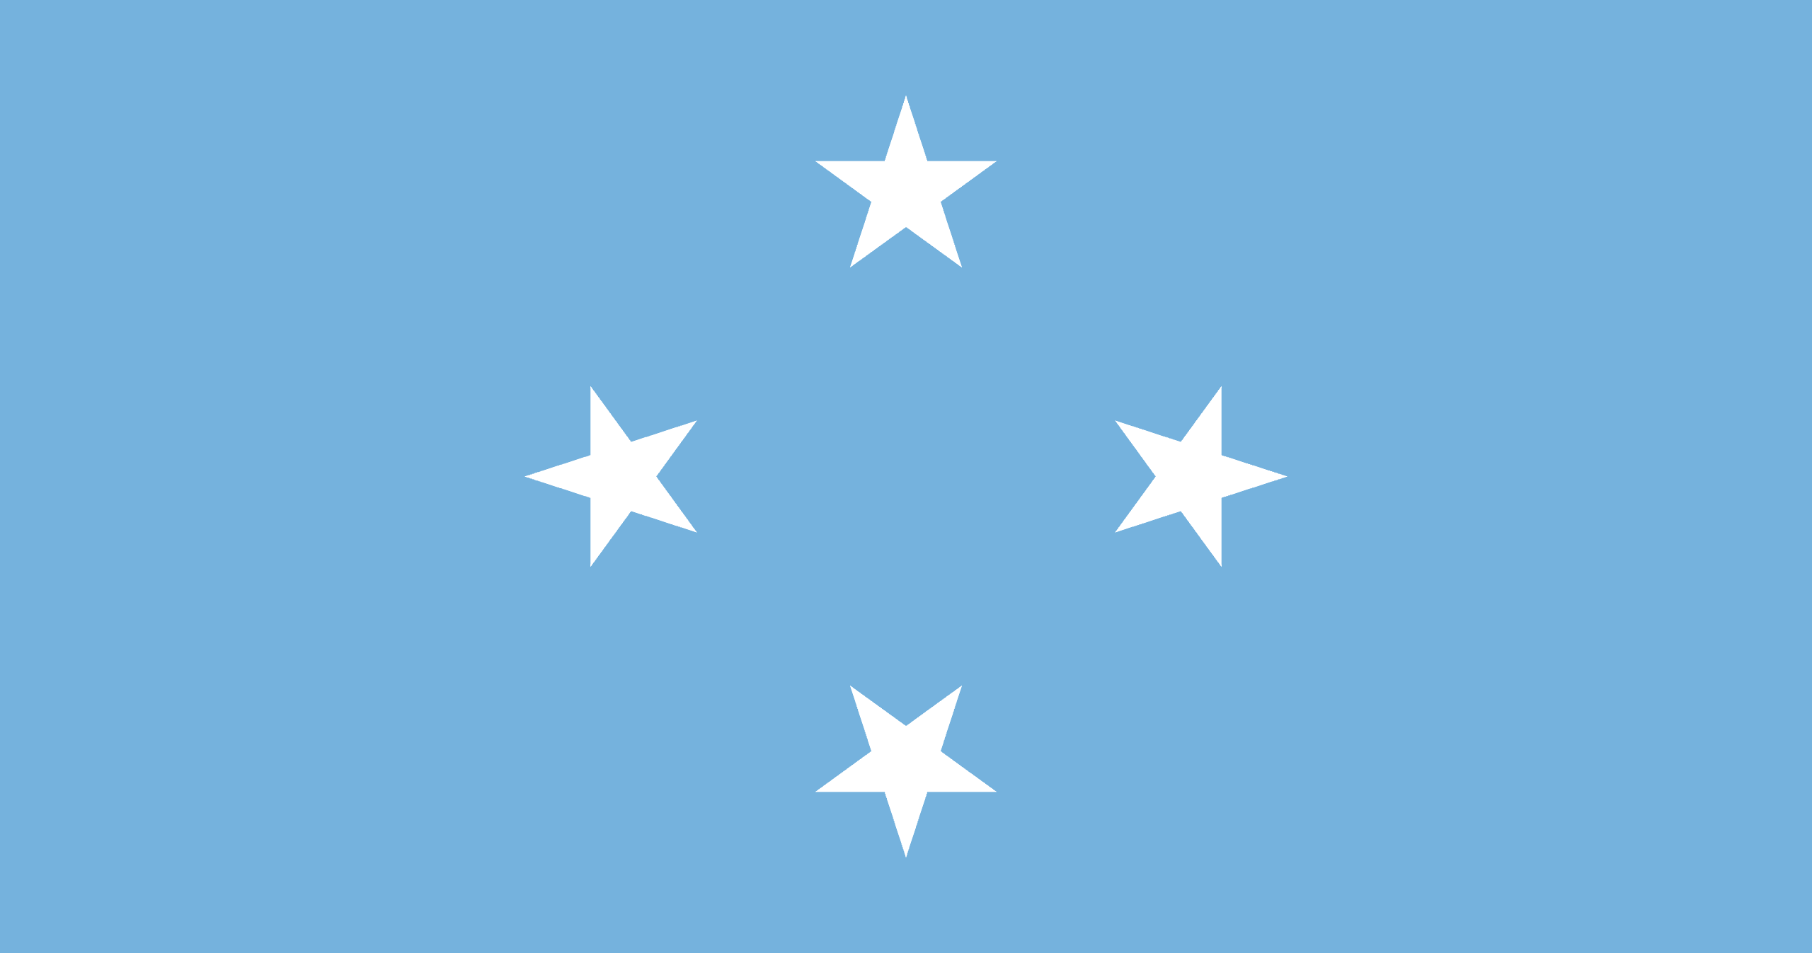
PRAYING FOR
FEDERATED STATES OF MICRONESIA

Slide 3
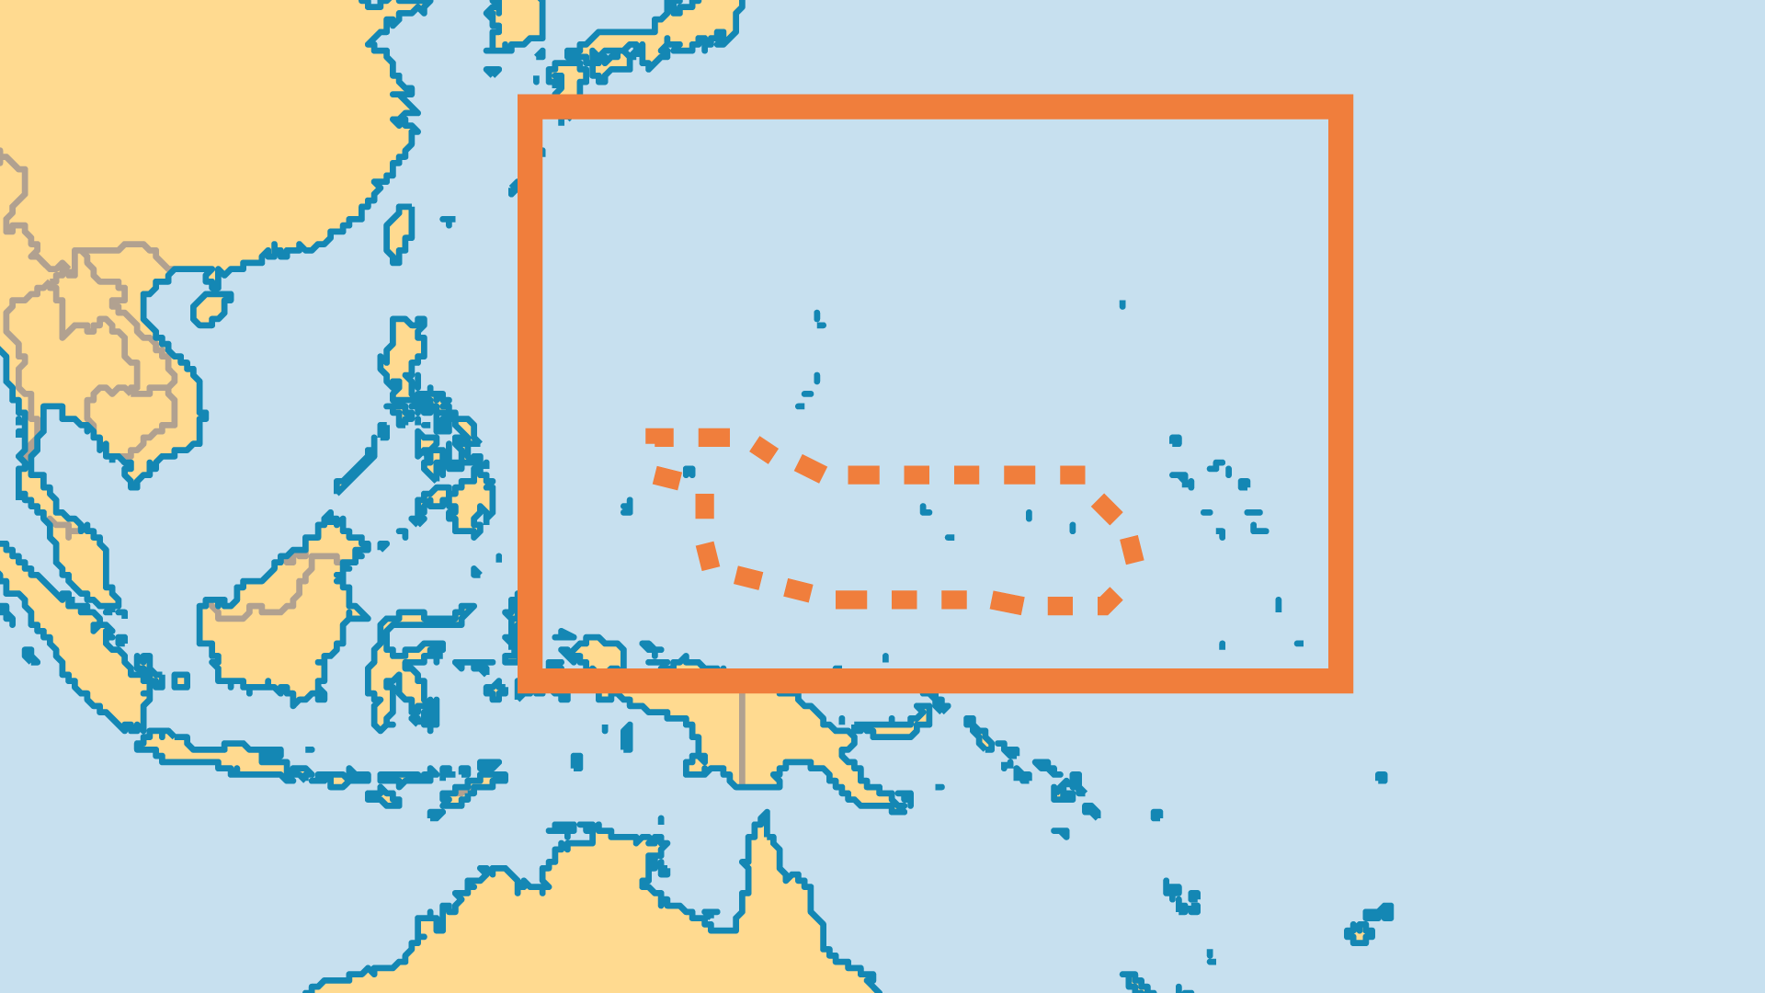
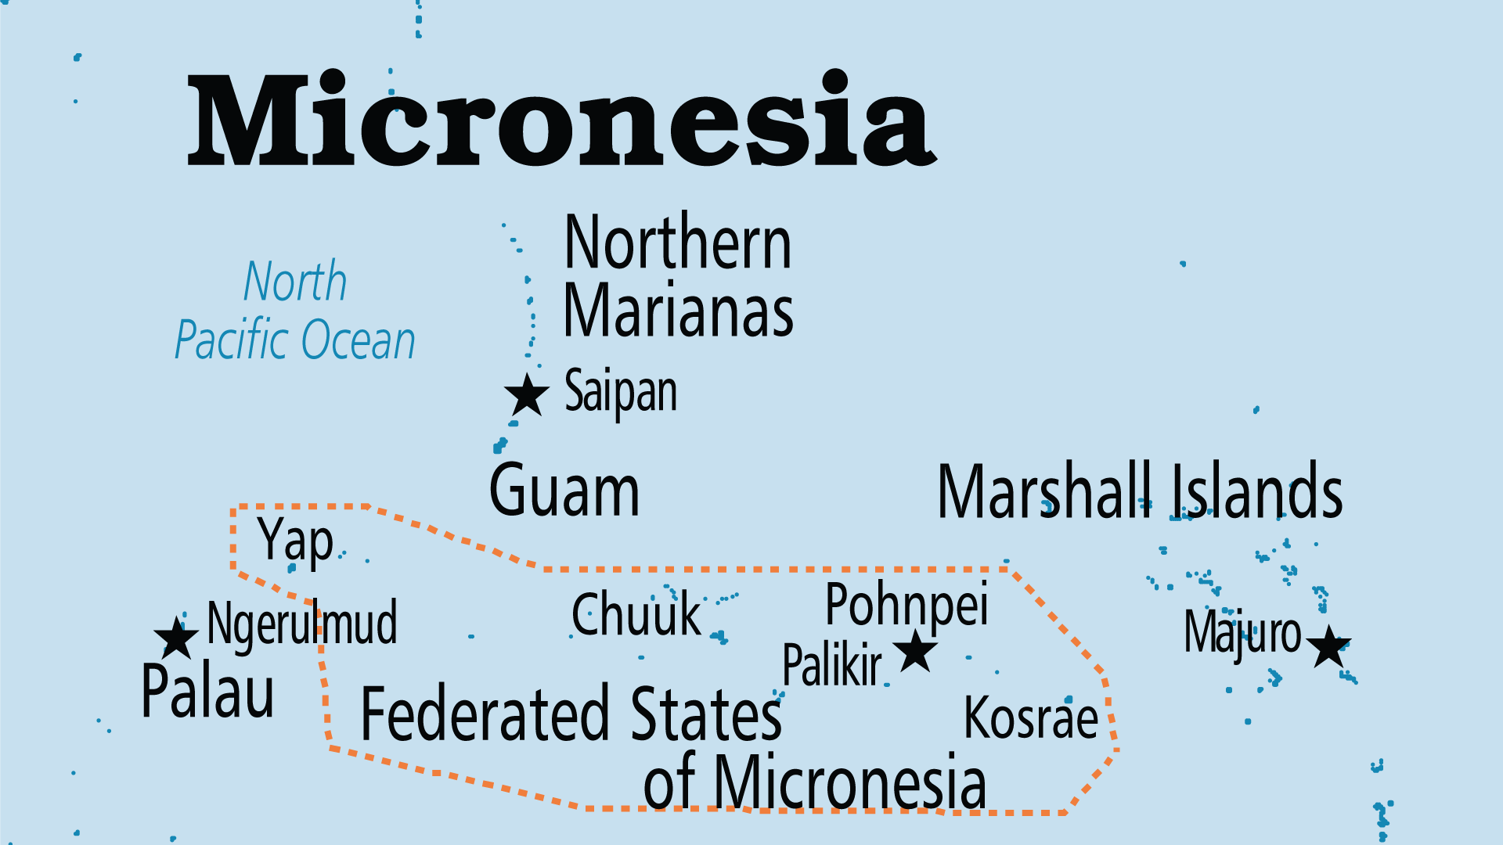
KEY STATS
Capital: | Palikir
Population: | 113,683
Official Language: | English
Languages: | 19
HDI Ranking: | 134/193
% Christian: | 96.7 %
% Evangelical: | 24.3 %
People Groups: | 25
Least Reached People Groups: | 1
% Unevangelized: | 1 %

Slide 4

FOR PRAYER
Biblical Christianity faces challenges on three fronts. On one front are the traditional cultural elements such as the use of magic and of sakau, the herbal drink used as a communal narcotic. Another front is the pull of Western consumerism encouraged by US aid and the temptation to migrate to the USA. Finally, Mormon missionaries are highly active in Micronesia. All three require a response of wisdom and faith. Pray for a revelation of the power and love of Jesus to the peoples of Micronesia.
Want to know more? Go to www.operationworld.org

