Slide 1




Slide 2

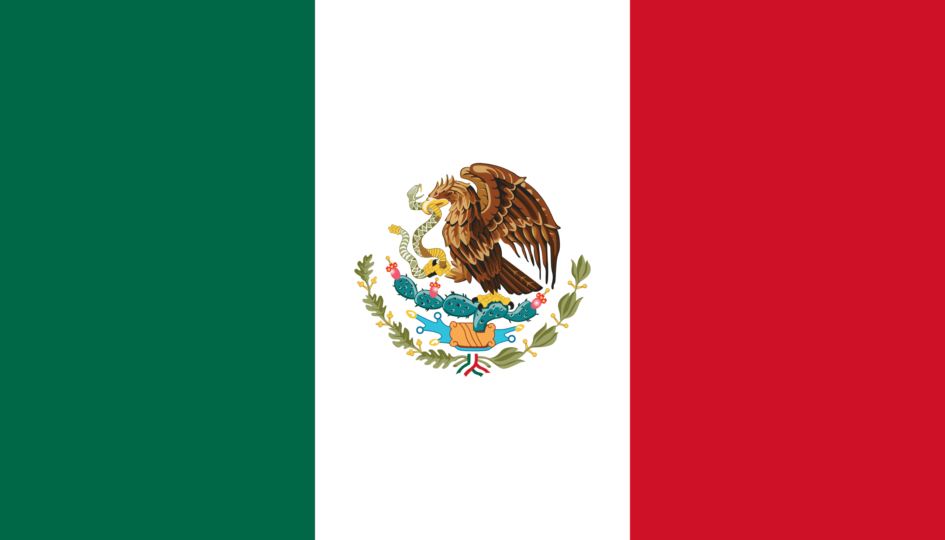
PRAYING FOR
MEXICO

Slide 3
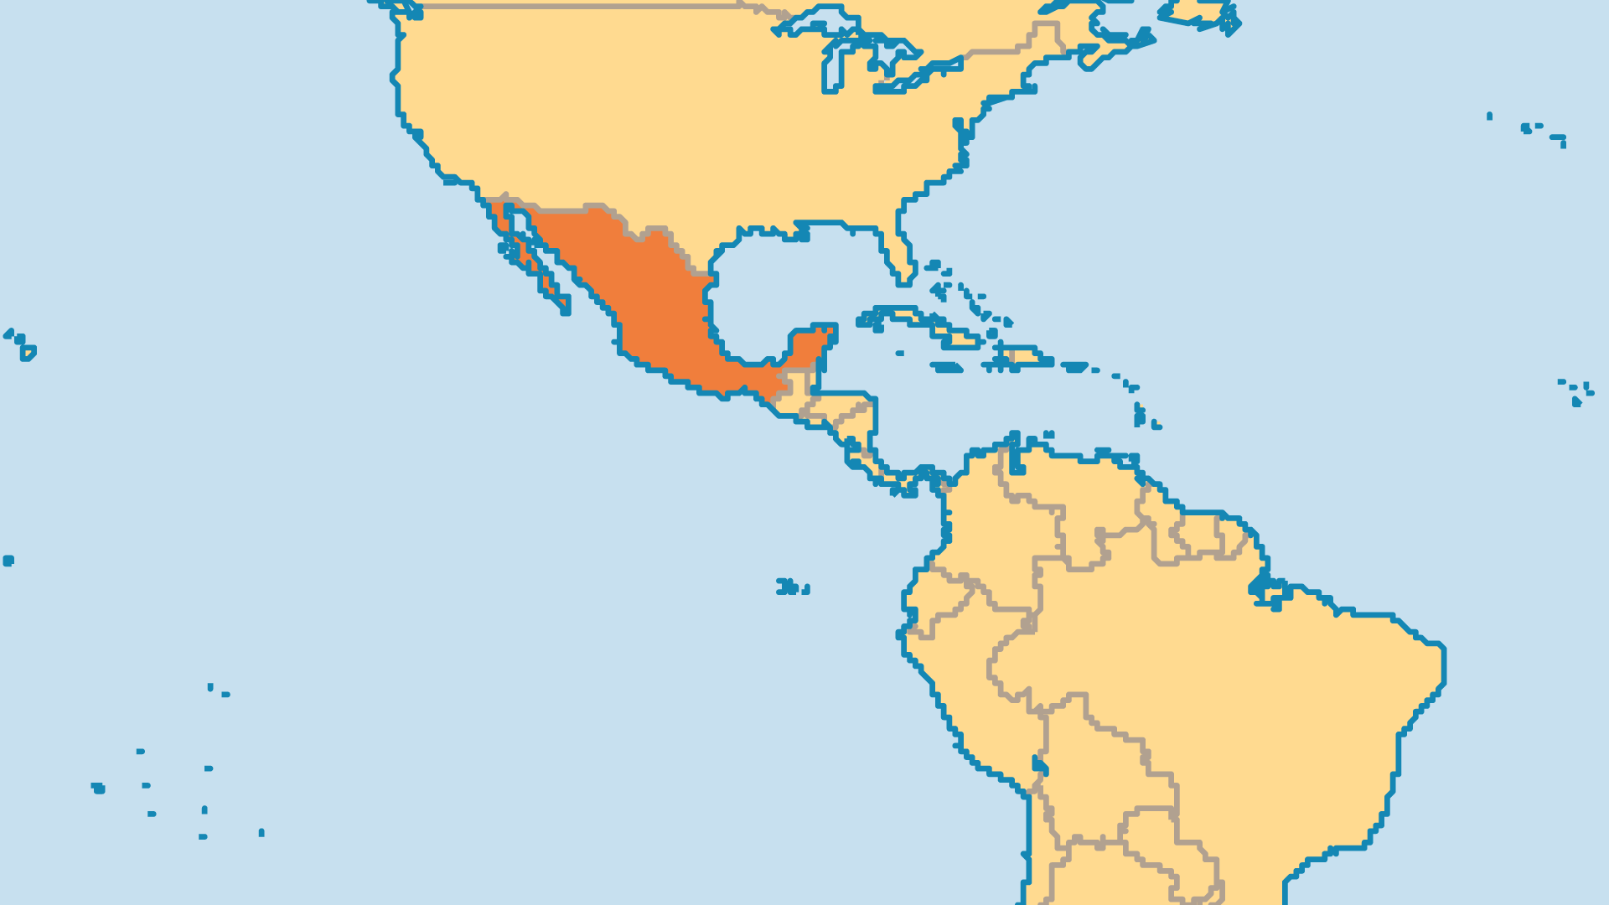
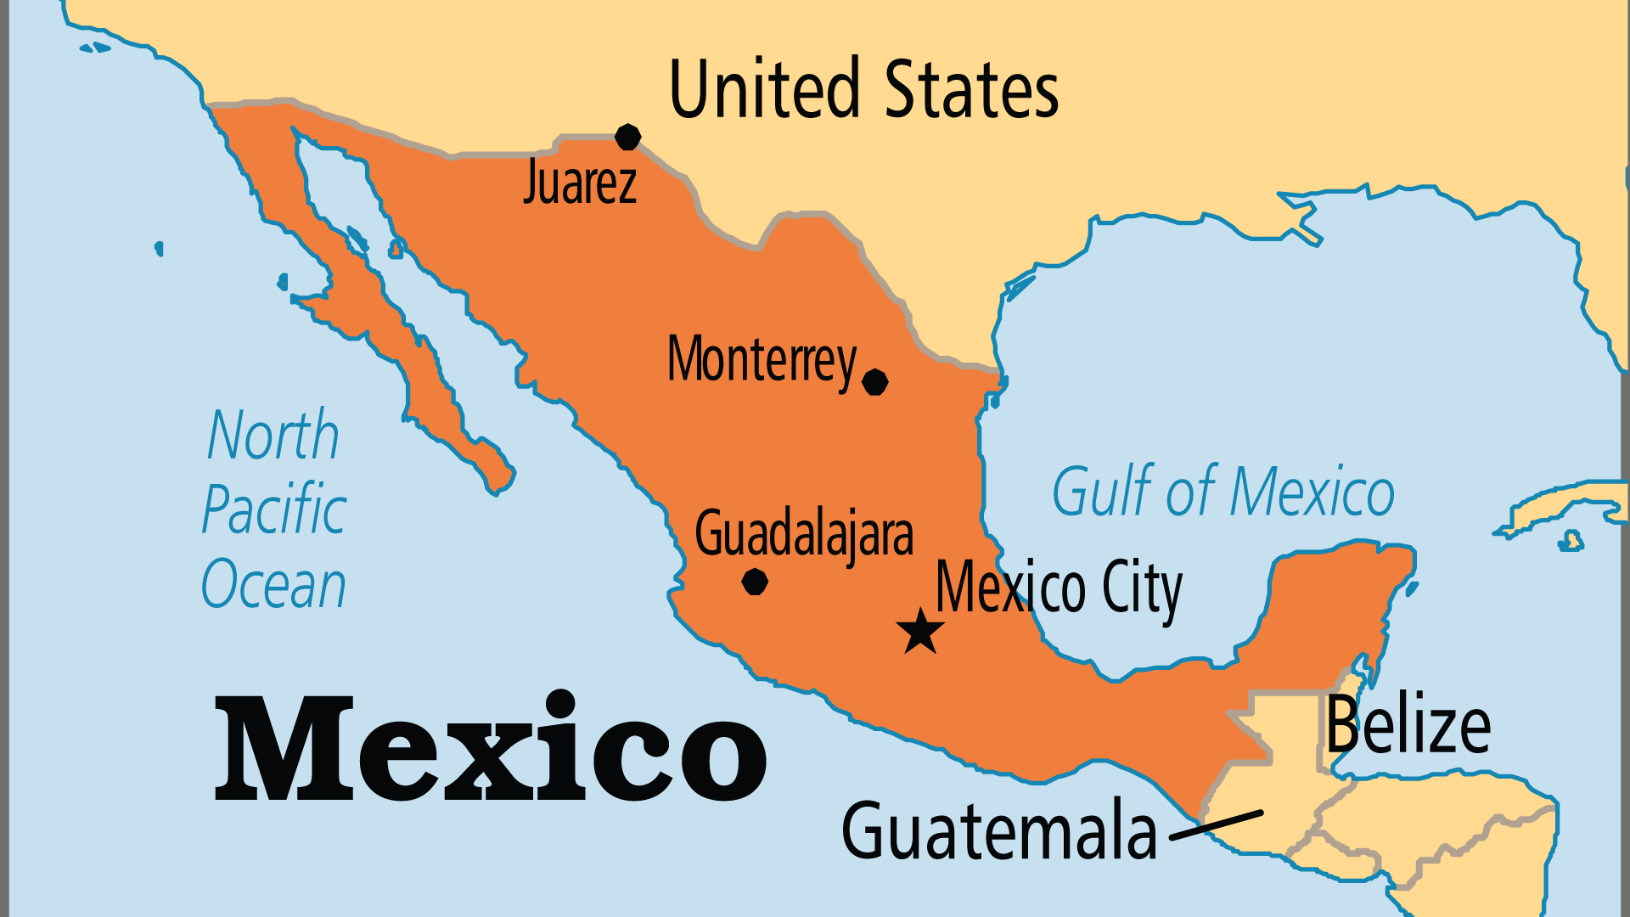
KEY STATS
Capital: | Mexico City
Population: | 131,946,900
Official Language: | Spanish
Languages: | 297
Life Expectancy: | 70.2 yrs (160th/236)
HDI Ranking: | 86/193
% Christian: | 95 %
% Evangelical: | 8.3 %
% Unevangelized: | 1 %
Persecution Ranking: | 31/50

Slide 4

FOR PRAYER
Pray into and against the massive drug trade and gang violence that accompanies it. Drug trafficking is big business in Mexico - thanks to both the USA's insatiable habit (and to a lesser degree, Europe's) and Mexico's own growing troubles. This illicit trade fuels and enables other structures of sin - the cartels have expanded their activities to human trafficking, kidnapping, extortion, and even avocados and limes.
Want to know more? Go to www.operationworld.org

Slide 5
FOR PRAYER
The Catholic Church dominated the country for 300 years, and now is very diverse. Most Mexicans are culturally Catholic but only 10% regularly attend church. Christ-centred renewal grew within the Catholic Church, and the Alpha course draws Catholics to Christ. Many Mexicans blend the gods and goddesses of Amerindian spiritism into a folk version of Catholicism. Pray for the Holy Spirit to break the influence of these ancient gods and the spirit world. Pray for renewal to spread through the Mexican Catholic Church.
Want to know more? Go to www.operationworld.org

Slide 6
FOR PRAYER
Evangelicals numbered 800,000 in 1960. They now number over 14 million, and the movement still grows! The Catholic Church oppressed ministry work in the past, but the government now gives freedom at local, state, and national levels. Both international denominations and indigenous movements grow well. Geographical distance and broken relationships divide many families, and many are first-generation believers who need help to grow in their commitment and faith. Pray for godly church leaders, and for more pastors willing to work among the poor in rural or slum areas. City jobs and bigger churches attract many new pastors.

