Slide 1




Slide 2

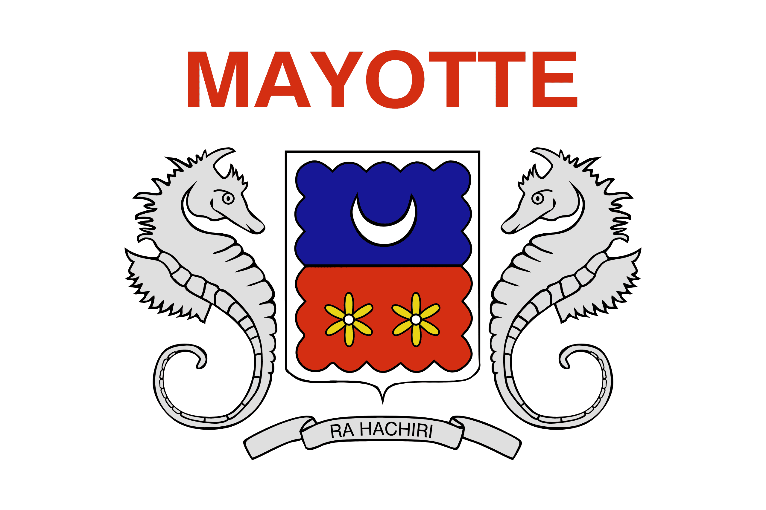
PRAYING FOR
MAYOTTE

Slide 3
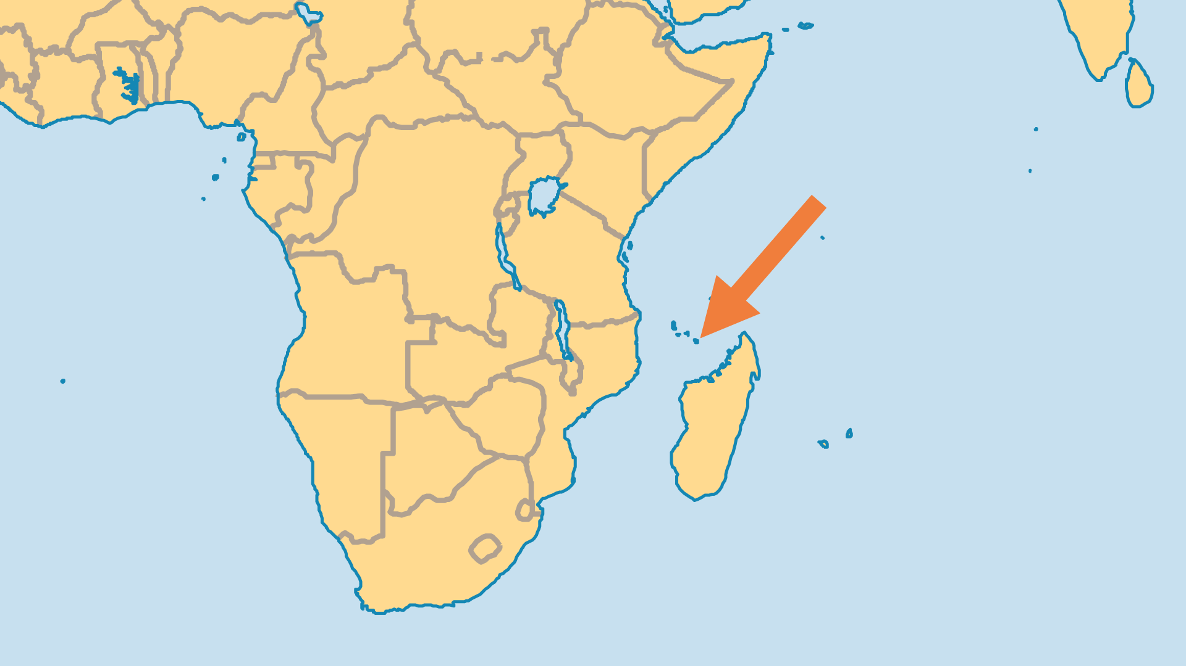
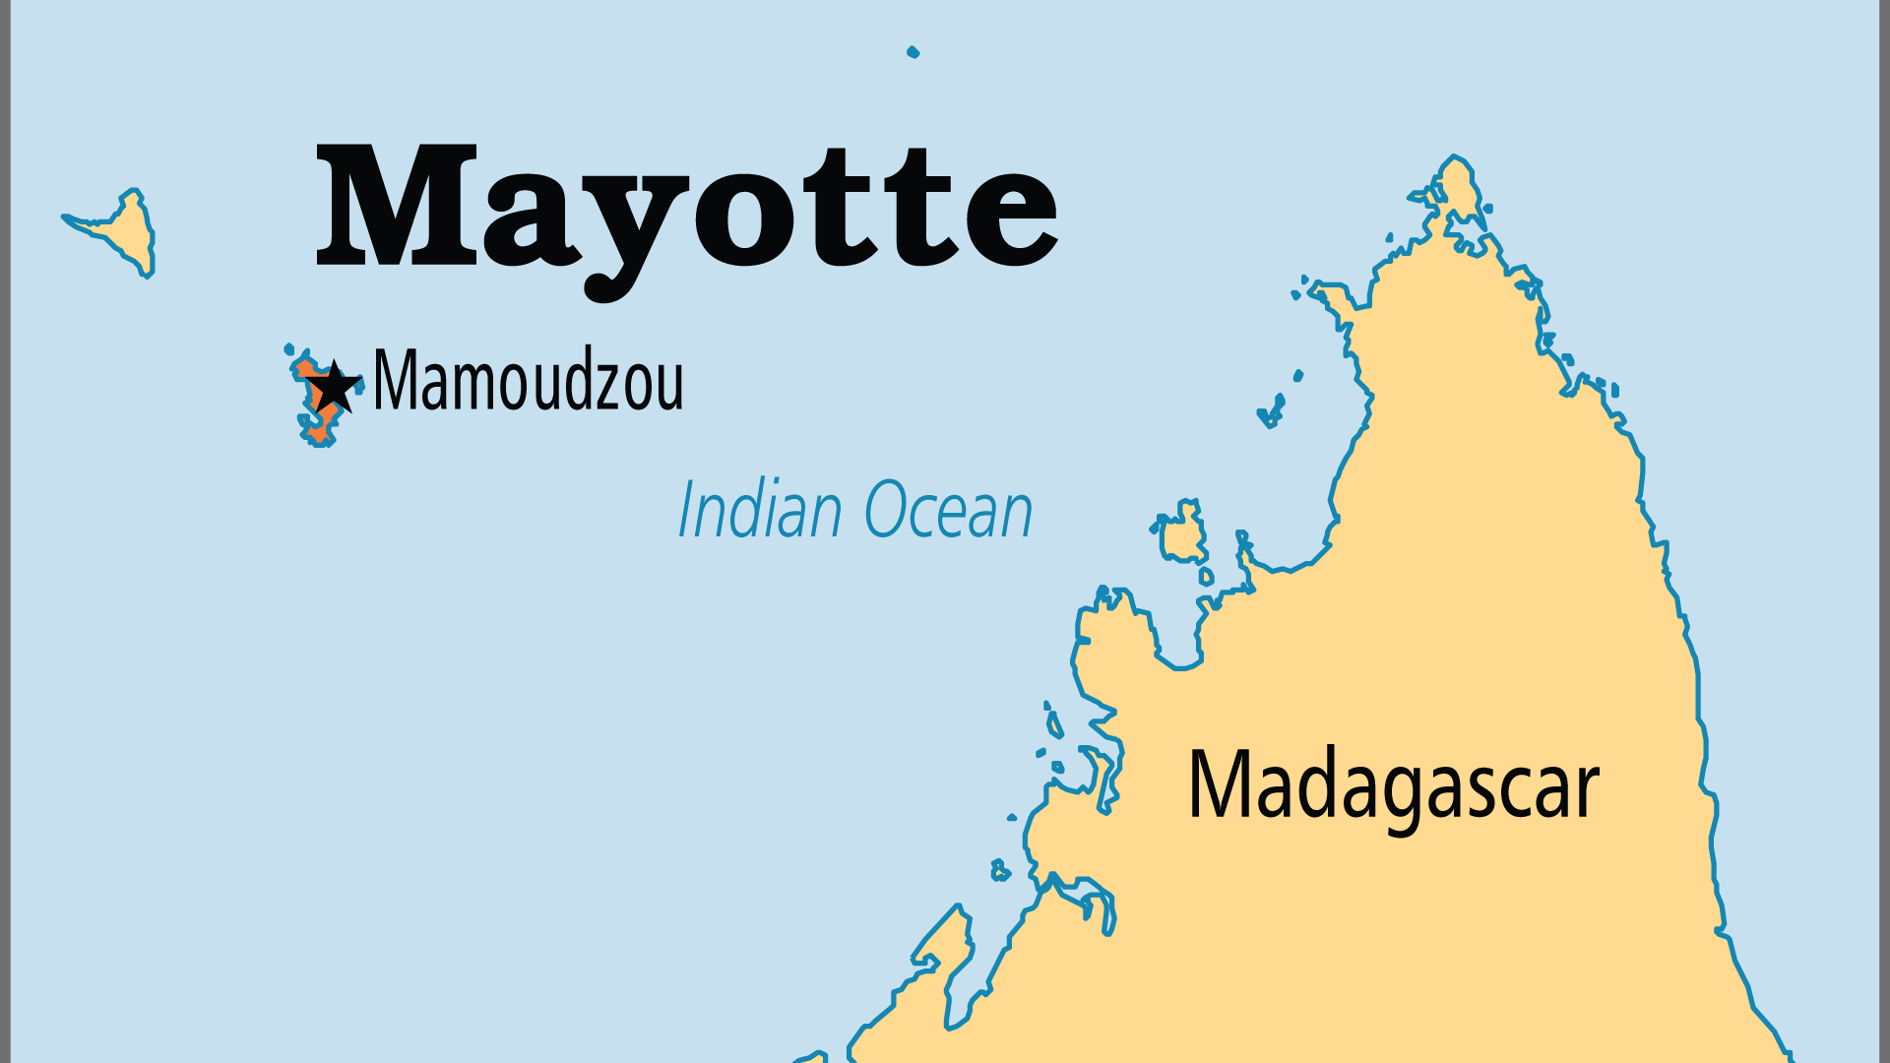
KEY STATS
Capital: | Mamoudzou
Population: | 337,011
Official Language: | French, Shimaore, Shibushi
% Christian: | 1.6 %
% Evangelical: | 0.1 %
Largest Religion: | Muslim
% Largest Religion: | 97.9 %
Least Reached People Groups: | 6
% Unevangelized: | 75 %

Slide 4

FOR PRAYER
The indigenous people of Mayotte are 99.9% Muslim. Although there is religious freedom and direct, open-air evangelism is permitted (and practiced by the AoG), response has been very slow, and most converts have returned to Islam. Maore folk Islam is heavily shaped by magic and cults practicing spirit possession. Despite this, a spirit of complacency rests upon the people, exacerbated greatly by the increased economic assistance from France and the EU. Pray for a spiritual breakthrough. The name Mayotte means "place of death"; pray that it may become a place of spiritual life in Christ.
Want to know more? Go to www.operationworld.org

