Slide 1




Slide 2

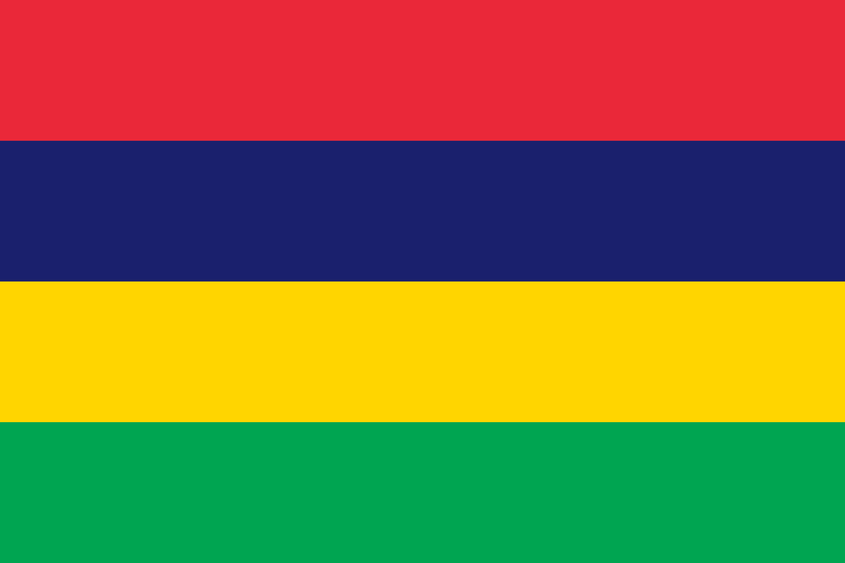
PRAYING FOR
MAURITIUS

Slide 3
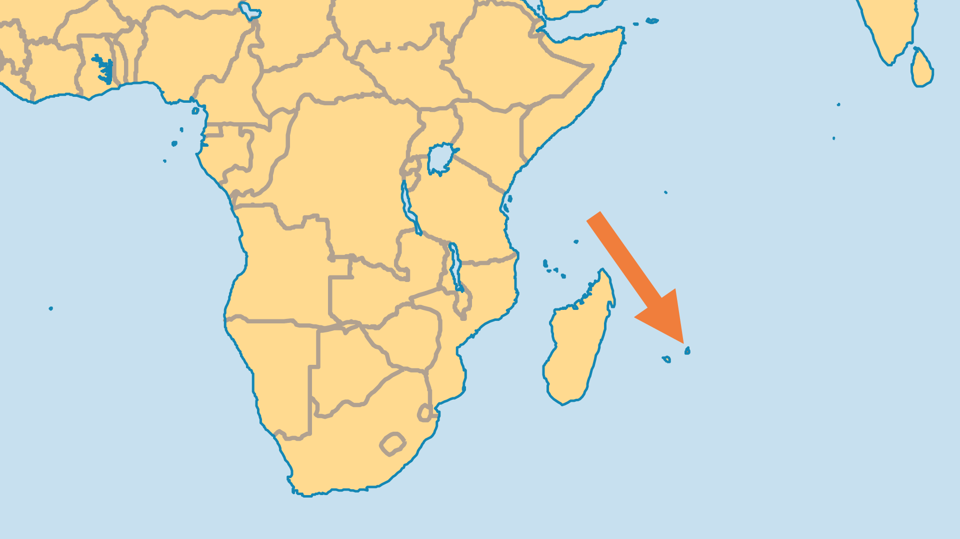
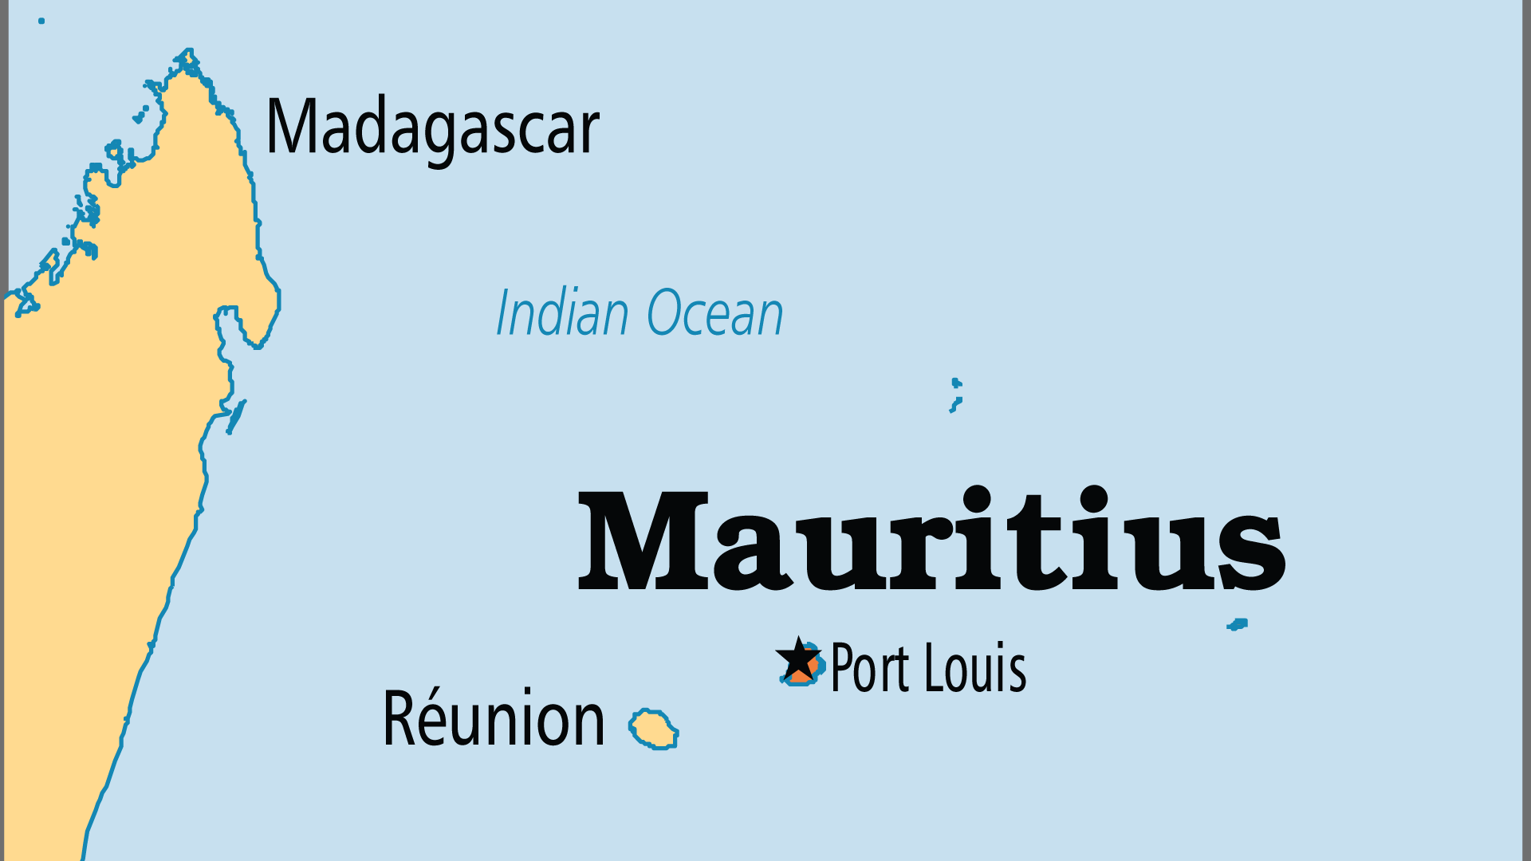
KEY STATS
Capital: | Port Louis
Population: | 1,268,280
Pop Under 15 Yrs: | 17.3 %
Official Language: | English
Languages: | 13
Life Expectancy: | 73.6 yrs (116th/236)
% Christian: | 32.7 %
% Evangelical: | 10.1 %
Largest Religion: | Hinduism
% Unevangelized: | 28 %

Slide 4

FOR PRAYER
This complex multi-ethnic and multi-religious society makes evangelism a challenge; pray for great wisdom and discernment among Christians. The Hinduization of government and culture, as well as strong ancestral and ethnic ties, make it difficult for Indians to become believers. However, large numbers of Hindus are coming to Jesus through the bold witness of evangelical/Pentecostal churches. Pray for continued church growth - may the body of Christ in Mauritius reflect the beautifully multi-cultural nature of God's Kingdom!
Want to know more? Go to www.operationworld.org

