Slide 1

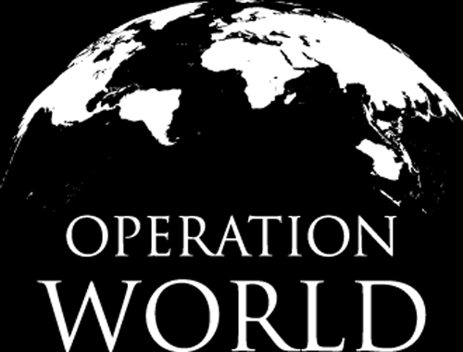


Slide 2

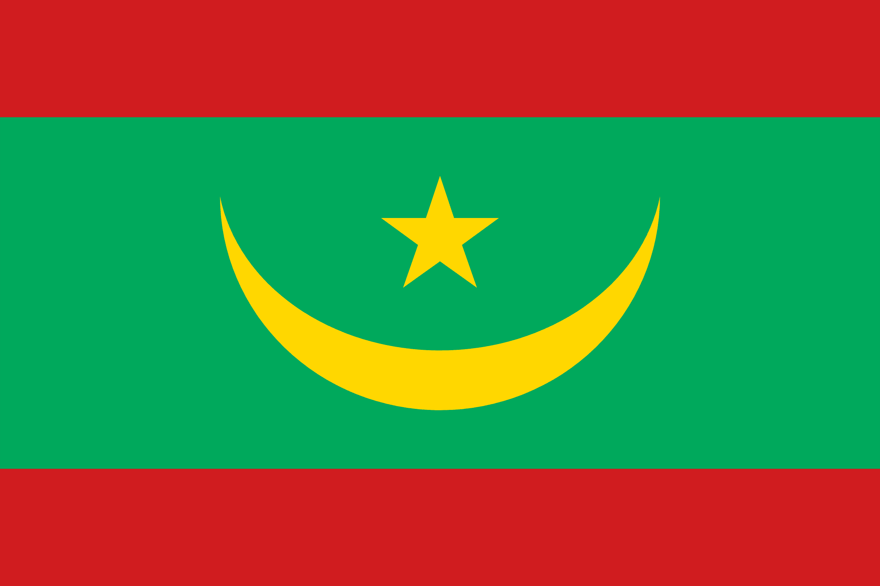
PRAYING FOR
MAURITANIA

Slide 3
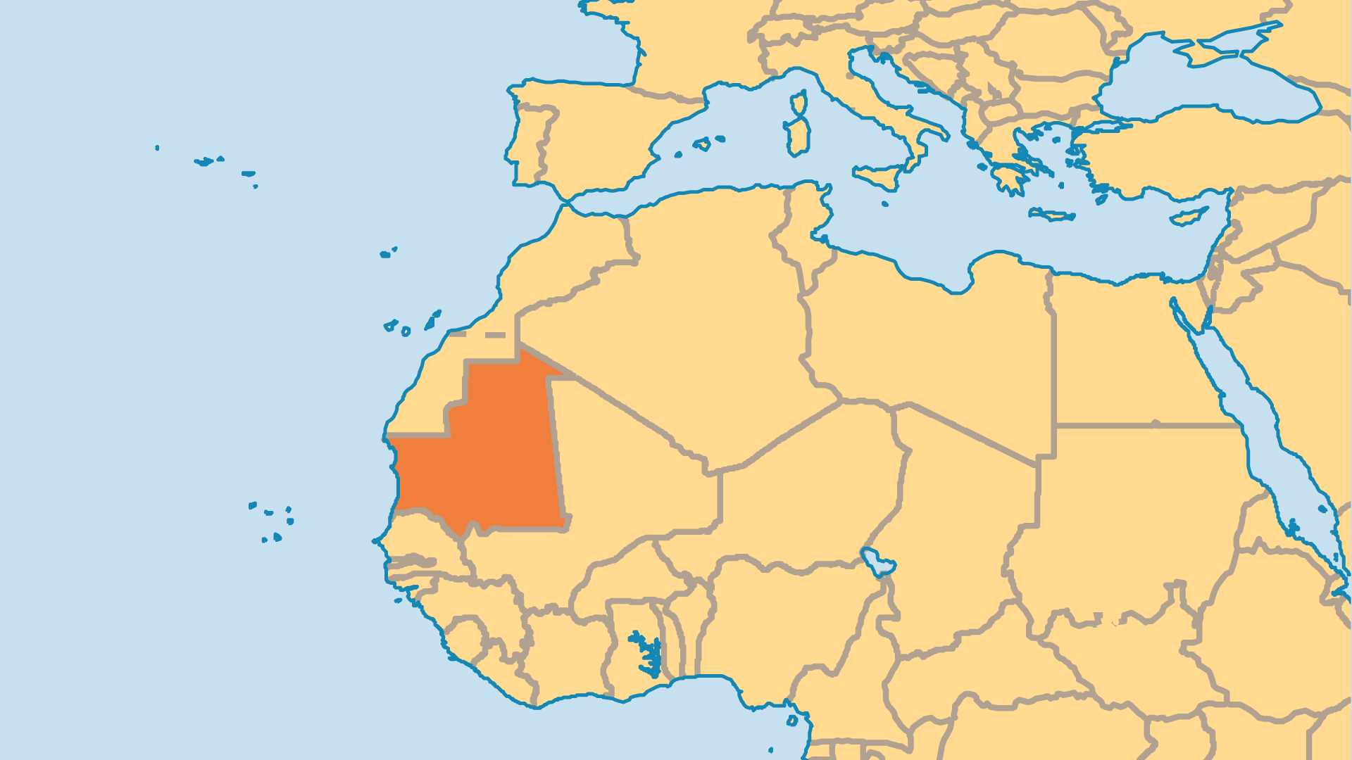
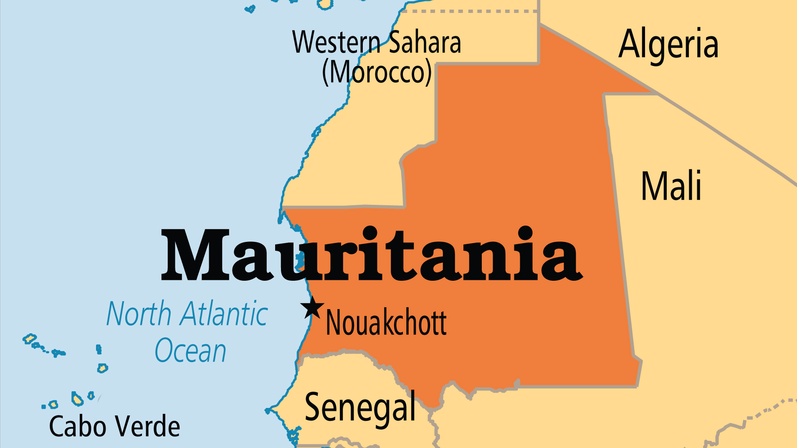
KEY STATS
Capital: | Nouakchott
Population: | 5,315,065
Official Language: | Arabic. Pular, Soninke and Wolof
Literacy Rate: | 52 %
HDI Ranking: | 158/193
% Christian: | 0.3 %
% Evangelical: | 0.1 %
Largest Religion: | Muslim
% Unevangelized: | 73 %
Persecution Ranking: | 23/50

Slide 4

FOR PRAYER
Mauritania must overcome huge economic and social challenges. One-third of Mauritanians live with food insecurity and malnutrition levels are at or beyond emergency thresholds. Widespread divorce leads to many social problems. Only about 1% of land can be farmed, and even that decreases as farmland becomes desert. New discoveries of oil could bring wealth but could also increase corruption and further divide rich and poor. 30% are below the poverty line, and half of the population is illiterate. Slavery is illegal, but thousands most likely still live as slaves. Pray for freedom and justice for all those oppressed.
Want to know more? Go to www.operationworld.org

