Slide 1




Slide 2

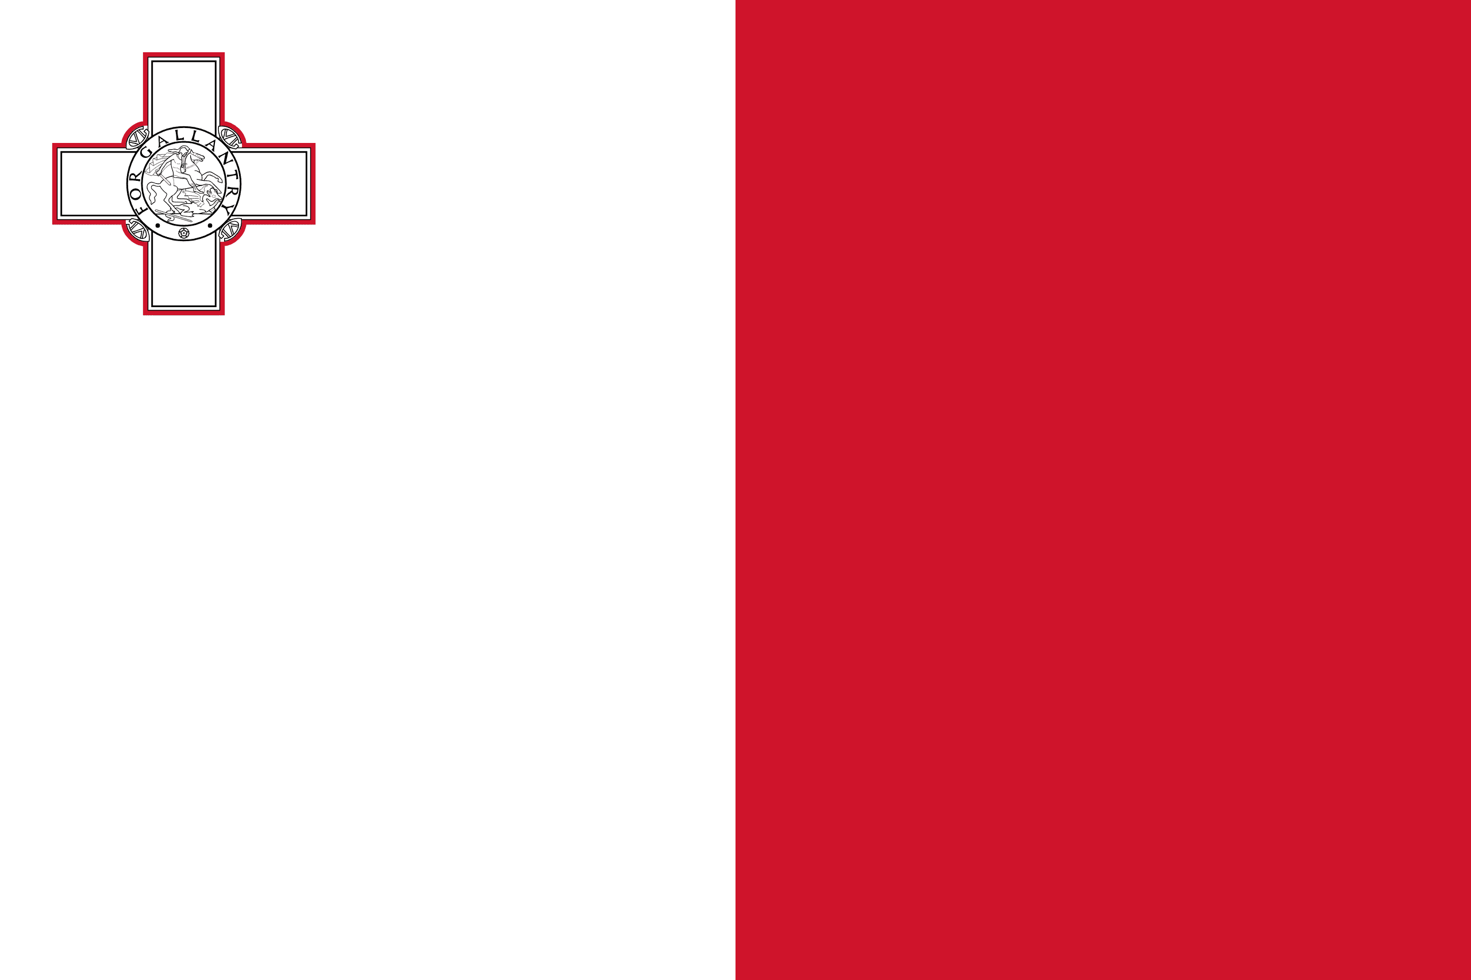
PRAYING FOR
MALTA

Slide 3
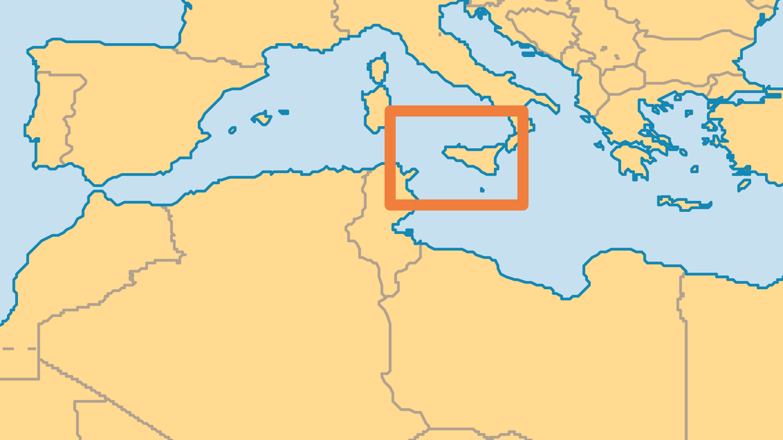
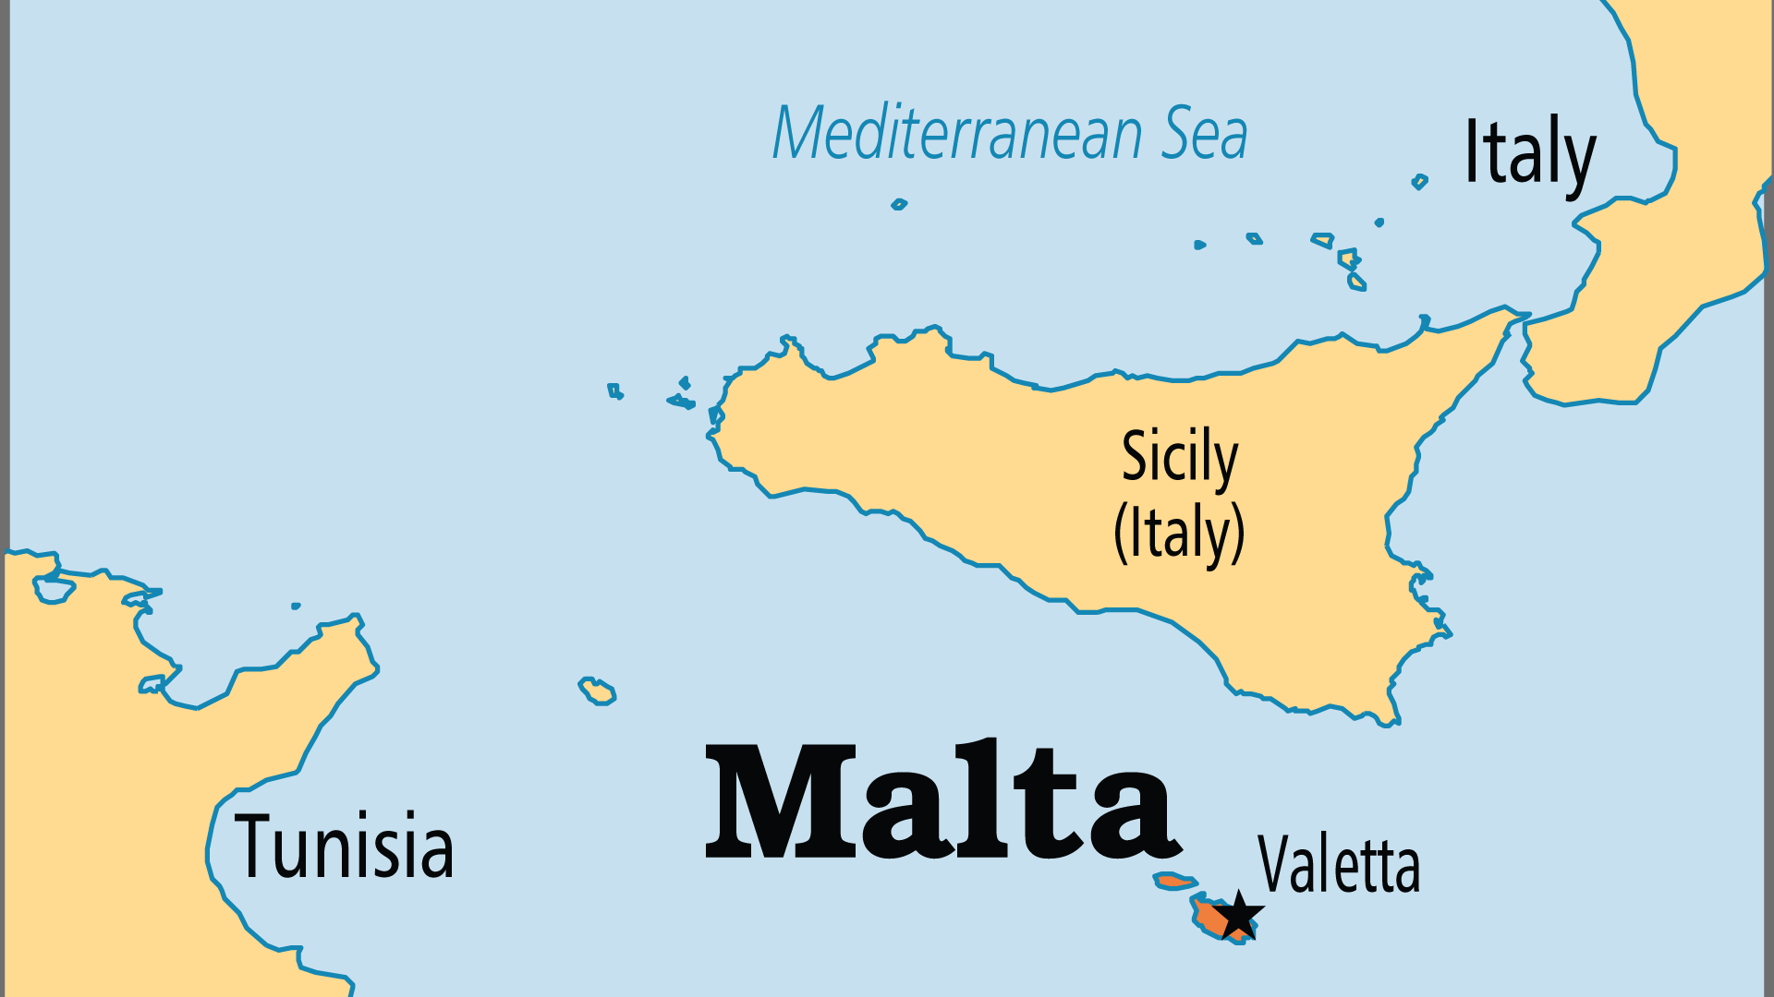
KEY STATS
Continent: | Europe
Capital: | Valetta
Population: | 545,405
Official Language: | Maltese, English
Life Expectancy: | 83.8 yrs (7th/236)
HDI Ranking: | 23/193
% Christian: | 96.8 %
% Evangelical: | 1.3 %
People Groups: | 10
Least Reached People Groups: | 3
% Unevangelized: | 1 %

Slide 4

FOR PRAYER
Malta was the first European nation to embrace Christianity, after the Apostle Paul was shipwrecked here. Many powers have seized control of these islands over the centuries, but the Maltese always kept their strong Christian identity. The majority regularly attend Catholic mass, and over 80% feel their religion is important. Malta remains the most religious nation in Europe. However, not many Maltese have a personal walk with the living Lord Jesus. Pray that the strong religious tradition will open the door into greater revelation of God in Jesus Christ.
Want to know more? Go to www.operationworld.org

