Slide 1




Slide 2

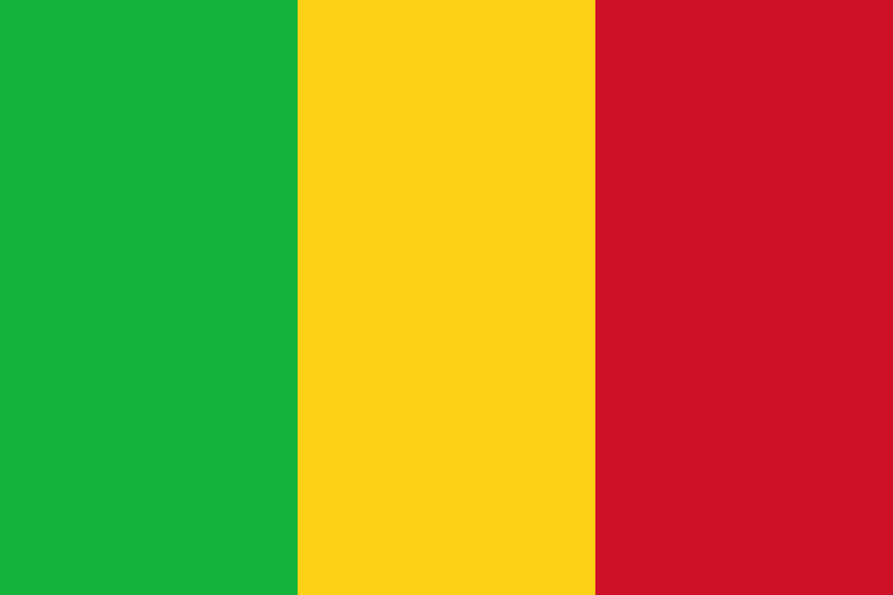
PRAYING FOR
MALI

Slide 3
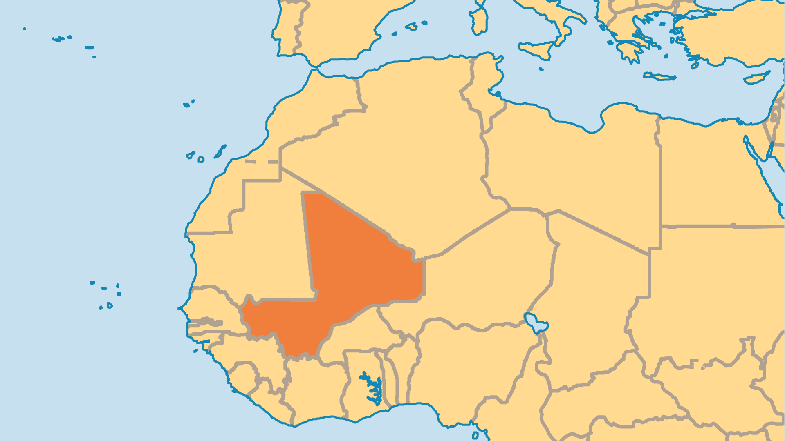
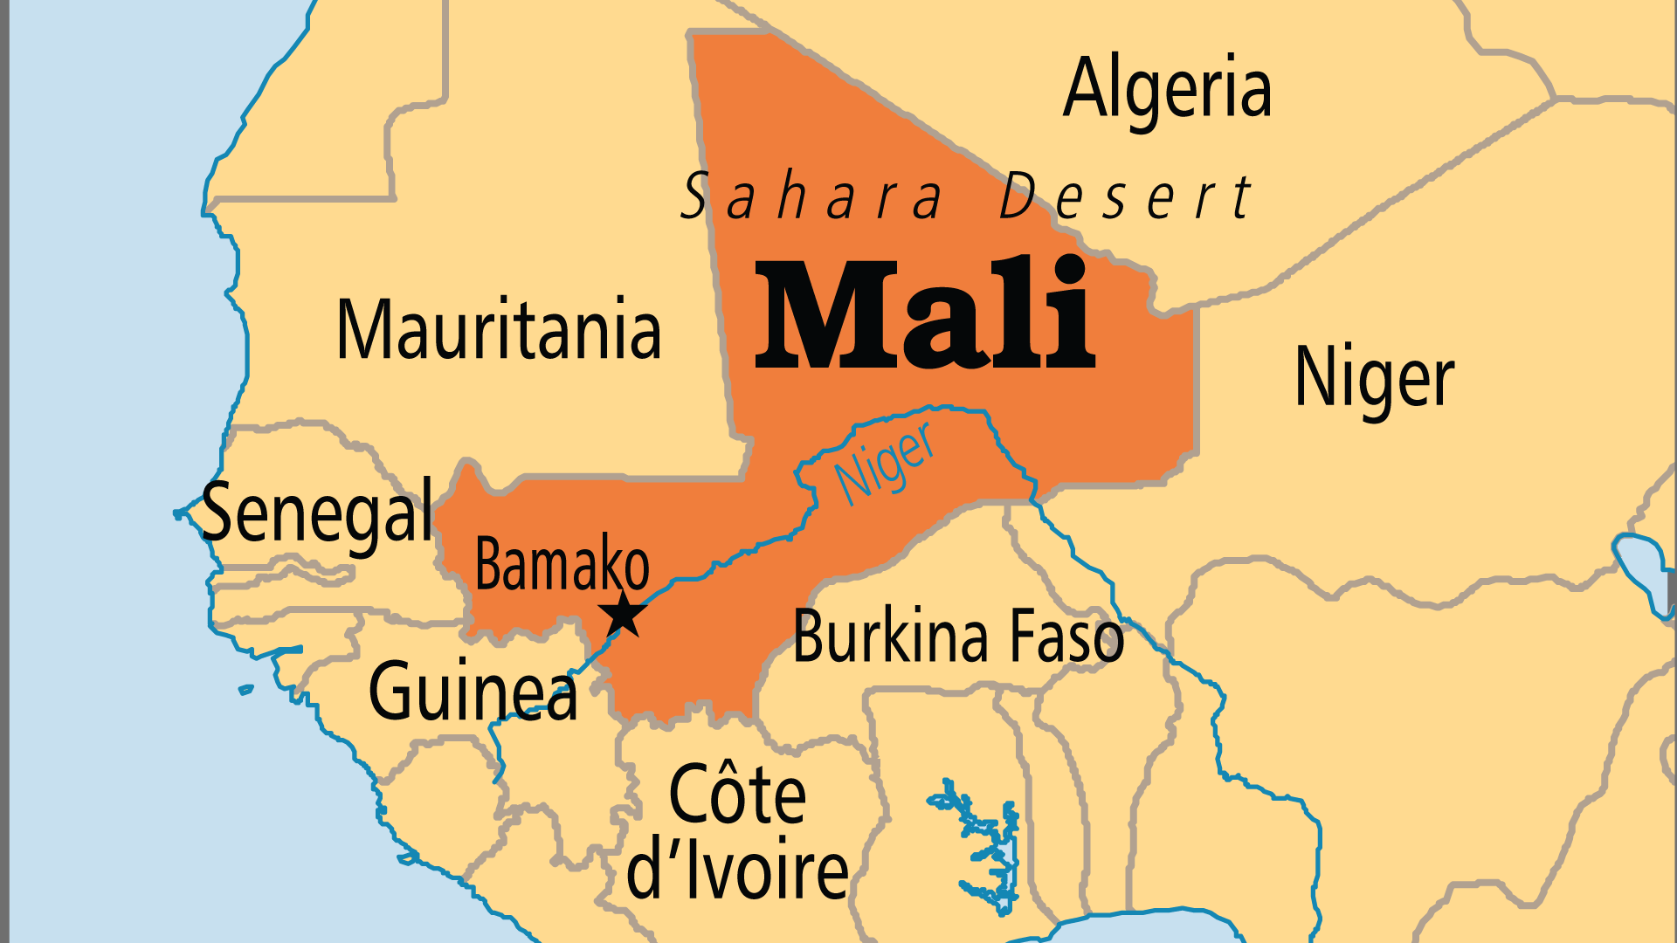
KEY STATS
Capital: | Bamako
Population: | 25,198,822
Official Language: | 13 official languages, Bambara the most widespread.
HDI Ranking: | 186/193
% Christian: | 2.6 %
% Evangelical: | 0.7 %
Largest Religion: | Muslim
% Unevangelized: | 62 %
Persecution Ranking: | 14/50

Slide 4

FOR PRAYER
Mali has experienced great upheaval in recent years, with 3 military coups since 2012. In 2012, rebels in the north caused up to 500,000 people, including most Christians in the region, to flee to the south or to other countries. 2024 elections were postponed indefinitely as the military regime fights against jihadist groups. The Islamic State has gained control of some of Mali's southeast. There is also conflict between nomadic Fulani herdsmen and the farming tribes of the Dogon and Bambara. Tensions have long existed between them, but it has escalated into murderous assaults by armed ethnic militias. All such developments mean intensifying challenges for Christians. May the Prince of Peace prevail in a land crippled by violence!

Slide 5
FOR PRAYER
Mali must overcome huge challenges of high child mortality rates, malnutrition, and desertification. Around 10% of children will not survive to the age of five. Out of those who do survive, 1 in 3 will be malnourished. 67% of the land area is desert or semi-desert, and the desert continues to spread. Pray that Mali's leaders will have wisdom, and will know how to provide health, education, and employment to their people. The country needs long-term stability and foreign investment. Many Christian ministry opportunities exist.
Want to know more? Go to www.operationworld.org

